Slide 1

Week 3 ENTREPRENEURSHIP
OPPORTUNITY RECOGNITION PROCESS
Lecture by Dr. Arifa Bhutto

Slide 2
Outline
Overview
OPPORTUNITY RECOGNITION PROCESS
OPPORTUNITY??
5 Stages of Opportunity Recognition
PRECONDITION
CONCEPTION
VISIONING
ASSESSMENT
REALIZATION
Is your Idea an opportunity?
The opportunity space
Global Environment of business
Opportunity Checklist

Slide 3
Overview
• Beyond knowing how entrepreneurial intentions and ideas are made, there is a need to recognize and assess these intentions and ideas as business opportunities.
• We will discuss the various states in recognizing and assessing opportunities and how these opportunities are translated into entrepreneurial ventures. For these opportunities to be realized as business ventures, the individual needs to commit resources and should have the capacity to absorb the uncertainties of any business undertaking.

Slide 4
OPPORTUNITY RECOGNITION PROCESS
OPPORTUNITY
A situation or occasion that makes it possible to do something that you want to do.
THREE Elements:
–YOU WANT TO DO SOMETHING
–THERE ARE CONDITIONS FOR THE REALIZATIONOF THE OBJECTIVES
–YOU MUST MAKE DECISIONS OR TAKE ACTIONON THESE CONDITIONS TO REALIZE YOU OBJECTIVE

Slide 5
OPPORTUNITY
In business, it is an exploitable set of circumstances with uncertain outcome requiring a commitment of resources and involving exposure risk

Slide 6
5 Stages of Opportunity Recognition
PRECONDITION
A preparatory stage during which the individuals assess his knowledge of the market
.Formal training
Personal experiences (including travel and previous employment)

Slide 7
5 Stages of Opportunity Recognition
CONCEPTION
Gestation phase during which entrepreneurial intentions and ideas are generated, using logic, creative thinking or both
Connecting ideas on the various ways of preparing bread can lead to a creative idea.

Slide 8
5 Stages of Opportunity Recognition
VISIONING
Provides the individual a hunch that can serve as an opportunity for business. This comes about as ideas become clearer and how the logic of connections leads the individual to a new idea.

Slide 9
5 Stages of Opportunity Recognition
ASSESSMENT
Involves the evaluation on whether the idea can be realized or not. The paramount question to the individual is whether the idea can be realized or not.

Slide 10
5 Stages of Opportunity Recognition
REALIZATION
Suggests the production of a prototype. This is the stage when the mental construct or idea is now felt in its tangible or physical form.

Slide 11
Is your Idea an opportunity?
Venture ideas are not venture opportunities. An idea is rarely worth anything, whereas an opportunity is based on a more elaborate concept of a potential future venture.
See the Trends:
How Big Is the Market?
Market Size Today and into the Future.
Frequency and Price.
Margins.

Slide 12
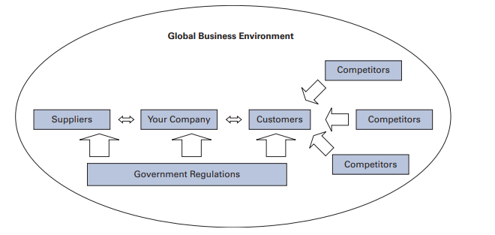
The opportunity space

Slide 13

Global Environment of business
The global business environment can be defined as the environment in different sovereign countries, with factors exogenous to the home environment of the organization, influencing decision making on resource use and capabilities.

Slide 14
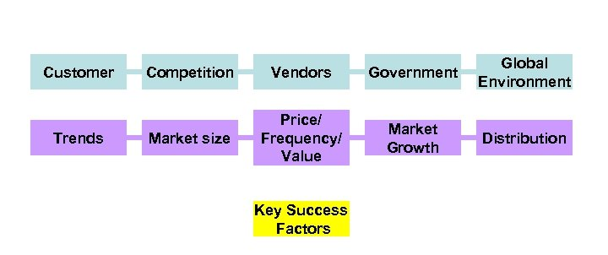
Opportunity Checklist

Slide 15
Thank you

