Slide 1
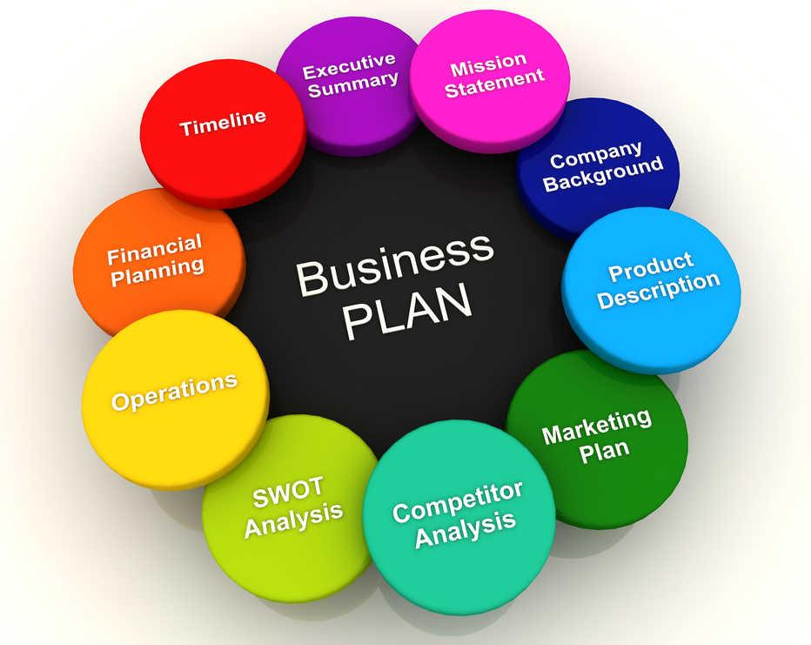
Week 4 ENTREPRENEURSHIP
Lecture by Dr. Arifa Bhutto

Slide 2
Outline
What Is the Business Plan?
Its Need & Importance in Entrepreneurship
Creating a business plan?
Business Idea?
What are the Sources of Business Idea
Business Model
Business model innovation
Cost model Revenue model
Total Entrepreneurial Activity (TEA)
Venture Capital? (VC)

Slide 3

Business Plan
A business plan is a very important and strategic tool for entrepreneurs. A good business plan not only helps entrepreneurs focus on the specific steps necessary for them to make business ideas succeed,
but it also helps them to achieve short-term and
long-term objectives.

Slide 4
Its Need & Importance in Entrepreneurship
Business plans are like road maps: it’s possible to travel without one, but that will only increase the odds of getting lost along the way.
Owners with a business plan see growth 30% faster than those without one, and 71% of the fast-growing companies have business plan.

Slide 5
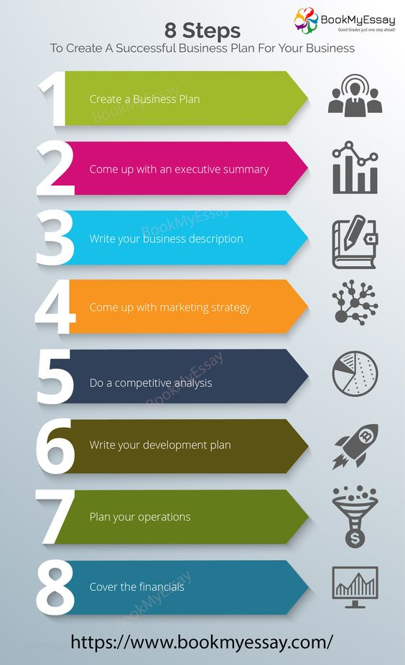
To create a Successful Business plan - 8 Steps

Slide 6
Business Idea?
A business idea is a concept that can be used for financial gain that is usually centered on a product or service that can be offered for money. An idea is the first milestone in the process of building a successful business.
The characteristics of a promising business idea are:
Innovative
Unique
Problem solving
Profitable
understandable

Slide 7
Sources of Business Idea
There are billions of entrepreneurs throughout the world and their testimonies suggest that there are many potential sources of business ideas.
Hobby.
Complaints.
Exhibitions.
Experience.
Brainstorming.
Surveys.
Mass media etc…

Slide 8
Sources of Business Idea
Source of business idea may comes from a person’s.
Experiences
Interests
Abilities
imagination
Inspiration of Ideas can come from
Listening to others
Reading
Visiting displays
Government Statistics
Finding a gap in the market

Slide 9
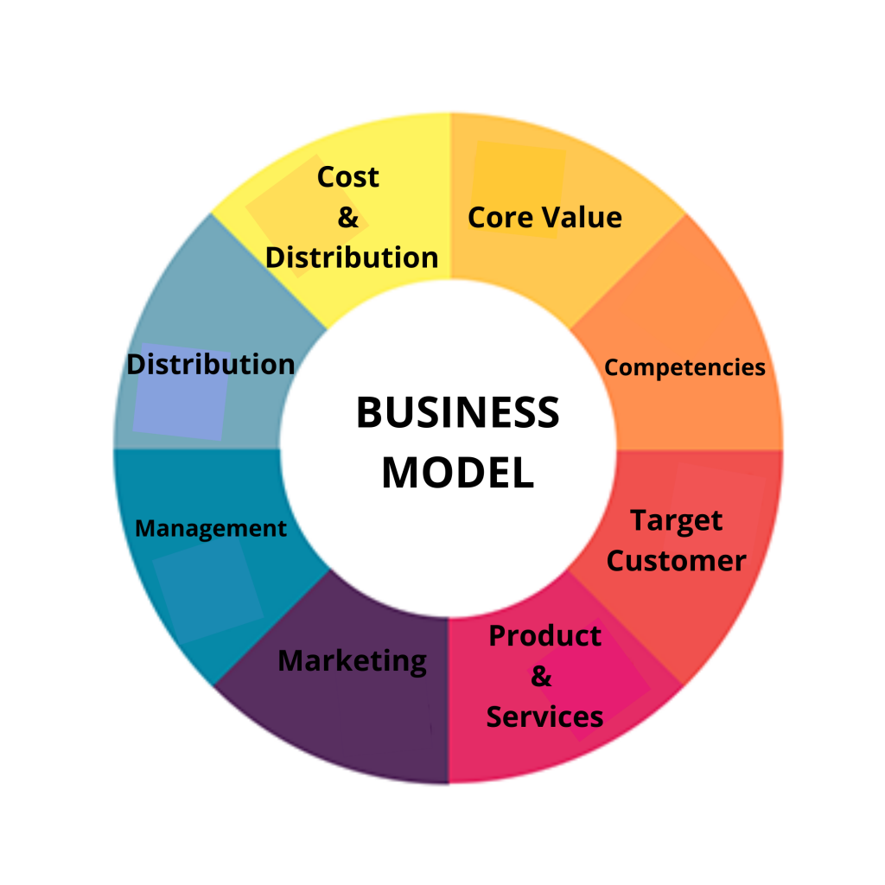
Business Model
The term business model refers to a company's plan for making a profit. It identifies the products or services the business plans to sell, its identified target market, and any anticipated expenses. Business models are important for both new and established businesses.

Slide 10
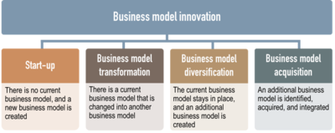

Slide 11
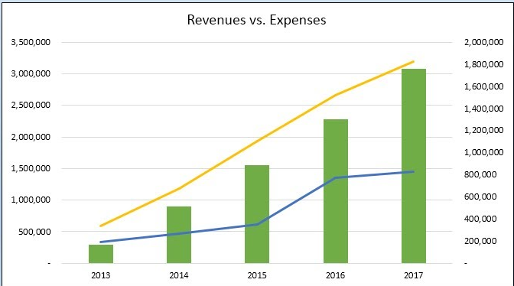
Cost model Revenue model
The two primary levers of a company's business model are pricing and costs. A company can raise prices, and it can find inventory at reduced costs. Both actions increase gross profit.

Slide 12
Its Need & Importance in Entrepreneurship
A well-written business plan is an important tool because it gives entrepreneurs and small business owners, as well as their employees, the ability to lay out their goals and track their progress as their business begins to grow.
Business plans are also important for attracting investors so they can determine if your business is on the right path and worth putting money into.

Slide 13

Total Entrepreneurial Activity (TEA)
Total early-stage Entrepreneurial Activity (TEA) is the % of 18-64 year old population that is either a nascent entrepreneur, or owner of a business. It is assessed through expert interviews in 100+ countries, roughly 200,000 per year. ... It is published by the Global Entrepreneurship Monitor.

Slide 14
Venture capital (VC)
Venture capital (VC) is a form of private equity and a type of financing that investors provide to startup companies and small businesses that are believed to have long-term growth potential. Venture capital generally comes from well-off investors, investment banks, and any other financial institutions.

Slide 15
Thank you

