Slide 1
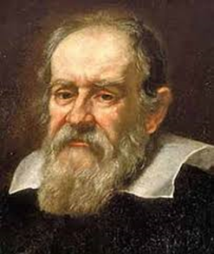
Network Science
Historical Background and network analysis metrics
“Measure what is measurable, and make measurable what is not so”
Galileo Galilei

Slide 2
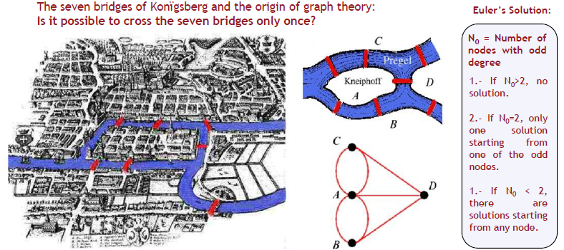
Birth of Network Science
Graph theory:
Euler, is known as the father of graph theory: 1741
The problem of seven bridges of Konïgsberg (his home)
.

Slide 3
Birth of Network Science (Cont..)
A solution path cannot exist on a graph that has more than two nodes with an odd number of links
Euler declared: “The existence of the path does not depend on our cleverness to find it. Rather it is a property of the graph”
Graphs (or networks) have properties hidden in their construction that limit or enhance our ability to do things with them
In 19th century, the advancement in the research field of graph theory continued by many mathematician including William Hamilton, Gustav Kirchoff, Thomas kirkman and Aruther Cayley (Ghoshal, 2009; Newman, 2011)
.

Slide 4
Birth of Network Science (Cont..)
Their research and development in graph theory was based on theoretical mathematical objects as compared to the problems related to real-world systems
Historically, the social scientists realized very earlier in the beginning of 20th century, the applications of network analysis and used sociograms as networks
The first person who as a sociologist and psychiatrist carried the systematic study of social relations as network was Jacob Moreno

Slide 5
Birth of Network Science (Cont..)
He systematically collected and analyzed the pattern of interactions in very small groups like school class rooms and worker groups (Moreno, 1953)
By observing the structure of social interactions and by drawing on the paper as nodes and links one can predict the future behavior or functioning of the network
He called his networks as sociograms in which nodes were represented as people and links were created if they had some kind of acquaintances

Slide 6
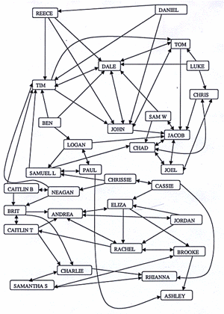
Birth of Network Science (Cont..)
Sociogram made by Jaccob Moreno

Slide 7
Milgrams Six degrees sepration
In 1967, Stanley Milgram, a social psychologist at Harvard, was interested in learning how many acquaintances it would take to connect two randomly selected individuals from the population
A group of people from Omaha (Nebraska) and Wichita (Kansas) was asked to send a letter to an unknown person in Boston (Massachussetts)

Slide 8
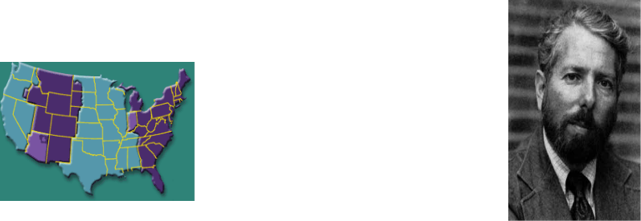



Basic Rule of the experiment:
People should forward the letter to a person that they consider closer to the target person
Results of one experiment
232 out of 296 letters never reached the target
64 letters reached the target (with paths from 2 to10)
The average path length was….5.2 (steps)
This is big world This is small world

Slide 9
Birth of Network Science (Cont..)
The quantitative analysis and research of social scientists helped in further development of mathematical techniques
Anatol Rapoport, a mathematical psychologist argued that the frequency distribution of links related with nodes in the network plays very important role to measure properties of network
With his collaborator R. Solomonoff he proposed random graph which was a simple model of network (Solomonoff and Rapoport, 1951)
His model then independently studied by Paul Erdos with his collaborator Alfred Renyi (Erdo¨s and R´enyi, 1960)
The ER model remained very popular from late Fifties to late Nineties and, the modeling of almost all complex networks was based on random graph theory
.

Slide 10

Network Analysis Metrics
Node degree and strength (Local measures) in social networks
The node degree is the number of links directly connecting to the node with other nodes, in the network
The degree ki of the node i can be computed as given in equation
where ki represents the degree of node i and a is the adjacency matrix and the entry aij represent connectivity if the value is 1, otherwise it is 0 and N is the total number of nodes in the network
.

Slide 11
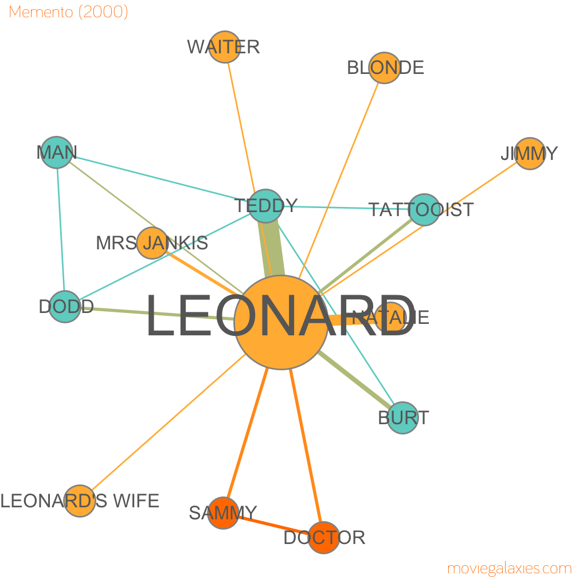
Network Analysis Metrics
Node degree and strength (Local measures) in social networks
.
moviegalaxies.com

Slide 12
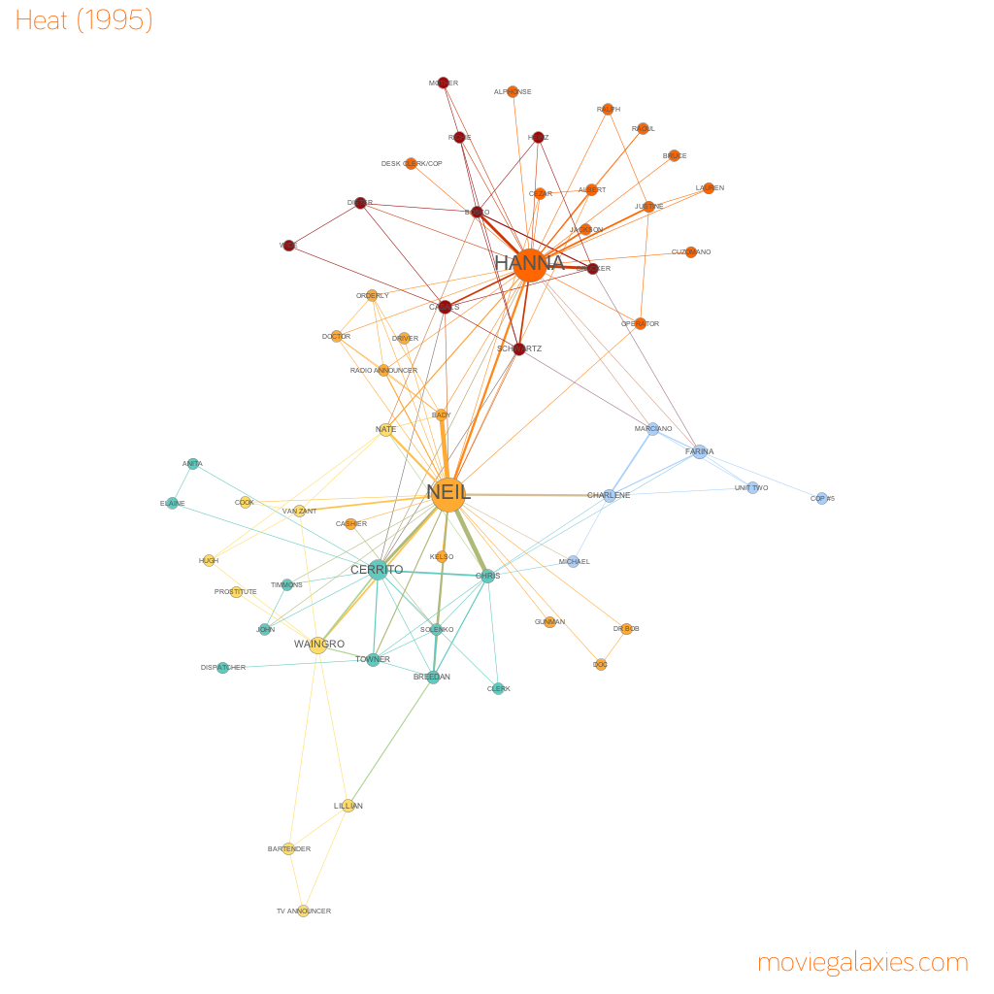
Network Analysis Metrics
Node degree and strength (Local measures) in social networks
.

Slide 13
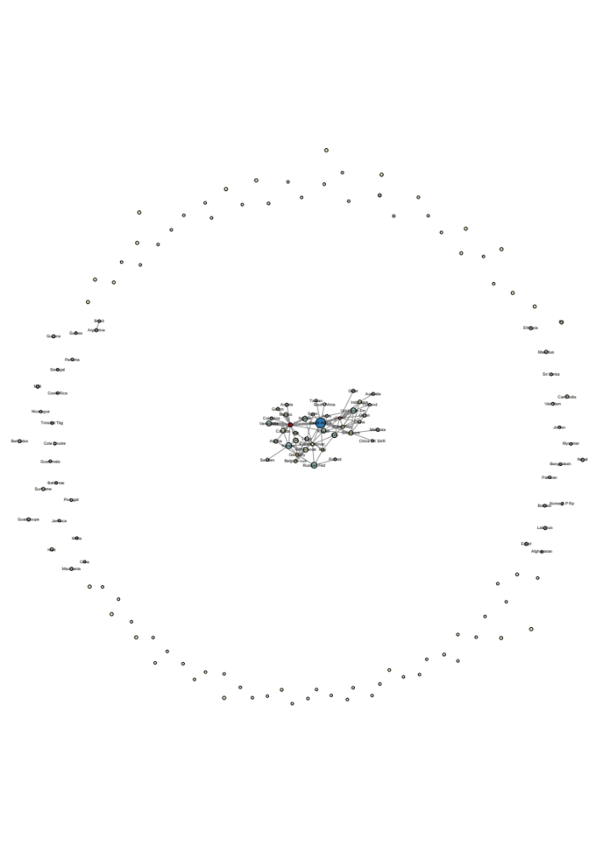
trade in petroleum and petroleum products, 1998, source: NBER-United Nations Trade Data

Slide 14
Quiz Q:
Which countries have high indegree (import petroleum and petroleum products from many others)
  Saudi Arabia
  Japan
  Iraq
  USA
  Venezuela

Slide 15
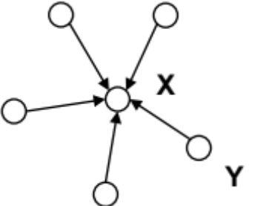
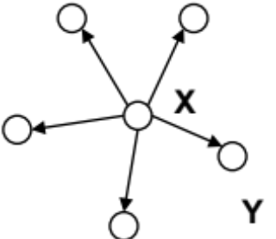
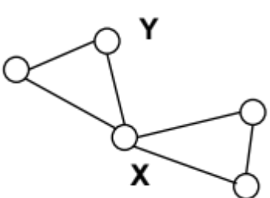
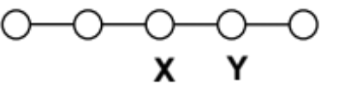
different notions of centrality
In each of the following networks, X has higher centrality than Y according to a particular measure
indegree
outdegree
betweenness
closeness

Slide 16

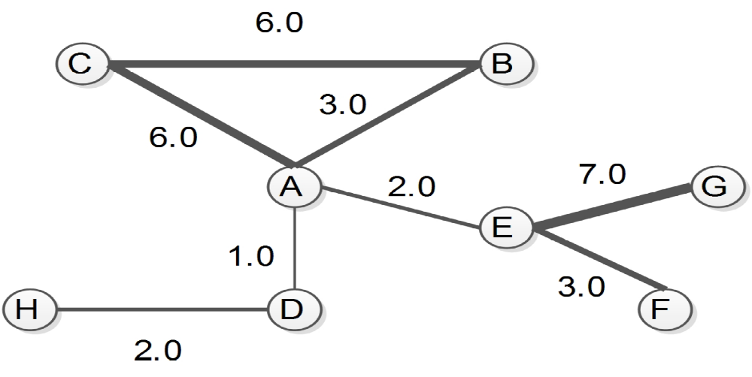
Network Analysis Metrics
Node degree and strength (Local measures)
Weighted degree or strength of node is used (Yang and Knoke, 2001), (Barrat et al., 2004a) in weighted networks, which can be defined as the sum of a node direct links weight as given in equation
where w represents the weighted adjacency matrix. The value of the entry wij in matrix is > 0, if the node i is connected with j, whereas the value show the weight of link
.

Slide 17
Network Analysis Metrics
Node degree centrality in social networks:
The identification of main or critical nodes in complex networks analysis has remained very important topic. Because, if a node is more central as compared to others in a network can have three main advantages
1. Placement or location can potentially control the traffic/flow among other nodes
2. It can have more direct links
3. From that node, one can reach to all other nodes very quickly
Further, as node strength do not consider the number of links with particular node, therefore it gives only rough idea for the nodes actual contribution and involvement in whole network from degree centrality point of view
.

Slide 18


Network Analysis Metrics
(Opsahl et al., 2010) has proposed a very realistic approach for degree centrality in weighted networks by considering both the number of links and the total weight of links (strength)
Where in this equation works as tuning parameter.
If the value of alpha is 0 then it will only focus on the number of links connected with nodes, and if the value is 1, then it will include the weight of links only
If the value of alpha is in the range of 0 and 1, then it will measure both the weights and degree, favorably
.

