Slide 1
Network Science
Bipartite graphs and Two-mode networks
“I think the next [21st] century will be the century of complexity” – Stephen Hawking

Slide 2
Types of network projection
Binary method
The simplest method of projecting a binary two-mode network is to select one set of nodes and connect the nodes if they are connected with the same node of other set
For example, in case of scientific collaboration network (Newman, 2001a) two scientists are considered to be connected if they are the authors of the same paper from the set of papers
Through this method, one-mode network is created with entries representing the presence of interconnection (c_{iβ} =1 where at least one paper is shared) and c_{iβ} =0 when there is no sharing
.

Slide 3
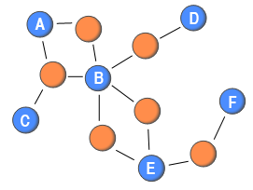
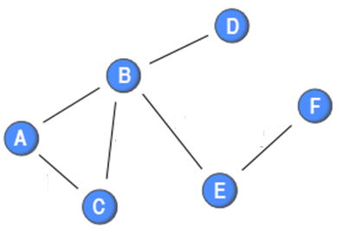
Types of network projection (Binary method)
Binary method
Through this method, one-mode network is created with entries representing the presence of interconnection (c_{iβ} =1 where at least one paper is shared) and c_{iβ} =0 when there is no sharing
.

Slide 4

Types of network projection (Weighted Binary method)
Weighted Binary method
Further, we can transform two-mode binary network as weighted one-mode network by defining the weights as the number of co-occurrences of nodes
For example, in case of scientific collaboration network, the number of papers those two authors had collaborated on
Thus, the method is formalized as given in equation (Padro´n et al., 2011):
.

Slide 5
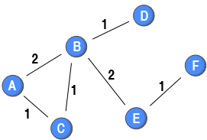
Types of network projection (Weighted Binary method)
Weighted Binary method
Where w_{ij} is the weight of link between node i and j, and p is the nodes of the other kind that node i and node j are connected to, their co-occurrences
.

Slide 6

Types of network projection (Weighted newman method)
Newman argued (Newman, 2001b) and proposed another method during his research on scientific collaboration network
He stressed on the point that the social bond weakens as the number of authors increase in collaboration
According to him, collaboration can be formalized as given in equation
where, Np is the number of authors on paper p
.

Slide 7
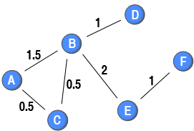
Types of network projection (Weighted newman method)
According to him, collaboration can be formalized as given in equation
where, Np is the number of authors on paper p
.

Slide 8
Types of network projection (Weighted newman method)
In the context of scientific collaboration networks, this implies that if two scientists who only write a single paper together with no other co-authors get a weight of 1 (e.g., node B and node D)
Moreover, if two scientists have written two papers together without any co-author, the weight of their tie would be 2 (e.g., node B and E)
However, if the two scientists have a co-author, the weight on the tie between them is 0.5 (e.g., node A and node C)
A more complicated example is the tie between node A and node B in the diagram
.

Slide 9
Types of network projection (Weighted newman method)
They have written two papers together: one without any other co-author and one with node C as a co-author
The first paper would give their tie a weight of 1, and the second tie would add 0.5 to the weight of this tie
Therefore, the weight attached to their tie is 1.5.
By discounting for the number of blue nodes attached to the same red node, this methods creates a one-mode projection in which the strength of a node is equal to the number of ties originating from that node in the two-mode network (e.g. the sum of weights attached to ties originating from node A in the one-mode projection is 2, and node A is connected to two red nodes)
.

Slide 10

Types of network projection (Sum method)
Therefore, by including weight of links in the network make the analysis richer as compared to network analysis with simple binary links in the network
The weighted two-mode network projection can be formalized as given in equation
Where w_{i,p} is the weight of ith node to pth event where i and j participated together
Through this method, it can be observed that how two nodes interact with common node in different sets and project it onto a directed weighted one- mode network
This method will not create truly directed network as two directed links exists between any two nodes connected with each other
.

Slide 11
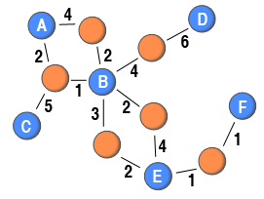
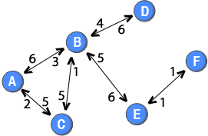
Types of network projection (Sum method)
This method will not create truly directed network as two directed links exists between any two nodes connected with each other
.

Slide 12
Types of network projection (Sum method)
The Figure shows that user A has posted 4 messages in a blog where B has also posted 2 messages
Similarly, 2 messages has been posted by user A in a blog where user B has posted 1 message
Here, link number shows the weight as from user A to blog
With such a method it is possible to differentiate how the two nodes interact with the common node, and to project it onto a directed weighted one-mode network
In this way, the data used for analysis is richer if the tie weights are included in the two-mode network than if they are discarded
.

Slide 13
Types of network projection (Sum method)
In this type of projected network, the weight of a link from a node to another node is not necessarily the same as the weight attached to the link from the latter node to the former node
It is not a truly directed network as two directed links exist between any connected node pair
The direction shows the difference that how two nodes interact with the common node in the network
We can say that 6 messages from (A) as compared to 3 messages from B as link weight
Through this method, no any link is made up of single directed link (asymmetric) in projected one-mode network
.

Slide 14

Types of network projection (Weighted newman method)
In a similar spirit as the method used by Newman (2001), it is also possible to discount for the number of nodes when projecting weighted two-mode networks
For example, it could be argued that if many online users post to a thread, their ties should be weaker than if there were few people posting to the thread
The weights can be calculated based on this approach by using generalization as given in equation
.

Slide 15

Types of network projection (Weighted Newman method)
This method would create a weighted directed one-mode network in which the out-strength of a node is equal to the sum of the weights attached to the links in the two-mode network that originated from that node
This will also not create truly directed network as two directed links exists between any two nodes connected with each other
.

Slide 16
Types of network projection (Commands in R)
# Load tnet
library(tnet)
# Binary one-mode projection
projecting_tm(net, method="binary")
# Simply the number of common red nodes
projecting_tm(net, method="sum")
# Newman's method
projecting_tm(net, method="Newman")
.

