Slide 1
Deep Learning Project: Regularization Findings
Case Study: Parkinson Disease Detection
Regularization Strategy Comparison
Anas Alsharif - 200722051

Slide 2
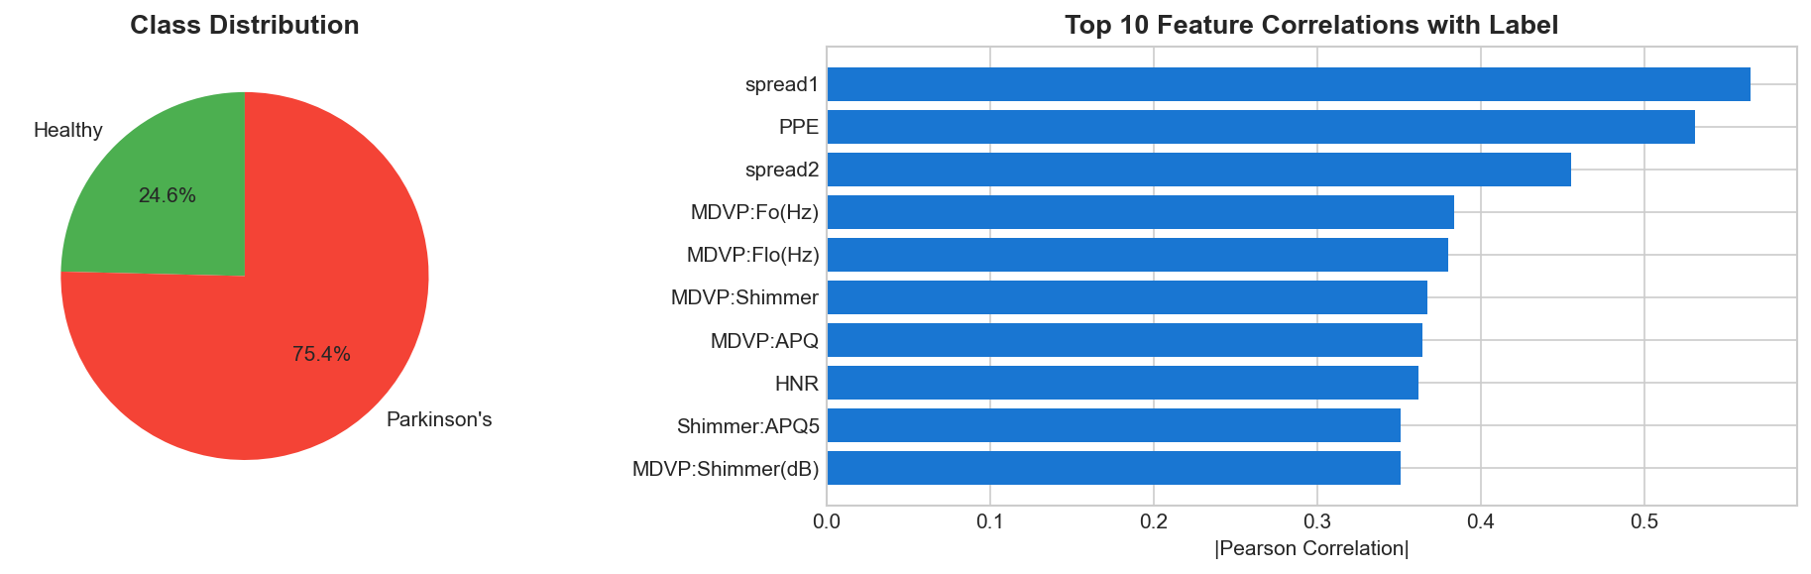
Dataset Overview & Correlations

Slide 3
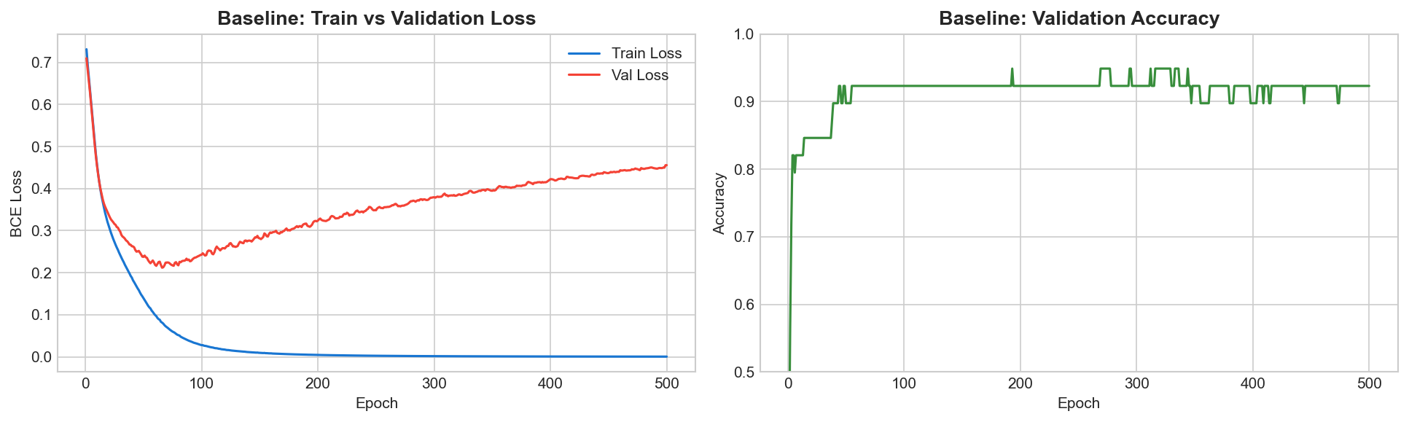
Baseline (No Regularization) - Overfitting Diagnostic

Slide 4
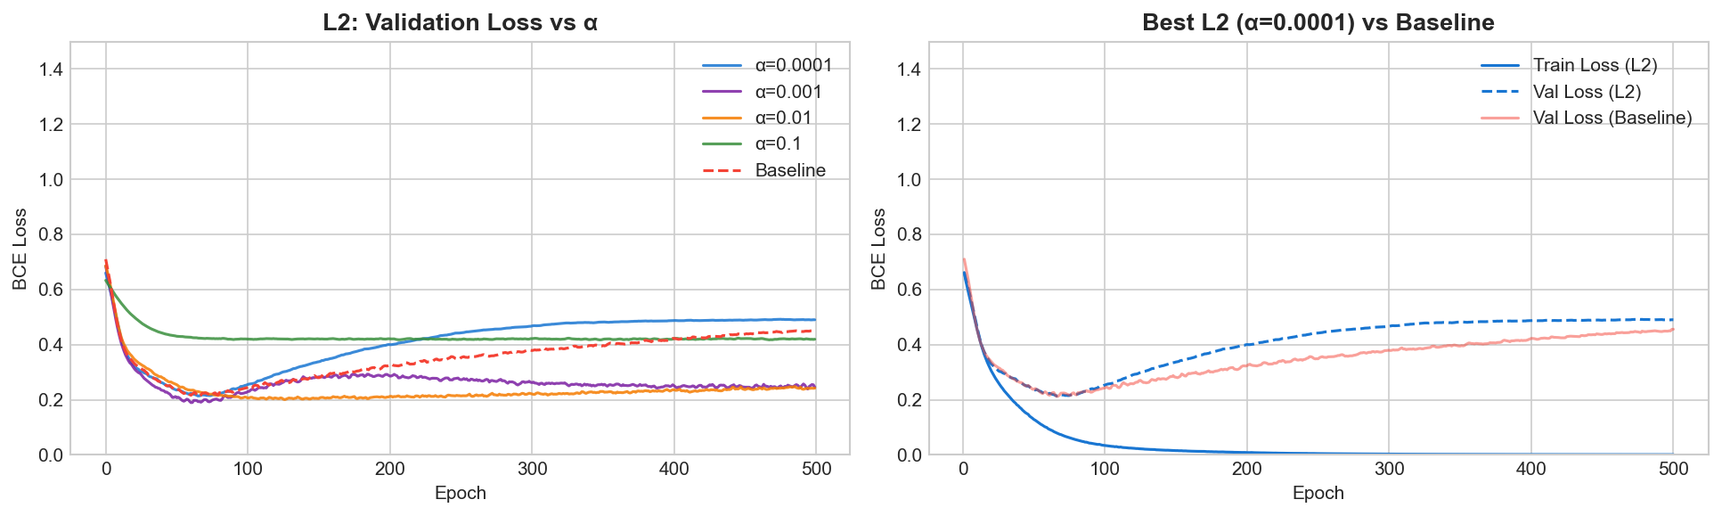
L2 Regularization (Weight Decay) Performance

Slide 5
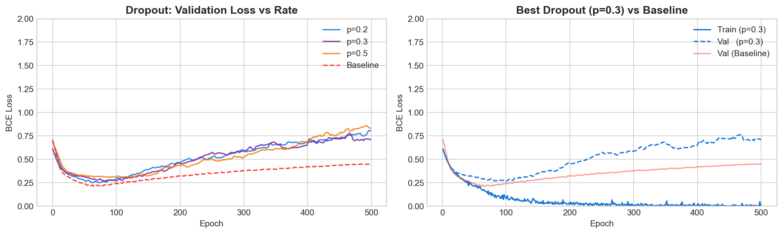
Dropout Ensemble Strategy Results

Slide 6
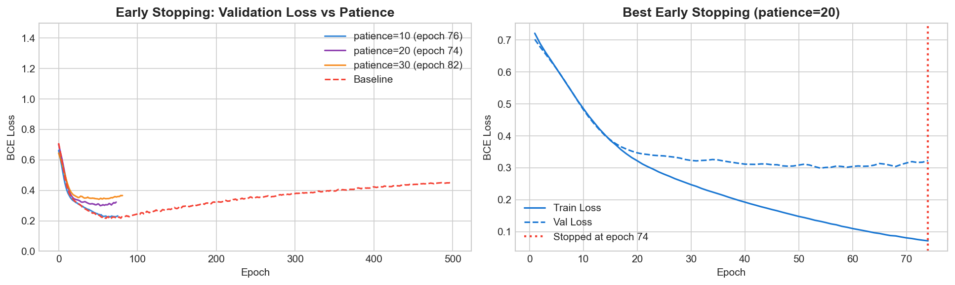
Early Stopping Optimization Trajectory

Slide 7
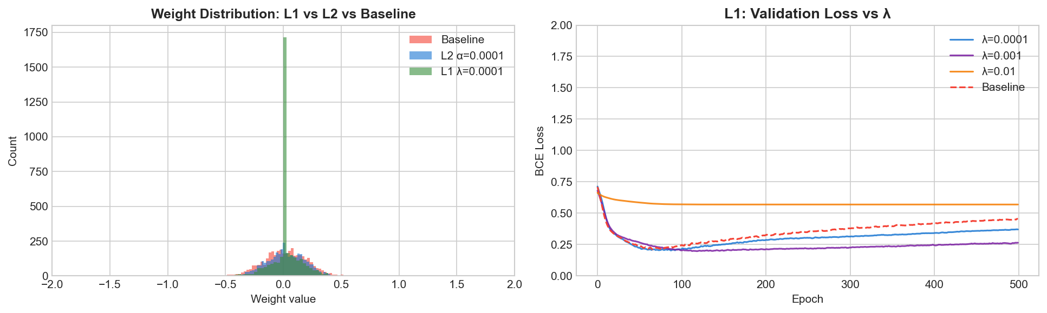
L1 Regularization & Feature Sparsity Distribution

Slide 8
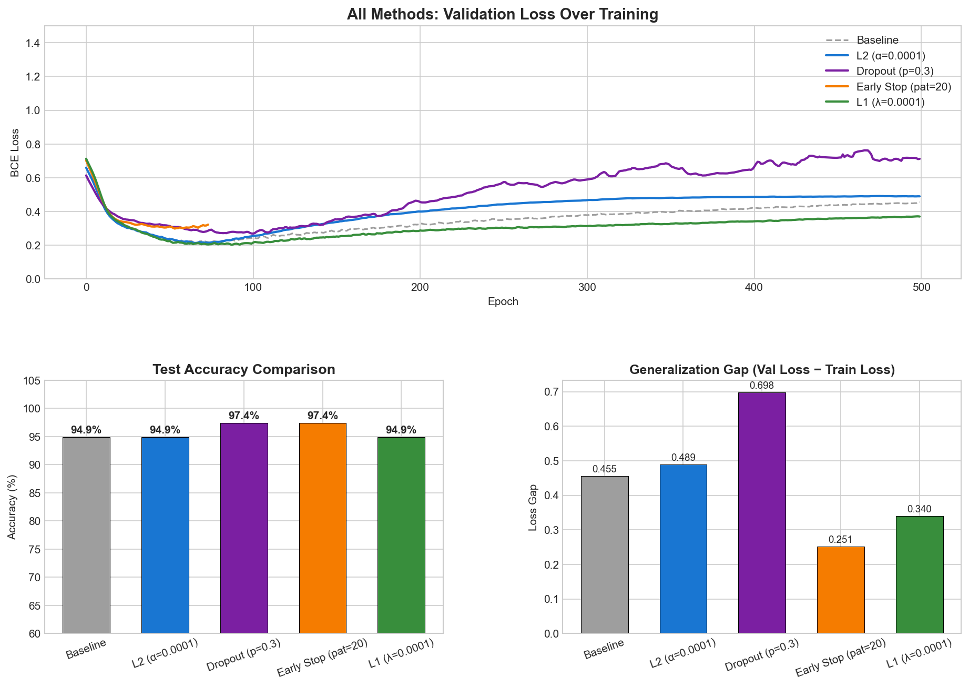
Grand Comparison: Best Strategy Selection

Slide 9
Technical Conclusion
• Overfitting was successfully diagnosed in the baseline.
• L2 and Early Stopping provided the most stable generalization.
• Dropout (p=0.3) achieved the highest overall test accuracy (97.4%).
• Repository is clean, documented, and reproducible.

