Slide 1
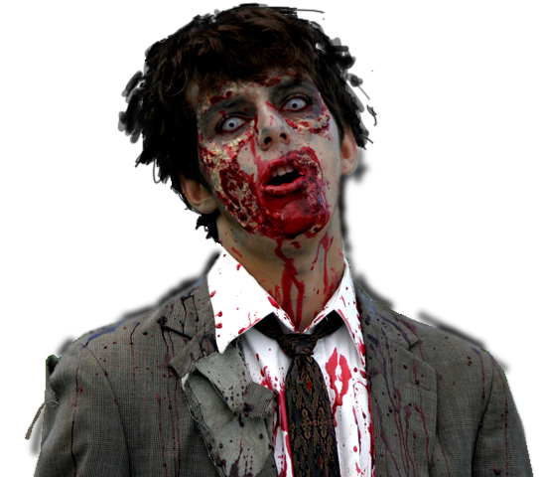
Zombie Outbreak
Simulator
Alice Forehand
Robert Pienta
Eric Reed
Notes:
http://abduzeedo.com/awesome-zombie-collection

Slide 2
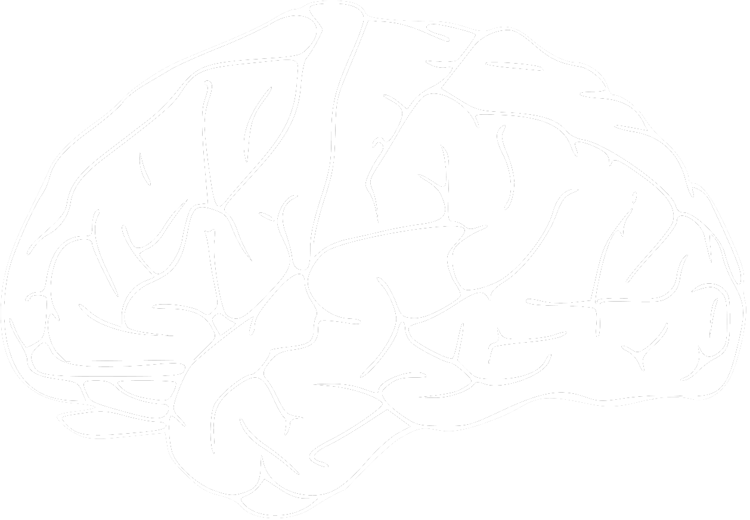
Previous Work l
Social Forces approach from Helbing et al.
Humans use social forces to:
Flee from zombies
Group together to form survivor cells
Avoid walls or other obstacles
Find gun caches
Zombies use social forces to:
Capture and eat or infect humans
Avoid walls
Wander in search of tasty brains
Notes:
1. Steering behaviors for autonomous characters. Reynolds, C W. 1999, Game Developers Conference, pp. 763-782.
2. Social Force Model for Pedestrian Dynamics. Helbing, D and Molnár, P. 1995, Phys. Rev., pp. 4282-4286.

Slide 3

Previous Work ll
Humans Panic under zombie attack
This approach is similar to the work of Helbing et al in Simulating Dynamical Features of Escape Panic
Notes:
3. Simulating Dynamical Features of Escape Panic. Helbing, D., Farkas, I. and Vicsek, T. 2000, Nature, pp. 487-490.

Slide 4



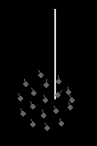
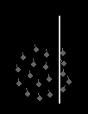
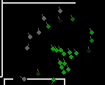
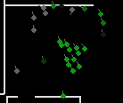
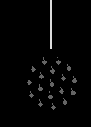

Agent Behavior - Humans
Flee from zombies
Group together to form survivor cells
Avoid walls or other obstacles
Notes:
http://www.pressthebuttons.com/2010/07/disco-zombie-doesnt-advertise.html

Slide 5
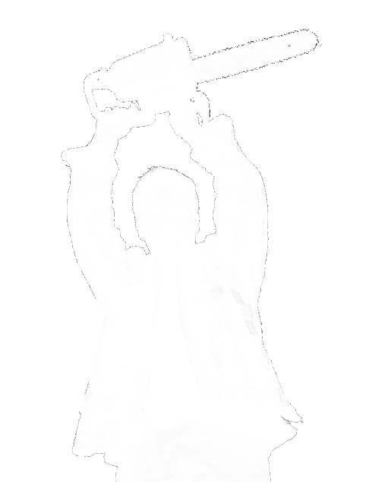
Experimental Results
Use varied
Notes:
http://www.flickr.com/photos/wonko-the-sane/3442488189/

Slide 6
Extensions
The system could be extended to be an approach modeling the spread of infectious contact-based diseases
Modify zombie agents to act like normal humans
During contact with uninfected humans use a probability to pass disease along
Using pre-existing wall structures to model:
Airports
Bus stations
Train stations
Schools
Hospitals
Office environments
Notes:
http://www.flickr.com/photos/wonko-the-sane/3442488189/

