Slide 1
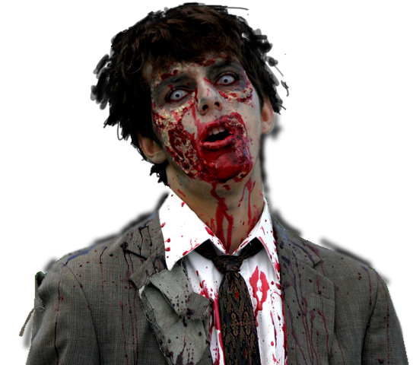
Zombie Outbreak
Simulator
Alice Forehand
Robert Pienta
Eric Reed
Notes:
http://abduzeedo.com/awesome-zombie-collection

Slide 2
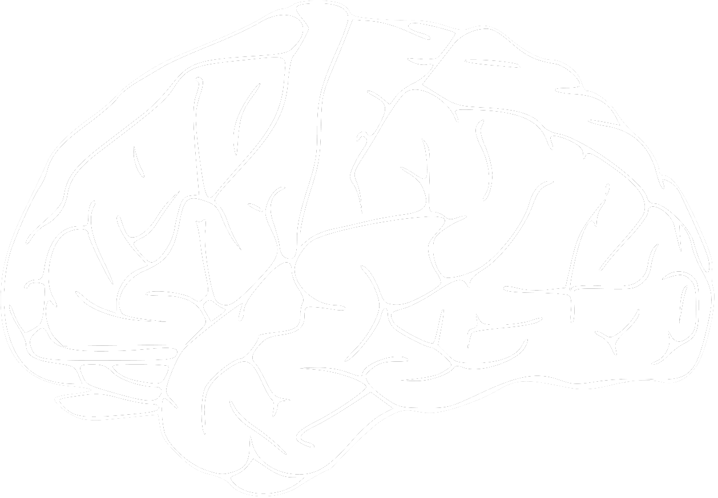
Previous Work l
Social Forces approach from Helbing et al.
Humans use social forces to:
Flee from zombies
Group together to form survivor cells
Avoid walls or other obstacles
Find gun caches
Zombies use social forces to:
Capture and eat or infect humans
Avoid walls
Wander in search of tasty brains
Notes:
1. Steering behaviors for autonomous characters. Reynolds, C W. 1999, Game Developers Conference, pp. 763-782.
2. Social Force Model for Pedestrian Dynamics. Helbing, D and Molnár, P. 1995, Phys. Rev., pp. 4282-4286.

Slide 3

Previous Work ll
Humans Panic under zombie attack
This approach is similar to the work of Helbing et al in Simulating Dynamical Features of Escape Panic
The panic induced in the humans is proportional to the number of zombies present
Often this can completely destroy the human flocks
Notes:
3. Simulating Dynamical Features of Escape Panic. Helbing, D., Farkas, I. and Vicsek, T. 2000, Nature, pp. 487-490.

Slide 4
Previous Work lll
Munz et al. created a mathematical model to analyze the spread of a zombifying infectious disease
The survival of the human race is unlikely
The most likely means of survival for the humans was to immediately eradicate the infected
The approach was a set of differential equations based on previous infectious disease work
Notes:
When zombies attack!: Mathematical modelling of an outbreak of. Munz, P, et al. 2009, Infectious Disease Modelling Research Progress, pp. 133-150.

Slide 5



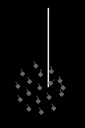
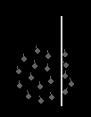
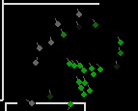
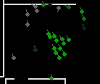
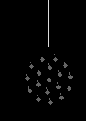

Agent Behavior - Humans
Flee from zombies
Group together to form survivor cells
Avoid walls or other obstacles

Slide 6


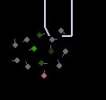
Agent Behavior - Zombies
Detect and chase humans
Bitten humans may incubate the disease, undetectable by other humans
They are displayed in darker shades of green

Slide 7


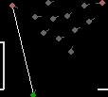
Agent Behavior – Gun Caches
Gun caches appear as small blue boxes, their size is proportional to the number of available guns within them
Humans with guns appear in pink
Humans can fire guns to kill zombies

Slide 8
Agent-Wall Implementation
D_{w}
F_{w} = e^(1/D_{w})

Slide 9
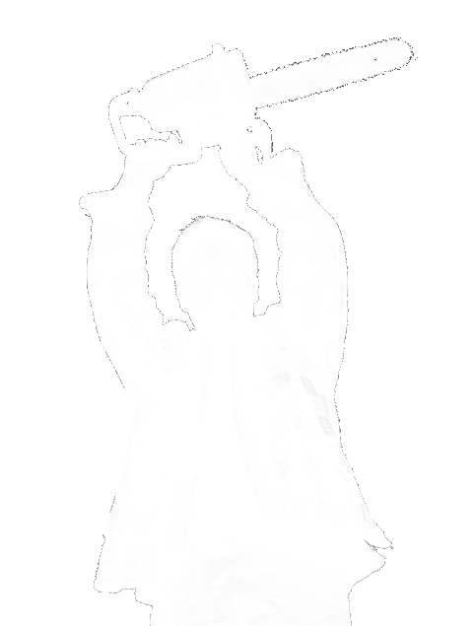
Experimental Results
Without a high saturation of guns the humans are in desperate trouble
This agrees with the infectious zombie modeling by Munz et al. in When Zombies Attack!: Mathematical Modeling of an Outbreak
Notes:
When zombies attack!: Mathematical modelling of an outbreak of. Munz, P, et al. 2009, Infectious Disease Modelling Research Progress, pp. 133-150.
http://www.flickr.com/photos/wonko-the-sane/3442488189/

Slide 10



Experimental Results l
Wall avoidance is highly dependent on:
Low maximum velocity
Sufficient sight range
An exponential repulsion force
Spirals form when the speed of the zombies and humans are equivalent
Notes:
When zombies attack!: Mathematical modelling of an outbreak of. Munz, P, et al. 2009, Infectious Disease Modelling Research Progress, pp. 133-150.
http://www.flickr.com/photos/wonko-the-sane/3442488189/

Slide 11
Application Extensions
The system could be extended to be an approach modeling the spread of infectious contact-based diseases
Modify zombie agents to act like normal humans
During contact with uninfected humans use a probability to pass disease along
Using pre-existing wall structures to model:
Airports
Bus stations
Train stations
Schools
Hospitals
Office environments
Notes:
http://www.flickr.com/photos/wonko-the-sane/3442488189/

Slide 12
Application Extensions ll
The system could be used to model attack scenarios for military applications
Modify zombie agents to act like the aggressors
Provide more realistic weaponry to locals and/or aggressors
Form village structure or city structure from satellite or other data
Can simulate a number of different military skirmishes and attack styles dependent on how the flocking of both sides is controlled
Could yield potential tactical data
Notes:
http://www.flickr.com/photos/wonko-the-sane/3442488189/

