Slide 1
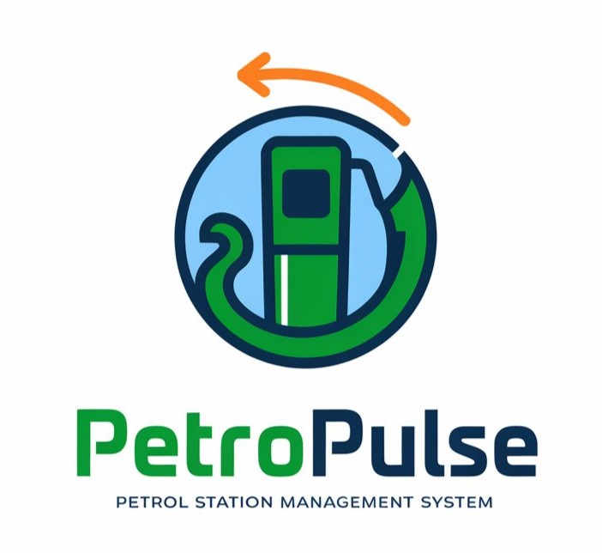
PetroPulse
Hasnain Akhtar 22i-1241
Anas Bin Rashid 22i-0907
Adan Malik 22i-1000

Slide 2
Introduction
The purpose of PetroPulse is to provide a petrol station management system that streamlines sales, fuel orders, payments, customer loyalty, and administrative tasks by defining its functional and non-functional requirements.
Problem: The issues that led to the creation of PetroPulse include inefficient manual processes, lack of real-time data, high administrative burdens, customer dissatisfaction due to slow transactions, and operational challenges in inventory tracking and fuel ordering. PetroPulse aims to solve these problems with an automated solution.

Slide 3
Scope & Objectives
PetroPulse offers a comprehensive solution for managing petrol stations, integrating fuel station management, inventory tracking, payment processing, customer management, and worker scheduling. It enables seamless interaction between owners, workers, and customers, with role-based access for efficient operations.
Objectives: The main objectives of PetroPulse are to automate operations, ensure accurate financial management, monitor inventory, simplify employee scheduling, enhance customer service, and provide data analytics for informed decision-making.

Slide 4
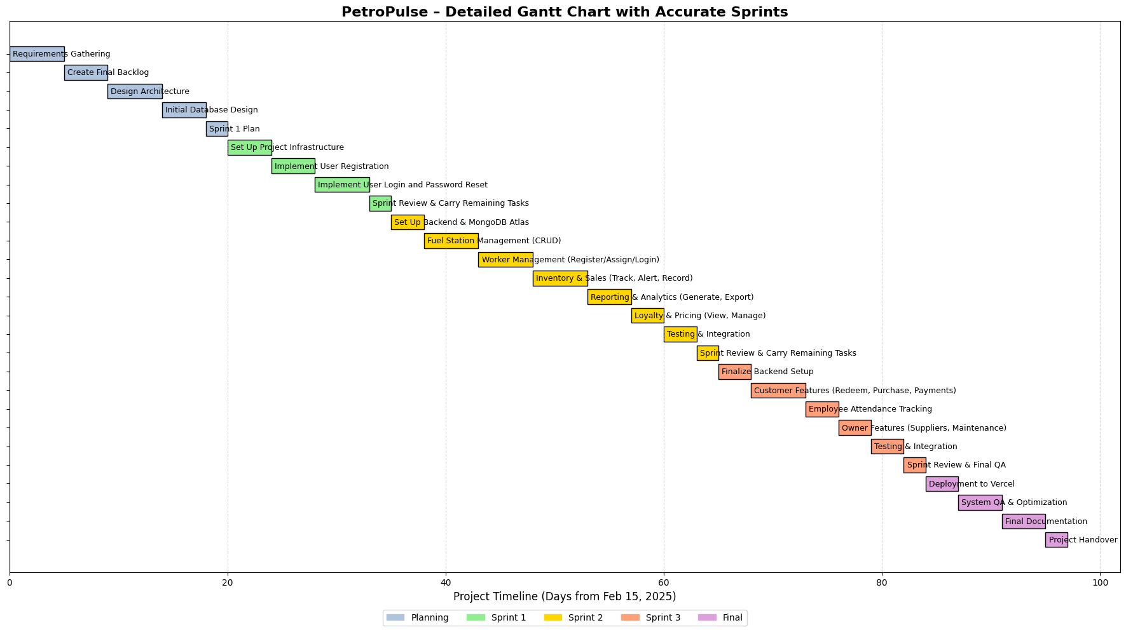
Implementation Phases

Slide 5
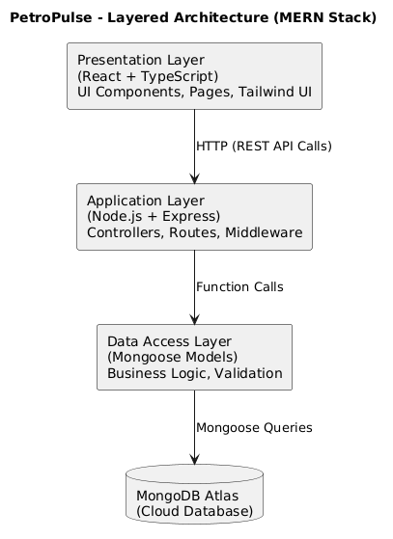
ARCHITECTURE

Slide 6
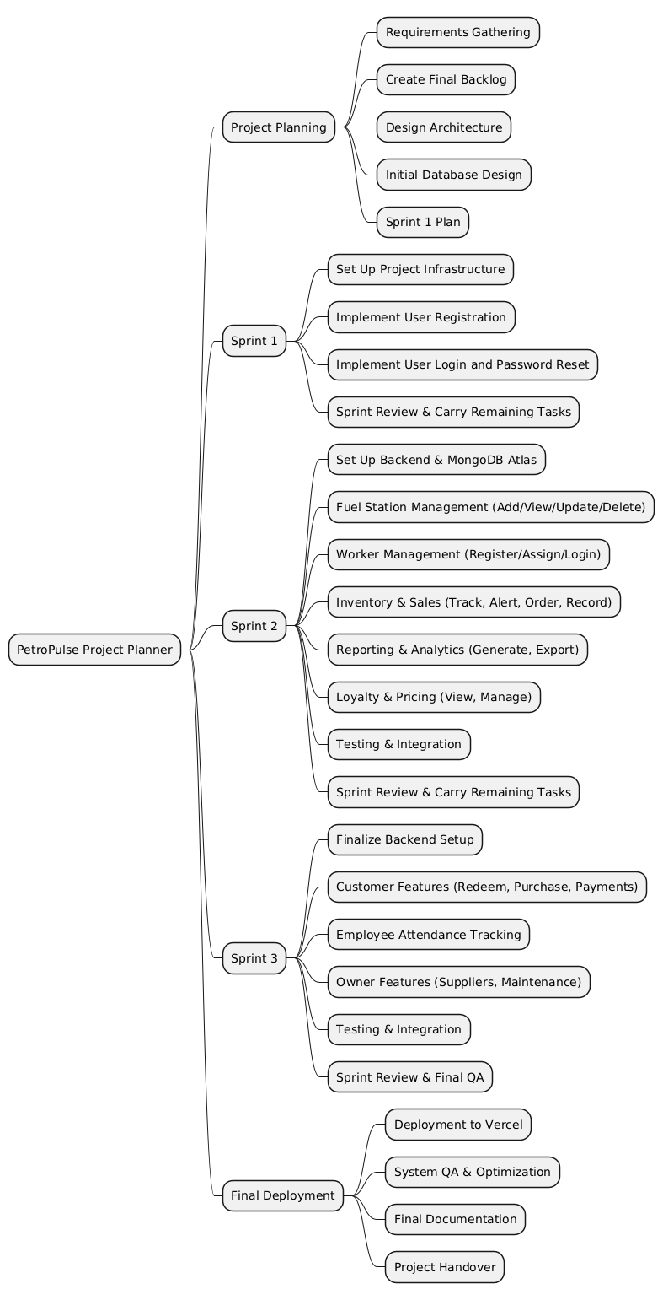
Project Planner

Slide 7
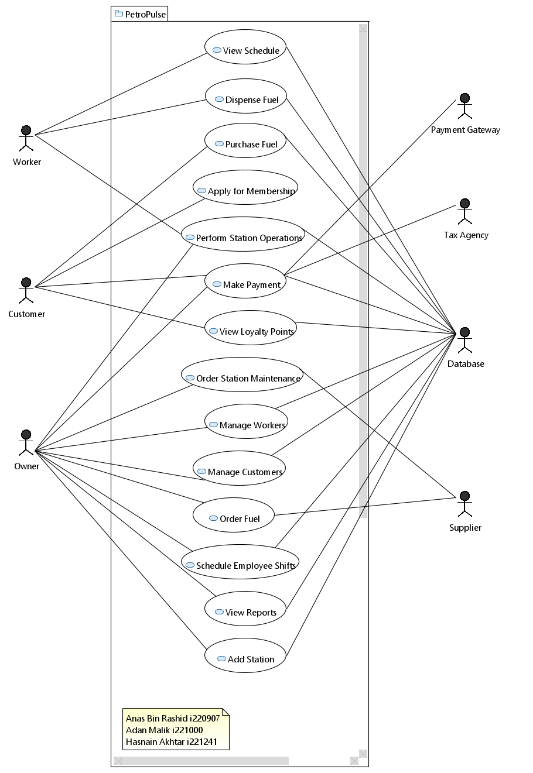
USE CASES & USE CASE DIAGRAM

Slide 8
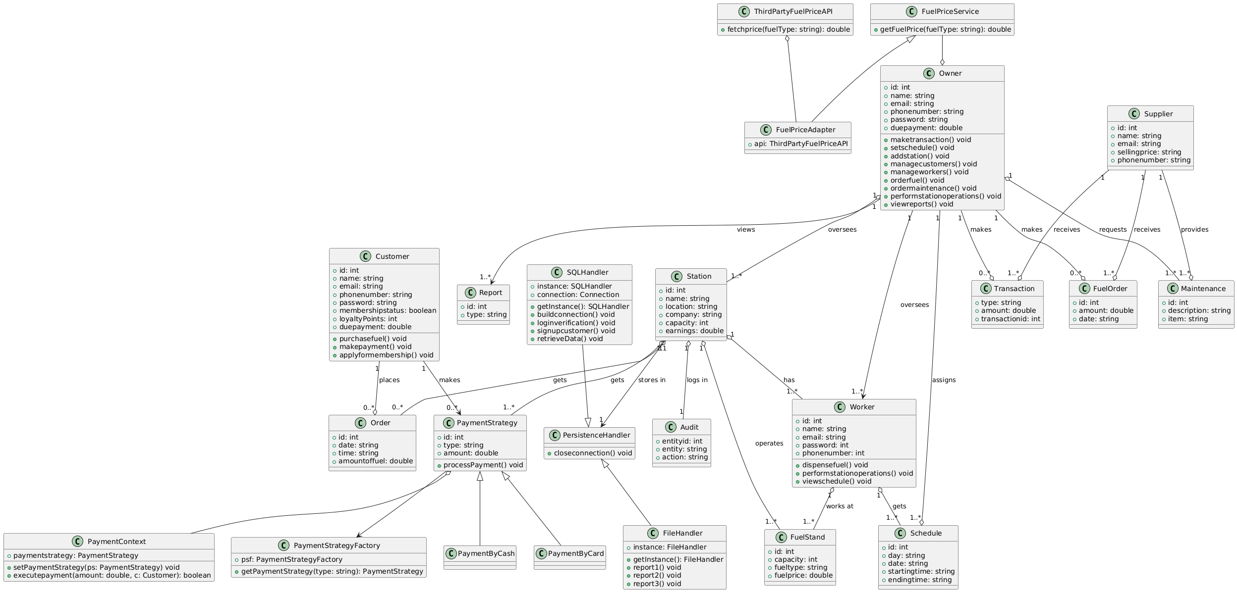
CLASS DIAGRAM

Slide 9
USER STORIES

Slide 10
USER STORIES
26 user stories in total
24 were implemented in 3 sprints

Slide 11
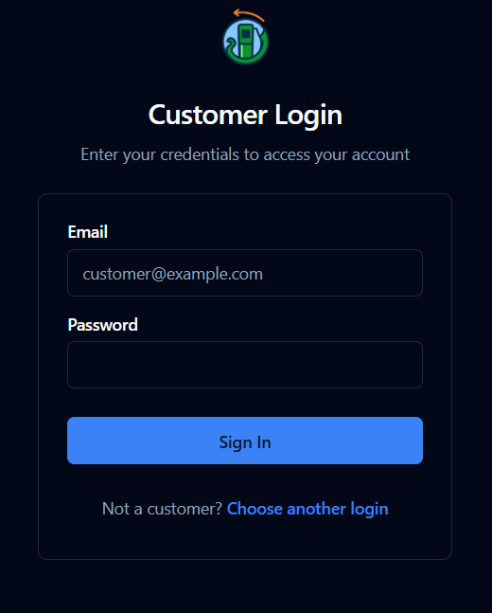
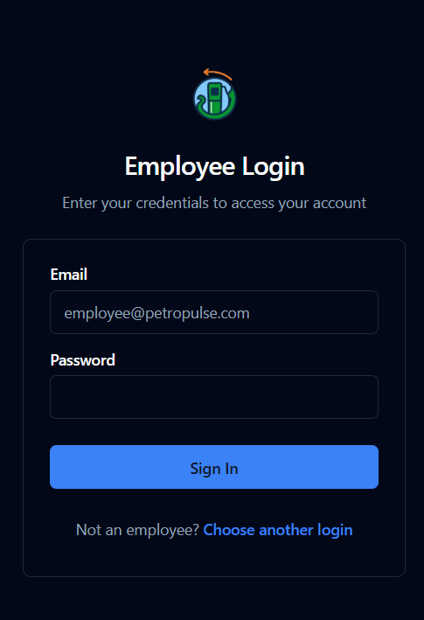
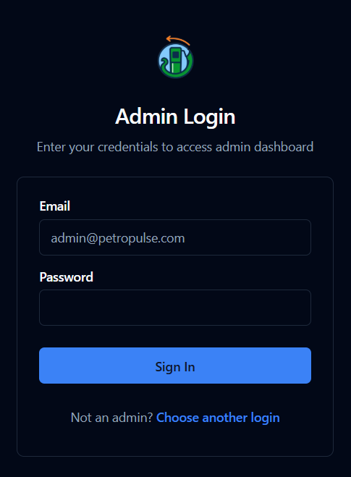
LOGIN

Slide 12
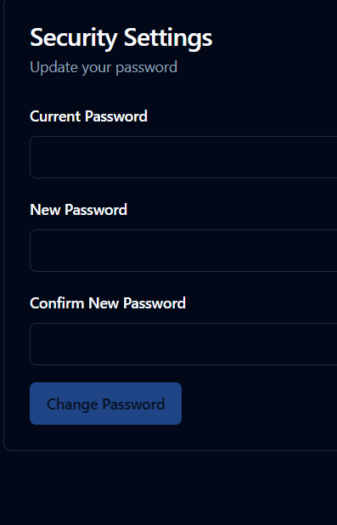
PASSWORD RESET + SECURE ACCESS

Slide 13
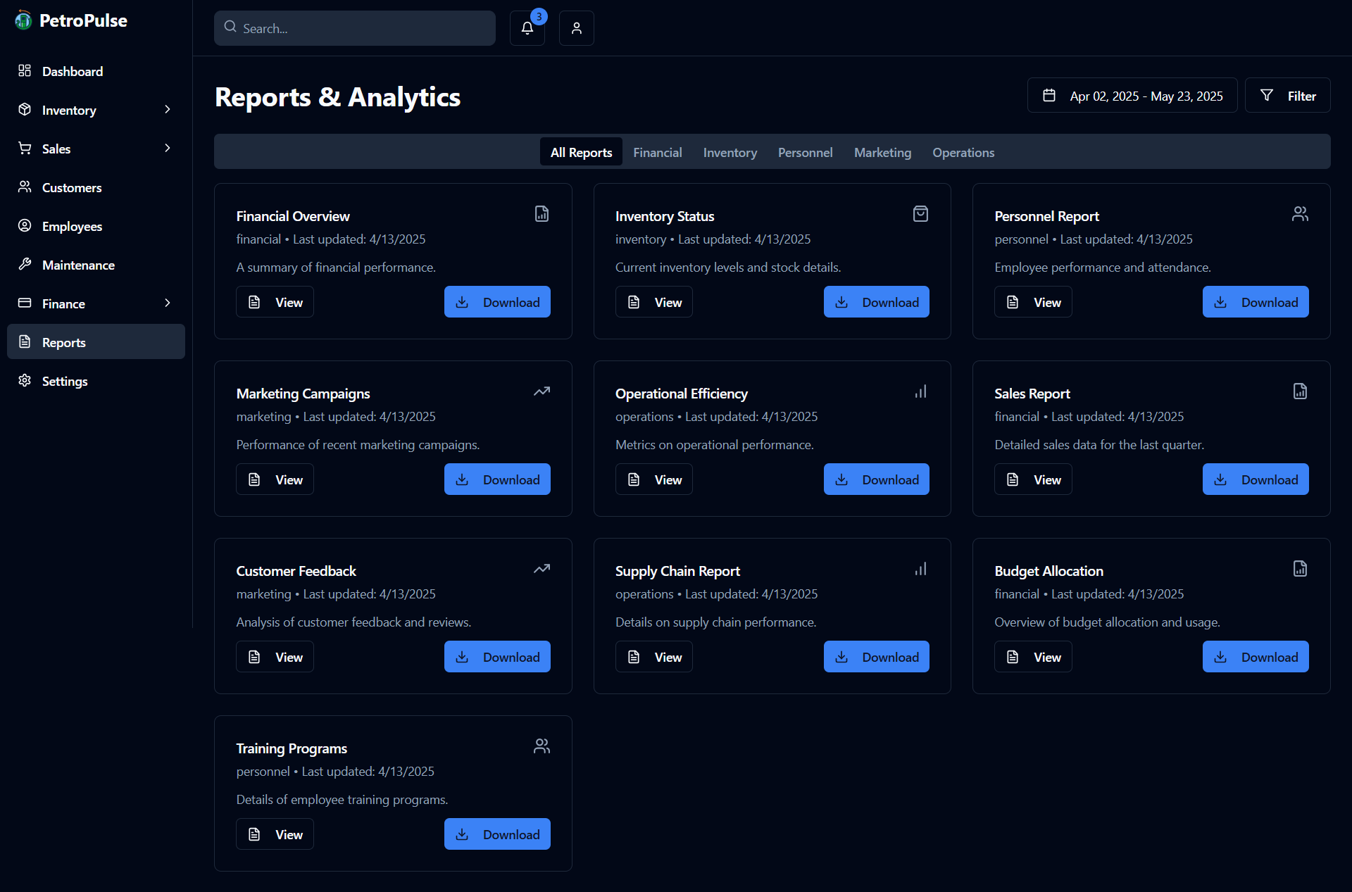
GENERATE SALES REPORTS

Slide 14
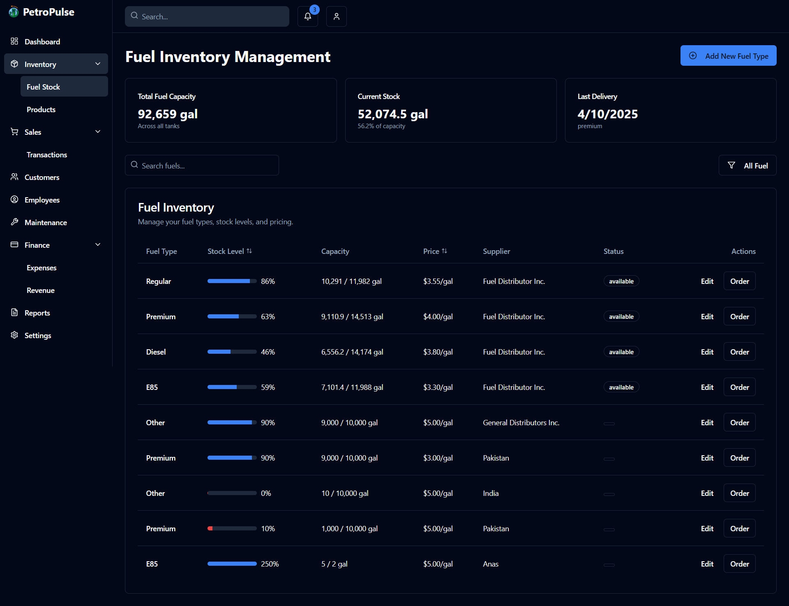
TRACK INVENTORY

Slide 15
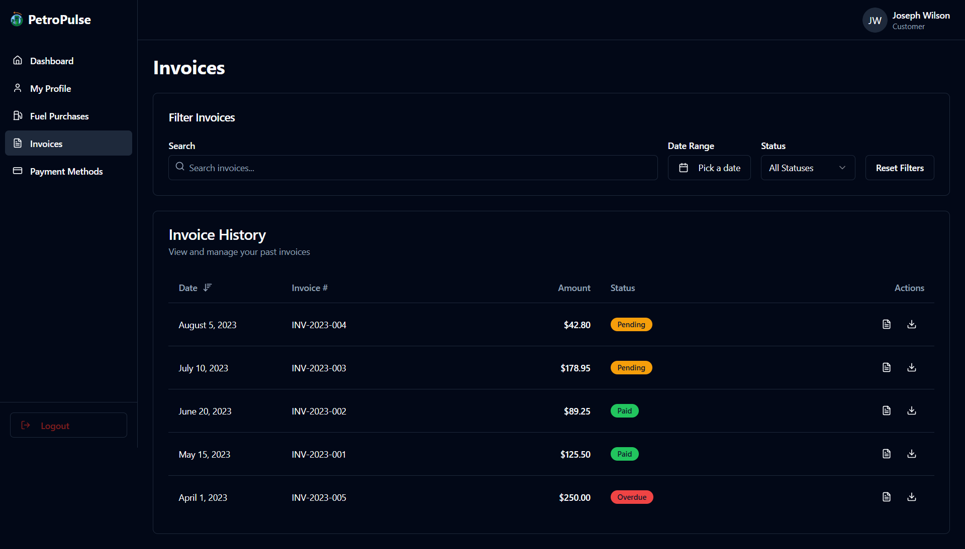
VIEW TRANSACTION HISTORY

Slide 16
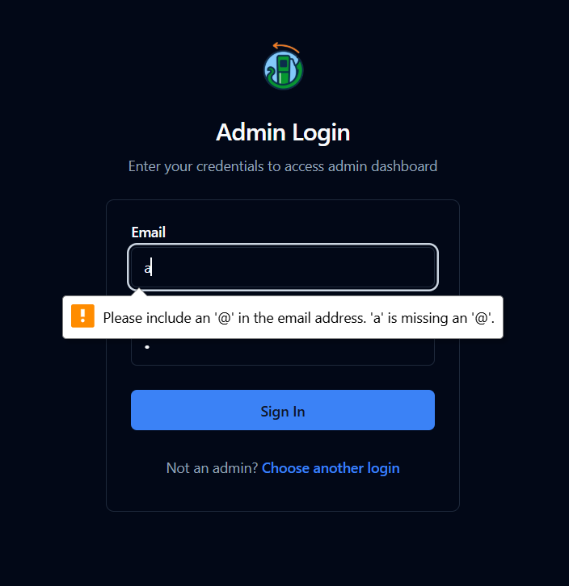
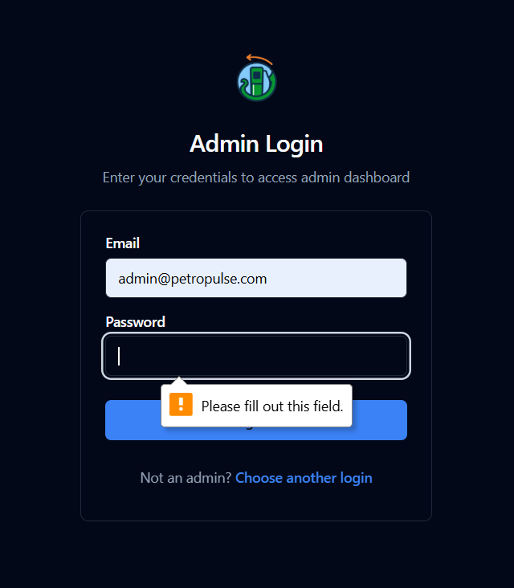
TESTING

Slide 17
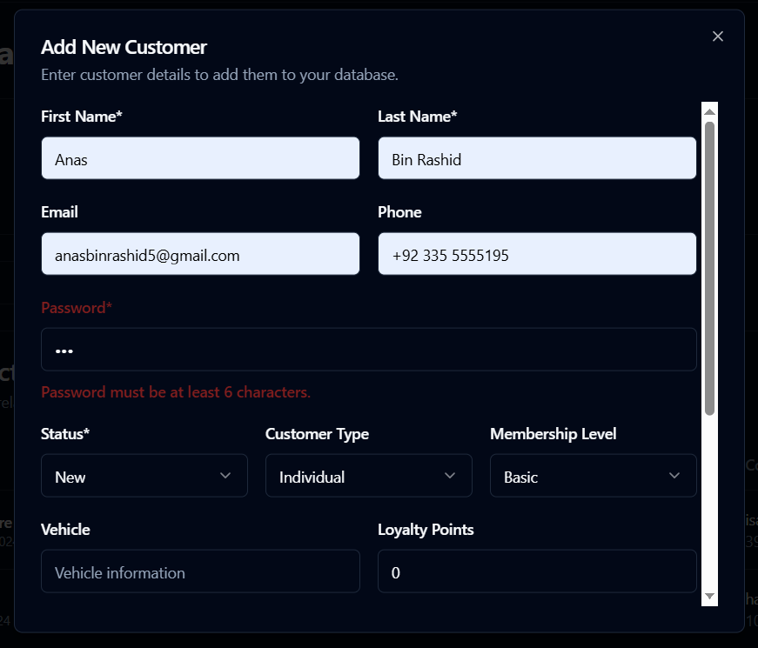
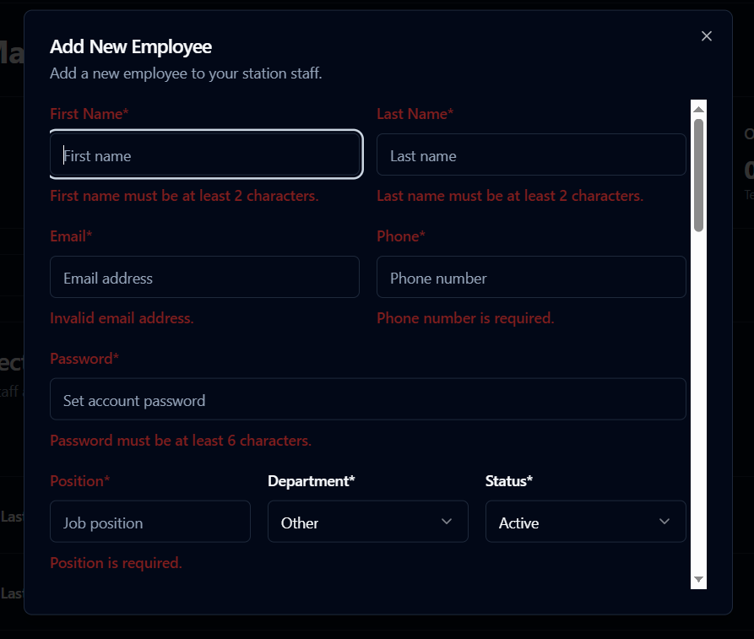
TESTING

Slide 18
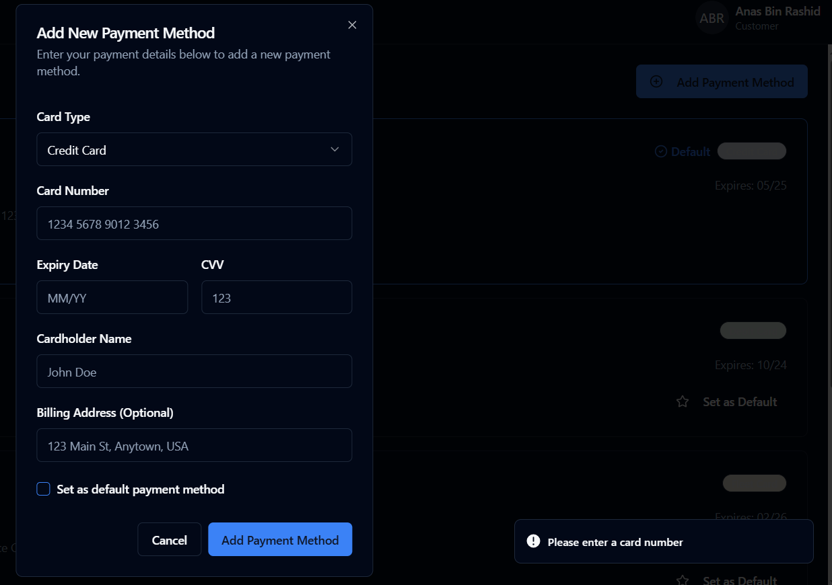
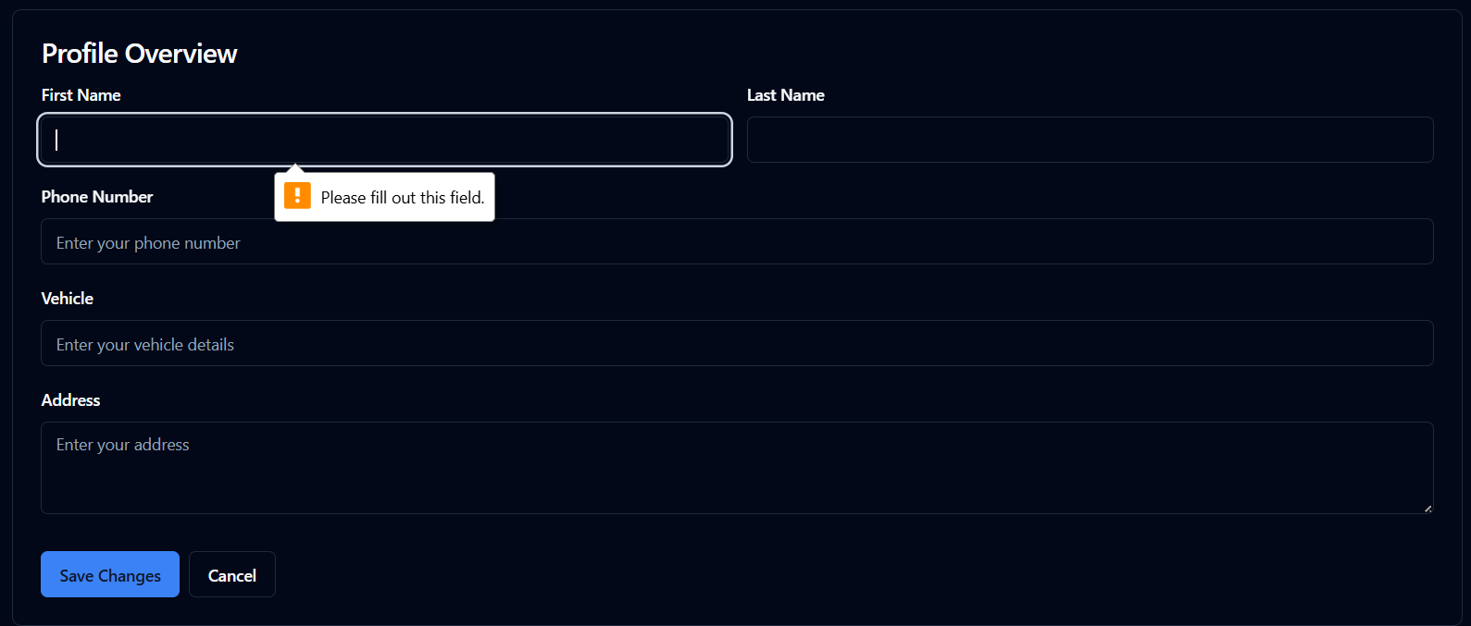
TESTING

Slide 19
BUSINESS OBJECTIVES
Enhance Operational Efficiency: Automate and streamline petrol station processes to reduce manual workload and improve productivity.
Boost Customer Satisfaction: Provide fast, seamless transactions and loyalty programs to improve the customer experience.
Improve Financial and Inventory Management: Ensure accurate tracking of sales, expenses, and fuel inventory for better oversight and decision-making.
Drive Business Growth: Expand market reach through scalable solutions and generate revenue from licensing, maintenance, and partnerships.

Slide 20
NON-FUNCTIONAL REQUIREMENTS
The system should handle concurrent usage and ensure fast transaction processing.
It must prioritize data privacy, secure payment transactions, and encrypted communication.
User authentication and role-based access control are essential for security.
Additionally, the system should be maintainable, scalable, reliable.
The system should have an intuitive user interface.

Slide 21
CONCLUSION
In conclusion, PetroPulse offers a comprehensive, automated solution that streamlines petrol station operations, enhances customer satisfaction, and improves financial and inventory management. By addressing key industry challenges, it provides a scalable platform for growth and efficiency. The project aims to revolutionize petrol station management for a more efficient and profitable future.

