Slide 1

AttendEZ: Effortless QR Attendance
Snehal Pawar - 23207002
Darshan Korde - 23207003
Harsh Tambade - 23207001
Anas Chougle - 23207006
Project Guide
Prof. Sheetal Jadhav

Slide 2
Contents
Introduction
Objectives
Scope
Features
Project Outcomes
Technology Stack
Block Diagram

Slide 3
1.Introduction
Problem Identified:
Attendance was not recorded properly due to technical and human error.
Not able to keep records in a systematic manner.
Time consuming and too extra work to do if error happens.
Solution proposed:
Our application provides user-friendly approach for easy and modern attendance method.
Scanning the QR code reduces much human work and time.

Slide 4
2. Objectives
To build a user friendly application for Attendance using QR Code for fast and modern way.
To overcome errors that are caused while listing the attendance.
To make it user friendly and easy to mark your attendance.

Slide 5
3. Scope
Can be useful for today’s generation which is all into such digital stuff.
Can be applied in an Organization or School/Colleges.
Can be used for a digital and fast lifestyle.
Can be used to minimize human errors and time consumed.

Slide 6
4. Features/Functionality
Fast Responsive Interfaces :Able to display interfaces at a good speed and the information is also shared much faster.
Authentication : Lets user access their account with particular username and password and scan the QR code for attendance.
Forms :Provided QR code lets us visit a form , just to make it more secure, which once filled will mark our attendance.

Slide 7
5. Project Outcome
The use of QR codes accelerates the attendance tracking process, reducing the time and effort required for both administrators and participants.
With QR codes, attendance data can be recorded in real-time, allowing for immediate monitoring and reporting.
The project facilitates the integration of attendance data with existing databases, student information systems for interconnected information environment.

Slide 8
6.Technology Stack
1) JDK: (20.0.2)
2) IDE (Apache Netbeans 19)
3) MySQL (8.0.28)
4) Java Server Pages (jsp).

Slide 9
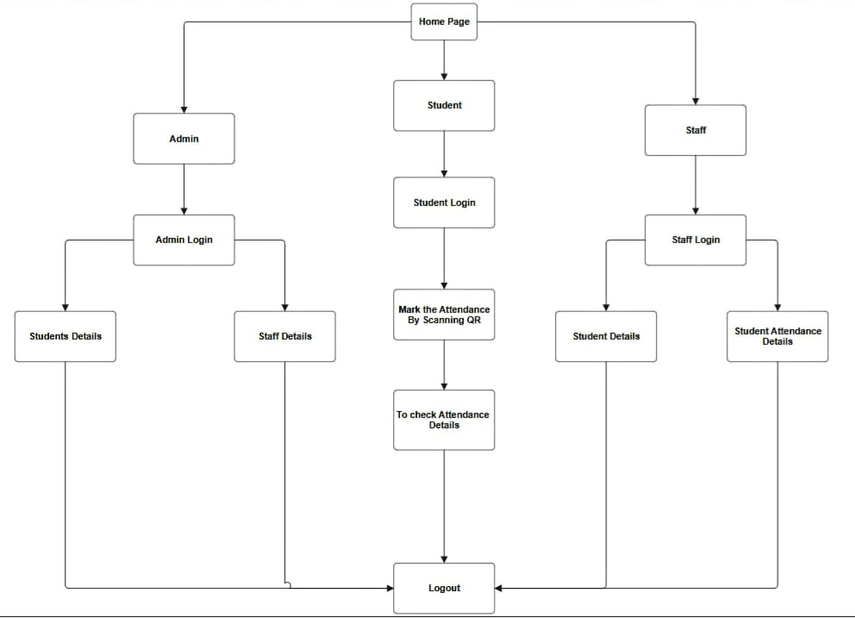
7. Block Diagram
7. Block Diagram

Slide 10
Thank You…!!

