Slide 1
Introduction to JavaScript Programming
Creating Interactive Web Pages

Slide 2
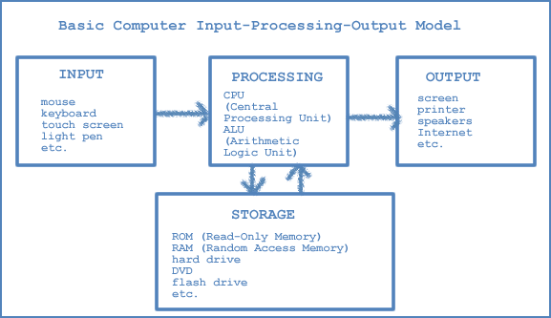
0.1
What is Computer?

Slide 3
What is a computer?
An electronic device that stores, processes, and retrieves information.
Performs tasks with speed, accuracy, and efficiency beyond human ability.
Used for solving problems, analyzing data, communication, and everyday tasks.
Has become a cornerstone of modern life.

Slide 4
Computers in Modern Technology
Everyday Life: Smartphones, laptops, ATMs, smart devices.
Education: Online learning, research, virtual labs.
Healthcare: Patient records, medical imaging, robotic surgery.
Business: Digital payments, online shopping, financial systems.
Science & Innovation: AI, space exploration, self-driving cars.

Slide 5
0.2
Computer Basics

Slide 6
Basic input-processing-output model

Slide 7
Input
Used to receive data from the outside world
Mouse
Keyboard
Voice activation
Touch screens
and more…

Slide 8
Processing
Used to receive data from the outside world
CPU: Central Processing Unit – considered the brain
ALU: Arithmetic-Logic Unit
Together they receive program instructions, perform operations to execute instructions, and control other computer components.

Slide 9
Storage
Internal Memory:
ROM: Read-Only Memory – unalterable instructions used during startup and for some other basic operations
  Non-volatile (permanent)
RAM: Random Access Memory – holds data being worked on at any given time
  Volatile (erased when computer is turned off)
External Memory:
Magnetic storage such as hard disks
Optical storage such as CDs and DVDs
Solid state storage such as flash (USB) drives

Slide 10
Output
Used to allow the computer to communicate with us
screens
printers
speakers
External storage
and more…

Slide 11
0.3
A Brief History of the Internet

Slide 12
Origins of the Internet
1960s – ARPANET: First network created by the U.S. Department of Defense to connect research computers.
1970s – TCP/IP Protocol: Developed by Vint Cerf and Robert Kahn, set the standard for communication between computers.
1980s – Expansion: Universities and institutions joined, creating a larger global network.

Slide 13
The Internet and Its Impact
1990s – World Wide Web: Introduced by Tim Berners-Lee, making the internet easy to use with websites and browsers.
Growth of email, search engines, and online services.
Today, the internet powers social media, e-commerce, cloud, and AI.
To build these online systems, programming languages (like JavaScript, Python, and Java) are essential

Slide 14
What is a WWW?
WWW: The World Wide Web (WWW or web) is a system of interlinked hypertext documents accessed via the Internet
URL: The Uniform Resource Locator (URL) is the unique address of every resource on the web
http://www.pearson.com/educator/Computer/javascrpt.htm
https://www.just.edu.so/

Slide 15
0.4
What is Programming?

Slide 16
Software
Programs are instructions in the computer’s memory.
Applications are programs used for many things.
Application Software:
Solves problems
Supplies information
Provides recreation
Enhances productivity
System Software:
Controls computer hardware
Communicates with the user

Slide 17
Programming and Scripting Languages
Machine languages
  All 0s and 1s
  Communicates only at computer level
  Example:
    0110 1101 1111 0111 0000 0001 0000 0000
Assembly language
  Symbolic representation of machine language
  Example:
    ADD A, B
High-level languages
  Contains English words and phrases
  Must be compiled or interpreted for computer
  Examples: C++, Java, Visual Basic, JavaScript

Slide 18
Programming and Scripting Languages
Programming languages are compiled
  A compiler works before the program is executed
  Example: C++, Java
Scripting languages are interpreted
  An interpreter works while the program is running
  Example: JavaScript

Slide 19
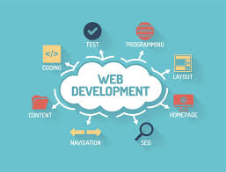
0.5
Web Development

Slide 20
What is Web Development?
  Web development, often simply referred to as "web dev," is the art and science of building and maintaining websites and web applications.
  It encompasses various aspects, including:
  Front-End Development (Client-Side): This involves creating the user interface and ensuring that the web content is visually appealing and interactive. Front-end developers use HTML, CSS, and JavaScript to achieve this.
  Back-End Development (Server-Side): This focuses on the server-side of web applications. Back-end developers work on server configuration, databases, and server-side scripting languages like Node.js, Python, Ruby, or PHP.

Slide 21
Why Web Development Matters?
Web development is crucial for several reasons:
Global Reach: Websites and web apps can be accessed by anyone with an internet connection, making them accessible on a global scale.
Business and E-Commerce: Many businesses rely on websites and online stores to reach customers and conduct transactions.
User Interaction: Web development enables interactivity and user engagement, allowing users to interact with web content, fill out forms, and receive dynamic responses.
Information Dissemination: Websites are a primary source of information dissemination, from news portals to educational resources.
Job Opportunities: Web development offers diverse job opportunities, from front-end and back-end developers to web designers and full-stack developers.

Slide 22
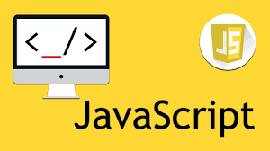
0.6
JavaScript
Programming language

Slide 23
What is JavaScript?
JavaScript, often abbreviated as JS, is a versatile and widely used
programming language. It is primarily employed for client-side scripting in
web development. JavaScript enables you to:
Add Interactivity: You can create interactive elements on web pages, such as forms, animations, and real-time updates.
Respond to User Actions: JavaScript allows web pages to respond to user interactions like clicks, mouse movements, and keyboard input.
Validate and Manipulate Data: You can validate user input, manipulate data, and perform calculations on the client side.
Communicate with Servers: JavaScript can make asynchronous requests to servers, retrieve data, and update web pages without reloading them.

Slide 24
Cont…
JavaScript was initially created to “make web pages alive”.
The programs in this language are called scripts. They can be written right in a web page’s HTML and run automatically as the page loads.
Scripts are provided and executed as plain text. They don’t need special preparation or compilation to run.
In this aspect, JavaScript is very different from another language called Java.

Slide 25
History of JavaScript
JavaScript, created by Brendan Eich in 1995 while he was at Netscape, is a versatile programming language that has had a profound impact on web development and beyond. Here's a brief summary of its history:
Birth (1995): JavaScript was introduced in Netscape Navigator 2.0 as a way to add interactivity to static web pages. Originally named "Mocha" and later "LiveScript," it was eventually named JavaScript.
Standardization (1996): JavaScript's standardization process began in collaboration with the European Computer Manufacturers Association (ECMA). The first official specification, ECMAScript, was released in 1997 and continues to evolve.

Slide 26
Cont…
DOM and Ajax (Early 2000s): JavaScript gained importance with the introduction of the Document Object Model (DOM), allowing dynamic manipulation of web content. Ajax emerged, enabling asynchronous data exchange between the browser and server.
JavaScript Frameworks (Mid-2000s): Frameworks like jQuery simplified DOM manipulation and cross-browser compatibility, contributing to the growth of web applications.
HTML5 and Modern Web (Late 2000s - Early 2010s): JavaScript played a vital role in HTML5's development, which introduced native multimedia support and advanced form handling.
Node.js (2009): Node.js brought JavaScript to the server side, unifying the language stack and allowing for scalable server applications.

Slide 27
Cont…
ECMAScript 6 (2015): ES6 introduced significant enhancements like arrow functions, classes, and template literals, making JavaScript more developer-friendly.
JavaScript Everywhere (Present): JavaScript is now used beyond web browsers, powering mobile apps (React Native, Angular, Vue.js), desktop applications (Electron), and IoT devices.
JavaScript keeps improving through ECMAScript updates, meeting the needs of modern development. Tools like Babel ensure it works on older browsers.
It has grown from a simple web scripting tool into a powerful language used everywhere in programming and web development

Slide 28
JavaScript's Role in Modern Web Development
In contemporary web development, JavaScript is indispensable:
Single-Page Applications (SPAs): SPAs, which load a single HTML page and dynamically update content, rely heavily on JavaScript frameworks like React, Angular, and Vue.js.
Mobile Development: JavaScript is used for building mobile apps using technologies like React Native and Apache Cordova.
Server-Side JavaScript: Node.js, a server-side JavaScript runtime, enables developers to use JavaScript for back-end development.
Responsive Design: JavaScript plays a role in making web applications responsive to various devices and screen sizes.

Slide 29
JavaScript in the Job Market
JavaScript proficiency is in high demand, and it offers a wide range of career
opportunities, including:
Front-End Developer: Specializes in creating user interfaces and interactive web elements using HTML, CSS, and JavaScript.
Back-End Developer: Focuses on server-side development, working with databases, APIs, and server technologies while often using JavaScript.
Full-Stack Developer: Masters both front-end and back-end development, making them versatile in building complete web applications.

Slide 30

0.7
Set up your
environment

Slide 31
Set Up Your Environment
Before you start writing JavaScript code and diving into web development,
it's essential to have the right tools and environment in place. In this section,
we'll guide you through setting up your development environment, which
includes selecting a text editor and configuring a web browser.

Slide 32
Choosing a Text Editor
A text editor is your primary tool for writing and editing code. Here are some popular text editors used by web developers:
Visual Studio Code (VS Code): A free, open-source code editor developed by Microsoft. It's highly extensible and offers features like syntax highlighting, code completion, and a rich ecosystem of extensions.

Slide 33



Cont…
Sublime Text: A lightweight and fast text editor known for its speed and simplicity. Sublime Text is customizable and has a large community of users.
Atom: An open-source, hackable text editor created by GitHub. Atom is highly customizable and comes with a package manager for adding extensions.
Brackets: An open-source code editor designed for web development by Adobe. It offers live preview and visual tools for web designers.

Slide 34
What is a browser?
A browser is a software application that is used to retrieve and display information fro the web
Uses the client/server model
    Your computer is the client
    The place where the page you request “lives” is the server

Slide 35

Configuring Your Web Browser
Your web browser is not just a tool for testing web pages but also an essential part of your development environment. Here's how to configure it:
Google Chrome: Chrome is widely used by developers. Install the browser if you haven't already.

Slide 36
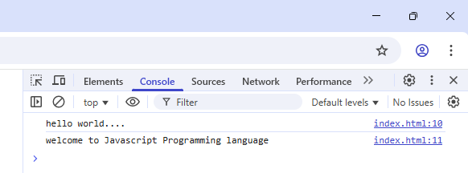
Configuring Your Web Browser
Chrome DevTools is a set of web developer tools built directly into the Google Chrome browser.
To access developer tools, press F12 or Ctrl + Shift + I (Windows/Linux) or Cmd + Option + I (Mac).

Slide 37
Configuring Your Web Browser
Mozilla Firefox: Firefox is another popular browser for development. Install it and access developer tools by pressing F12 or Ctrl + Shift + I (Windows/Linux) or Cmd + Option + I (Mac).
Other Browsers: While Chrome and Firefox are common choices, it's a good practice to test your code in multiple browsers, including Microsoft Edge, Safari, and others.

Slide 38
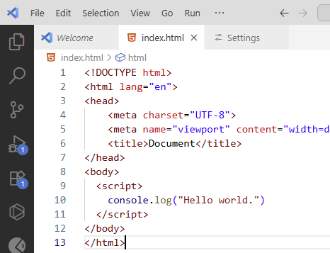
0.8
Writing your
Frist program

Slide 39
Your First JavaScript Code
Now that you have your development environment set up, let’s write your first JavaScript code. We'll begin with a simple "Hello, World!" program to get you acquainted with the basic structure of a JavaScript script and how to execute it within a web page.

Slide 40
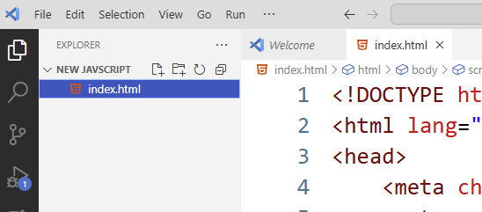
Writing "Hello, World!" in JavaScript
Open your chosen text editor (e.g., Visual Studio Code, Sublime Text, Atom) and follow these steps:
Step-1: Create a new file with the ".html" extension. You can name it "index.html" or something similar.

Slide 41
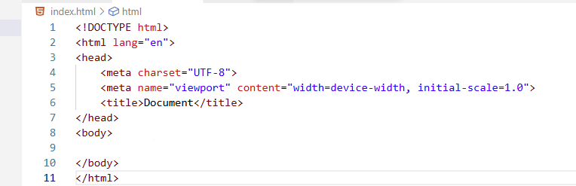
Writing "Hello, World!" in JavaScript
Stept-2: Inside this HTML file, create a basic HTML structure by typing the cfollowing:

Slide 42
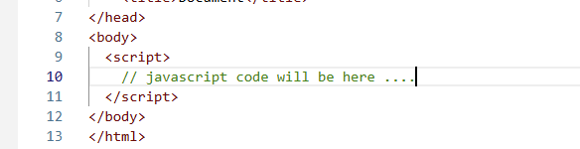
Writing "Hello, World!" in JavaScript
Stept-3: Now, let's add a <script> tag inside the <body> section of the HTML to include our JavaScript code. Place it just before the closing </body> tag:

Slide 43
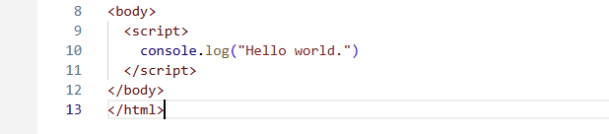
Writing "Hello, World!" in JavaScript
Stept-4: Inside the <script> tag, write your "Hello, World!" JavaScript code.
In JavaScript, you can use the console.log() method to print messages to the browser's console:

Slide 44
Writing "Hello, World!" in JavaScript
With your code in place, it's time to execute it in a web browser:
Save the HTML file (e.g., "index.html") in your workspace or chosen directory.
Open this HTML file using your web browser. You can either double-click the file or use your browser's "Open File" option.
To view the result of your JavaScript code, open the browser's developer console. Typically, you can do this by pressing F12 or Ctrl + Shift + I (Windows/Linux) or Cmd + Option + I (Mac). Navigate to the "Console" tab.
You should see "Hello, World!" displayed in the console. Congratulations! You've successfully executed your first JavaScript code.

Slide 45
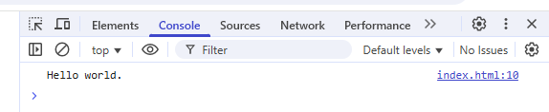
Writing "Hello, World!" in JavaScript

Slide 46
END

