Slide 1
the Repetition Structure
Chapter 4

Slide 2
Objectives
Introduction to Repetition Structures
Loops in JavaScript
Types of Loops in JavaScript
Syntax of Loops
Special Loop Types
Loop Control Statements

Slide 3
Repetition Structure(LOOP)
A repetition structure is a control structure that executes a block of code repeatedly, either for a fixed number of times or until a condition is met.
Important of repetition structure:
  Automate repetitive tasks.
  Reduce code duplication.
  Make programs shorter and easier to read.
  Enable iteration over data structures (arrays, objects, strings).

Slide 4
Loops in JavaScript
JavaScript provides several types of loops:
  For loop
  While loop
  Do…while loop
  For…Each loop
  For…of loop
  For…in loop
This chapter will primarily focus on the for loop, while loop and do…while loop.

Slide 5
Iterations in loop
Loops repeat tasks multiple times.
In computer lingo, The number of times a task is repeated is called iteration
Loops can be:
Count-controlled: You know number of iterations in advance (e.g., for loop).
Condition-controlled: Iterations continue until a condition is met (e.g., while loop).

Slide 6
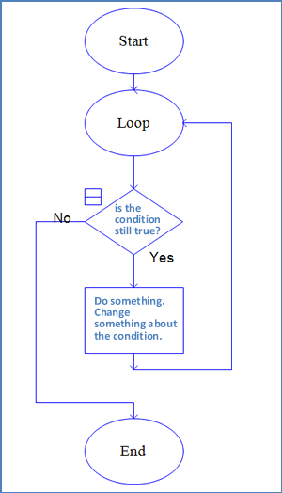
4.2
Types of Loops

Slide 7
Types of loops
Loops in JavaScript can be divided into:
Pre-test Loops:
  The condition is checked before executing the loop body.
  If the condition is false initially, the loop body never runs.
    for loop
    while loop
    Post-test Loops
      The condition is checked after executing the loop body.
      The loop body executes at least once, even if the condition is false at the start.
        do...while loop

Slide 8
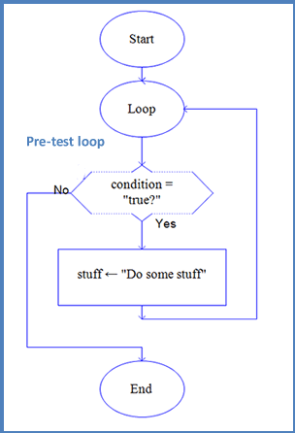
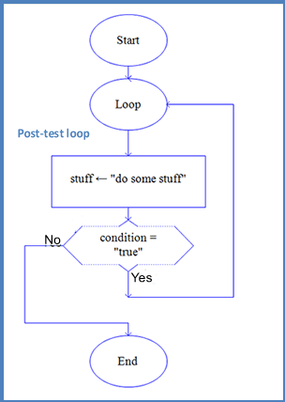
Pre-Test and Post-Test Loops

Slide 9
Pre-Test and Post-Test Loops
The general form of a pre-test loop is as follows:
Is some condition true? If yes, enter the loop: {
Do some tasks
}
Program continues
The general form of a post-test loop is as follows:
Enter the loop:
{
Do some tasks
}
Is some condition true? If yes, go back to line 1 .
Program continues

Slide 10
For loop
The for loop is pre-test loop and it is a fundamental control structure used for iterating over a specific number of times or over a sequence of items, such as an array. It consists of three parts
Initialization: This is where you initialize a loop control variable
Condition: This is the condition that determines whether the loop should continue executing or not. If the condition evaluates to true, the loop
Increment/Decrement: This is an operation that is performed after each iteration.
Here's the syntax of a for loop:
    for (initialization; condition; increment/decrement) {
    // code to be executed in each iteration
    }

Slide 11
For loop
  for (let i = 1; i <= 5; i++) {
  console.log("Iteration number: " + i);
  }
  let i = 1 initializes the loop control variable i to 1.
  i <= 5 is the condition. The loop will continue executing as long as i is less than or equal to 5.
  i++ increments i by 1 in each iteration.

Slide 12
While loop
The while loop is pre-test loop and it is a control structure that allows you to execute a block of code repeatedly as long as a specified condition remains true.
Condition: the condition is evaluated before each iteration. If the condition evaluates to true, the loop continues executing, if it evaluates to false, the loop terminates.
Syntax:
while (condition) {
// code to be executed as long as the condition is true
}

Slide 13
While loop
  let i = 1; // start from 1
  while (i <= 5) { // condition checked first
  console.log("iteration: " + i);
  i++; // increment
  }
  let i = 1 initializes a loop control variable i to 1 before entering the loop.
  i <= 5 is the condition. The loop will continue executing as long as i is less than or equal to 5.
  i++ increments i by 1 after each iteration.

Slide 14
Do…While Loop
The do...while loop is a post-test loop and it is another control structure used to execute a block of code repeatedly. It's similar to the while loop, but it guarantees that the code block will execute at least once before checking the loop condition.
The code block within the do portion is executed first.
Then, the loop checks the condition. If the condition is true, the loop continues; if it's false, the loop terminates.
Syntax:
    do {
    // code to be executed
    } while (condition);

Slide 15
Do…While loop
  let i = 1; // start from 1
  do {
  console.log("Iteration number: " + i);
  i++; // increase by 1
  } while (i <= 5); //check the condition
The code block within the do section is executed first, which logs the value of i.
Then, it increments i by 1 using i++.
After each iteration, loop checks the condition i <= 5. If this condition is true, the loop continues to the next iteration; if it's false, the loop terminates.

Slide 16
Beware the Infinite Loop!
An infinite loop is a loop that never ends because its stopping condition is never met or because there is no condition at all to stop it.
let num1, num2;
do {
num1 = parseInt(prompt("Enter a number: "));
num2 = num1 + 1;
console.log("Hello!");
} while (num1 <= num2); // repeat until num1 > num2
console.log("The End");
The test condition is impossible to achieve.
The loop will run forever.

Slide 17
Sentinel Loop
A sentinel loop is a loop that continues to run until it encounters a special value (called a sentinel value) that signals the loop to stop.
The sentinel value is not a valid data value, but a special marker to end input.
It is often used when the number of inputs is unknown in advance.
  let num = parseInt(prompt("Enter a number (-1 to stop):"));
  while (num !== -1) {
  console.log("You entered: " + num);
  num = parseInt(prompt("Enter a number (-1 to stop):"));
  }
  console.log("Loop ended.");

Slide 18
Break And Continue
Both break and continue can be used with for, while, and do-while loops, providing you with flexibility in controlling the flow of your loops. They are particularly useful for handling specific cases where you need to exit a loop early or skip certain iterations based on conditions.

Slide 19
Break Statement
The break statement is used to exit or terminate a loop prematurely.
When break is encountered inside a loop, it immediately stops the loop's execution, and the program continues with the next statement after the loop.
It's typically used to exit a loop when a certain condition is met.

Slide 20
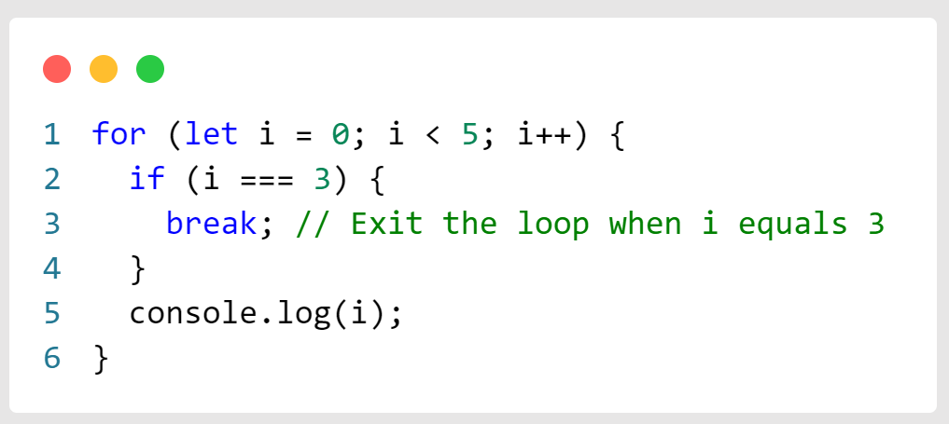
Break Example

Slide 21
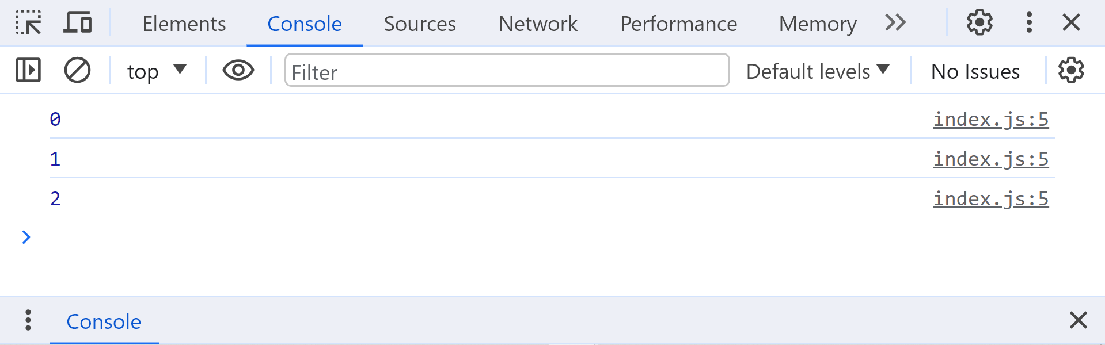
Output
the break statement is triggered when i becomes 3. As a result, the loop terminates, and the program continues with the next statement outside the loop.

Slide 22
Continue Statement
The continue statement is used to skip the current iteration of a loop and proceed to the next iteration.
It's typically used when you want to skip certain iterations based on a condition but continue with the rest of the loop iterations

Slide 23
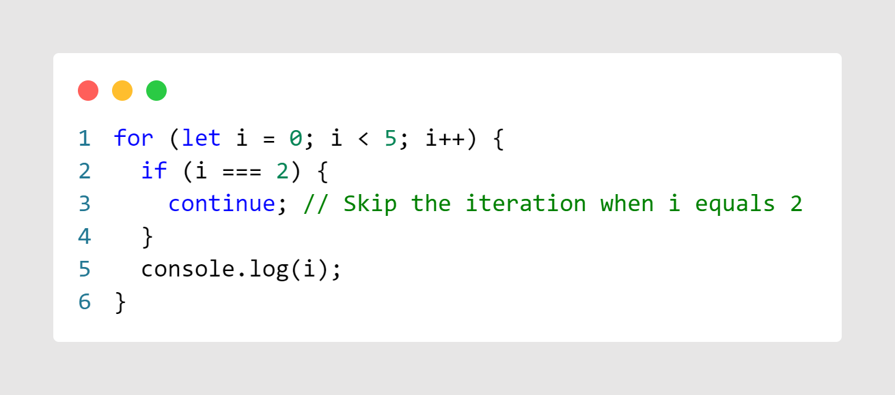
Continue Example

Slide 24
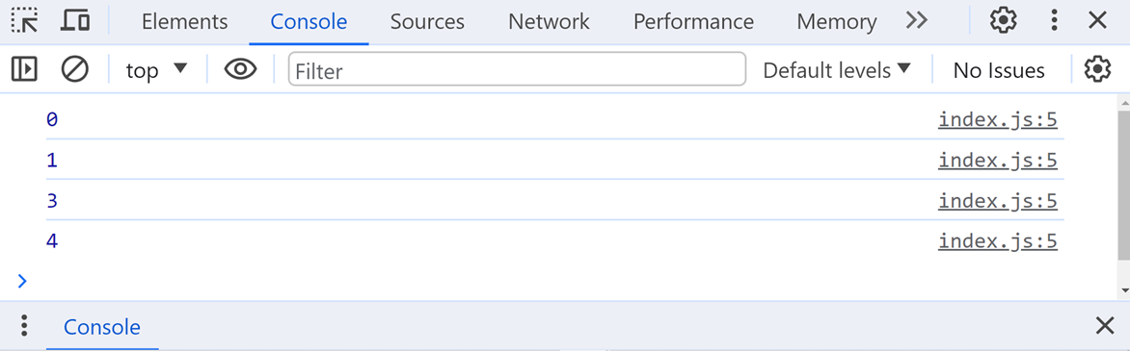
Output
The continue statement is triggered when i is equal to 2. It skips the code block within the loop for that iteration but continues with the loop to process the remaining values of i.

Slide 25
Nasted loop
Nested loops are loops that are placed inside another loop. They are used when you need to perform repetitive operations on multiple levels or when dealing with multi-dimensional data structures, such as arrays of arrays. Nested loops allow you to iterate through the elements of a two-dimensional or multi-dimensional array, generate combinations, or handle more complex patterns.

Slide 26
Nasted Loop
A nested loop means one loop inside another loop.
  The outer loop runs first.
  For each time the outer loop runs, the inner loop runs full
Using For
  for (let outer = 0; outer < ...; outer++) {
  for (let inner = 0; inner < ...; inner++) {
  // statements
  }
  }
  Using While
  while (outer_condition):
  while (inner_condition):
  statements

Slide 27
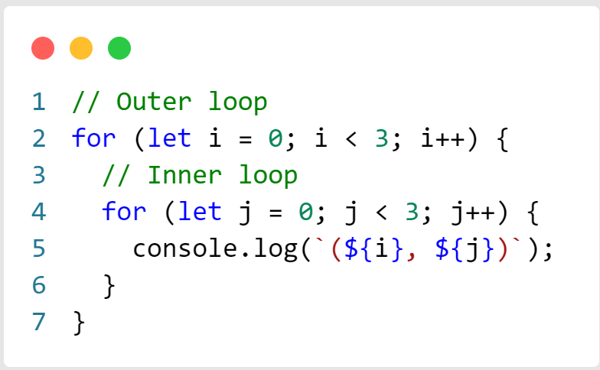
Example of Nasted Loop

Slide 28
Example Of Nested loop
In this example:
There are two for loops: an outer loop and an inner loop.
The outer loop (controlled by i) iterates from 0 to 2.
The inner loop (controlled by j) iterates from 0 to 2 for each iteration of the outer loop.
The console.log statement prints the combination of i and j for each pair of values.

Slide 29
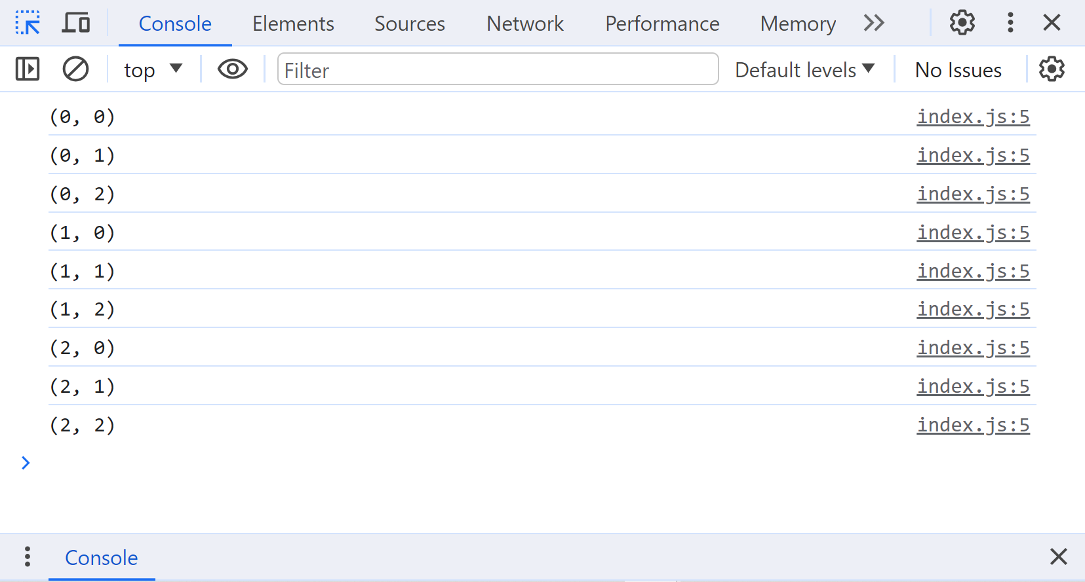
Output

Slide 30
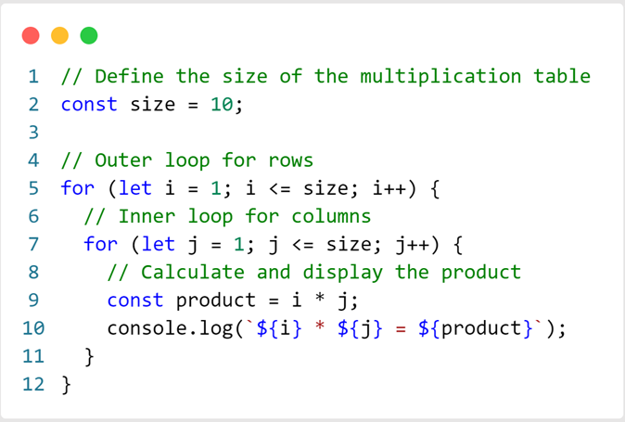
Multiplication table using nested loops
Creating a multiplication table using nested loops in JavaScript is a common exercise.

Slide 31
Multiplication table using nested loops
We define the size variable to determine the size of the multiplication table (e.g., 10x10).
The outer loop (controlled by i) iterates from 1 to size to represent the rows.
The inner loop (controlled by j) iterates from 1 to size to represent the columns.
Inside the inner loop, we calculate the product of i and j and display it along with the multiplication factors.

Slide 32
END

