Slide 1
Functions in JavaScript
Chapter 5

Slide 2
Functions in JavaScript
A function in JavaScript is a block of reusable code that performs a specific task. It allows you to write code once and use it many times — which makes programs more organized and efficient.
Important of functions:
  Code reusability
  Code organization
  Avoid repetition
  Easy maintenance
  Return and reuse of values

Slide 3
Function Definition and Function Calling
  Function definition: is the process of creating a function. It specifies the name of the function, any parameters it accepts, and the code block that runs
  Function calling: is the process of executing a function that has been defined. To call a function, you simply use its name followed by parentheses.

Slide 4
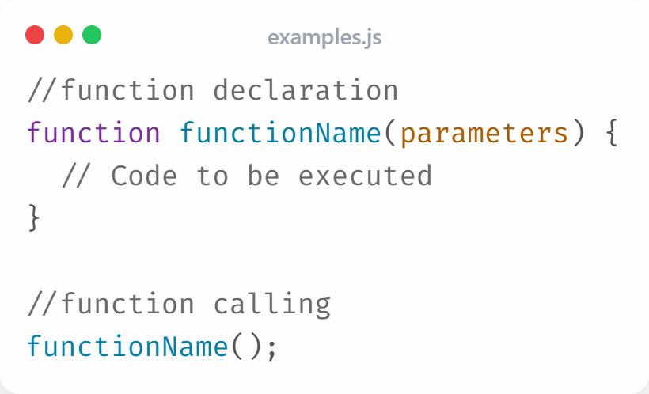
Example

Slide 5
Types of Functions in JavaScript
In JavaScript, functions can be categorized into two.
Void Functions:
  These functions do not return any value.
  They perform a task like printing a message or updating something.
Value-Returning Functions:
  These functions return a value using the return keyword.
  You can store the returned value in a variable or use it in expressions.

Slide 6
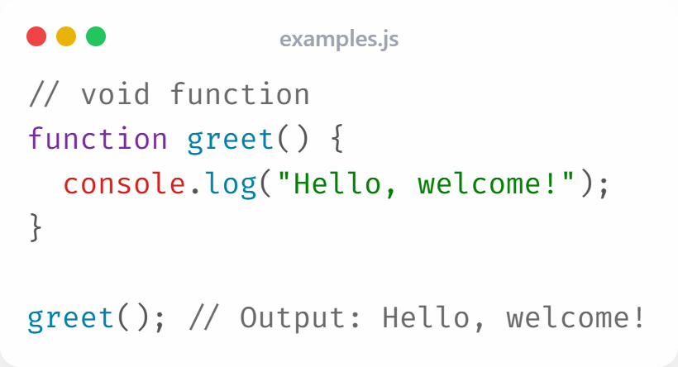
Void Function

Slide 7
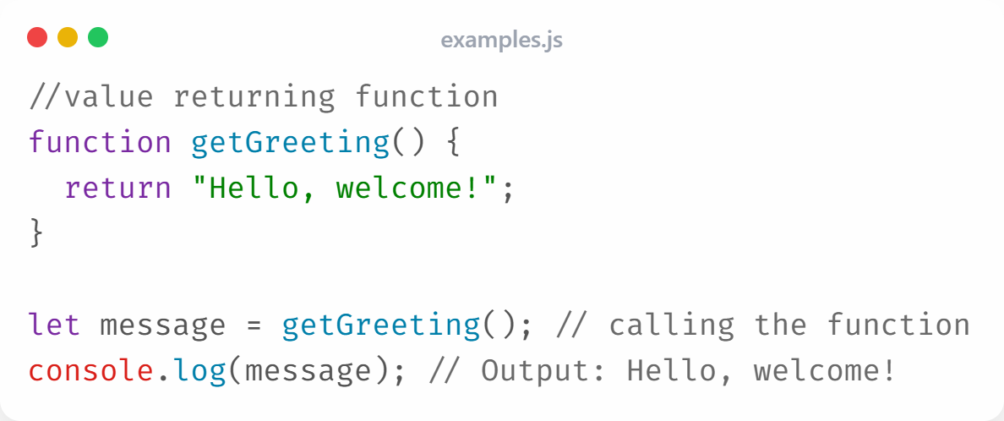
Value Returning Function

Slide 8
Parameter and arguments
Functions in JavaScript often require input to perform tasks on different data. This input is provided through parameters and arguments.
Parameters:
  Parameters are placeholders defined in a function. They specify the values that the function expects when it is called.
  Parameters are optional: functions can be declared without parameter.
  Parameters can be multiple: functions can use more than 1 parameter.
Example:
  function greet(name) { // 'name' is a parameter
  console.log("Hello, " + name + "!");
  }

Slide 9
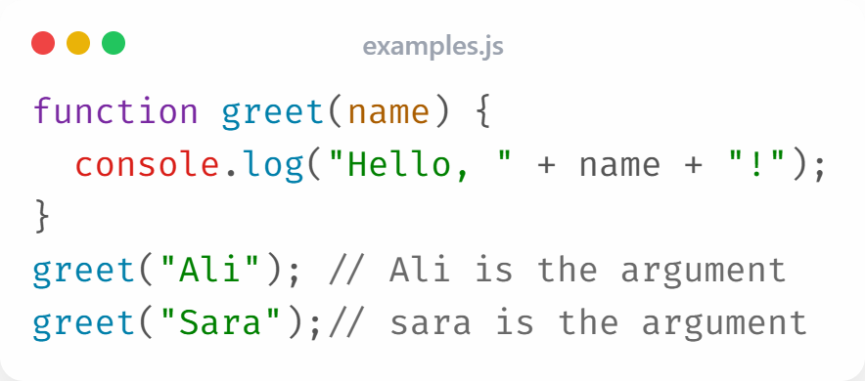
Parameter and arguments
Arguments are the actual values passed to a function when it is called. They correspond to the function’s parameters and provide the data the function will work with.
Example:

Slide 10
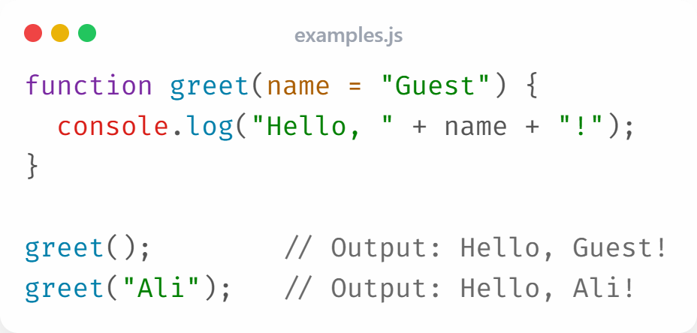
Default parameters
Default parameters allow a function to have a predefined value for a parameter if no argument is provided when the function is called. This makes functions more flexible and prevents undefined values.
Example:

Slide 11
Function Expressions
JavaScript provides multiple ways to define functions beyond the traditional function declaration.
Two important types are function expressions and arrow functions.
A function expression defines a function and assigns it to a variable.
Can be anonymous (without a name) or named.
The function is stored in a variable, so it can be passed around like data.

Slide 12
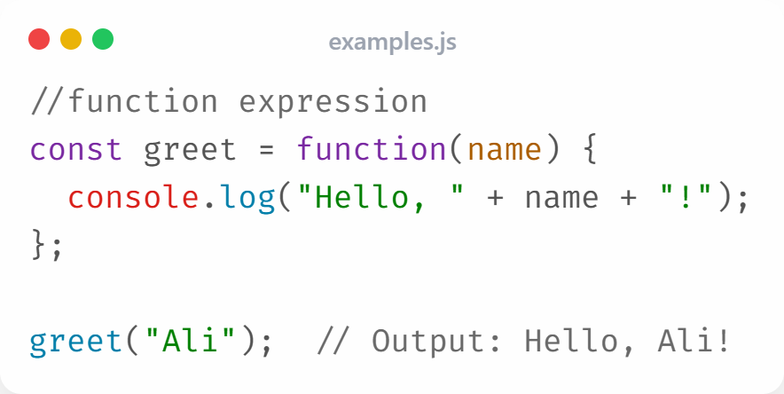
Syntax (anonymous function expression)

Slide 13
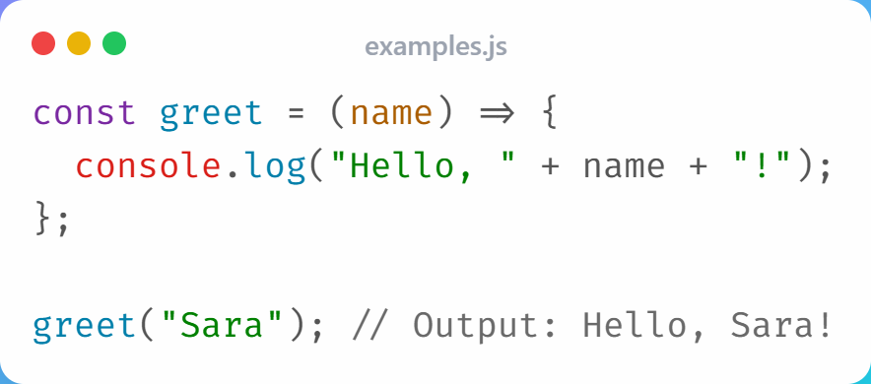
Arrow functions
Arrow functions are a shorter syntax for writing function expressions.
Use the => syntax.
Parentheses () can be omitted if there’s only one parameter.

Slide 14
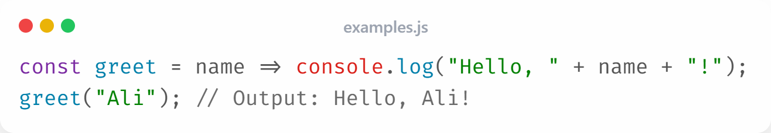
Arrow functions
Single-parameter: Parentheses can be omitted if there’s only one parameter.
Single-expression: a functions that return a value directly, braces and return can be omitted.

Slide 15
Variable Scope
Variable scope in JavaScript refers to the visibility and accessibility of variables within different parts of your code.
Importance:
Controls where variables can be used.
Prevents naming conflicts.
Manages variable lifetime.
Main Types:
Global Scope
Local (Function) Scope
Block Scope (ES6 and beyond)

Slide 16
Global Scope
Variables declared outside any function or block are in the global scope.
Key Points:
Accessible from anywhere in your program.
Can be modified inside functions.
Should be used carefully to avoid conflicts.

Slide 17
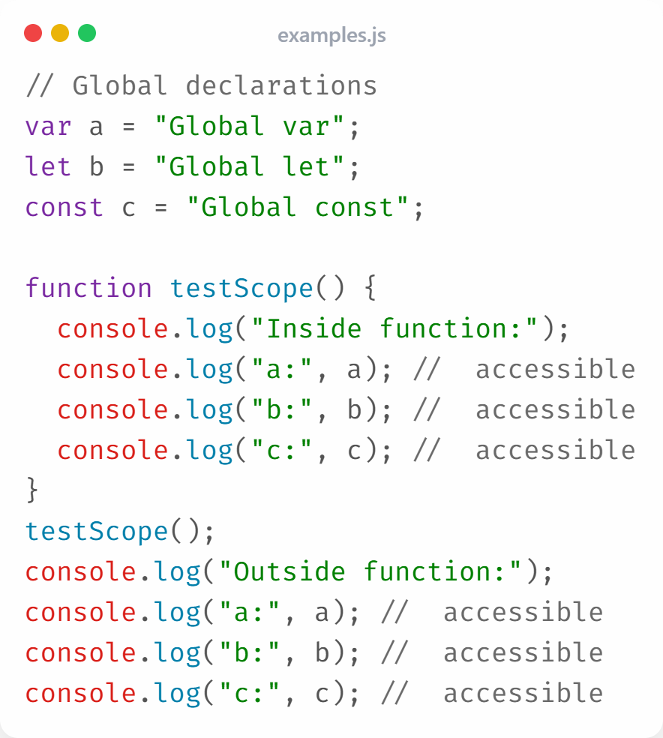
Global Scope

Slide 18
Local (Function) Scope
Variables declared inside a function belong to the local scope.
Key Points:
Accessible only within the function.
Each function has its own scope.
Variables with the same name in different functions do not conflict.
Destroyed when the function finishes executing.

Slide 19
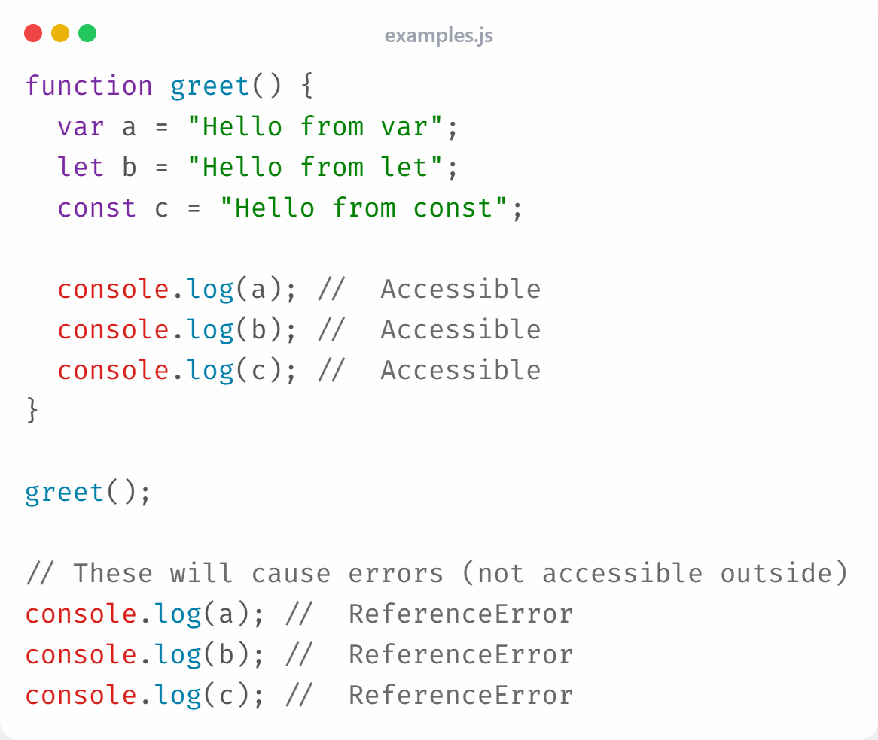
Local (Function) Scope

Slide 20
Block Scope (ES6 and Beyond)
Variables declared with let or const inside { } have block scope.
Key Points:
Scope is limited to the block (e.g., loops, conditionals).
Not accessible outside the block.
Prevents accidental reuse of variables.
VAR does not follow block scope.

Slide 21
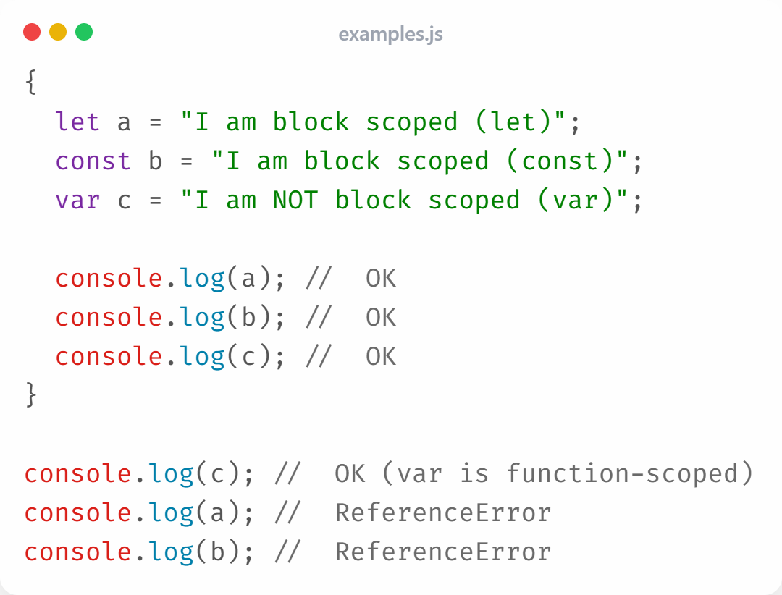
Block Scope (ES6 and Beyond)

Slide 22
Callback Functions in JavaScript
A callback function is a function passed as an argument to another function and executed after the outer function completes a task.
Why Use Callbacks:
Handle asynchronous operations (like loading data).
Control the order of execution.
Reuse and simplify code logic.
Respond to events such as clicks or timeouts.

Slide 23
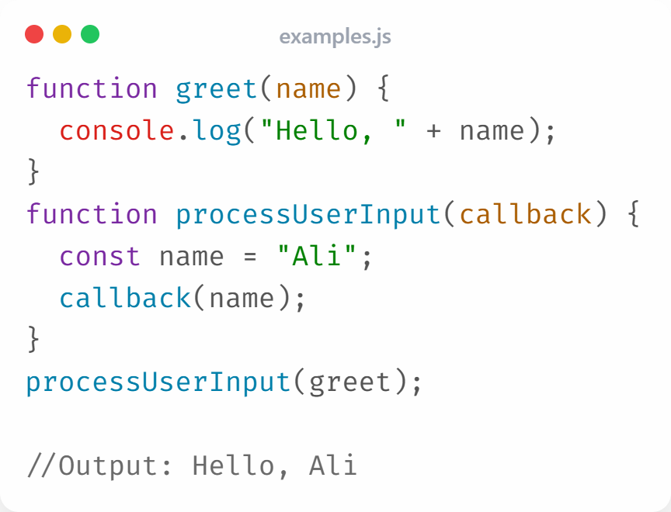
Callback Functions in JavaScript

Slide 24
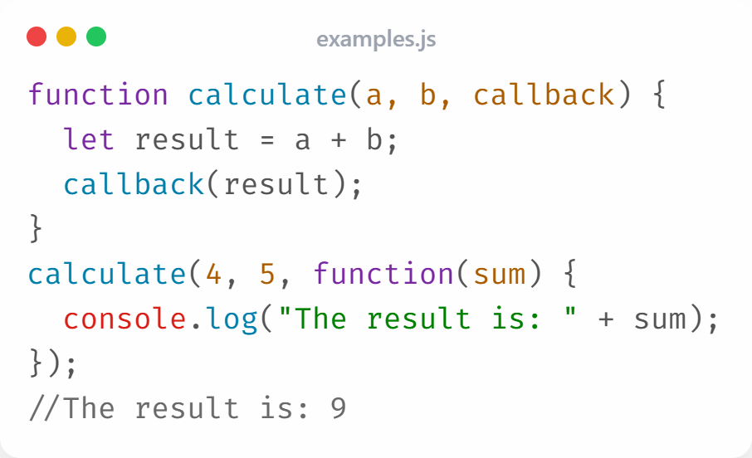
Anonymous callback function
an anonymous function is used as a callback — it has no name and is executed directly.

Slide 25
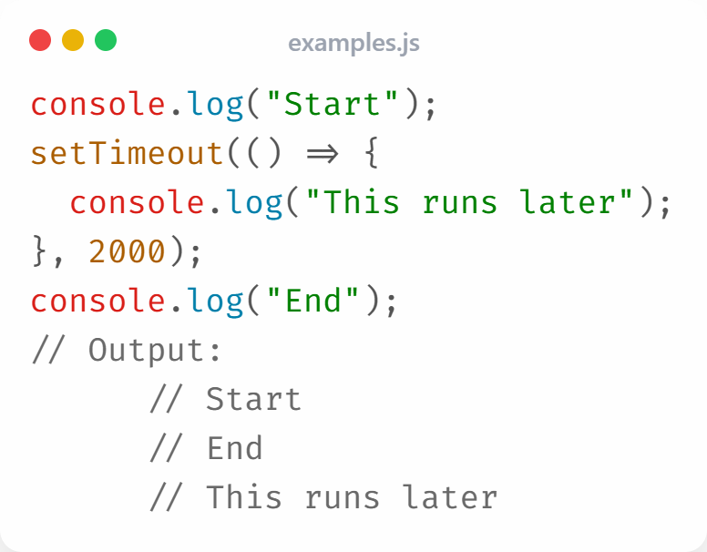
Callback with setTimeout() function

Slide 26
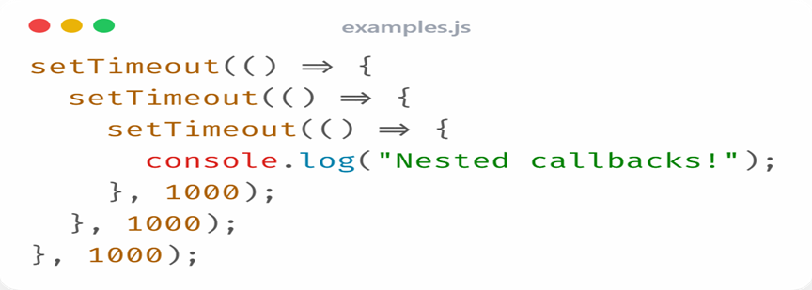
Callback Hell
Avoid using nested callbacks it is hard to read and maintain.

Slide 27
END

