Slide 1
Chapter 6
Arrays in JavaScript

Slide 2
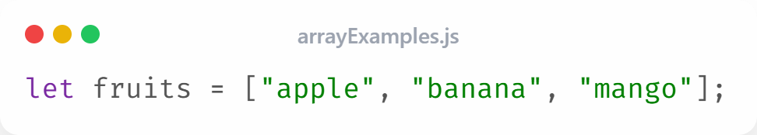
Arrays
An array is a collection of elements stored in a single variable. or
Arrays are special variables that can hold multiple values at once.
They make it easy to store, organize, and work with lists of data such as names, prices, or grades.
Each element has an index (position number).
Arrays can store numbers, strings, or even other arrays.

Slide 3
Key Characteristics of Arrays
  Characteristics of Arrays:
  • Ordered: items keep their position
  • Zero-indexed: first element is index 0
  • Dynamic: can grow or shrink
  • Can hold different data types
  • Store related data together (e.g., student names)
Why Use Arrays?
  • Easily loop through multiple values
  • Perform operations like sorting, filtering, summing
  • Simplify code and reduce repetition

Slide 4
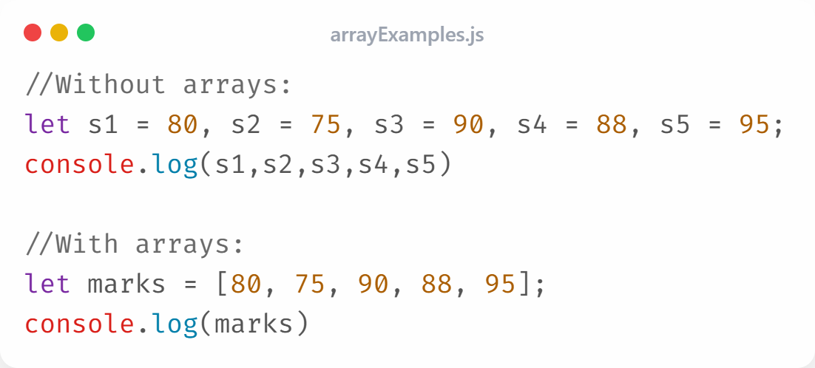
Real-Life Example

Slide 5
Creating Arrays
JavaScript offers several ways to create arrays:
1. Array literal []
2. Array constructor
3. Empty array
4. Array.of()
5. Array.from()
6. Spread operator ...

Slide 6
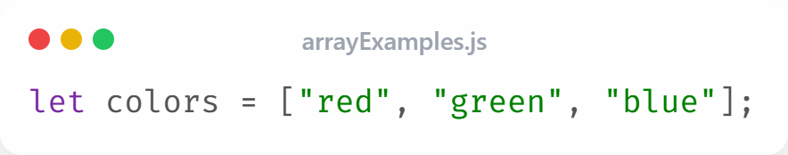
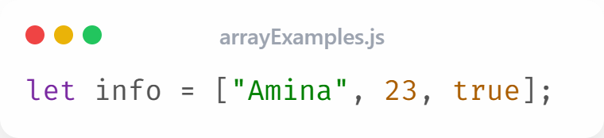
Using Array Literals
The simplest and most common way to create an array in JavaScript is by using square brackets [ ]
You can also store different data types in the same array:

Slide 7
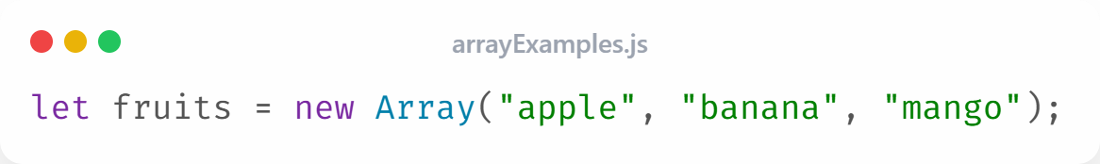
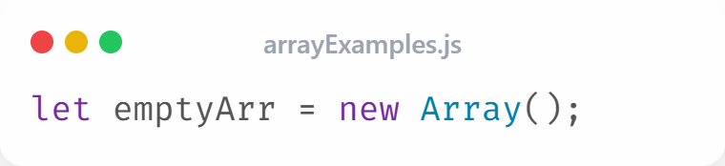
Using the Array Constructor
In JavaScript, you can create arrays using the Array() constructor with the new keyword.
You can also create an empty array:

Slide 8
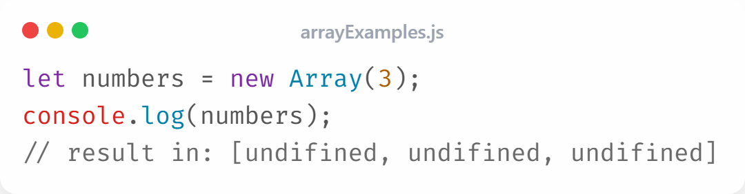
Array Initializer
Use the array initializer syntax to create an array with a specified length. The elements are initially undefined.
If you pass a single number, it will create an array of empty slots with that length:

Slide 9
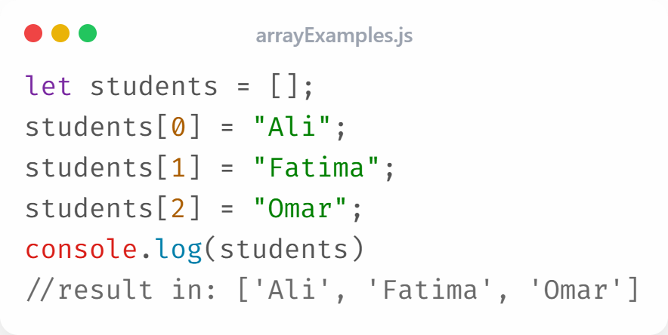
Empty Arrays
Create an empty array and fill it later:

Slide 10
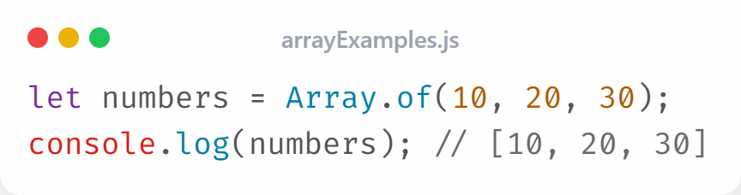
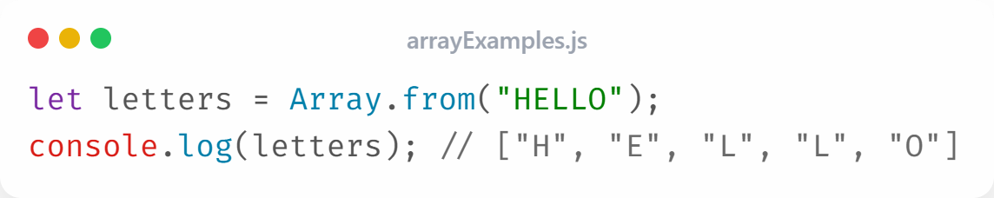
Using Array.of() & Array.from()
Creates a new array from given arguments:
Converts iterable objects into arrays:

Slide 11
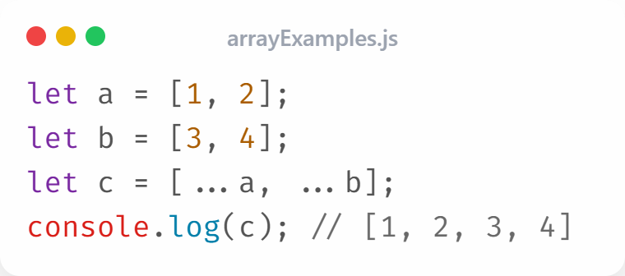
Using the Spread Operator
The spread operator (...) allows you to copy, combine, or expand arrays easily in JavaScript.

Slide 12
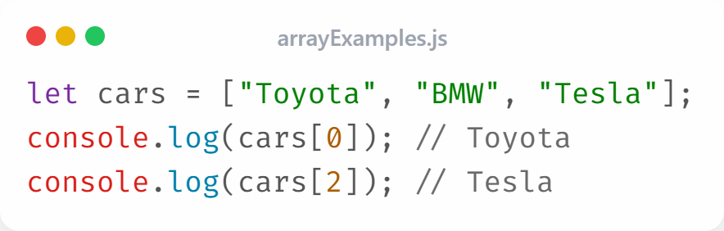
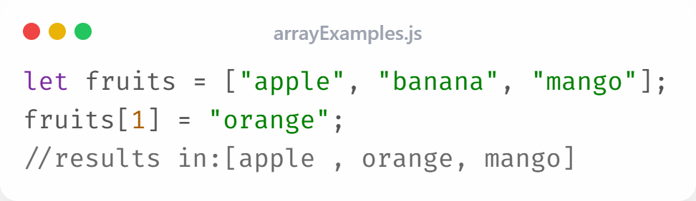
Accessing & Updating Array Elements
Each element in a JavaScript array has a unique index number that tells its position in the array.
You can change or replace an element in an array by using its index number.

Slide 13
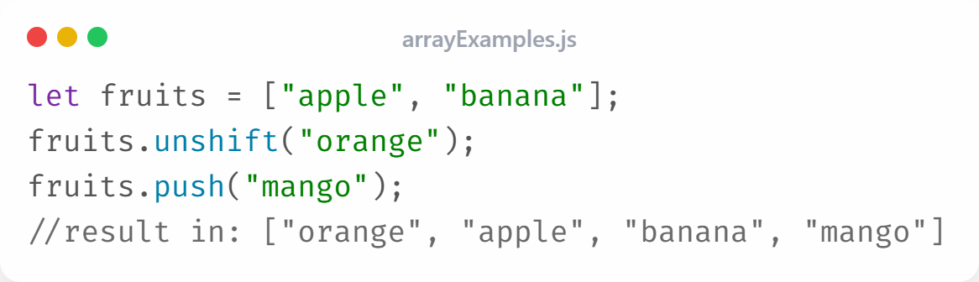
Adding Elements
JavaScript provides two easy methods to add new elements to an array:
unshift(): adds a new element to the beginning of the array.
push(): adds a new element to the end of the array.

Slide 14
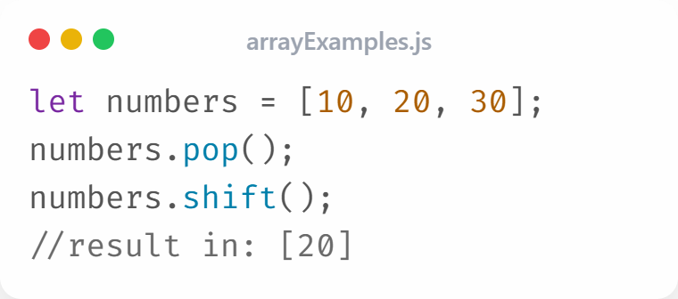
Removing Elements
JavaScript provides two simple methods to remove elements from an array:
shift(): removes the first element of the array.
pop(): removes the last element of the array.

Slide 15
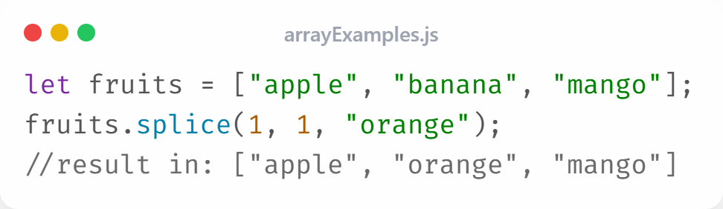
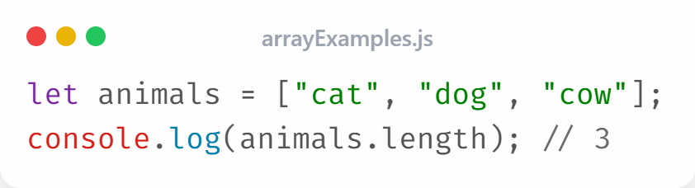
Using splice() & length()
The splice() method is used to add, remove, or replace elements in an array.
Get total number of elements: use Length()

Slide 16
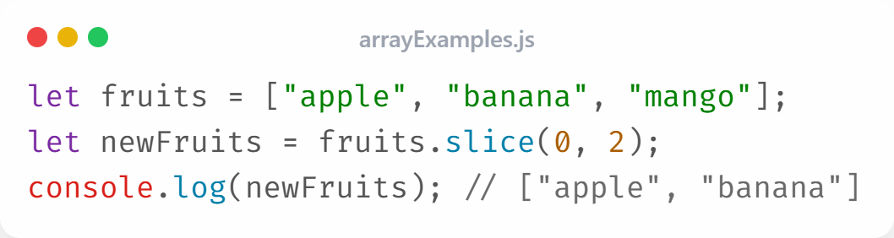
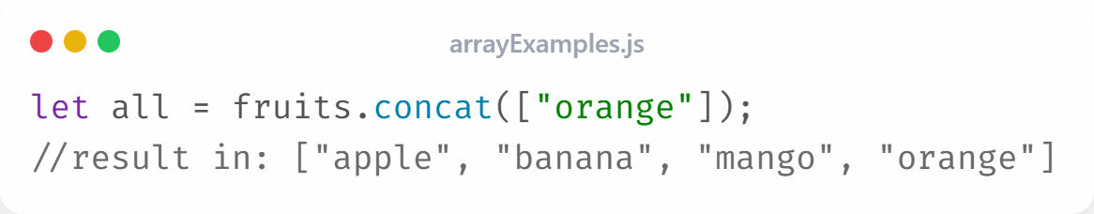
Using slice() and concat()
Slice(): To copy a part of an array without changing the original array.
Concat(): To combine more arrays into a new array.

Slide 17
Iterating Through Arrays
To iterate through (loop over) an array in JavaScript, you can use different types of loops. each with its own purpose and style.
  • for loop
  • for...of
  • forEach()
  • map()

Slide 18
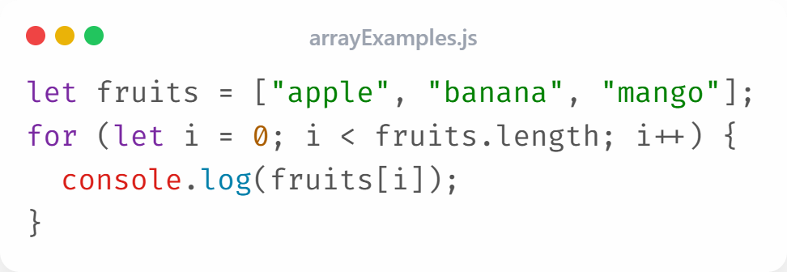
Using a for Loop
This is the most basic and traditional type of loop. It gives you full control over:
  The starting point
  The ending condition using array.length
  The step (increment or decrement)

Slide 19
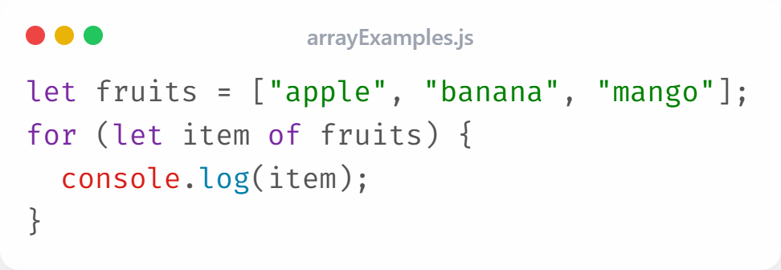
Using for...of Loop
Introduced in ES6, this loop makes it simpler to go through arrays and other iterable objects like strings or sets.
You don’t need to manage indexes — it gives you the values directly

Slide 20
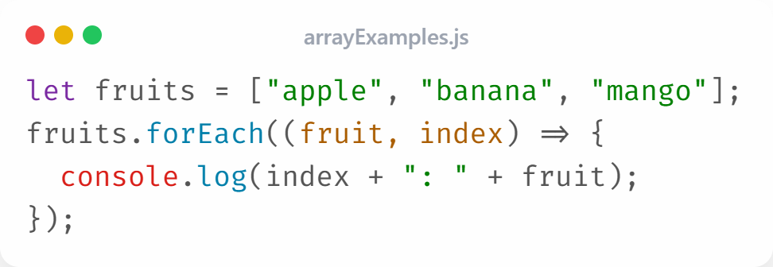
Using forEach()
This is a built-in array method.
It calls a callback function once for every element in the array.
Fruit: the current element
Index: the current position

Slide 21
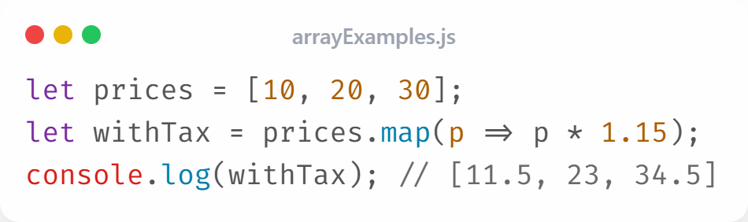
Using map()
map() method in JavaScript is used to create a new array by applying a function to each element of an existing array.
It does not change the original array.
It returns a new array with the modified values.
It is commonly used when you want to transform or process every element in an array.

Slide 22
Using map()
The map() method goes through each value in prices [10, 20, 30].
For each value p, it multiplies by 1.15.
The result [11.5, 23, 34.5] is stored in withTax, Which is new array.
So, map() is perfect when you want to make a new array with updated values based on the old one.

Slide 23
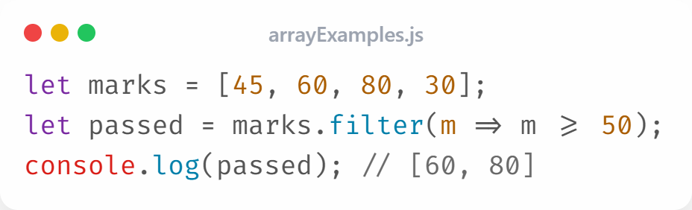
Using filter()
The filter() method in JavaScript is used to select elements from an array that meet a specific condition.
It checks each element in the array.
It returns a new array containing only the elements that pass the test (the condition).
It does not modify the original array.

Slide 24
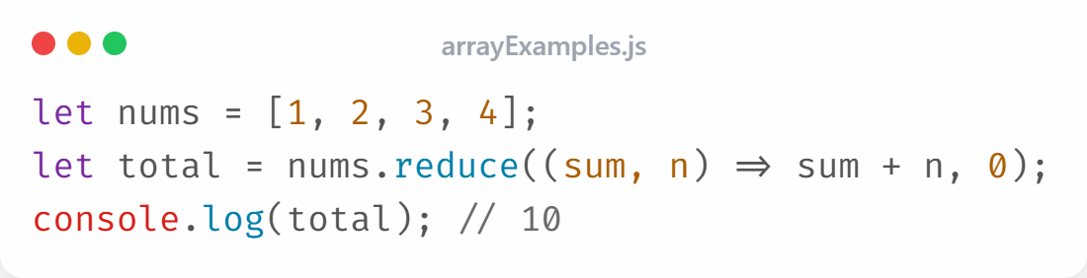
Using reduce()
The reduce() method in JavaScript is used to combine all elements of an array into a single value such as a sum or product.
It processes the array from left to right.
It takes a callback function with two main parameters:
accumulator (sum): stores the running total.
current value (n): the current element being processed.

Slide 25
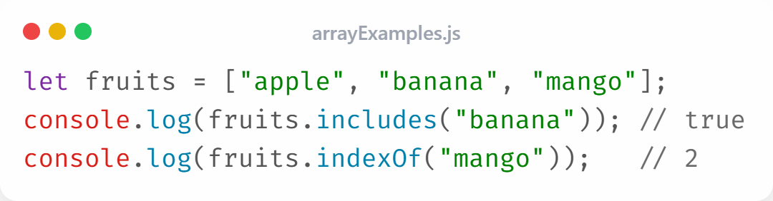
Searching Elements
The includes() and indexOf() methods in JavaScript are used to search for elements inside an array.
includes():
  Checks if a specific value exists in the array.
  Returns true if found, otherwise false.
indexOf():
  Finds the position (index) of a specific element.
  Returns the index number if found, or -1 if not found.

Slide 26
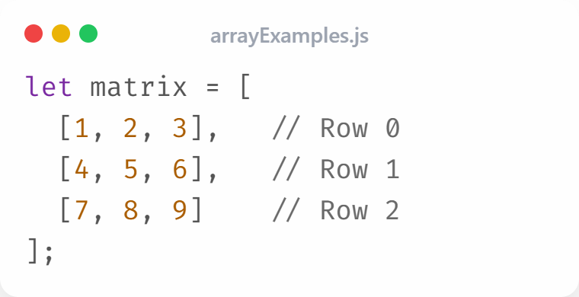
Multidimensional Arrays
A multidimensional array in JavaScript is simply an array that contains other arrays as its elements. It allows you to store data in rows and columns, similar to a table or grid.
A one-dimensional array stores a single list of items.
A two-dimensional array stores lists within a list (like a table).

Slide 27
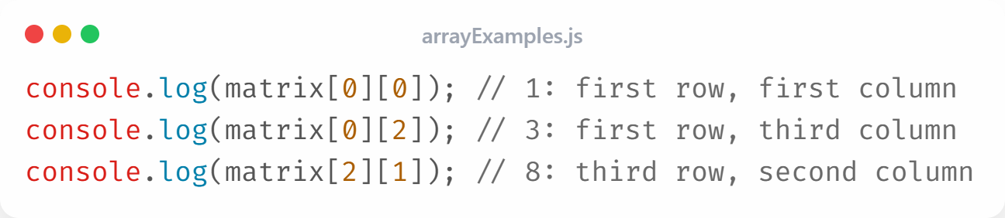
Accessing 2D Array Elements
To access elements in a multidimensional array (like a 2D array), you use multiple index numbers. one for each level of the array.
You use two indexes:
  The first index: selects the row.
  The second index: selects the column inside that row.

Slide 28
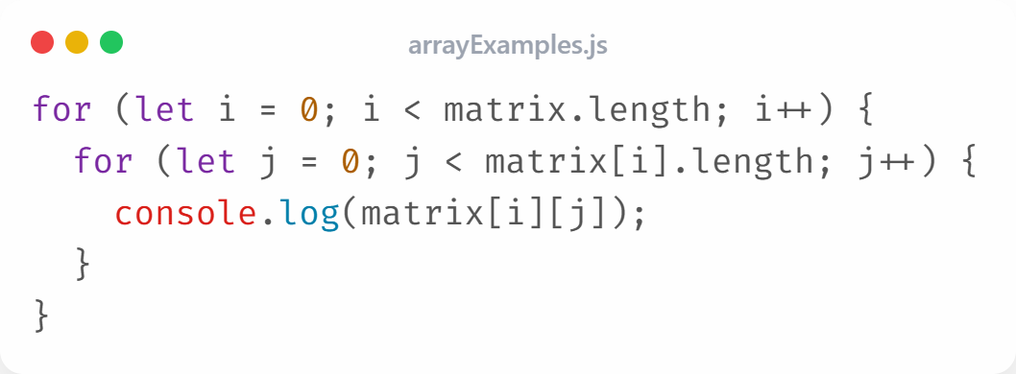
Iterating 2D Arrays
You can use nested loops to go through every value:

Slide 29
END

