Slide 1


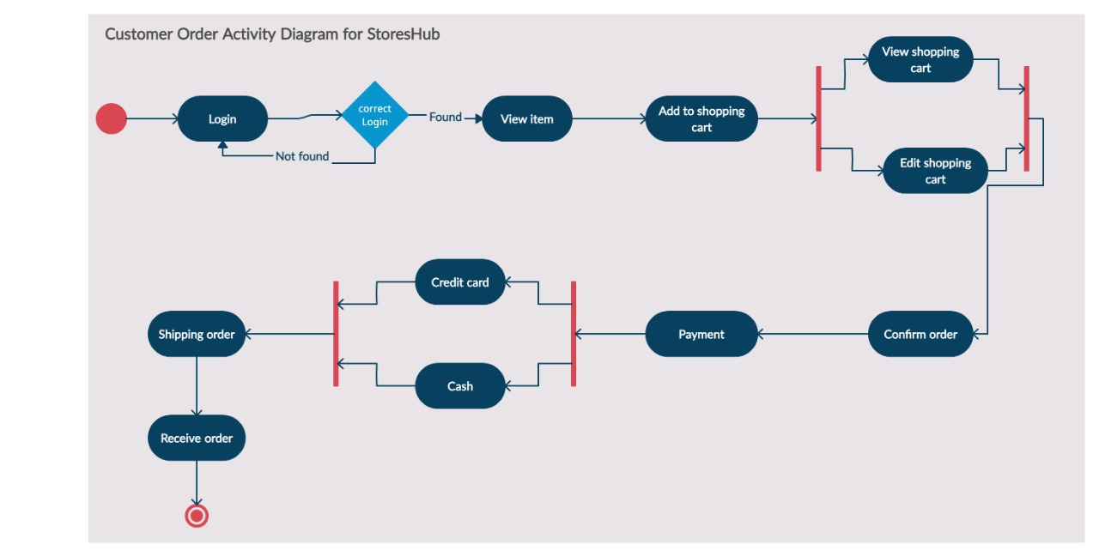
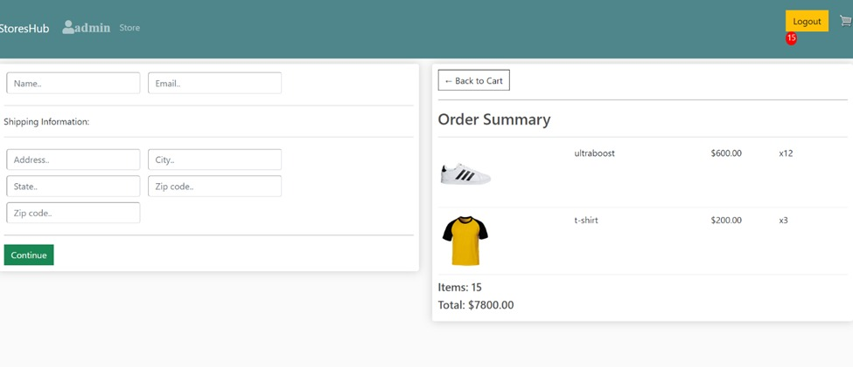
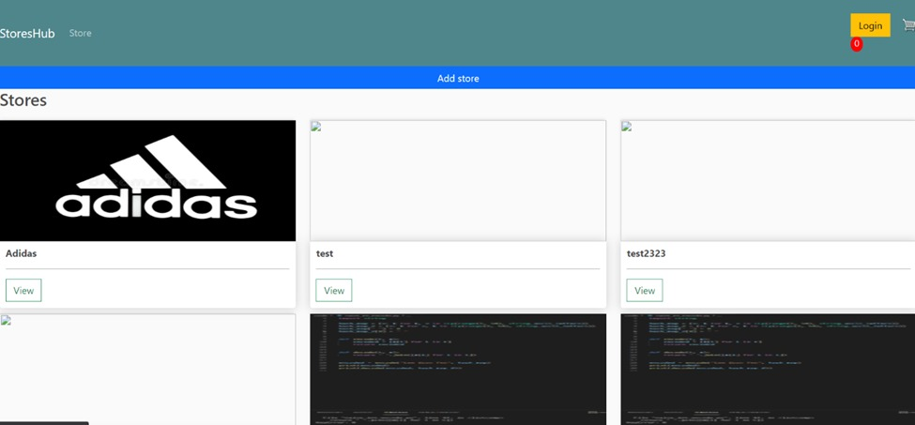
StoresHub
Department of Computer Science, College of Computer and Information Sciences, Imam Mohammed bin Saud Islamic University
Hashem Bajabaa 437015783 -Anas Alzhran 438011286 - Rayan Alshanabah 438012286
Abstract
Methodology
Activity Diagram
The e-commerce industry is developing rapidly around the world year after year. Now days, it’s impossible to imagine the world without e-commerce, where consumers could buy whatever, they need anytime, anywhere conveniently. With large quantity of EC web apps appearance for each store, consumers have been distracted. Although to provide the stores owners the ability to host their products, people who would like to start a business and can’t afford the cost. Our platform will solve it all where, diverse products from various shops and dealers will be available. In order, to implement it, coding will take the largest effort for frontend and backend. Frontend require JavaScript, html, CSS, and react.js and python language for server side as backend.
In methodology we choose to build a web application platform to implement our idea. We used django framework to implement the backend side of our project and HTML, CSS, JavaScript and bootstrap for designing and handling our front-end side. we have developed a complete e-commerce web application that gives the merchant the ability to create his store and add the product and edit. Although, for our customer they have the feature to shop through our system. We make sure that our customers have a great experience by adding some features such as, add to cart, checkout, and PayPal payment gateway.
1.1 Activity Diagram
Design
In design we used MVT patterns to implement our project which is will make the data flow easer and more secure to handle, then for system architecture we used SPA that will let client side and server side communicate faster and smother. Here a design project prototype for the application below.
the introduction
Trading process from long time ago until now days based on the idea of a place where merchants and consumers gather in one place to trade. People used to go out to the market to buy what they need and merchants could sell their products. Sometimes customers need to visit more than one place to buy his needs. Usually as many countries have independent market to sell a specific product for instance, gold market, Perfume market, clothing mall and tech store. Our platform will gather all those stores under one umbrella. Although we will be creating a fertile environment that will empower beginner Entrepreneurs to reach their customers easily in one place without needing to rent a store or build their own E-commerce website/app. The platform will save cost for marketing, store, development and difficulty to manage operations, inventory, payments, shipping privacy and security. “In 2020, E-Commerce sales are expected to account for 15.5 percent of retail sales worldwide.”. To reach our project we will build a web application as our platform. In order, we need to learn HTML, CSS, bootstrap, JavaScript for Frontend and python, django.py and SQL for Backend. However, we will be using more technologies undecided yet to build the web application such as, AWS for hosting.
1.2 Check out
1.3 Store Page
Conclusion
In conclusion, we want our merchants and customers to entire the e-commerce industry by using our web application and give them better experience and the functionalities that they needs by make our software easy to use with various of features to use.

