Slide 1
Money Manager
Java Suite
Software Requirements Specification
Version 1.0 • JavaFX Desktop Client & Spring Boot Web Application
March 26, 2026
Approved for Development

Slide 2
Agenda
01
Introduction & Purpose
07
Non-Functional Requirements
02
Product Overview & Features
08
I/O Specification & Use Cases
03
Stakeholders & User Classes
09
Database Design & ER Model
04
System Architecture (3-Tier)
10
Sequence Diagrams
05
SOLID Design Principles
11
Future Enhancements
06
Functional Requirements
12
Constraints & Assumptions

Slide 3
Introduction & Purpose
Purpose
Scope
This SRS defines the functional and non-functional requirements for the Money Manager Java Suite.
It is the authoritative contract between stakeholders, developers, QA engineers, and maintainers.
All design and implementation decisions must conform to this document.
Track income & expenses
Categorize transactions
Monthly budgets with warnings
Savings goals & notes
Visual dashboard reports
Offline JavaFX + SQLite (Desktop)
Spring Boot + PostgreSQL (Web)

Slide 4
Product Features
Secure Auth
Transactions
Smart Budgets
Dashboard
BCrypt-hashed passwords for all user accounts
Log, edit, delete income and expense entries
Category caps with amber 80% and red 100% alerts
PieChart & BarChart rendering spending trends
Savings Goals
Notes
Validation
Deadlined milestones with progress tracking
Embedded scratchpad for financial outlines
Strict rules preventing cap or limit violations

Slide 5
Stakeholders & User Classes
End User
Primary consumer — needs ease of use, secure offline/web access
Developer
Implements features — 3-tier separation, DI, JUnit tests, Lombok
QA Engineer
Validates correctness — business rules, validation, integration tests
Architect
Owns design — SOLID compliance, JDBC patterns, Java 21 LTS
Product Owner
Defines scope — feature parity, user retention, UX standards

Slide 6
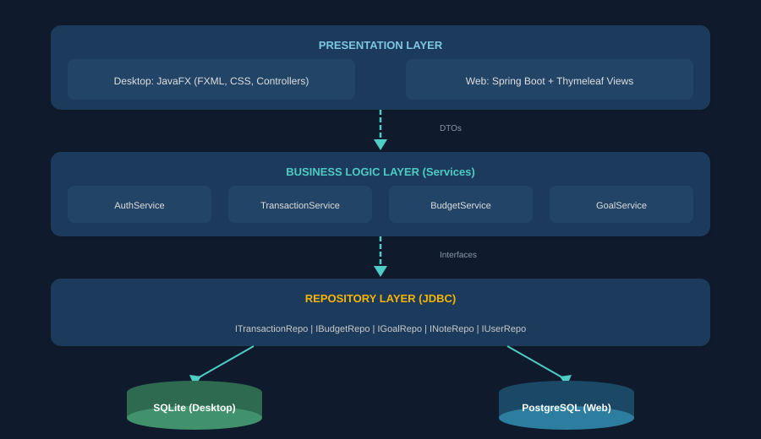
System Architecture — 3-Tier Overview

Slide 7
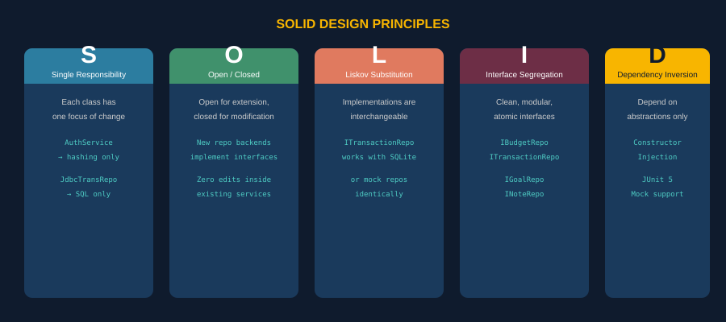
SOLID Design Principles

Slide 8
Functional Requirements
FR-01 Transaction Mgmt
FR-02 Budget Management
Record transactions (title, amount, category, type, date)
View, query, and filter dynamically
Modify or delete with confirmation alerts
Feed into monthly budget calculations
Define per-category monthly spending limits
Real-time aggregation vs active limits
Color-coded: green <80%, amber 80-99%, red >=100%
FR-03 Dashboard & Analytics
FR-04 Notes & Goals
KPI blocks: Total Income, Expenses, Net Balance
PieChart for expense categories
BarChart for 6-month trends
Create notes with title, content, timestamp
Savings goals with progress and deadlines
Color-coded deadline alerts

Slide 9
Non-Functional Requirements
NFR-01
NFR-02
Performance
Reliability
Desktop boot < 3s; web routes < 200ms
Atomic DB transactions with rollback
NFR-03
NFR-04
Usability
Security
New users productive within 5 minutes
BCrypt password hashing, no plaintext
NFR-05
NFR-06
Maintainability
Portability
80%+ JUnit 5 test coverage, Javadocs
Fat JARs on any Java 21 runtime
NFR-07
NFR-08
Scalability
Data Integrity
Decoupled repos, swappable DB backends
Foreign keys + ON DELETE CASCADE

Slide 10
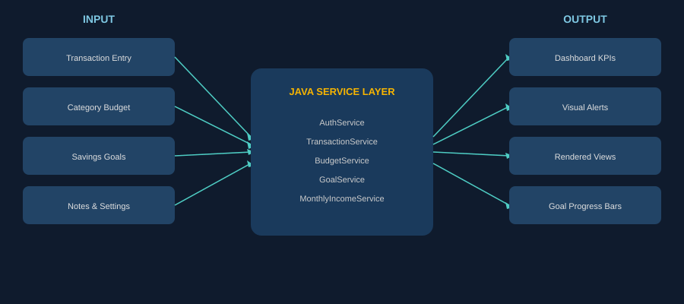
Input / Output Specification

Slide 11
Use Case Descriptions
UC-01: Add Transaction
UC-02: Set & Monitor Budget
Actor: End User | Precondition: Logged in
Actor: End User | Precondition: Authenticated
Navigate to Transactions view
Enter Title, Amount, Category, Date, Type
System validates inputs
BudgetService checks category caps
TransactionService saves to repository
UI refreshes tables and dashboard charts
Alt: Validation fails → alert + retry
Alt: Budget exceeded → warning alert
Navigate to Budgets view
Select category, define monthly cap
System validates and stores budget
Expenses matched to active budgets
Progress bars display % graphically
80-99% → amber/orange progress bar
>=100% → red bar + alert warning

Slide 12
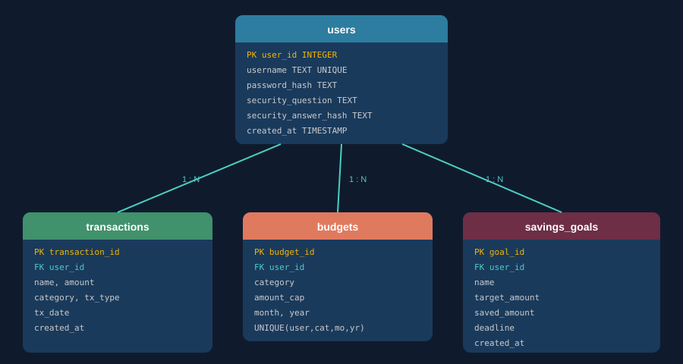
Database Design — ER Model
SQLite (Desktop, offline-first) + PostgreSQL 16 (Web, centralized)

Slide 13
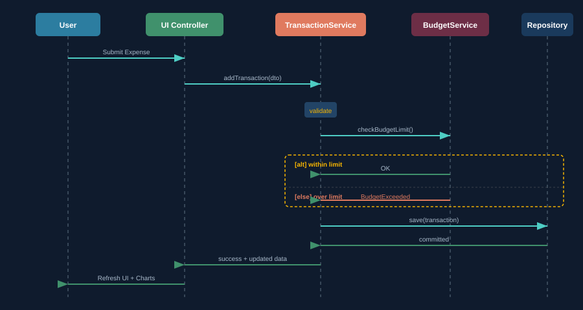
Sequence Diagram — Add Expense

Slide 14
Future Enhancements
Mobile Client Ports
Flutter or React Native apps syncing via REST APIs to PostgreSQL backend
Cloud Synchronizer
Optional push-sync from local SQLite to Supabase or AWS RDS
AI Spending Insights
ONNX models to auto-categorize, detect anomalies, and generate tips
Document Exports
OpenPDF / JasperReports for styled PDF statements and Excel workbooks
Multi-User Profiles
Family access controls with view-only or collaborative editor permissions

Slide 15
Constraints & Assumptions
Development Constraints
Core Assumptions
v1.0 locks desktop to local-only profiles
Pure JavaFX controls — no HTML/JS in desktop
All desktop data stays local in SQLite
Desktop runs fully offline, no internet required
Builds as standalone shaded JARs (Maven Shade)
Users have standard financial tracking familiarity
Maven 3.9+ and JDK 21 available
SQLite JDBC sufficient for single-user concurrency
BigDecimal for all monetary calculations
ISO 8601 dates (SQLite) / native DATE (PostgreSQL)

Slide 16
Technology Stack Summary
Component | Technology
Language | Java 21 LTS
Desktop GUI | JavaFX 21 (FXML + CSS)
Web Framework | Spring Boot 4.0.6 + Thymeleaf
Desktop Database | SQLite (embedded, offline)
Web Database | PostgreSQL 16
Data Access | JDBC + PreparedStatements
Architecture | 3-Tier + SOLID Principles
Build Tool | Maven 3.9+ (Shade Plugin)
Testing | JUnit 5 (80%+ coverage target)
Security | BCrypt (at.favre.lib)

Slide 17
Thank You
Money Manager Java Suite — SRS v1.0
Approved — Ready for Production Development
Version 1.0 • March 26, 2026

