Slide 1
Observable
Observable
ontolex:Form
ontolex:LexicalEntry
ontolex:LexicalSense
ontolex:LexicalConcept
history:
- CC: originally „ontolex:Element“
- JM: no extension of lemon core admitted
- CC: „frac:Element“ (disambiguated by frac namespace)
- Dec 2019 consensus: too generic => „frac:Observable“

Slide 2

rdf:rest
ContextualRelation
dc:description: String
rdf:value: double
rdf:List
corpus
Collocation
Similarity
rdf:first,
rdf:_1, ...
rdf:first, rdf:_1, ...
embedding
Embedding
dc:description: String
dc:extent: int
rdf:value: Literal
corpus
Bag (of words)
rdf:value: JSON
TimeSeries
rdf:value rdf:JSON
FixedSizeVector
rdf:value rdf:Literal
frequency
CorpusFrequency
rdf:value: int
corpus
Corpus
total: int
Observable
attestation
$⊑$ citation
Attestation
quotation: string
attestationGloss:string
locus
locus
URI
ontolex:Form
ontolex:LexicalSense
ontolex:LexicalConcept
ontolex:LexicalEntry
... (user-defined)
Notes:
got embeddings in. note that we need
attestation embeddings, too

Slide 3
Frequency
frequency
CorpusFrequency
rdf:value: int
corpus
Corpus
total: int
Observable

Slide 4
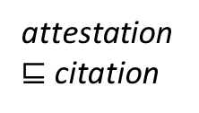
Attestations
attestation
$⊑$ citation
Attestation
quotation: string
attestationGloss:string
locus
locus
URI
Observable

Slide 5
embedding
embedding
Embedding
dc:description: String
dc:extent: int
rdf:value: Literal
corpus
Corpus
total: int
Observable

Slide 6
collocations / similarity
rdf:List
corpus
ContextualRelation
dc:description: String
rdf:value: double
Corpus
total: int
Collocation
Similarity
rdf:first,
rdf:_1, ...
rdf:first,
rdf:_1, ...
Observable
Embedding
not discussed yet

Slide 7
Sandbox
Area for drafting extensions

Slide 8
Sandbox: Adding ContextualRelations
and consolidating diagram

Slide 9
contextual relations
challenging to integrate into diagram because with recent additions, embeddings would be too densely connected
introduce „Observation“ as superclass of FrAC classes
nice symmetry with Observable that stands out less, then
inherit property frac:corpus to all of them
i.e., Attestations can be defined against a corpus!
do we really need „locus“?
the subclasses could inherit rdf:value
incl. attestations
if no attestation has both a quotation and an attestationGloss, we can define the type of attestation as a separate property and provide its value as rdf:value

Slide 10
rdf:rest
ContextualRelation
dc:description: String
rdf:value: double
rdf:List
Collocation
Similarity
rdf:first, rdf:_1, ...
rdf:first, rdf:_1, ...
Observable
Observation
rdf:value: Literal
Quotation
attestation
$⊑$ citation
corpus
ontolex:Form
Attestation
rdf:value: string
Corpus
total: int
locus
ontolex:LexicalEntry
instanceEmbedding
locus
URI
ontolex:LexicalSense
embedding
Embedding
dc:description: String
dc:extent: int
ontolex:LexicalConcept
... (user-defined)
BagOfWords
rdf:value: JSON
TimeSeries
rdf:value rdf:JSON
FixedSizeVector
frequency
CorpusFrequency
rdf:value: int

Slide 11
suggested changes to existing vocabulary
Observation class
embedding, attestation inherit rdf:value
attestation inherits frac:corpus
Quotation subclass of attestation
eliminate frac:quotation and frac:attestationGloss
adding contextual relation as originally foreseen, but with fewer edges

Slide 12
consequences for overall diagram
relatively simple diagram
visually reasonably structured: left col the elements applied to, middle col is type of corpus-based information, right col additional metadata
inheritance
rdf:value for Attestation?
subproperty to define the kind of value?
suggestion: subclass Quotation that is an attestation that contains the original string (default would be a source-specific representation)
corpus for Attestation? (possibly along with locus)
Similarity operates also on attestations and frequencies
for frequencies, that makes sense, cf. frequency classes in Wortschatz
except that they should not necessarily be addressed as „similarity“
for attestations, that also makes sense, because we can now provide clusters of examples as an explict data structure
downside is that we cannot enforce that „similarity“ only holds between elements of the same (sub-)type (of Observation)
but also about collocates (that makes sense)
and similarities
nested similarity clusters?
maybe rename to „similarity cluster“ and „collocation set“, then

Slide 13
a bit more compact, with conventional aggregator symbols instead of properties-only
ContextualRelation
dc:description: String
rdf:value: double
Collocation
Similarity
Observable
Observation
rdf:value: Literal
Quotation
attestation
$⊑$ citation
corpus
ontolex:Form
Attestation
rdf:value: string
Corpus
total: int
locus
ontolex:LexicalEntry
instanceEmbedding
locus
URI
ontolex:LexicalSense
embedding
Embedding
dc:description: String
dc:extent: int
ontolex:LexicalConcept
... (user-defined)
BagOfWords
rdf:value: JSON
TimeSeries
rdf:value rdf:JSON
FixedSizeVector
frequency
CorpusFrequency
rdf:value: int

Slide 14
Sandbox: Adding Embeddings

Slide 15
embedding (CC, 2020-06-25)
Embedding
dc:description: String
dc:extent
rdf:value: Literal
embedding
corpus
Observable
Corpus
TimeSeries
rdf:value !rdf:JSON
(JSON array)
Bag (of words)
rdf:value rdf:JSON
(JSON map)
FixedSizeVector
rdf:value ?xsd:string (orig)
(JSON array?)
e.g., recording of
movements
e.g., collocation vector,
weighted by frequency
or otherwise
e.g., word (or sense)
embeddings

Slide 16

draft without contextual relations
embedding
Embedding
dc:description: String
dc:extent: int
rdf:value: Literal
corpus
Bag (of words)
rdf:value: JSON
TimeSeries
rdf:value rdf:JSON
FixedSizeVector
rdf:value rdf:Literal
frequency
CorpusFrequency
rdf:value: int
corpus
Corpus
total: int
Observable
attestation
$⊑$ citation
Attestation
quotation: string
attestationGloss:string
locus
locus
URI
ontolex:Form
ontolex:LexicalSense
ontolex:LexicalConcept
ontolex:LexicalEntry
... (user-defined)

Slide 17

+ contextualized embedding (embedding per attestation)
attestation
$⊑$ citation
Attestation
quotation: string
attestationGloss:string
locus
locus
URI
instanceEmbedding
embedding
Embedding
dc:description: String
dc:extent: int
rdf:value: Literal
corpus
Observable
Corpus
total: int
Bag (of words)
rdf:value: JSON
TimeSeries
rdf:value rdf:JSON
FixedSizeVector
rdf:value rdf:Literal
frequency
CorpusFrequency
rdf:value: int
corpus
ontolex:Form
ontolex:LexicalSense
ontolex:LexicalConcept
ontolex:LexicalEntry

Slide 18
+ contextualized embedding (embedding per attestation)
attestation
$⊑$ citation
Attestation
quotation: string
attestationGloss:string
locus
locus
URI
instanceEmbedding
embedding
Embedding
dc:description: String
dc:extent: int
rdf:value: Literal
corpus
Observable
Corpus
total: int
Bag (of words)
rdf:value: JSON
TimeSeries
rdf:value rdf:JSON
FixedSizeVector
rdf:value rdf:Literal
frequency
CorpusFrequency
rdf:value: int
corpus
ontolex:Form
ontolex:LexicalSense
ontolex:LexicalConcept
ontolex:LexicalEntry

Slide 19
RELICS
older slides, may be important for understanding how the model evolved

Slide 20
full version as of GlobaLex-2020 (June 2020)
attestation and frequency agreed upon
embeddings and collocation/similarity not

Slide 21
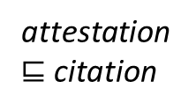
rdf:rest
ContextualRelation
dc:description: String
rdf:value: double
rdf:List
corpus
Collocation
Similarity
rdf:first,
rdf:_1, ...
rdf:first, rdf:_1, ...
Embedding
dc:description: String
dc:extent: int
rdf:value: Literal
embedding
corpus
frequency
CorpusFrequency
rdf:value: int
corpus
Corpus
total: int
Observable
attestation
$⊑$ citation
Attestation
quotation: string
attestationGloss:string
locus
locus
URI
ontolex:Form
ontolex:LexicalSense
ontolex:LexicalConcept
ontolex:LexicalEntry
... (user-defined)

Slide 22
first published version
Chiarcos et al. 2020@GlobaLex
(embeddings, collocations and similarity omitted)

Slide 23
Frequency and Attestation (Chiarcos et al. 2020@GlobaLex)
CorpusFrequency
rdf:value: int
corpus
Corpus
total: int
frequency
Attestation
quotation: string
attestationGloss: string
locus
locus
URI
attestation
subPropertyOf citation
Observable
ontolex:LexicalEntry
ontolex:LexicalConcept
ontolex:LexicalSense
ontolex:Form

Slide 24
initial draft (Nov 2018)

Slide 25
rdf:rest
ContextualRelation
dc:description: String
rdf:value: double
rdf:List
dc:source
Collocation
Similarity
rdf:first,
rdf:_1, ...
rdf:first, rdf:_1, ...
Embedding
dc:description: String
dc:extent: int
rdf:value: Literal
embedding
dc:source
attestation
Attestation
quotation: string
Observable
Citation
citation
makesAttestation
dc:source
CorpusFrequency
rdf:value: int
corpus/locus URI
frequency
dc:source
ontolex:Form
ontolex:LexicalSense
ontolex:LexicalConcept
ontolex:LexicalEntry

Slide 26
development of attestation model

Slide 27
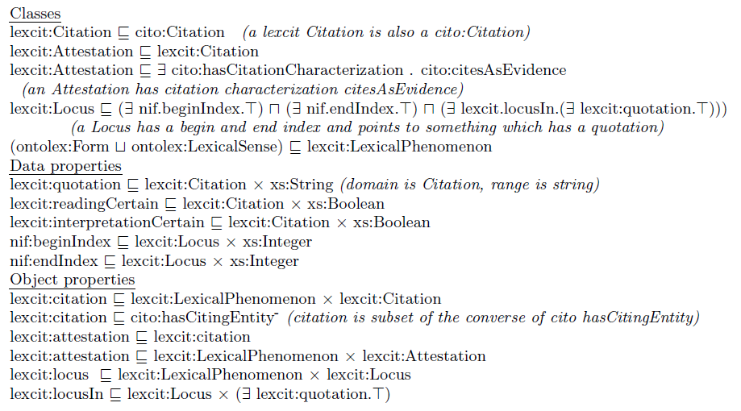
attestations after Depuydt & de Does 2018
Locus
nif:beginIndex***
nif:endIndex***
locusIn**
locus
Citation
quotation: string
readingCertain: boolean****
interpretationCertain: boolean****
citation
Element*
attestation
* i.e., D&dD: lexcit:LexicalPhenomenon
** simplified: pointing to an anonymous superclass of
something that contains a quotation
*** I would prefer not to prescribe nif properties in order to permit other means of cross-referencing, e.g., nif URIs, WebAnnotation selectors, etc.
**** I would prefer to leave certainly etc. to lexinfo
Attestation

Slide 28
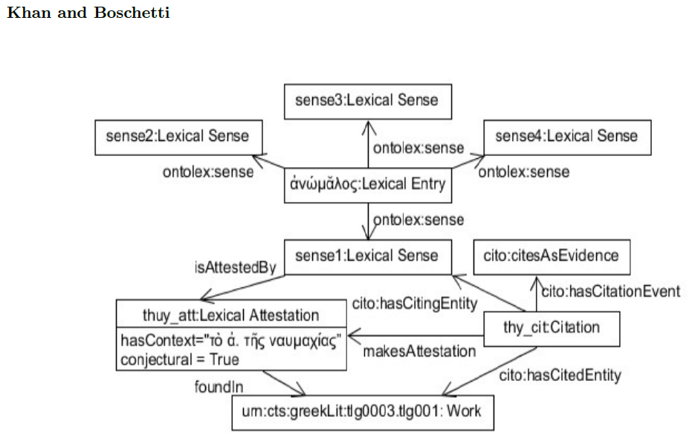
attestations after Khan & Boschetti (2018)
attestation**
Attestation***
hasContext: str(6*)
conjectural: boolean****
makesAttestation
Element*
Citation
foundIn(7*)
work URI*****
* originally restricted to LexicalSense
** originally „isAttestedBy“
*** originally „LexicalAttestation“
**** I would prefer to leave certainty etc. to lexinfo
***** originally „Work“
(6*) maybe rename such that that also context-free examples fit
(7*) I had dc:source at other occasions
as in the other proposal, cito properties and
concepts are skipped, these are beyond the module

Slide 29
attestations: proposal for a minimal consensus
we do not cover:
scientific citations (should refine Citation, using external vocabularies)
corpus pointers (can be NIF objects, NIF URIs, WebAnnotation selectors, CTS URNs, URLs, etc.)
dc:source (6*)
attestation***
Attestation*
quotation: string**
Element
locus URI
makes
Attestation
(5*)
Citation
citation****
* D&dD: Citation
** K&B: hasContext
*** D&dD: attestation
**** K&B: inv of hasCitingEntity
5* D&dD: implicit
6* D&dD: inv of locusIn, K&B: foundIn

Slide 30
attestation
Attestation
quotation: string
dc:source
Element
locus URI
makes
Attestation
Citation
citation
proposed minimal consensus | D&dD | K&B
ontolex:Element | LexicalPhenomenon | (LexicalSense)
attestation | attestation | isAttestedBy
Attestation | Attestation | Attestation
Citation | ~ Citation | Citation
citation | ~ citation | (indirectly via makesAttestation)
makesAttestation | [identity/subClassOf] | makesAttestation
dc:source | ^locusIn | foundIn
quotation | quotation | hasContext
(locus URI) | Locus | Work
(indirectly via attestations) | locus | (hasCitingEntity/hasCitedEntity)

