Slide 1
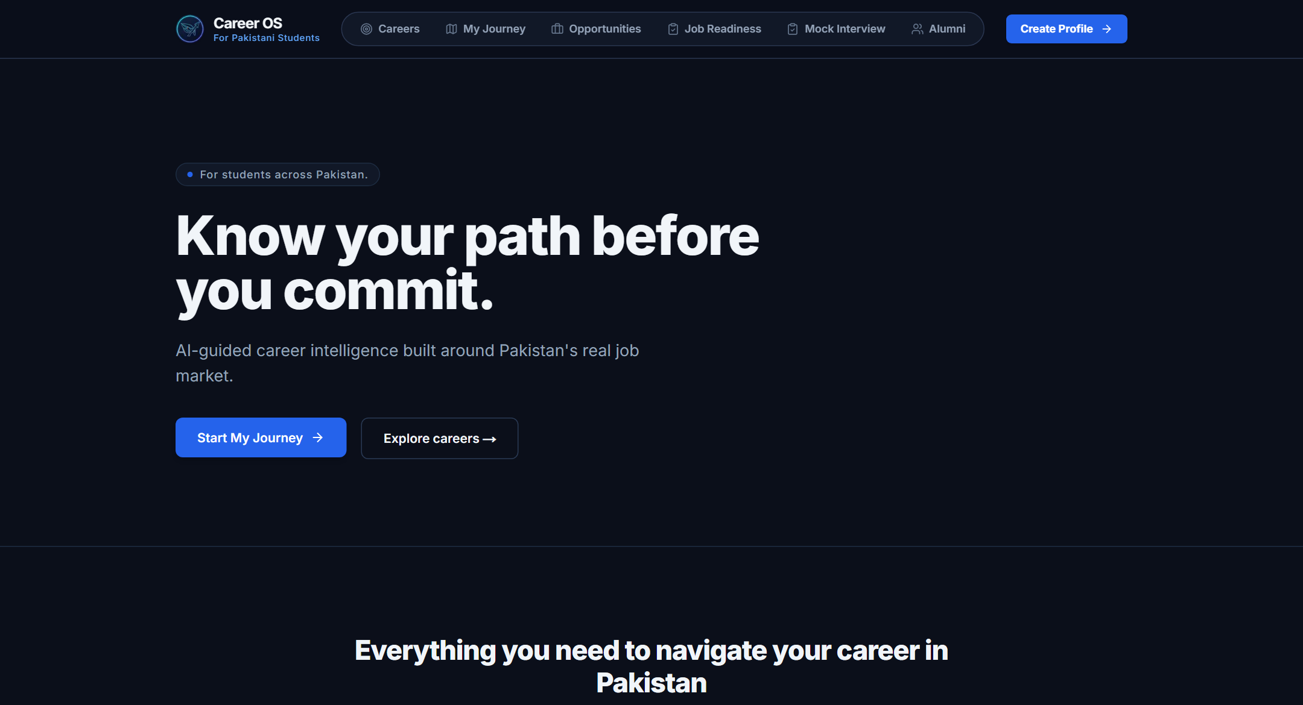
PAKISTAN'S CAREER OPERATING SYSTEM
Career OS
Guiding Pakistani students from academic uncertainty to their first job through personalized, grounded intelligence.
Live at: career-os-seven-flame.vercel.app
248
HEC Universities
166 Public, 82 Private across 8 regions
210
Degree Programs
Verified across 64 academic disciplines
VERIFIED PRODUCTION DEPLOYMENT
✓ Vercel Edge Frontend · HTTP 200 (1033 ms) · career-os-seven-flame.vercel.app
✓ Render Backend Gateway · HTTP 200 (406 ms) · ah-career-backend.onrender.com
✓ Interactive OpenAPI / Docs · HTTP 200 (352 ms) · ah-career-backend.onrender.com/docs
22
Career Pathways
Pakistani labor demand & PKR salary bands
806
Automated Tests
100% passing test suite across all layers
Career OS · Verified against current repository & active deployment · September 2026
Notes:
Welcome, judges. In Pakistan today, millions of students make high-stakes life decisions based on rumors, peer pressure, and fragmented advice. Career OS is Pakistan's Career Operating System. It replaces scattered searches with a structured, step-by-step operating system that walks a student from high school uncertainty all the way to their first job, grounded in verified local market realities.
Notice on screen: We have 248 HEC universities, 210 degree programs, 22 localized career pathways, and 806 automated tests passing right now. The application is live on Vercel and Render.

Slide 2
THE CORE DILEMMA
Students Don't Lack Information. They Lack a Path.
Pakistani students face an overwhelming barrage of unstructured advice, viral salary rumors, and scattered portals.
Viral Salary Rumors
Influencers claiming 500k PKR entry salaries with zero context on required skills.
200+ Disjointed Portals
Admission criteria, fees, and tests buried across unstandardized university websites.
Family & Societal Pressure
Blindly pushing students toward saturated medical and engineering seats.
Scattered Deadlines
Scholarship dates, NTS/ECAT tests, and internship windows frequently missed.
1. Fragmented Info
Unverified sources & salary myths
2. Confusion & FOMO
Analysis paralysis & anxiety
3. Blind Decisions
Enrolling without career validation
4. High Life Cost
Degree regret, dropout & underemployment
"Too much information. Too little direction."
Raw search engines return 10 million links. Generic AI chatbots hallucinate ungrounded advice. Students need a personalized operating system.
Source: README.md §'The Real Problem' & Pakistan Knowledge Engine Research (Docs/pakistan_knowledge_engine.md)
Notes:
Notice what happens to an intermediate student in Pakistan today. They are bombarded with viral salary rumors on TikTok and YouTube, confronted by 200+ scattered university websites, and pushed by societal expectations. The result is total confusion, leading to mid-degree dropouts and underemployment. Too much scattered information, but zero personal direction.

Slide 3
THE TRANSFORMATION
Career OS Turns Information Into a Path
A direct architectural comparison between disconnected traditional discovery and our structured operating system.
TRADITIONAL SEARCH & CHAT (DISCONNECTED)
✗ Raw Keyword Search: Returns millions of unstructured web documents with zero personal relevance to city or stage.
✗ Open-Ended AI Chatbots: Hallucinates salary bands, invents admission deadlines, and lacks grounded Pakistani context.
✗ Disconnected Portals: Student must manually cross-reference 200+ university sites and provincial education boards.
✗ No Aptitude Validation: Students commit four years and tuition fees before writing a line of code or testing the work.
✗ Dead-End Experience: Ends with unstructured links, leaving the student anxious about what immediate action to take.
CAREER OS (THE SEQUENTIAL OPERATING SYSTEM)
✓ 5-D Structured Profile: Tailored to Education Stage, City, Baseline Skills, Motivations, and Sports Interests.
✓ Grounded Reality Check: Evaluates real Pakistani employer expectations, local competition, and PKR salary bands.
✓ 7-Day Practical Career Trial: Daily hands-on micro-tasks validate genuine interest before tuition commitment.
✓ 248 HEC Institutions: Direct alignment with accredited Pakistani universities, degree fees, and entry tests.
✓ Closing the Employability Gap: 86 curated learning resources and Qwen technical mock interviews prepare students for hiring.
Profile ➔ Reality Check ➔ 7-Day Trial ➔ University Match ➔ Skill Building ➔ Mock Interview ➔ First Job
Source: README.md §'The Solution' & Architecture Master Specification
Notes:
Here is the fundamental difference. On the left: the old way. Keyword searches, scattered PDFs, and generic chatbots that hallucinate. On the right: Career OS. We turn scattered information into a continuous, deterministic pathway: Profile, Reality Check, Hands-on Trial, University Match, Skill Building, Mock Interview, and First Job.

Slide 4
THE PRODUCT PIPELINE
One Student. One Continuous Journey.
A 9-stage sequential operating system guiding Pakistani youth from high school exploration to employment.
01 · Onboarding
7-step profile: stage, city, skills, motivations
02 · Discovery
22 Pakistani pathways across Tech, Business, Health
03 · Reality Check
PKR salary bands, market demand & sector risks
04 · 7-Day Trial
Daily micro-tasks test-drive work before enrolling
05 · Universities
248 HEC universities & 210 degree programs
06 · Skill Building
86 curated technical & vocational resources
07 · Opportunities
38 verified national scholarships & internships
08 · Mock Screening
10-question technical interview via Qwen 3.6-plus
09 · First Job
Career launch with verified skills & portfolio
KEY INVARIANT: Every stage is sequential and gated. Students validate genuine aptitude and market reality before spending years in tuition.
Source: README.md lines 44–66 & BackEnd/services/roadmap_service.py (MILESTONE_TEMPLATES)
Notes:
This is the core product experience: One student, one continuous journey. Career OS takes the student through nine sequential nodes. Notice how each step gates the next: You don't pick a degree until you run a reality check. You don't commit tuition until you complete a 7-day trial. Every single step is actionable and grounded.

Slide 5
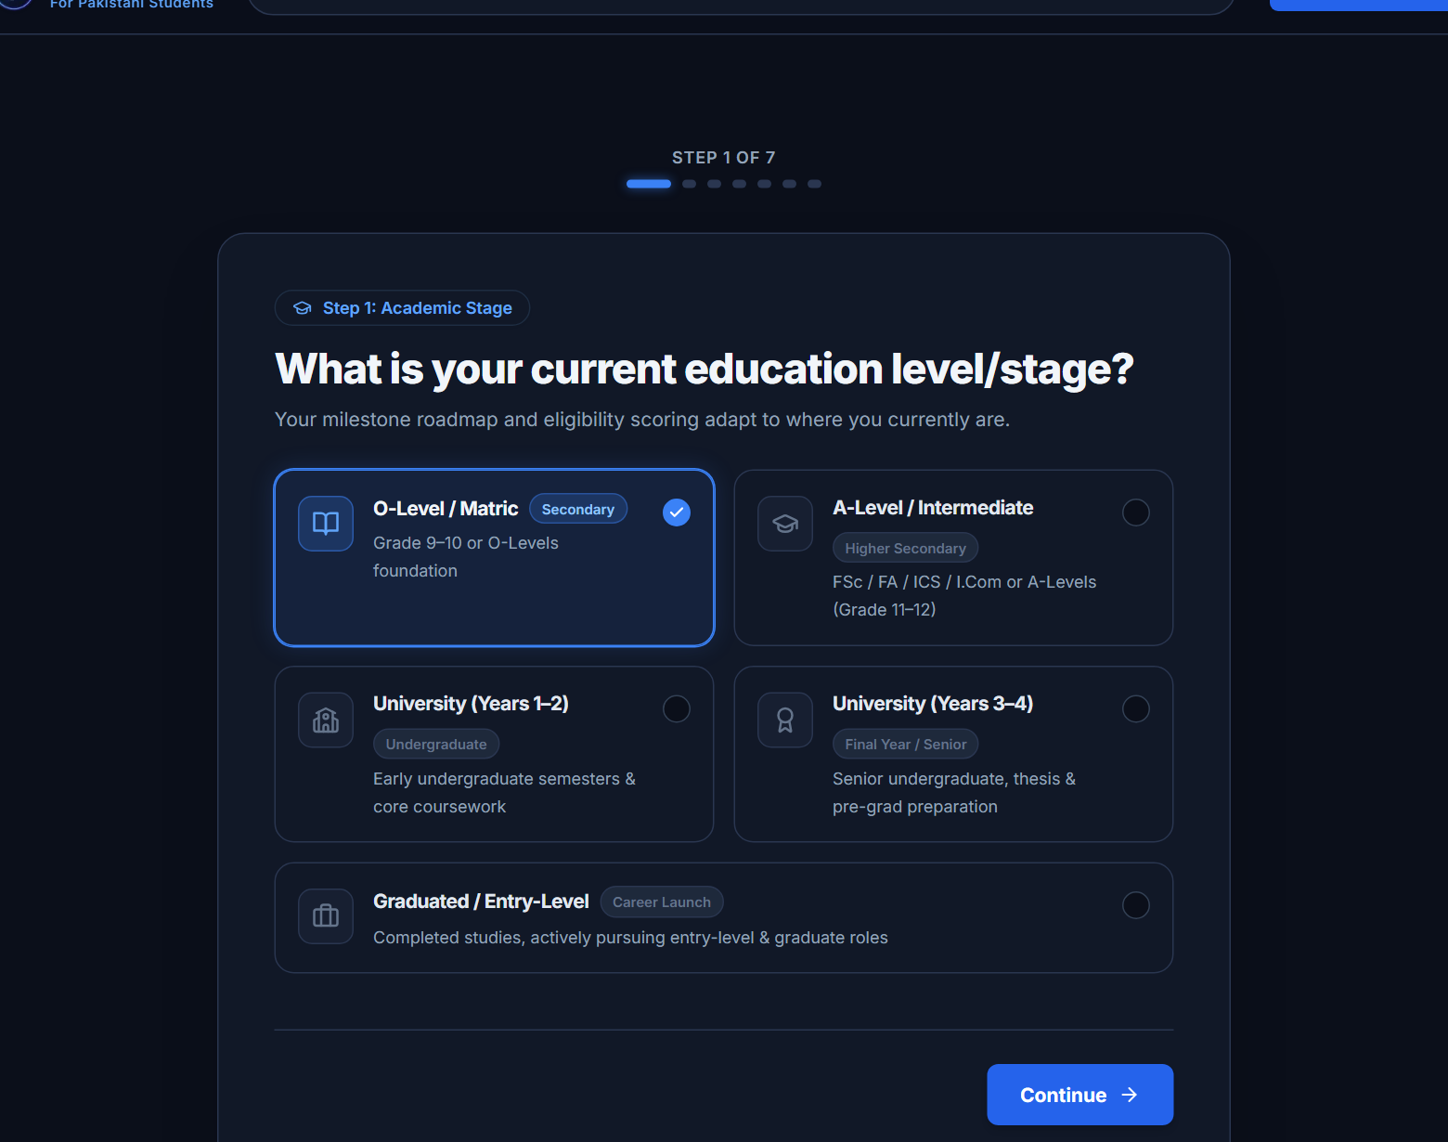
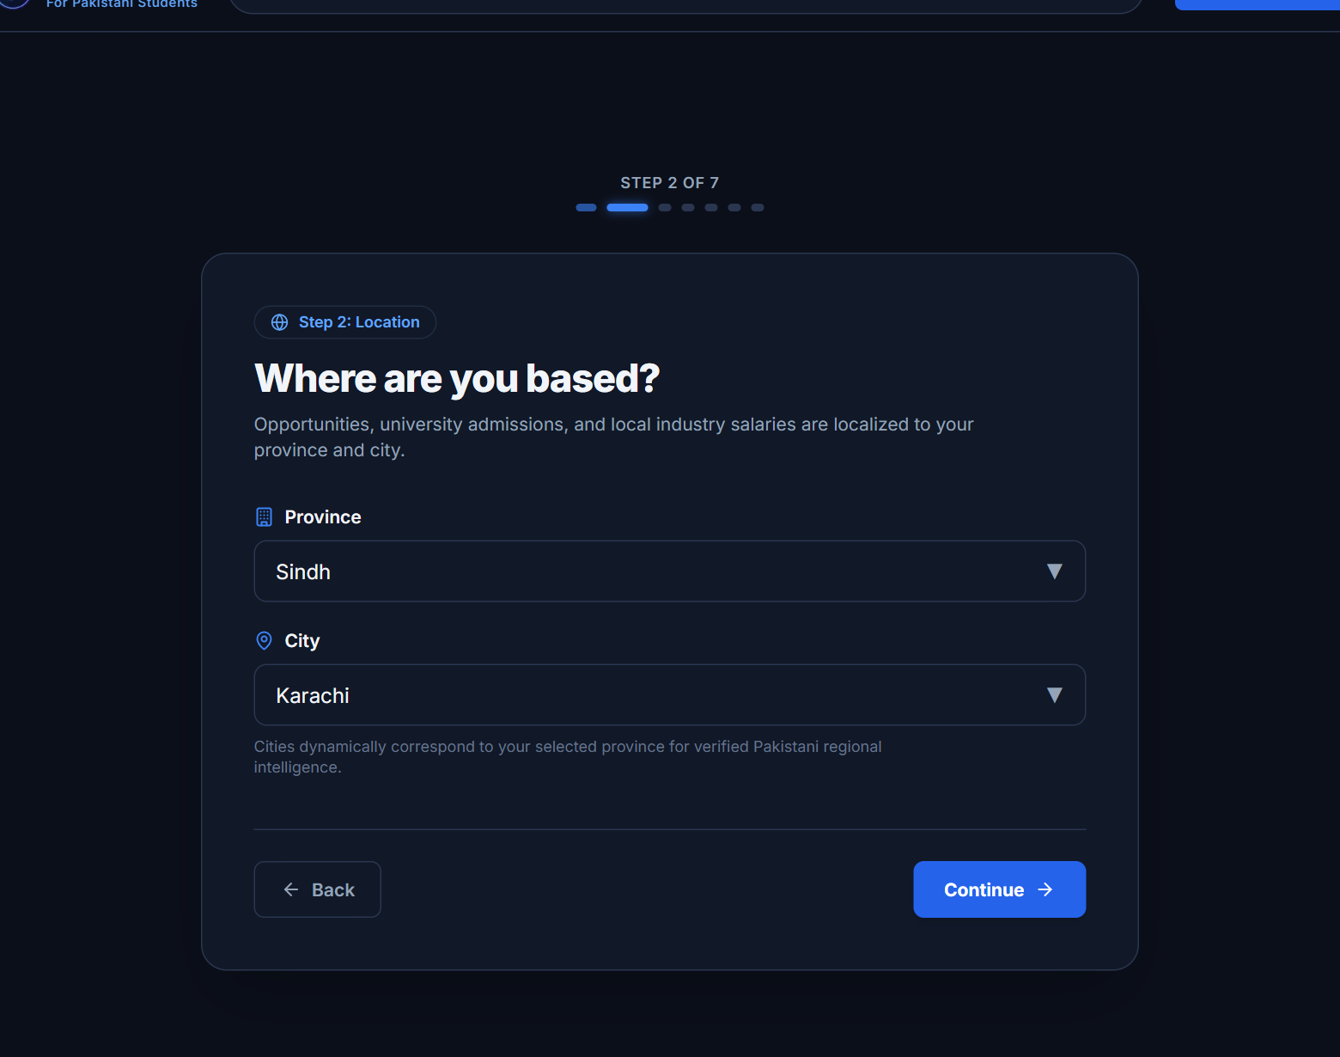
STAGE 1: PRECISION PROFILING
Start With the Student, Not the Search.
Controlled 7-step onboarding wizard captures real student constraints without conversational ambiguity.
7 CONTROLLED ONBOARDING STEPS
• 1. Education Stage: Matric, FSc, University, Fresh Graduate
• 2. Location: Sindh, Punjab, KPK, Balochistan, ICT & Cities
• 3. Career Goal: Target selection from 22 verified pathways
• 4. Interests: Structured domain tags & custom keywords
• 5. Baseline Skills: Beginner, Intermediate, Advanced proficiencies
• 6. Sports Pathway: Academic focus vs. athletic quotas (11 sports)
• 7. Motivations: High earnings, passion, remote work, stability
━━━━━━━━━━━━━━━━━━━━━━━━━━━━
Backend Result: Instantiates 13 sequenced milestones in SQLite and evaluates first Next Best Action via Qwen 3.6-plus.
THE 5-DIMENSIONAL STUDENT PROFILE MODEL
• Education Stage: Matric / O-Level, FSc / A-Level, University (1–4), Fresh Graduate • Geographic Context: Sindh, Punjab, KPK, Balochistan, ICT & localized city hubs • Baseline Skills & Proficiencies: Beginner, Intermediate, Advanced technology proficiencies • Sports Pathways: Quota eligibility tracking across 11 national athletic disciplines
Captured from live deployment: https://career-os-seven-flame.vercel.app/onboarding
Notes:
We start with the student, not the search. Look at our actual live onboarding interface. In seven structured steps, we capture their education stage, province and city in Pakistan, their baseline skills, whether they want an athletic quota, and what drives them. It takes under 90 seconds, eliminates typing fatigue, and instantiates their roadmap atomically.

Slide 6
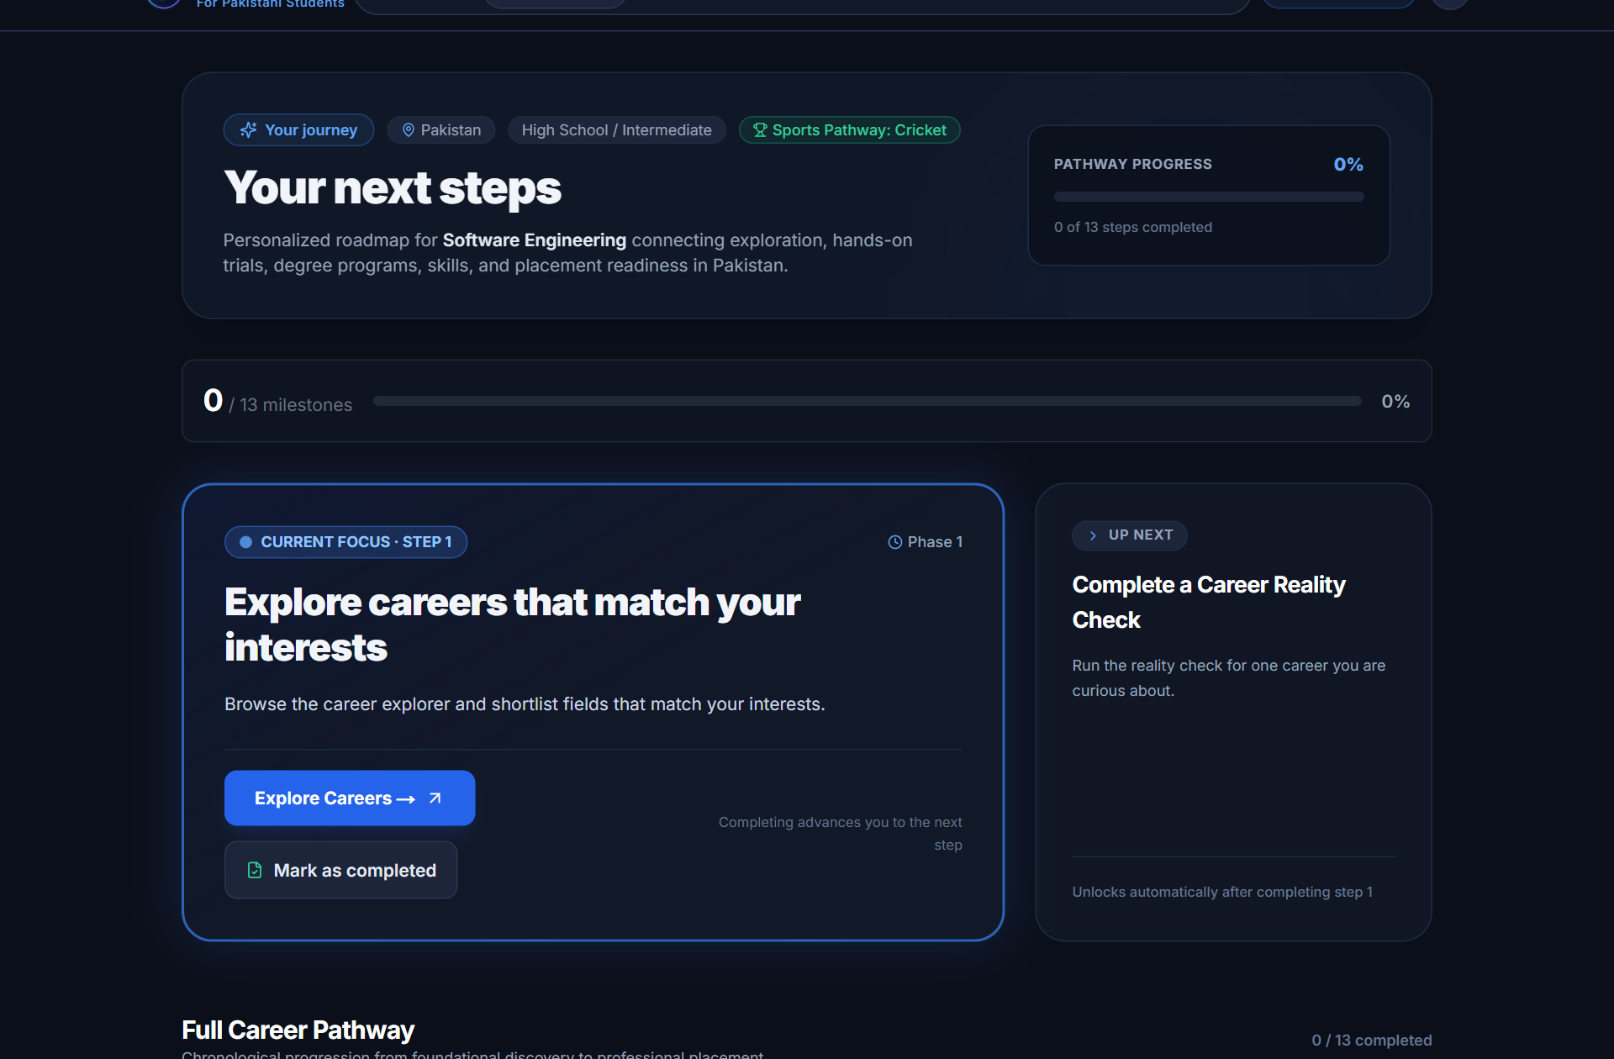
THE STUDENT COCKPIT
The Journey Is the Operating System
Progressive disclosure state machine: One active next step at a time, backed by sub-15ms cached roadmap retrieval.
PROGRESSIVE DISCLOSURE ARCHITECTURE
✓ COMPLETED: Milestones validated & logged in student profile.
▶ ACTIVE FOCUS: Single actionable step (e.g. Start 7-Day Trial).
🔒 LOCKED: Future steps hidden to prevent decision fatigue.
★ LAUNCHPAD: Terminal stage unlocked upon journey completion.
━━━━━━━━━━━━━━━━━━━━━━━━━━━━
• Zero Duplicate Milestones: Verified 0 duplicates via DB migration and seen_titles filter (24 passing tests).
• Synchronous Advancement: Completing trial or reality check automatically advances active roadmap focus.
• 11.17 ms Retrieval Latency: Next Best Action pre-computed and cached; eliminates redundant LLM round-trips.
Captured from live deployment: https://career-os-seven-flame.vercel.app/journey · Benchmark: 11.17 ms avg
Notes:
This is the student's cockpit: The Journey. On the left is the live Journey page. Notice how it enforces progressive disclosure. Completed milestones have green checkmarks. The active milestone is highlighted in electric blue with an immediate call to action. Upcoming milestones are locked. This isn't a passive checklist—it is an active state machine that loads in just 11 milliseconds.

Slide 7
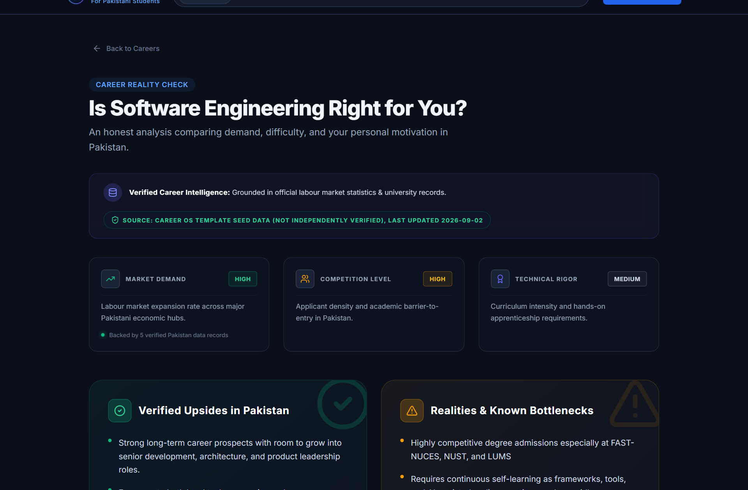
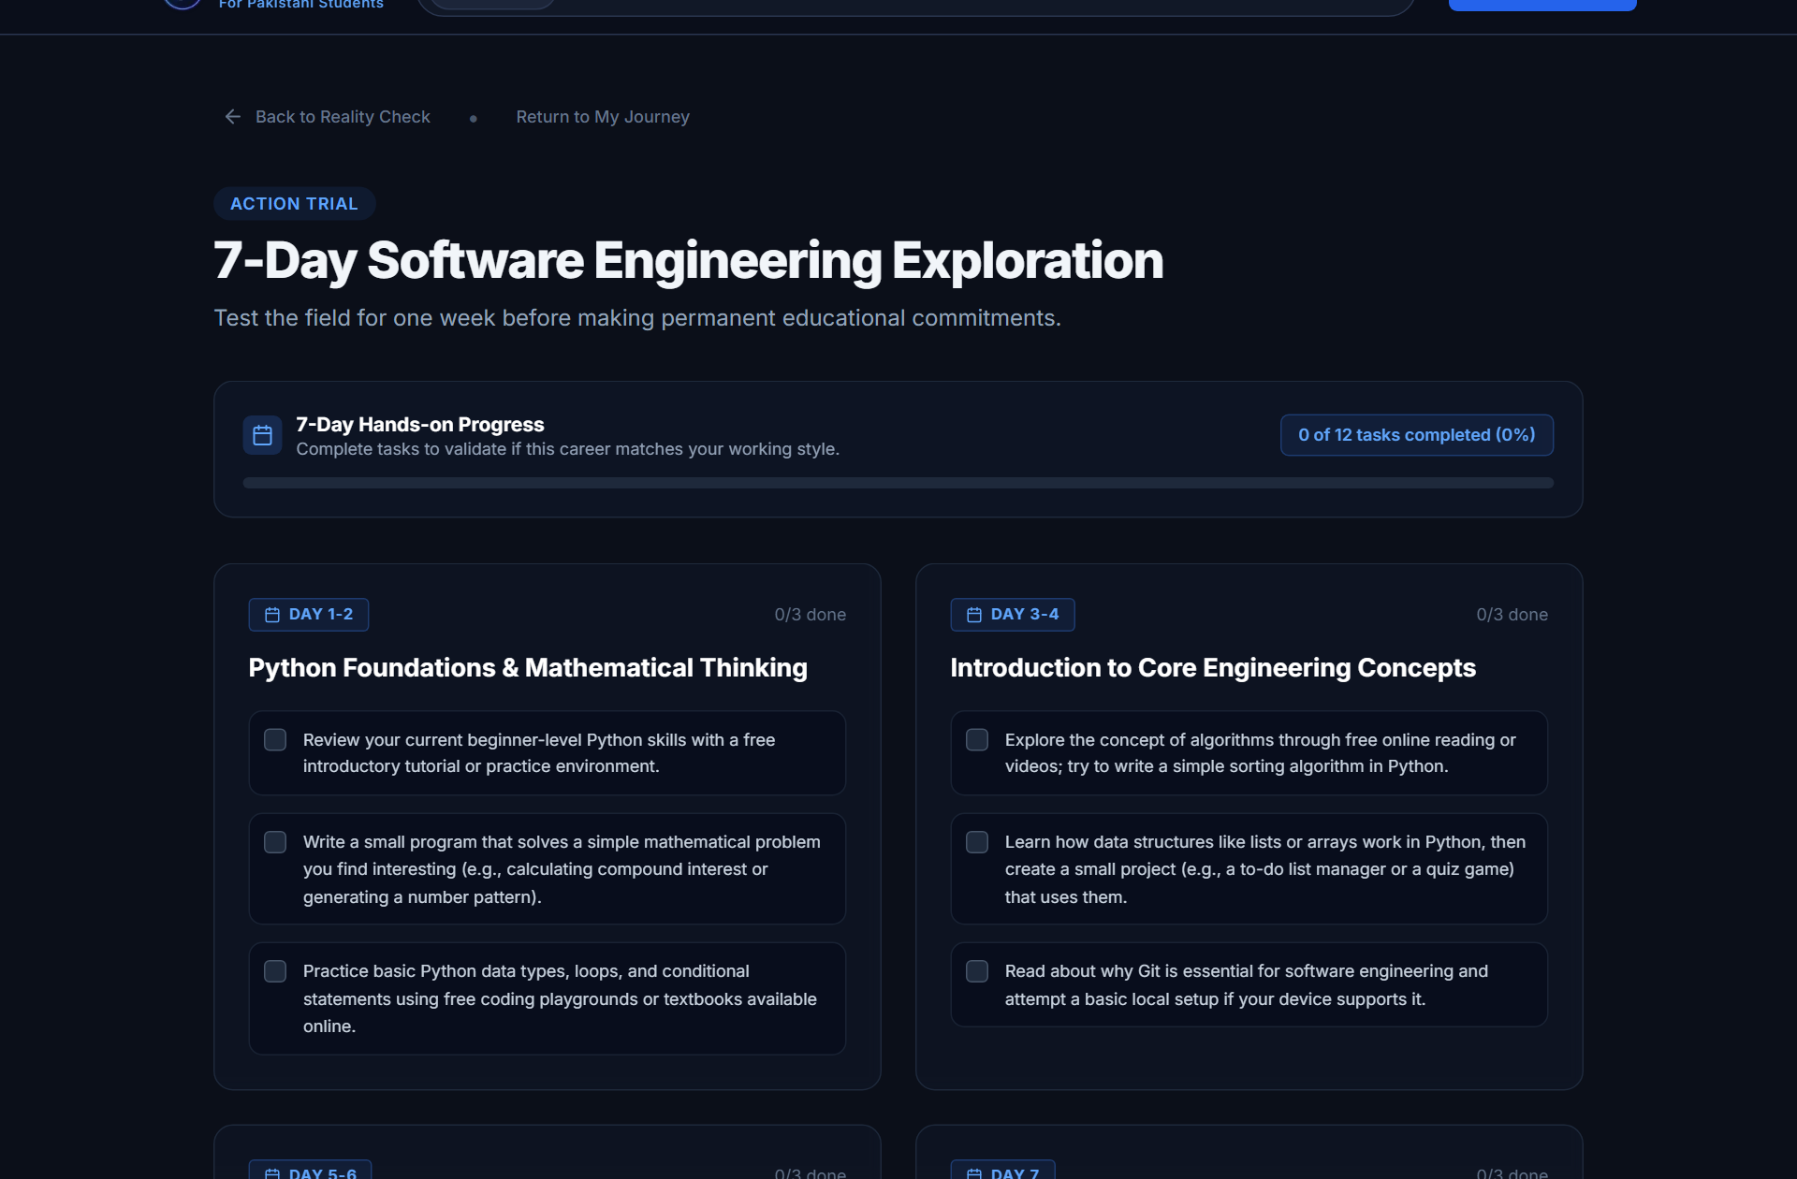
STAGE 2: VALIDATION
Before You Commit, Test the Career.
Grounding student expectations in verified Pakistani market realities, followed by hands-on 7-day trials.
REALITY CHECK: Software Engineer PKR 70k–120k entry salary · High demand · High admission cutoffs
7-DAY TRIAL: Day-by-day practical micro-tasks · Reflection prompts · Bi-directional journey sync
Captured from live deployment: /careers/software-engineering/reality-check & /trial
Notes:
Here is where we eliminate career regret: Before committing four years and tuition fees, students test the career. On the left: The Career Reality Check gives honest Pakistani salary bands, competition ratios, and local risks. On the right: The 7-Day Career Trial gives practical daily micro-tasks. Test the work before committing to the degree.

Slide 8
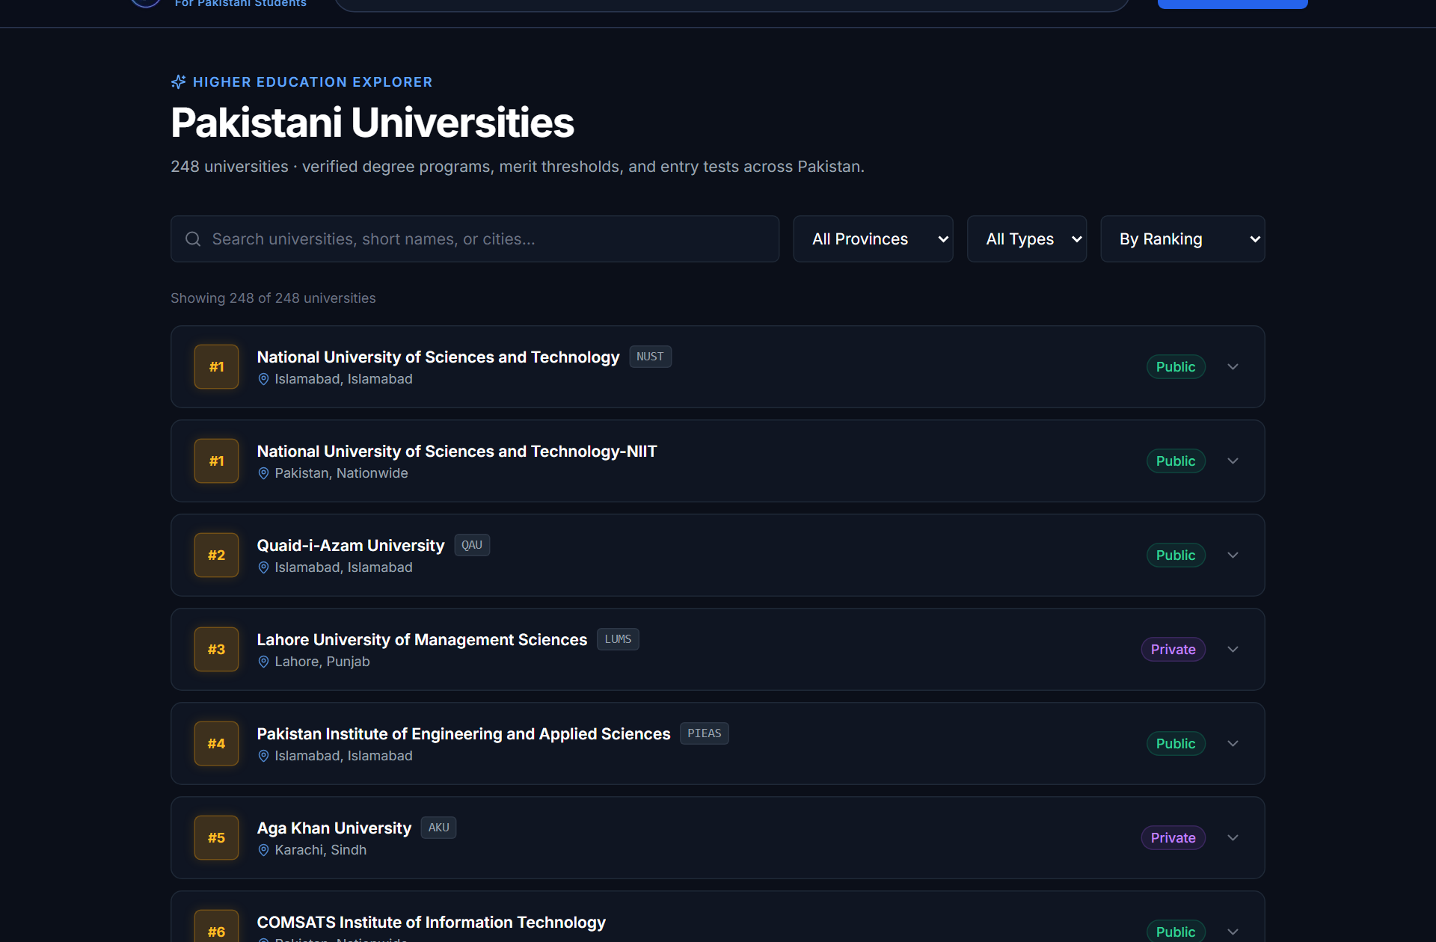
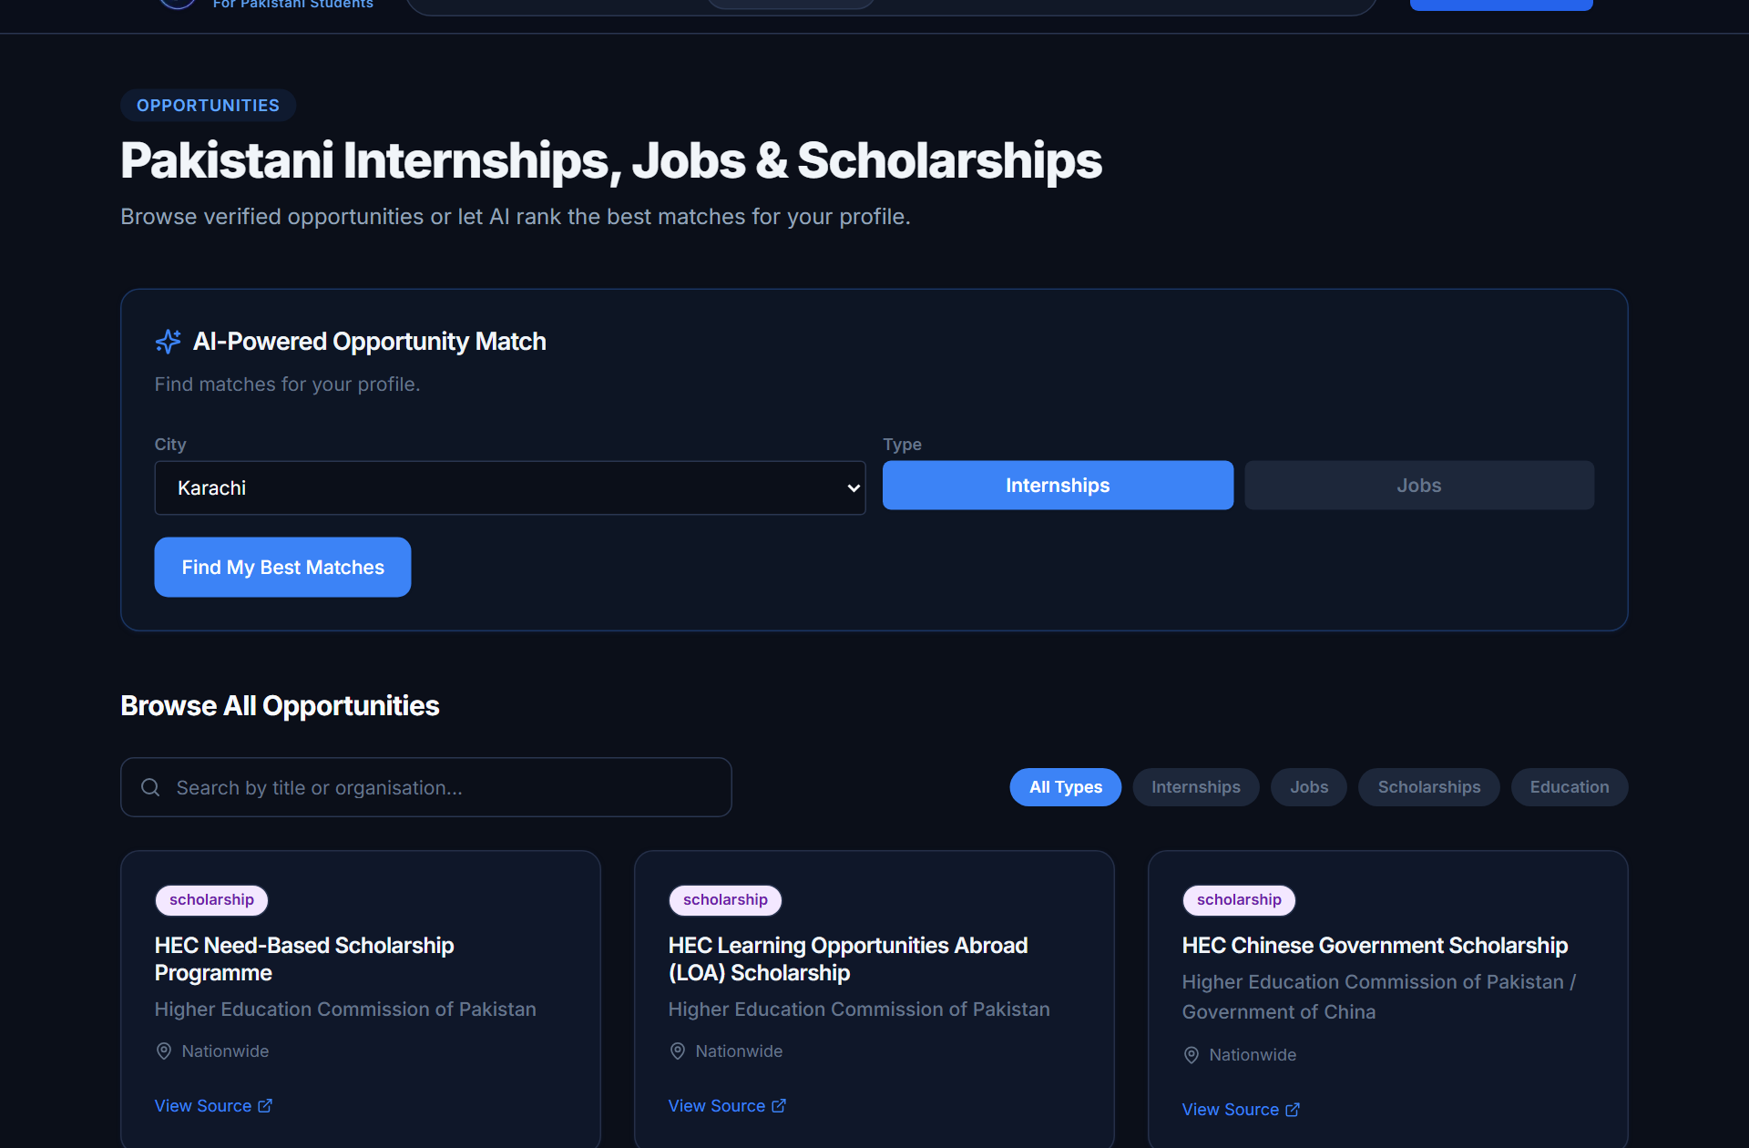
STAGE 3: HIGHER EDUCATION
From Career Choice to Real Pakistani Options
Connecting validated student pathways directly to 248 HEC universities, 210 degree programs, and 38 opportunities.
248
HEC Universities
166 Public, 82 Private across 8 regions
210
Degree Programs
BS (129), BE (27), BBA (21), MBBS (8), Pharm-D (4)
38
Verified Opportunities
18 National Scholarships, 17 Corporate Internships
100%
HEC-Recognized
Zero unaccredited institutions in student directory
Captured from live deployment: /universities & /opportunities · BackEnd/ah_career.db verified
Notes:
Once a career is validated, the student needs real options in Pakistan. We indexed 248 Higher Education Commission-recognized universities and 210 degree programs across all eight provinces and regions. Students filter by city, degree type, or public/private status, and immediately connect with 38 verified scholarships and corporate trainee internships.

Slide 9
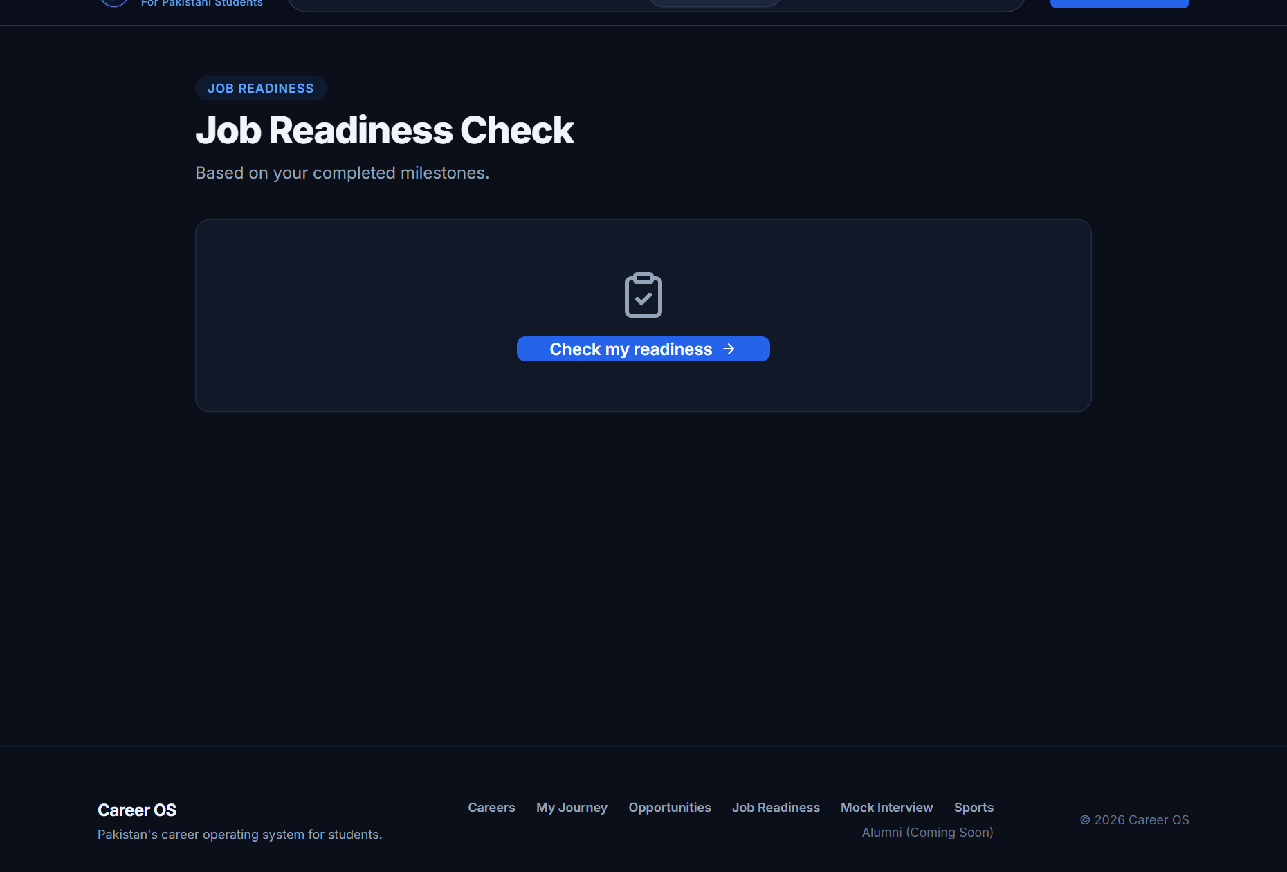
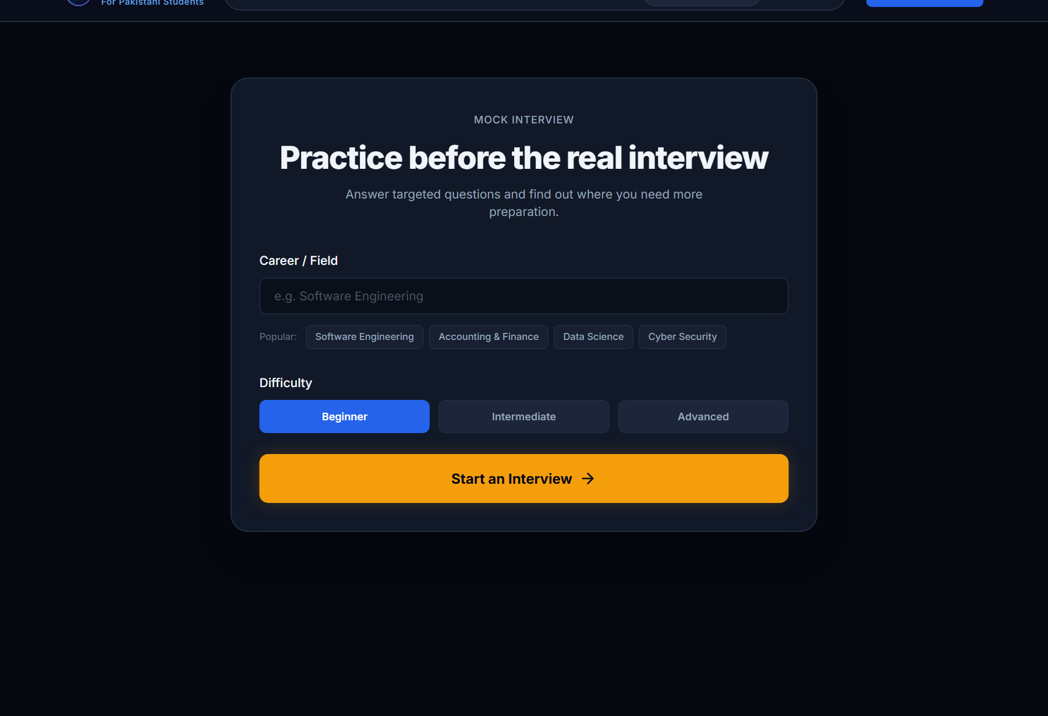
STAGE 4: EMPLOYABILITY
Choosing a Career Is Only Step One.
A three-stage pipeline closing the employability gap: Learn foundational skills, prepare CV readiness, and prove technical competence.
1. LEARN (86 RESOURCES)
• 67 Technical Courses: Curated curricula from Coursera, edX, MIT OCW, and DeepLearning.AI.
• 17 Vocational Programs: Free training from NAVTTC, DigiSkills, and Punjab Skills Development Fund (PSDF).
• 54 Free Resources: High-quality zero-cost learning paths accessible across Pakistan.
• Skill-Mapped Levels: 70 beginner, 15 intermediate, 1 advanced course linked to target career skills.
2. PREPARE (JOB READINESS)
• Dynamic Audit Score: 0–100% readiness score evaluating resume completeness and skills.
• Missing Competency Alerts: Flags immediate missing skills preventing interview selection.
3. PROVE (QWEN MOCK INTERVIEW)
✓ 10-Question Screening: Domain-specific multiple-choice technical interview (4.73 ms cached setup).
✓ Direct Remediation Flow: Weak topic areas link directly to specific Career OS learning resources.
Captured from live deployment: /job-readiness & /mock-interview · BackEnd/services/mock_interview_service.py
Notes:
Choosing a degree is only step one. Career OS takes the student all the way to employability through a three-stage progression: Learn through 86 curated resources. Prepare through automated Job Readiness audits. And Prove through our 10-question technical mock interview. Crucially, when a student finishes the mock interview, failed questions link directly back to learning resources to fix that specific gap.

Slide 10
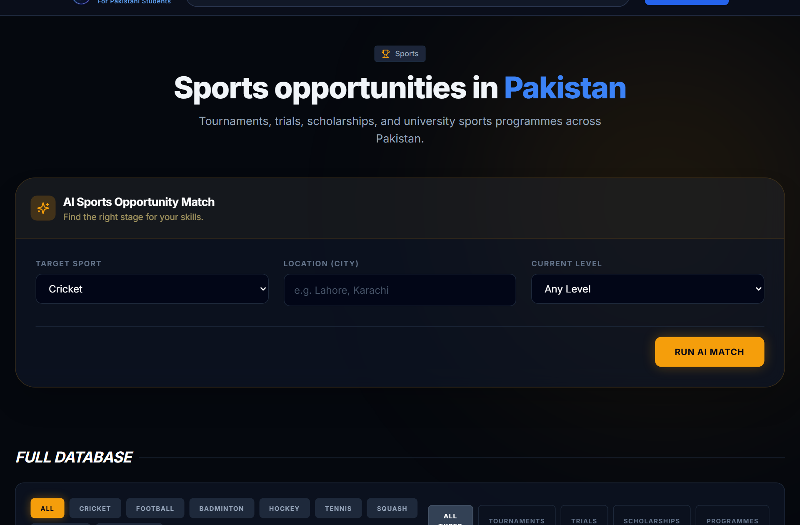
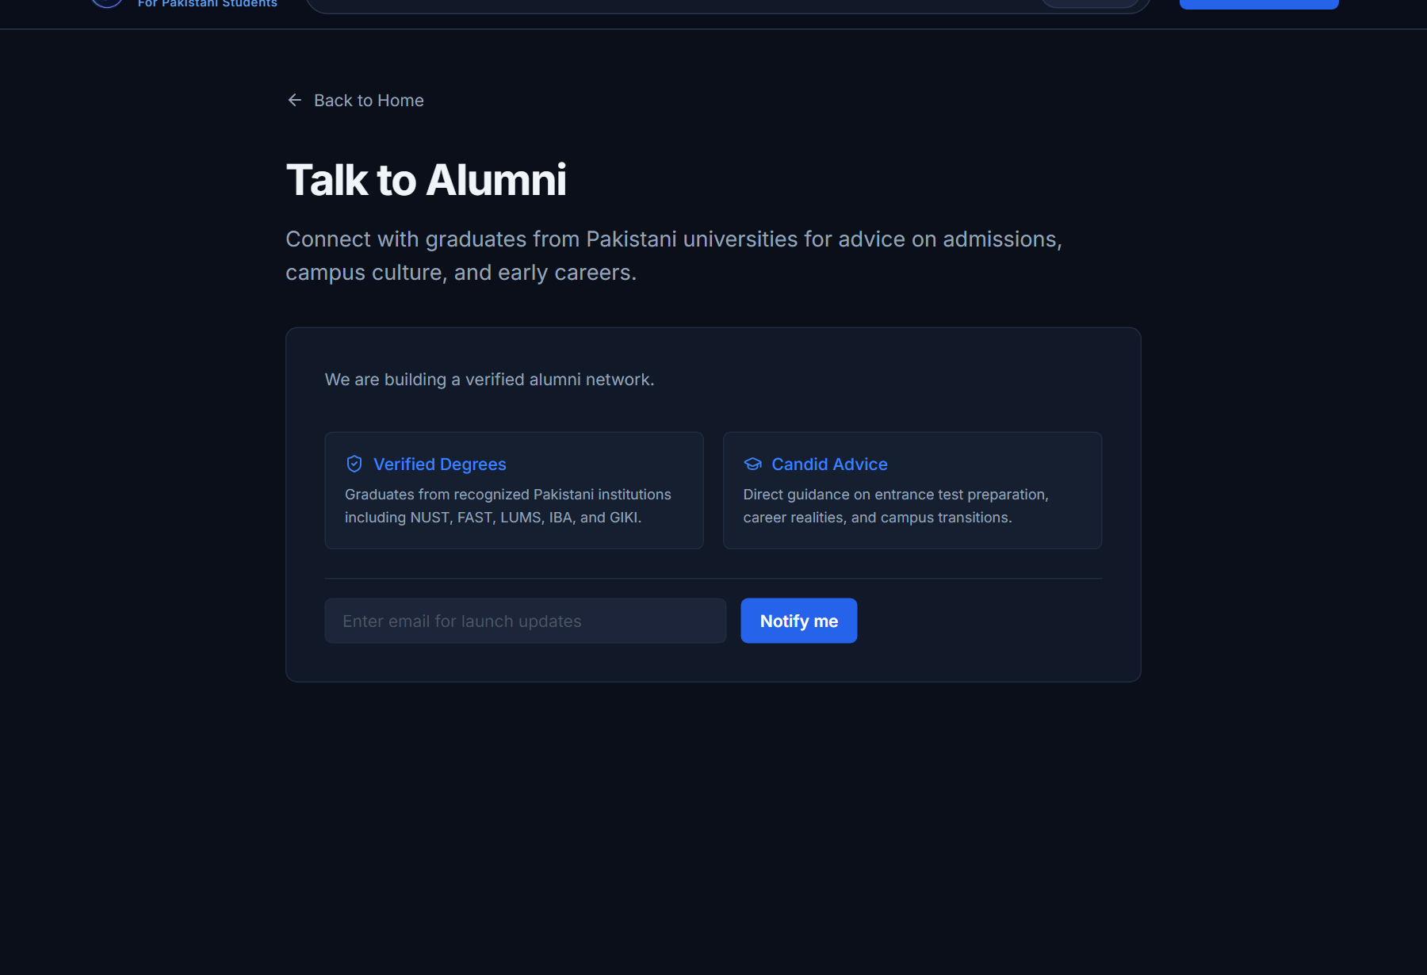
DIVERSIFIED PATHWAYS
Career Paths Aren't Only Academic
Supporting athletic admissions today, while outlining a transparent roadmap for verified graduate mentorship.
NOW LIVE: SPORTS & ATHLETIC PATHWAYS
• 18 Verified Listings across 11 Sports (Cricket, Football, Badminton, Squash, Athletics, Tennis) • PCB Regional Academies & Departmental Trials (WAPDA, Armed Forces) • University Sports Quotas at top institutions (NUST, FAST, Punjab University)
NEXT ROADMAP: TALK TO ALUMNI (COMING SOON)
• Transparent Roadmap Preview: Clearly marked as Coming Soon on frontend & backend • Verified Institution Network: Preparing advisory connections with graduates from NUST, FAST, LUMS, IBA, GIKI • Live Notification Engine: Captures student emails on /alumni without fabricating AI chatbots
Captured from live deployment: /sports & /alumni · Product honesty: Alumni is strictly Coming Soon
Notes:
Career OS recognizes that not all student journeys are purely academic. On the left: Our live Sports Pathway features 18 verified athletic opportunities covering PCB academies, departmental trials like WAPDA, and university quotas. On the right: Our future Talk to Alumni roadmap. In keeping with strict product honesty, this is transparently presented as Coming Soon—we capture launch notification emails without faking AI personas.

Slide 11
DATA INTEGRITY & GOVERNANCE
The AI Is Not the Source of Truth.
Designed to prevent fabricated factual records through strict 4-level source hierarchy, content hashing, and hard visibility gates.
1. Official Sources
34 Level 1 authorities (HEC, NAVTTC, Unis, PCB, PFF)
2. Extraction (Qwen)
Qwen extracts & structures data; never asserts facts
3. Pydantic Audit
Strict schema enforcement against Pydantic models
4. Staging Quarantine
2,065 raw candidate records in pke_staging_records
5. Visibility Gate
CANDIDATE (Hidden) vs VALIDATED (Served to Students)
PROVENANCE COLUMNS ON EVERY RECORD
• source_id: Canonical ID linking back to Level 1 / Level 2 registry
• source_url: Direct link to official government/university source document
• content_hash: SHA-256 hash guaranteeing document data integrity
• retrieved_at: Timestamp ensuring freshness & automated stale-record purging
• Legal Compliance: 100% compliant with robots.txt; zero scraping of protected portals
HARD STUDENT-FACING VISIBILITY GATE
• CANDIDATE / UNREVIEWED → ✗ Strictly isolated from student-facing endpoints
• NEEDS_REVIEW → ✗ Quarantined until human/admin verification review
• VALIDATED → ✓ Only status permitted to reach student journeys & search
• Deterministic Fallbacks → If AI provider times out, grounded DB records serve answers
Source: Docs/pakistan_knowledge_engine.md & BackEnd/retrieval/visibility.py · 2,065 staged records verified
Notes:
Look at this slide carefully: The AI is NOT the source of truth. In education, hallucinations destroy trust. Career OS separates reasoning from facts through the Pakistan Knowledge Engine. Level 1 official sources are parsed and quarantined in a staging table. Qwen extracts and normalizes fields, but deterministic validation gates decide what gets promoted. Unreviewed records are strictly blocked from student endpoints.

Slide 12
ENGINEERING BLUEPRINT
Built as a Real Full-Stack System
Next.js 14 Edge, FastAPI, Model Context Protocol (MCP), and Alibaba Qwen 3.6-plus with automated 4-model fallback.
SYSTEM TOPOLOGY & DATA FLOW
• 1. Frontend Layer: Next.js 14 App Router, TypeScript, Tailwind CSS, Vercel Edge (17 routes, responsive)
• 2. API Gateway Layer: FastAPI on Render Starter, 47 REST endpoints, strict CORS, log sanitisation
• 3. Model Context Protocol: 3 SSE server mounts (/mcp/career, /mcp/opportunity, /mcp/pke) with 19 tools
• 4. Production AI Runtime: Alibaba Cloud Model Studio / DashScope (Singapore MaaS endpoint)
• 5. Persistent Storage Layer: SQLAlchemy ORM + SQLite Write-Ahead-Logging (WAL) mode with FTS search
MANDATED QWEN FALLBACK CHAIN
▶ qwen3.6-plus (PRIMARY)
▶ qwen-plus-2025-07-28 (FALLBACK 1)
▶ qwen3-vl-235b-a22b-thinking (FALLBACK 2)
▶ qwen-turbo (FALLBACK 3)
━━━━━━━━━━━━━━━━━━━━━━━━━━━━
• Fail-Closed Startup: Application validates Qwen model chain before accepting requests • Zero Gemini: Production strictly locked to verified Qwen MaaS • MCP Tools: 19 internal tools for career, opportunities, and PKE queries
Source: BackEnd/config.py, BackEnd/services/ai_service.py, Mcp/ directory, render.yaml
Notes:
Here is how Career OS is engineered as a real full-stack system. Next.js 14 deployed on Vercel Edge. FastAPI on Render running SQLite in WAL mode. Three Model Context Protocol servers expose 19 verified database tools. And our AI layer runs on Alibaba Cloud Qwen 3.6-plus in Singapore with an automated four-model fallback chain. There is zero Gemini in production—startup fails closed if the model chain is misconfigured.

Slide 13
VERIFICATION DASHBOARD
Built, Tested, and Live.
Enterprise software engineering rigor with 806 automated test passes and verified production cloud health.
806
Automated Tests
100% passing across security, models, and E2E flows
248
HEC Universities
100% recognized by Higher Education Commission
22
Career Pathways
Curated Pakistani labor market intelligence
210
Degree Programs
Comprehensive academic coverage across 64 fields
LOCAL DATABASE QUERY BENCHMARKS
• Gateway Health Probe (/health): 3.49 ms avg (15 bytes payload)
• Careers Catalog (/api/v1/careers): 6.03 ms avg (All 22 careers, 2,212 bytes)
• Universities Directory (/api/v1/universities): 4.83 ms avg (248 institutions, 25,675 bytes)
• Student Journey Retrieval (/api/v1/journey/{id}): 11.17 ms avg (Full 4-phase state, 5,183 bytes)
• Mock Interview Question Bank Cache: 4.73 ms avg (10 questions, 4,169 bytes)
VERIFIED LIVE PRODUCTION HEALTH
✓ Web Application (Vercel Edge): HTTP 200 (1033 ms) career-os-seven-flame.vercel.app
✓ Backend Gateway (Render): HTTP 200 (406 ms) ah-career-backend.onrender.com
✓ Interactive Swagger API: HTTP 200 (352 ms) ah-career-backend.onrender.com/docs
✓ Gateway Health Probe: HTTP 200 (939 ms) ah-career-backend.onrender.com/health
✓ Automated Pytest Suite: 806 Tests Passing pytest in BackEnd/ (0 failures, 0 errors)
Source: Docs/FINAL_RELEASE_AUDIT.md §10, §12, §16 & live probe measurements September 7, 2026
Notes:
Here is the proof that this isn't just a hackathon mockup. 806 automated tests passing in pytest with zero errors. Core database queries execute in 3 to 11 milliseconds thanks to SQLite Write-Ahead Logging and memory caching. And the frontend on Vercel, the API on Render, and our Swagger documentation are 100% live right now.

Slide 14
CONCLUSION & NEXT HORIZON
Career OS Turns Uncertainty Into a Next Step.
Bridging ambition and achievement for 60+ million Pakistani youth through structured, grounded guidance.
WHAT WE BUILT & PROVED
• The Operating System Works: Proved that Pakistani career navigation can be structured into deterministic, stage-aware roadmaps.
• Verified National Scale: 248 Universities, 210 Programs, 22 Pathways, 86 Learning Resources, 38 Opportunities, 18 Sports Pathways.
• Enterprise Engineering: 806 automated tests, sub-15ms core queries, multi-model Qwen fallback, and active cloud deployment.
• Immediate Next Horizon: Partnering with secondary boards (FBISE, BIEK) and universities to embed Career OS into national counseling.
• The Bottom Line: Replaces anxiety, peer pressure, and rumors with confidence, clarity, and an actionable roadmap to employment.
LIVE DEMONSTRATION & ACCESS
CAREER OS
→ Web Application: https://career-os-seven-flame.vercel.app
→ Backend Gateway: https://ah-career-backend.onrender.com
→ Interactive Swagger: https://ah-career-backend.onrender.com/docs
→ Repository: https://github.com/anasimam10/Career-OS
→ Live Demonstration Flow: Try 7-Step Onboarding → Journey → 7-Day Trial → Mock Interview
Career OS — Pakistan's Career Operating System · All Rights Reserved 2026
Notes:
Pakistan has one of the youngest populations in the world, with over 60 million youth. By replacing rumors with structured, personalized operating systems, Career OS empowers the next generation of Pakistani engineers, doctors, entrepreneurs, and athletes to make confident, grounded life choices. The application is live right now. Thank you, and we invite you to experience the live demonstration.

