Slide 1
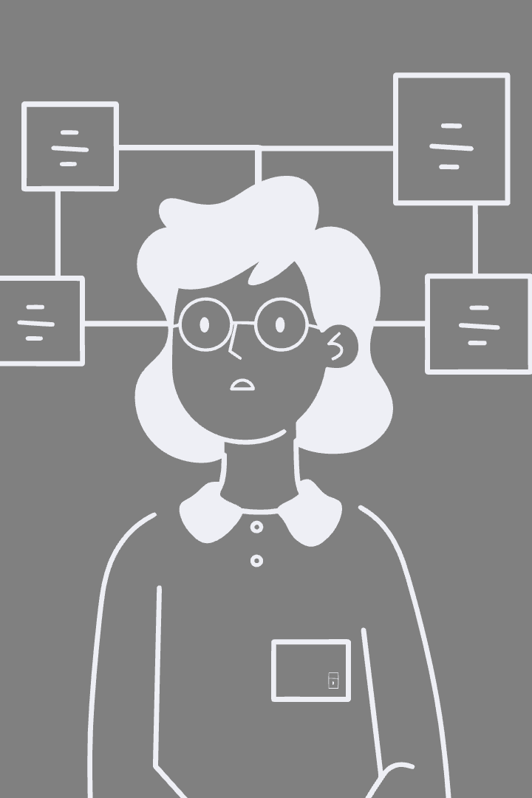
Multi-agent Databases via Independent Learning
Exploring cooperative learned components to improve query latency.
by Anas Khalid

Slide 2
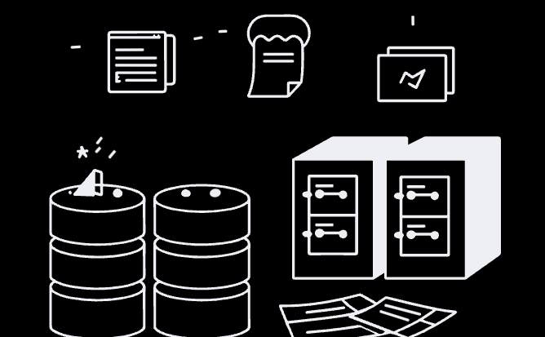
Motivation and Challenge
Multiple DB components affect query performance
Current ML replaces single components independently
Need cooperative learning for end-to-end optimization
Key Question
Can learned components cooperate to reduce query latency?

Slide 3

MADB System Overview
Components
Approach
Goal
Learned query scheduler and optimizer
Cooperative multi-agent reinforcement learning
Reduce overall query execution time

Slide 4
Learned Query Scheduler
Function
Inputs
Schedules queries to maximize buffer pool hits
Buffer pool state (cached data blocks)
Uses Q-learning and Markov Decision Process
Expected data block requests per query

Slide 5
Learned Query Optimizer
Function
Inputs
Determines efficient join orderings for queries
Latest executed query join ordering
Trained via learning from demonstrations
Base relations to join in current query

Slide 6
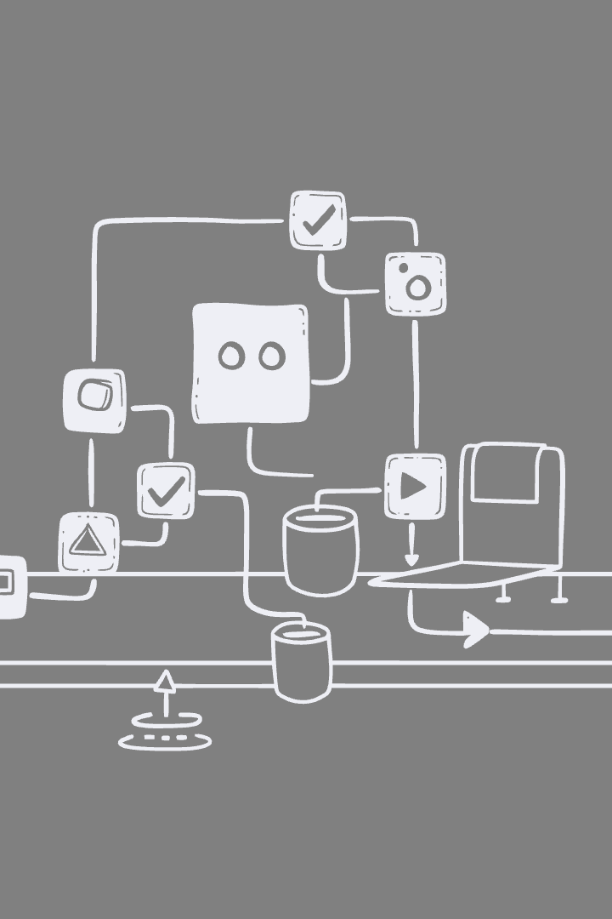




Cooperative Multi-Agent Learning
Independent Learning
Agents learn policies based on local observations
Information Sharing
Scheduler and optimizer exchange state info
Training
Centralized training, decentralized execution
Goal
Minimize total query latency collaboratively

Slide 7

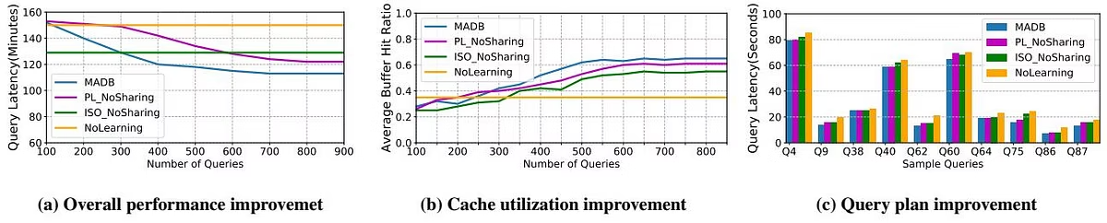
Preliminary Experimental Results
Performance
Cache Utilization
MADB outperforms non-cooperative and no-learning baselines
65% buffer hit ratio, highest among approaches
Latency
9%-32% faster query execution than alternatives

Slide 8

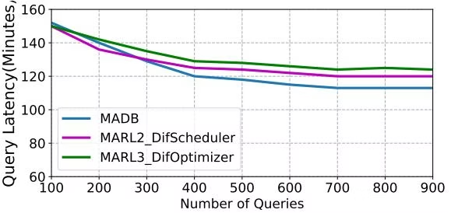
Impact of Information Sharing
Sharing Data Blocks
Sharing Execution Plans
Improves scheduler's decision quality
Enhances optimizer's policy adaptation
Result
6%-12% performance gain over partial sharing

Slide 9
Thank You
Thank you for your attention and interest in our presentation.

