Slide 1


What is Virtual Reality?
Virtual reality (VR) is a simulated experience that can replicate real-world environments and situations. Using specialized VR hardware like headsets, users are able to see, hear, and interact with computer-generated environments as if they were physically present.
by M. Sannan Ahmed
Ma

Slide 2
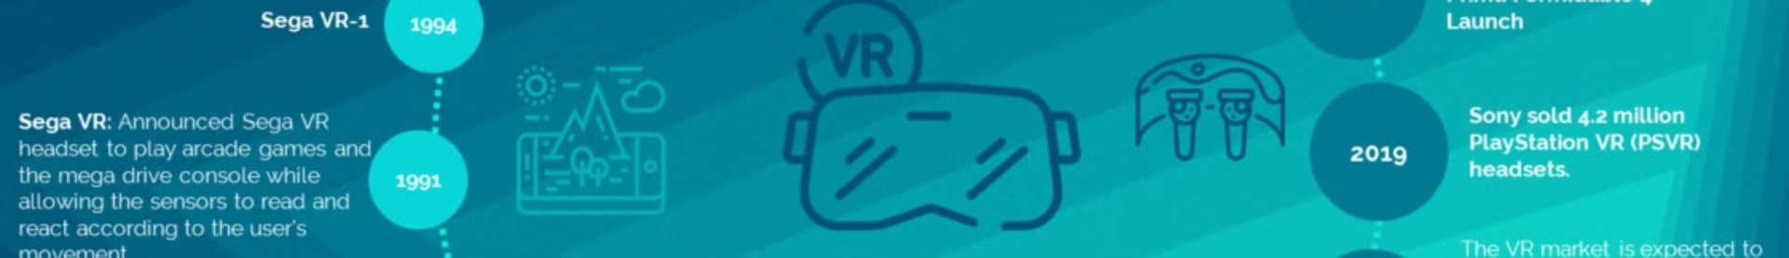
The History of VR
2010s-Today
1960s
Affordable consumer VR headsets like the Oculus Rift and HTC Vive have brought VR into the mainstream, transforming gaming, entertainment, and various industries.
The first virtual reality systems were developed, such as the Sensorama and the Sword of Damocles head-mounted display.
1
2
3
1980s-1990s
Advances in computing power and graphics allowed for more immersive VR experiences, though they remained limited to research and military applications.

Slide 3
How VR Works
Head Tracking
Stereoscopic Display
Motion Controllers
VR headsets use sensors to track the movement of the user's head, allowing them to look around the virtual environment.
The headset displays a separate image for each eye, creating a 3D illusion of depth and immersion.
Hand-held controllers enable users to interact with the virtual environment, allowing for natural and intuitive interactions.

Slide 4
The Hardware of VR
VR Headsets
Motion Controllers
Tracking Systems
Key components include the display, lenses, and tracking sensors. Popular models include the Oculus Rift, HTC Vive, and PlayStation VR.
Handheld controllers with buttons, joysticks, and tracking sensors allow for natural interaction with the virtual environment.
Sensors and cameras track the user's head and hand movements to provide a seamless, responsive VR experience.

Slide 5
The Applications of VR
1
Gaming and Entertainment
2
Education and Training
VR has revolutionized the gaming industry, offering immersive and interactive experiences that were never before possible.
VR can create simulated environments for hands-on learning, allowing students to engage with content in new ways.
3
Healthcare and Therapy
4
Design and Visualization
VR is being used for pain management, phobia treatment, and rehabilitation, providing new avenues for patient care.
VR allows designers and architects to visualize and interact with their creations in a 3D space.

Slide 6
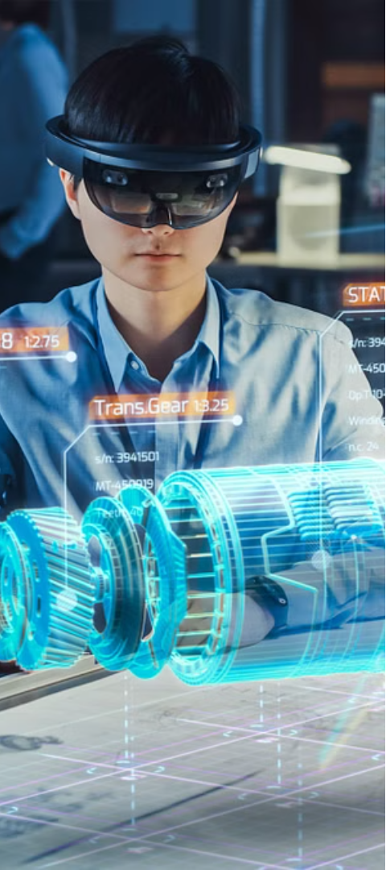



The Future of VR
Increased Affordability
As technology advances, VR hardware is expected to become more accessible and affordable for consumers.
Improved Realism
Advancements in display resolution, field of view, and haptic feedback will create even more immersive VR experiences.
Diverse Applications
VR will continue to expand into new industries, such as remote work, social interaction, and collaborative experiences.

Slide 7



Conclusion
Immersive
Transformative
Promising Future
VR provides a highly immersive and engaging experience, transporting users to new virtual worlds.
The potential of VR technology is transforming industries and changing the way we interact with digital content.
As VR hardware and software continue to evolve, the future of this technology looks increasingly exciting and limitless.

