Slide 1


Slide 2
INDEX
INTRODUCTION
ADVANTAGES
DISADVANTAGES

Slide 3
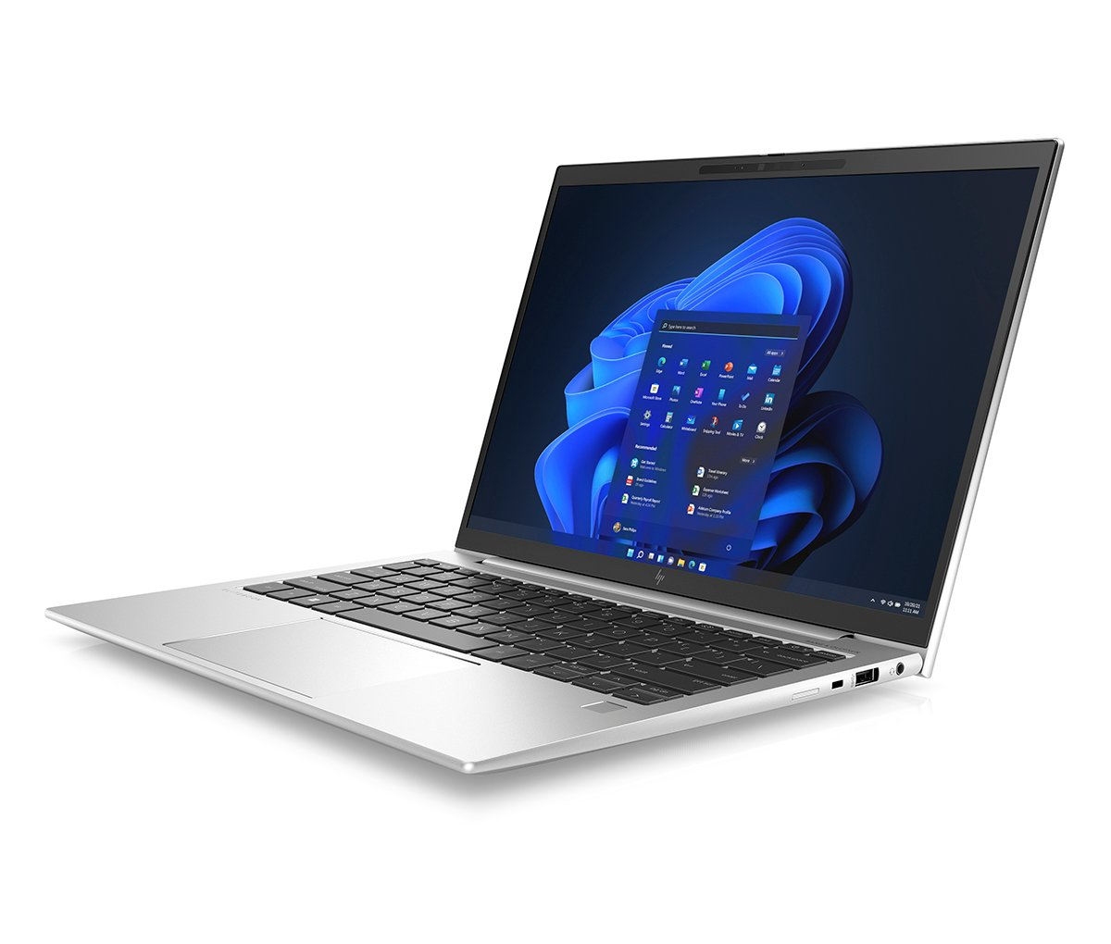
INTRODUCTION
A laptop, sometimes called a notebook computer by manufacturers, is a battery- or AC-powered personal computer (PC) smaller than a briefcase. A laptop can be easily transported and used in temporary spaces such as on airplanes, in libraries, temporary offices and at meetings.

Slide 4
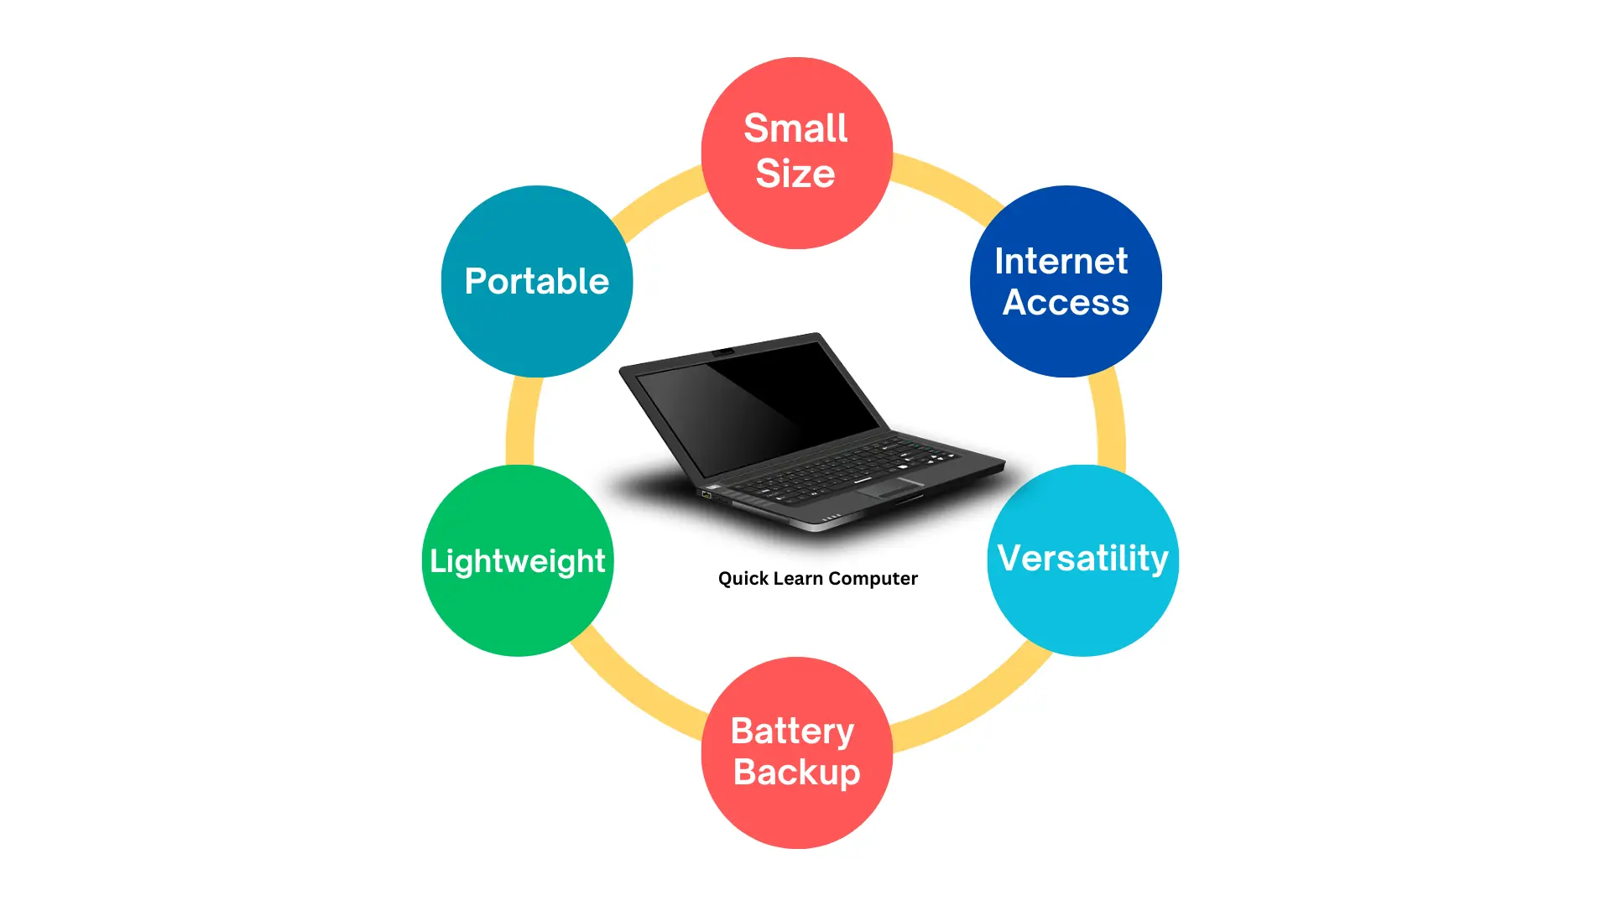
ADVANTAGES
The main advantage of a laptop, as compared with a stationary computer, is its mobility. The lightweight, compact size, the built-in battery within the laptop allowing it to simply move from one place to a different one. Many models are often worn in the least times, utilized in a park, cafe, or carted during a car.
The laptop is straightforward to use with none additional devices. It’s everything like its own keyboard, built-in mouse (touchpad), built-in speakers, built-in microphone, many laptops have a built-in camera.
Internet access is the second advantage for the increase in demand for the laptop because it provides the power to access the web through wireless technology Wi-Fi.
Usually carrying a laptop means your ticket to instant access to information, be it personal or professional. It results in better collaboration between co-workers or students.

Slide 5
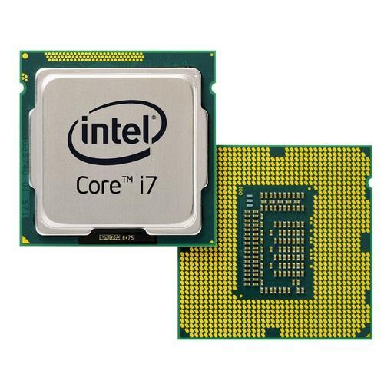
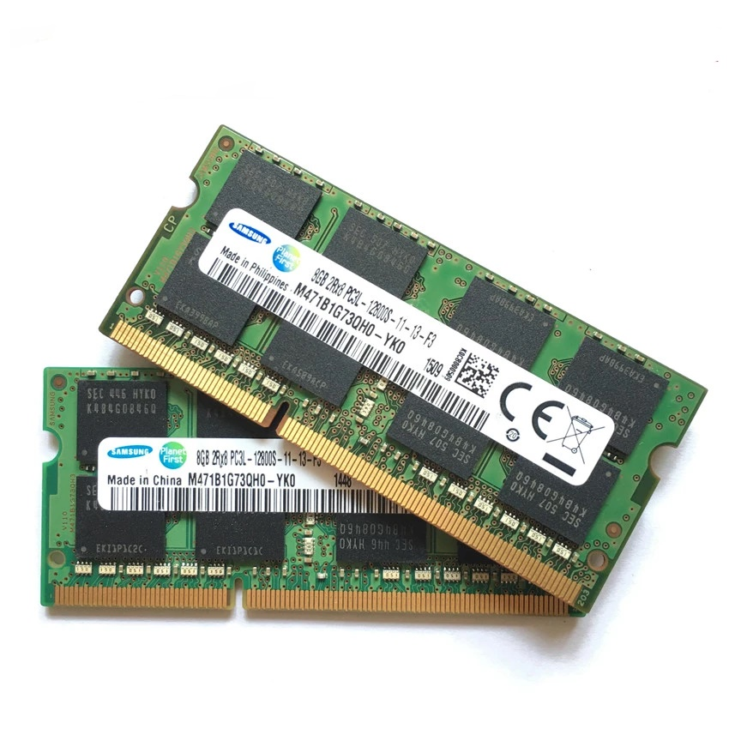
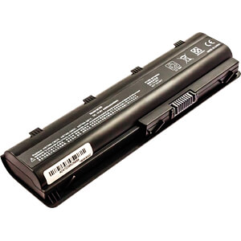
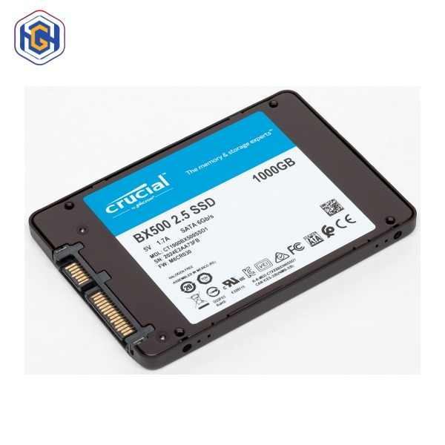

Slide 6
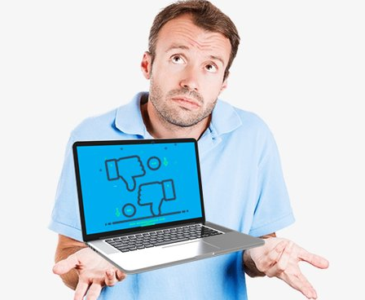
DISADVANTAGES
The laptops are difficult to upgrade thanks to their integrated design. The sole parts which will be upgraded are hard disc and memory as these are the sole parts that are accessible to the user. It’s very difficult to repair it. The laptop doesn’t offer an option for personalization consistent with one’s requirements.
The laptop only gives access to the computer’s memory and disk drive. The opposite components like processors, graphics cards, and cooling systems aren’t easy to access and replace.
It is easier to run as many video cards as possible on a desktop at a time, but laptops have a lot of limitations when it comes to the use of video cards because laptops are not compatible with the consumption of high power and may lead to permanent damage.

Slide 7
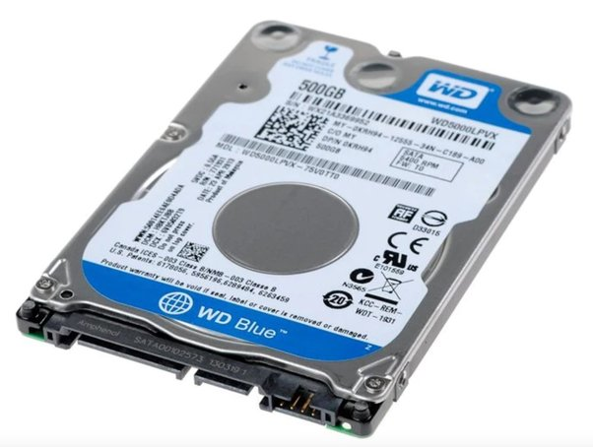
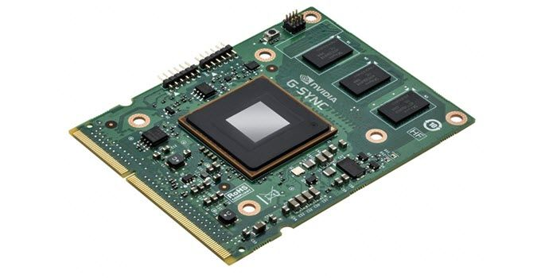
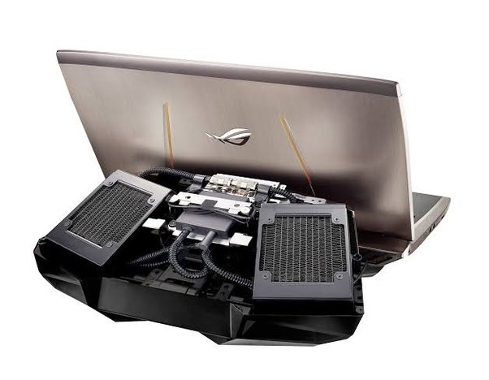

Slide 8
