Slide 1

INVENTORY MANAGEMENT SYSTEM
Web Application on ASP.NET MVC
Supervisor:Engr.Jahanzaib Ali Khan
Co-Supervisor:Engr.Tariq Pirzada
Group Members:
Anas Usmani (Group Leader)
Wajahat Ullah khan
Hafiza Sidra Khan

Slide 2
TABLE OF CONTENTS
IMS on MVC
Why MVC
What we have done
Screenshots
What is left?
Work plan

Slide 3
Inventory management system On MVc
Improved Delivery Performance.
A good inventory management strategy helps save time and money.
Inventory management can have real time and monetary benefits.
By keeping track of which products you have on-hand or ordered, you save yourself the effort of having to do an inventory recount to ensure your records are accurate.
A good IMS can ease your Document Generation task:

Slide 4
Why MVC ?
Faster development process: MVC supports rapid and parallel development. With MVC, one programmer can work on the view while other can work on the controller to create business logic of the web application. The application developed using MVC can be three times faster than application developed using other development patterns.
Ability to provide multiple views: In the MVC Model, you can create multiple views for a model. Code duplication is very limited in MVC.
SEO friendly Development platform: Using this platform, it is very easy to develop SEO-friendly URLs to generate more visits from a specific application.

Slide 5
What we have done
Designed complete database.
Designed the Layout of application.
Created accounts with complete read and write action.
Created inventory with complete read and write action.
Master detailed entry for Vouchers.
User log in / log out

Slide 6
SCREEN SHOTS:

Slide 7
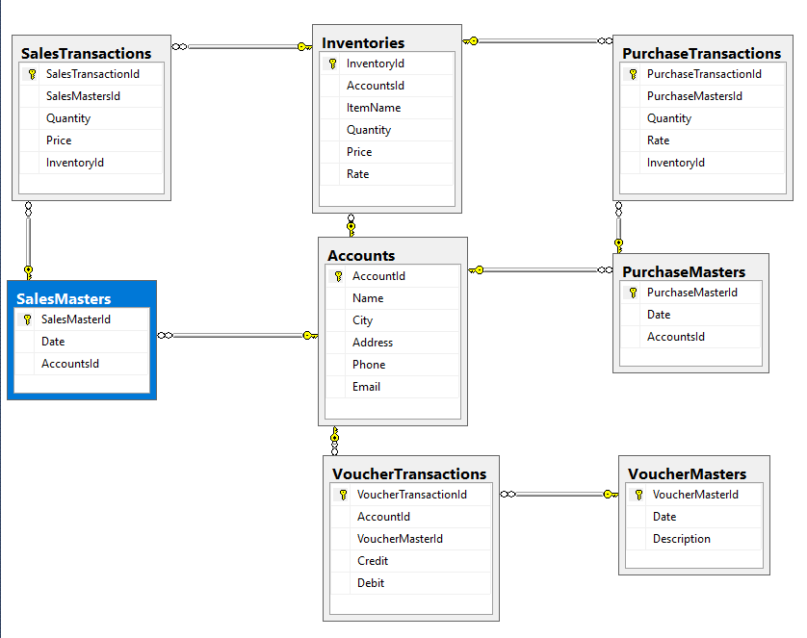
Database:

Slide 8
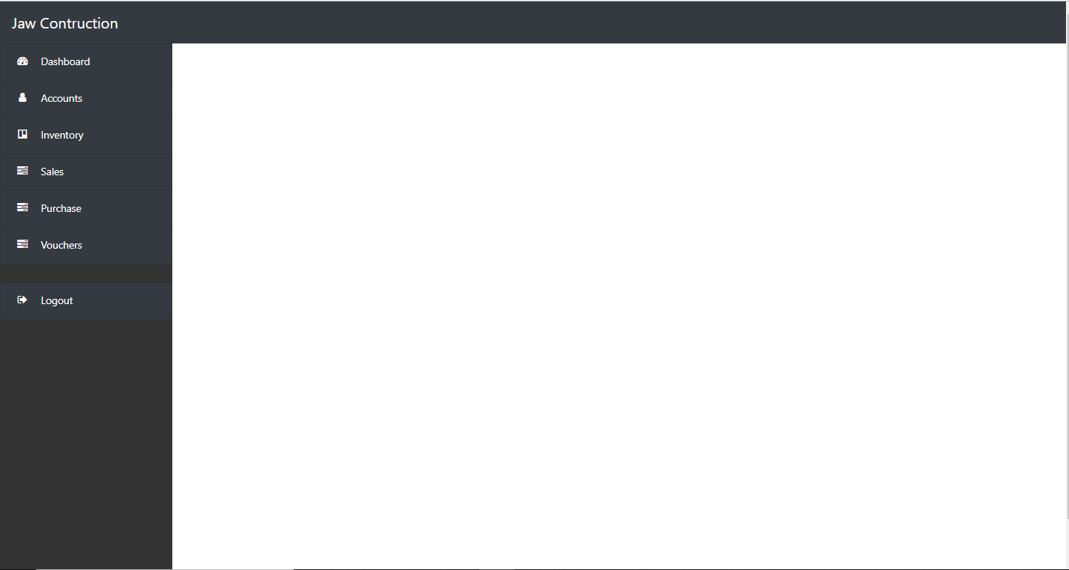
Layout Page

Slide 9
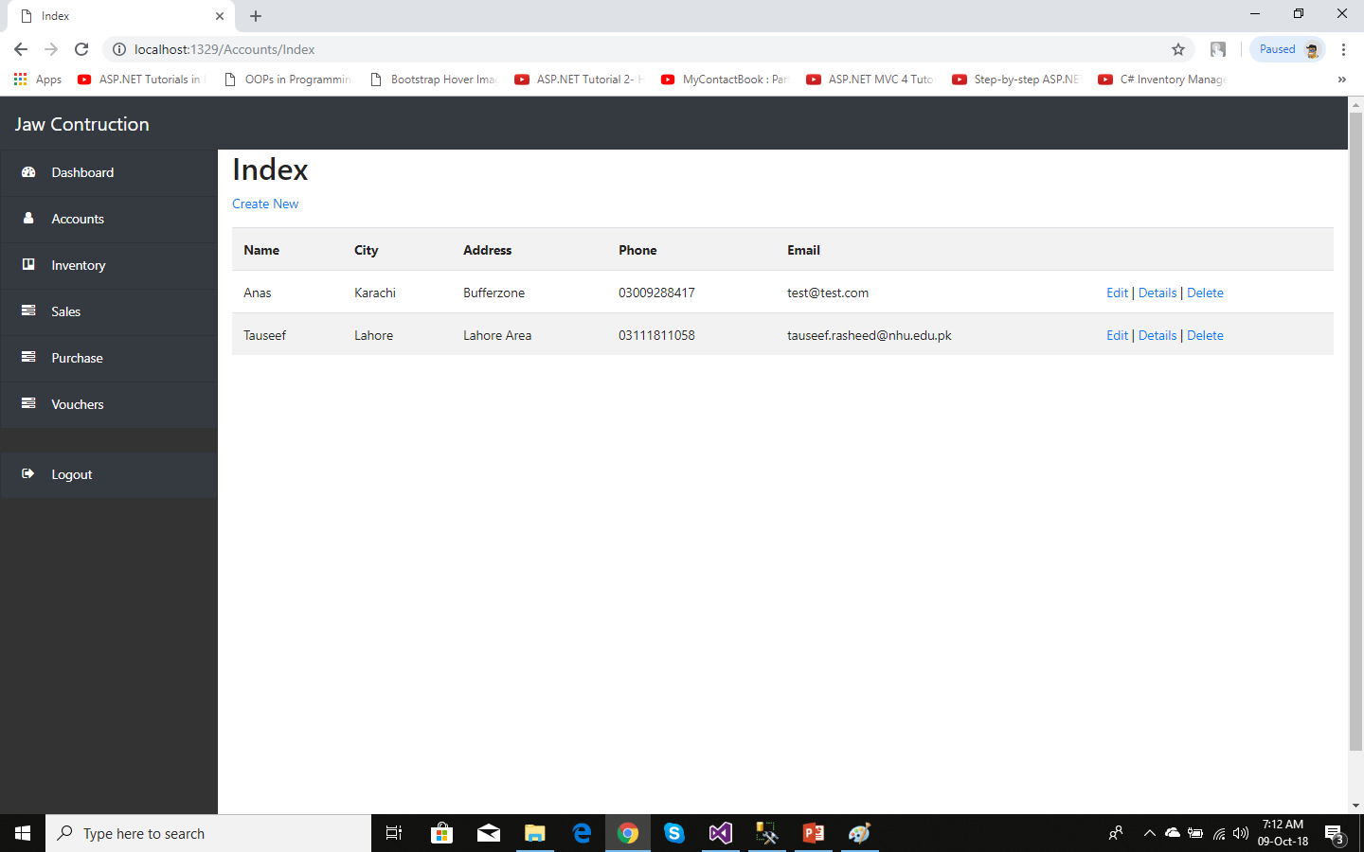
Accounts :

Slide 10
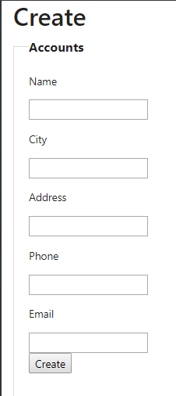
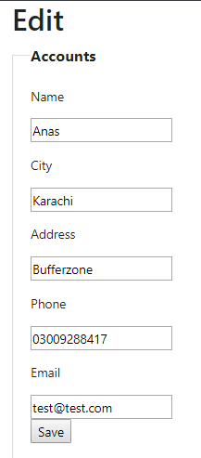
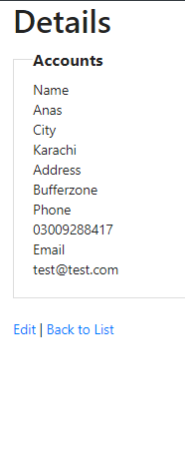
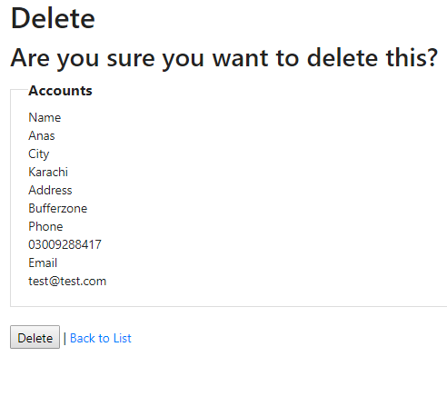
Accounts (Read / Write) Views

Slide 11
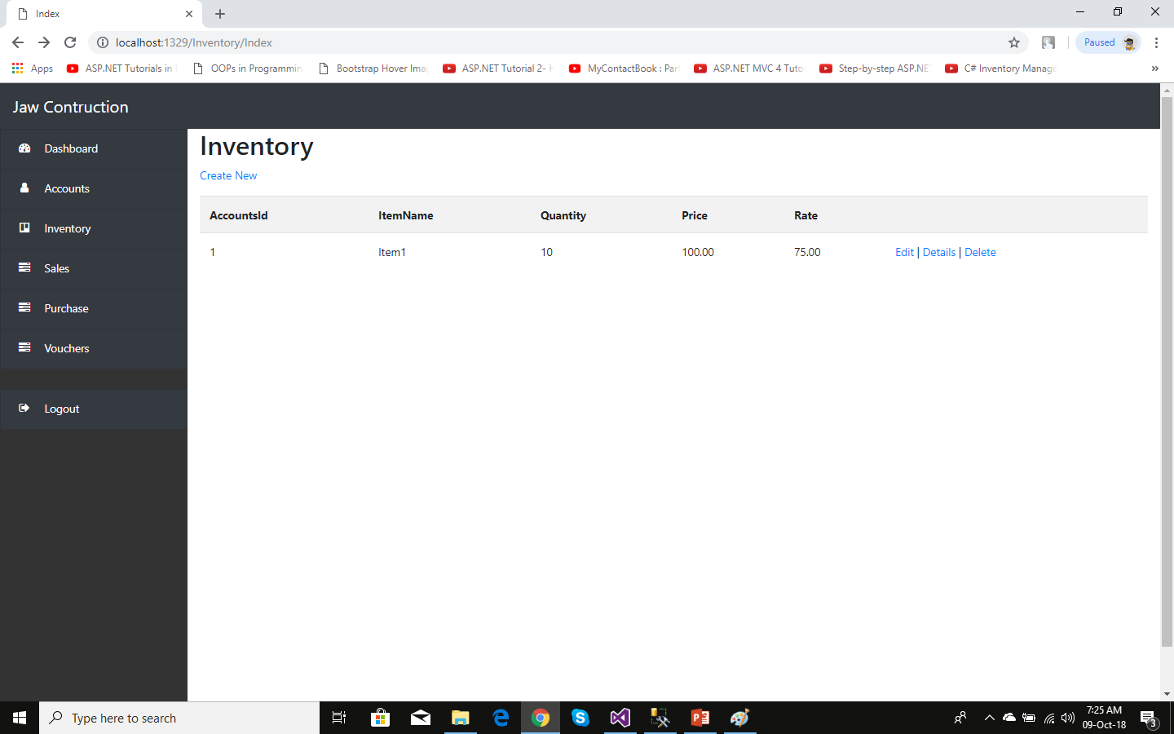
Inventory:

Slide 12
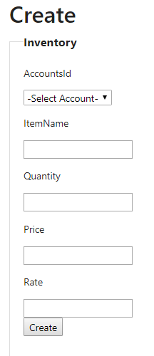
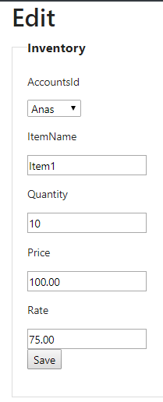
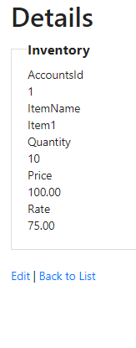
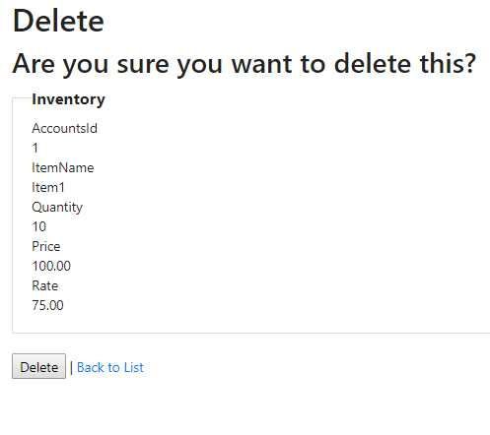
Inventory (Read / Write) Views

Slide 13
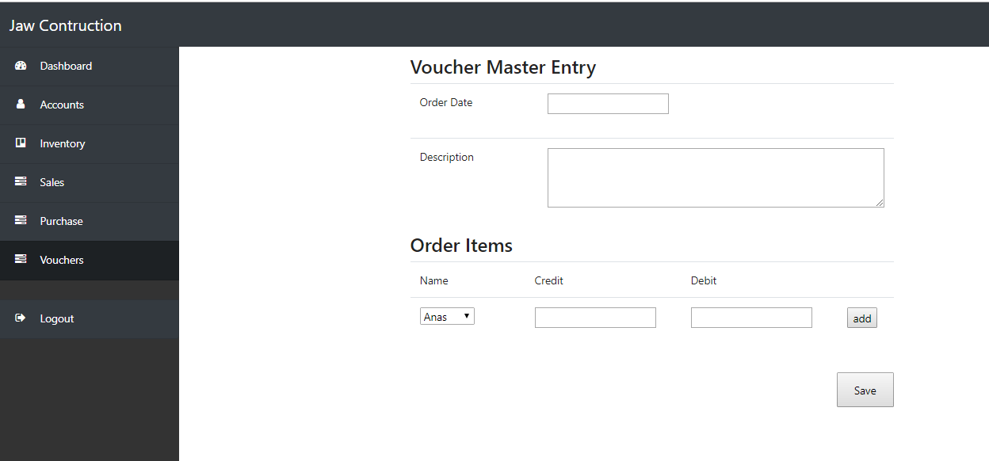
Master Detail Entry (Voucher)

Slide 14
what is left:
Master Detail Entry (Sales/ Purchase).
Reports of vouchers/ sales / purchase Transactions.
Design of dashboard
Thesis Write up

Slide 15
Work plan:
Month Required | Work Plan
1st month | Literature review , workflow, analysing problems and requirements.
2nd month | Planning structure of the system.
3rd month | Learning of the different technologies.
4th month | Database Design

Slide 16
Work plan:
Month Required | Work Plan
5th month | Designing and Programming
6th month | Designing and Programming
7th month | Designing &Testing
8th month | Thesis Write-Up

Slide 17


