Slide 1
My notes on git

Slide 2
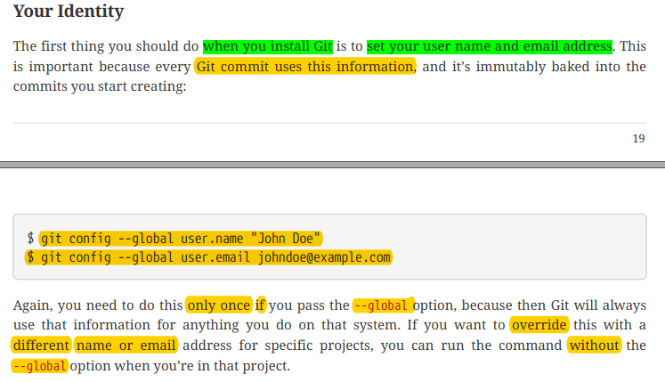

Slide 3
How to clone a repo and work and push?
git clone url_of_the_repo
It will clone the repo into your current dir
cd repo_name
To move inside the cloned repo folder
git add .
To stage all the changes u made
git add finename
To stage specific file name

Slide 4
Continued
git add *.txt
To stage all the txt files
git commit –m “ write some commit message here“
git push origin master

Slide 5
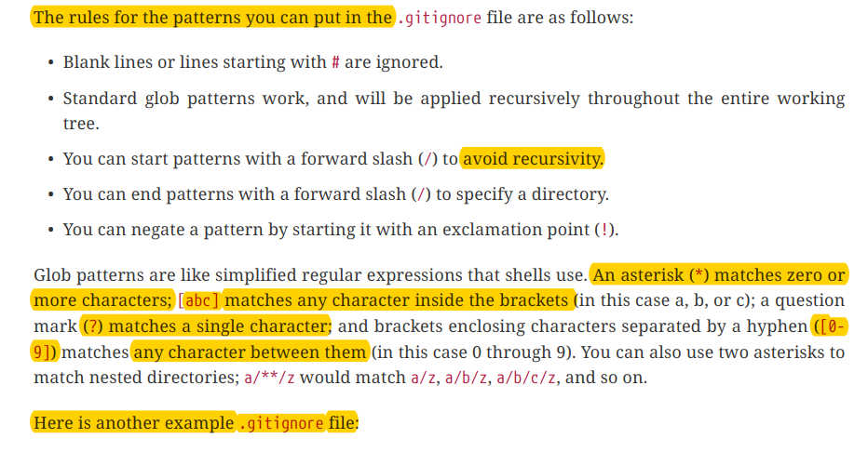
Everything about .gitignore

Slide 6
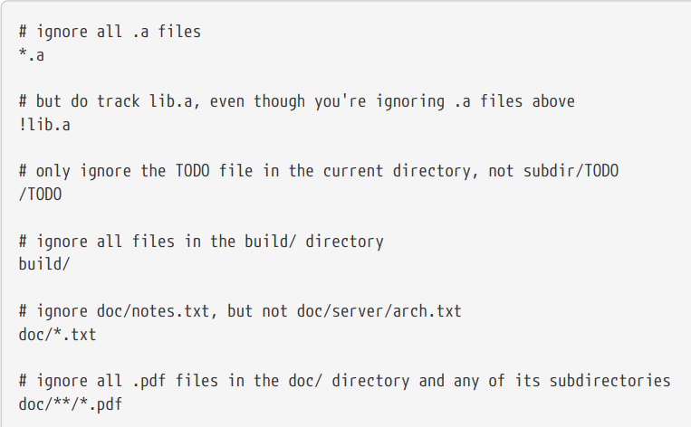
.gitignore (cont’d)

Slide 7
Commands

Slide 8
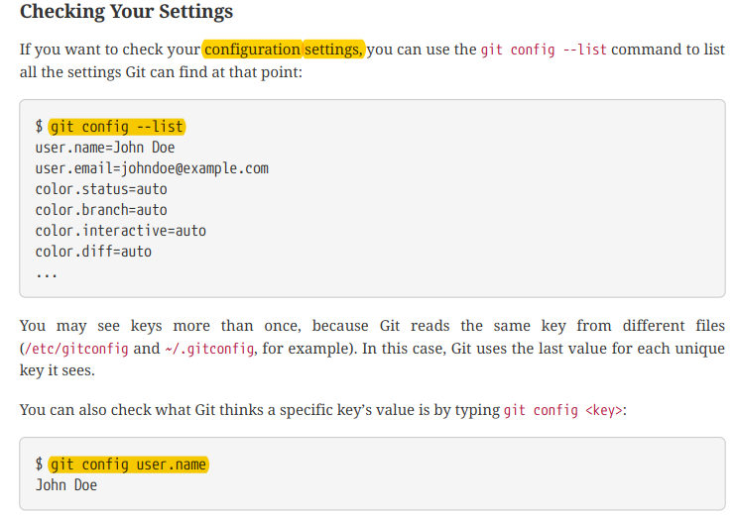
git --version

Slide 9
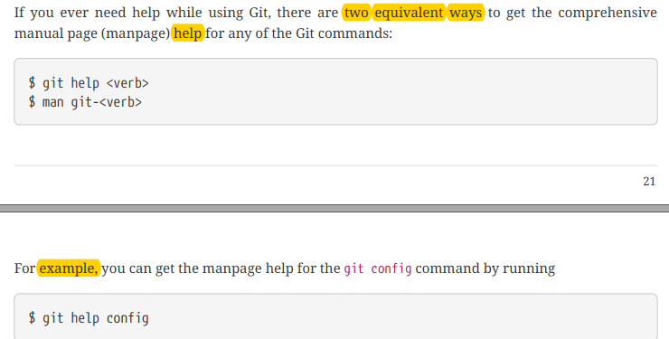

Slide 10
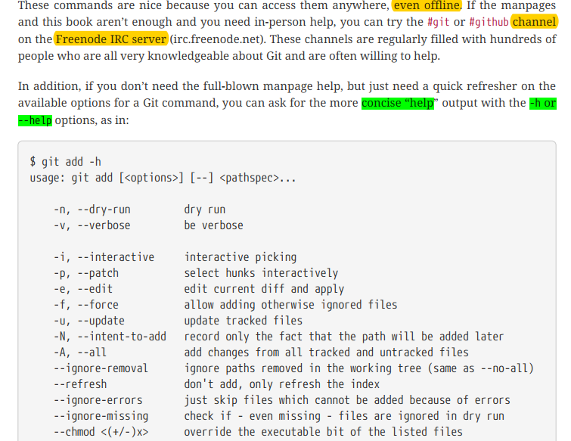

Slide 11
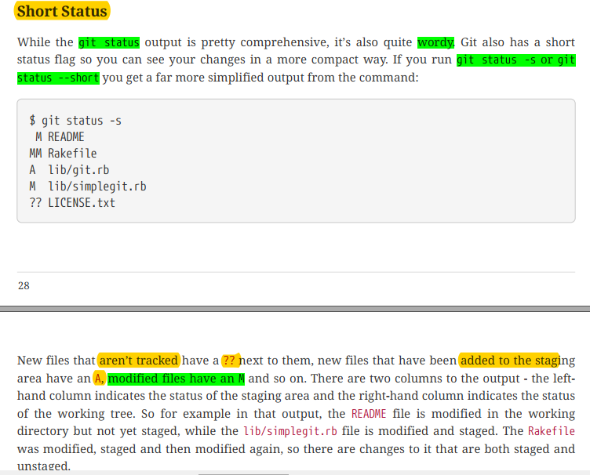

Slide 12
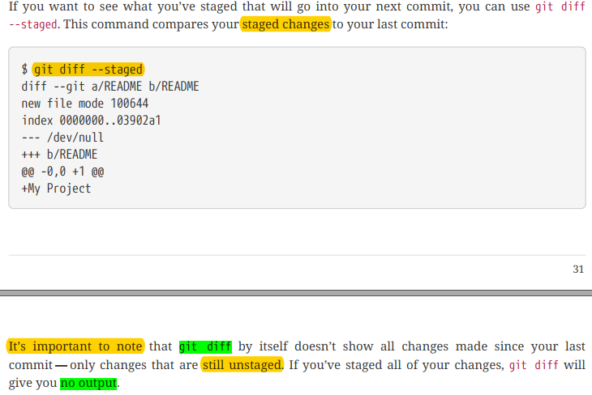

Slide 13
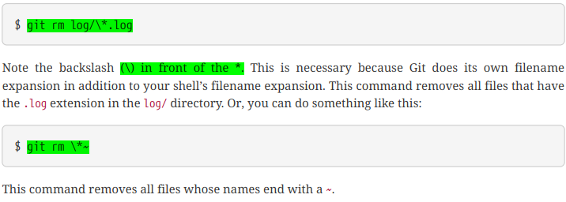


Slide 14
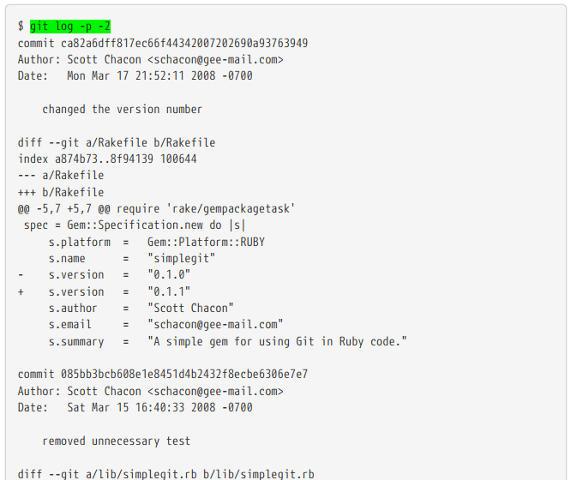

Slide 15
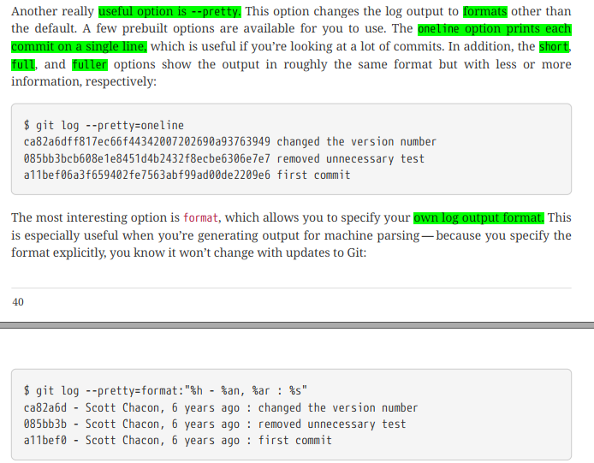

Slide 16
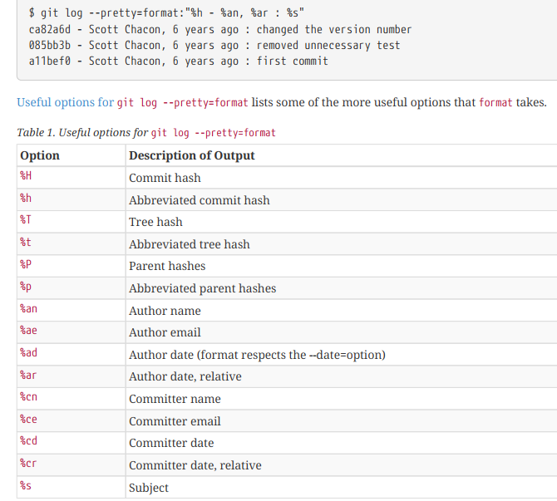

Slide 17
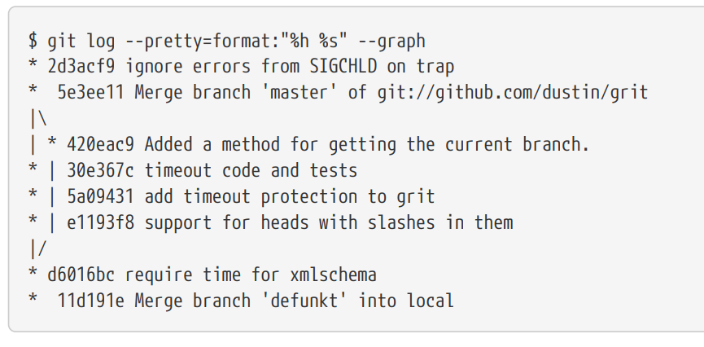

Slide 18
