Slide 1
My notes on git

Slide 2
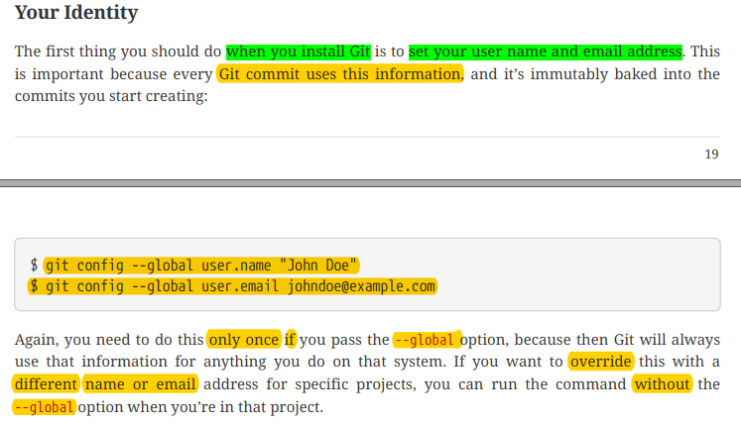

Slide 3
How to clone a repo and work and push?
git clone url_of_the_repo
It will clone the repo into your current dir
cd repo_name
To move inside the cloned repo folder
git add .
To stage all the changes u made
git add filename
To stage specific file name

Slide 4
Continued
git add *.txt
To stage all the txt files
git commit –m “ write some commit message here“
git pull
Remote repo may have new updates, so local needs to be updated
git push origin master
More generally – git push origin branch_name

Slide 5
Branching
How it works?
When we create a new branch, a new copy of the repo is created. Whatever changes we make in this branch stays in that copy until we commit the branch and merge it to the master branch
Suppose, alice and bob are working on a same project. Alice wants to add feature A and bob wants to add feature B to the project. Now what they will do is they both create a branch and add their feature to that branch, then finally merge the branches to master (main project)
Usually branches are deleted after merging to the master branch

Slide 6
Branching
Creating a branch :
git checkout –b “branch_name”
Example : git checkout –b “new-branch”
Checkout meaning you will move to new branch that you just created
Switching between branches:
git checkout branch_name
Example : git checkout master
Delete a branch
git branch –d branch_name
git branch –D branch_name (incase you are deleting a unmerged branch)

Slide 7
Branching
Merging two branches:
command : git merge branch_name
Updates as “current_branch = current_branch U branch_name”
Example : git merge main
Say, you are in branch “b”,
Above command will change b to b = b U main ;
but main branch will remain unchanged
Merge conflict
What if two branches change the same file, git doesn’t know how to merge
Easy way : fix manually inside the file.
After showing merge conflict error, git adds some indicator inside the file to help manual conflict removal

Slide 8
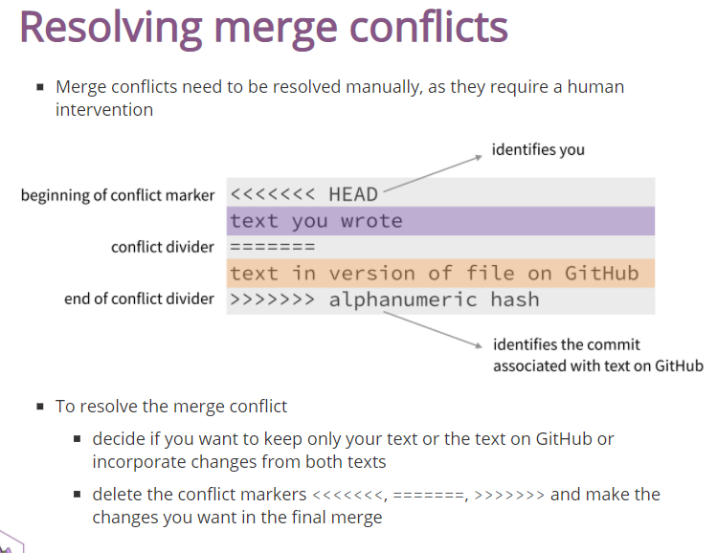

Slide 9
Fork
How it works?
Suppose, I want to edit “github.com/spondon/offline” repository
But I don’t have edit access. So, I’ll fork that repo which will create a copy repo of that repo. So after forking, I’ll find a new repo “github.com/anasmoni/offline” in my account which I can edit.
So, it’s useful when you want to customize a open source software
We fork from UI instead of writing command

Slide 10
Pull
You found a bug in “github.com/spondon/offline” repo. You forked it. Fixed the bug. And you want spondon to adopt the fix into his repo. So what you will do is make a pull request to spondon’s repo. Now spondon will be notified with the request and can response anyway.
git pull demo : https://youtu.be/rgbCcBNZcdQ

Slide 11
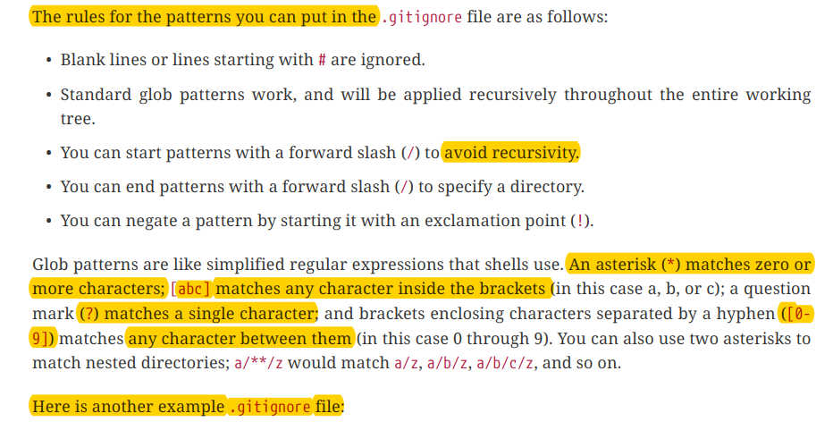
Everything about .gitignore

Slide 12
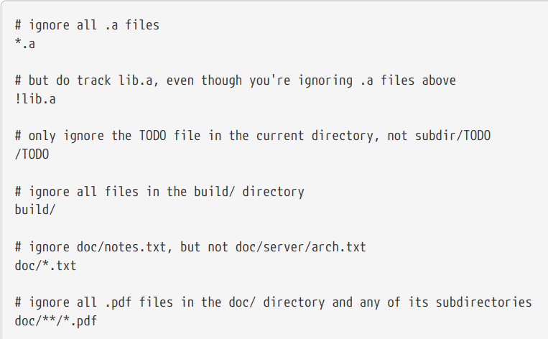
.gitignore (cont’d)

Slide 13
Commands

Slide 14
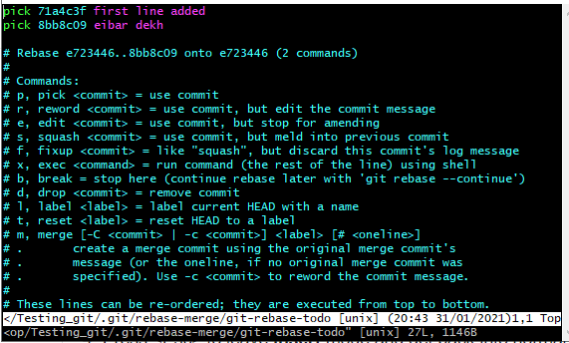
Steps to quite the above vim window. 1. press “i” to enter into insert mode , do editing task 2. press “esc” “:“ “w” “q” 3. hit enter

Slide 15
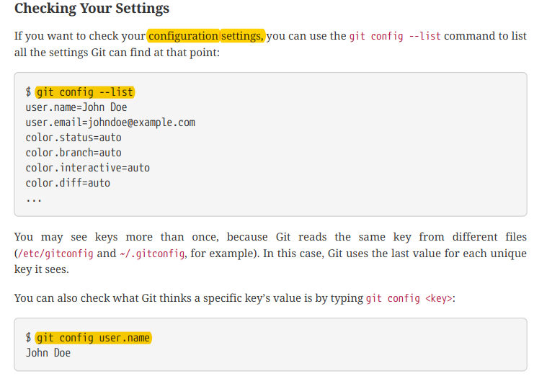
git --version

Slide 16
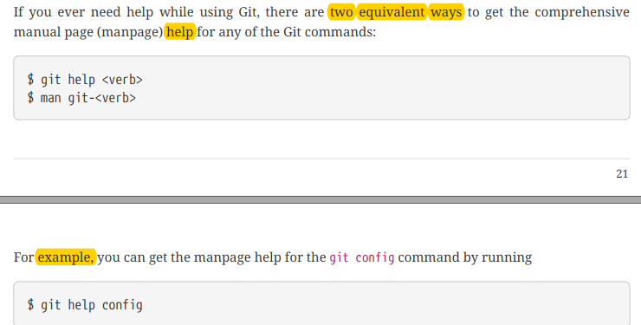
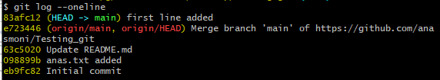

Slide 17
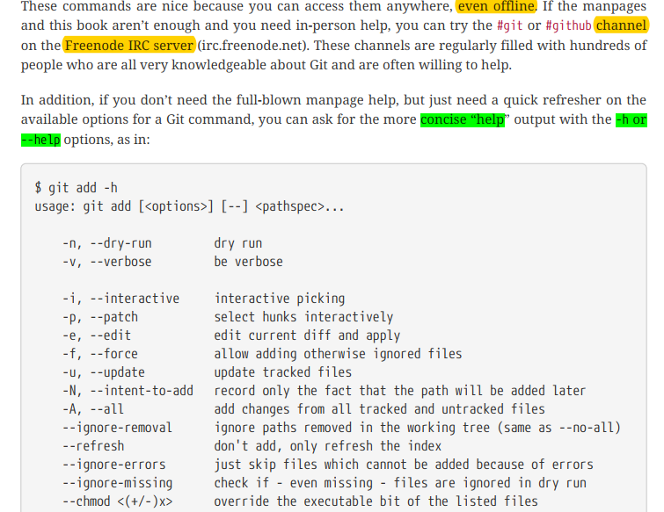

Slide 18
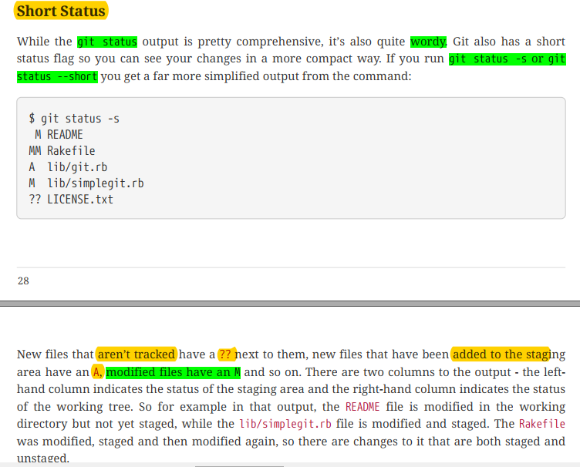

Slide 19
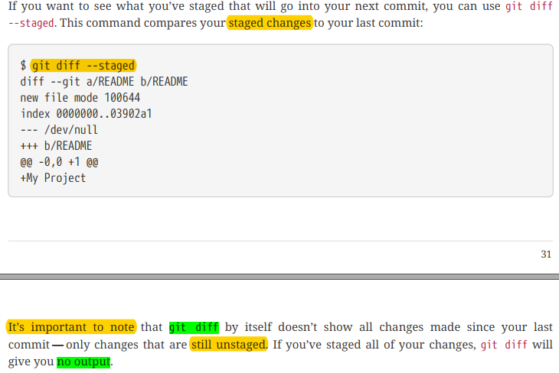

Slide 20
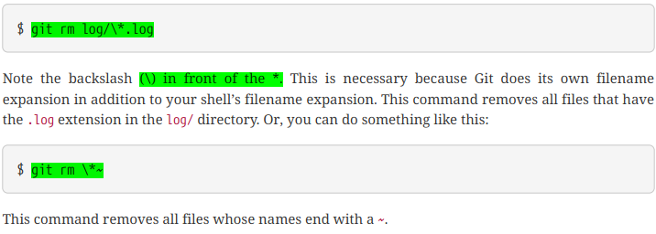


Slide 21
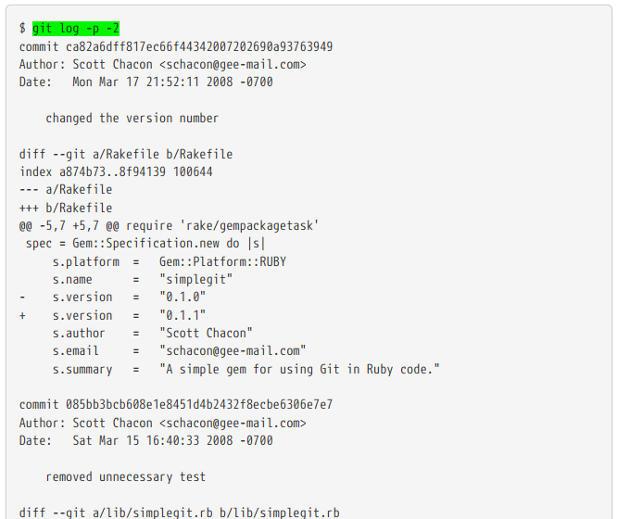

Slide 22
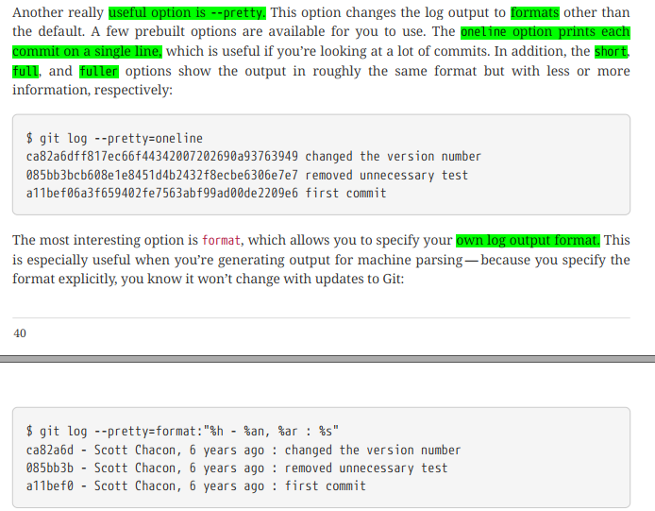

Slide 23
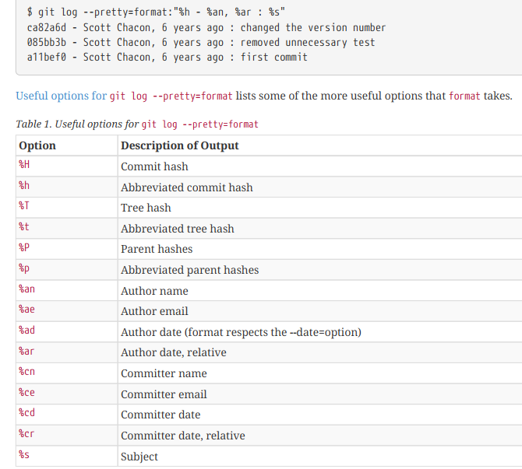

Slide 24
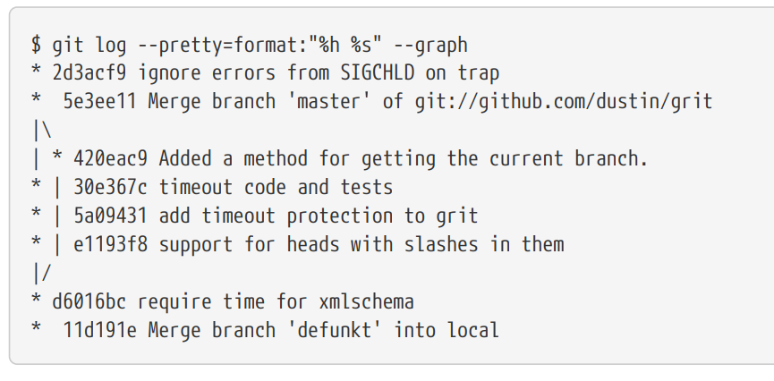

Slide 25
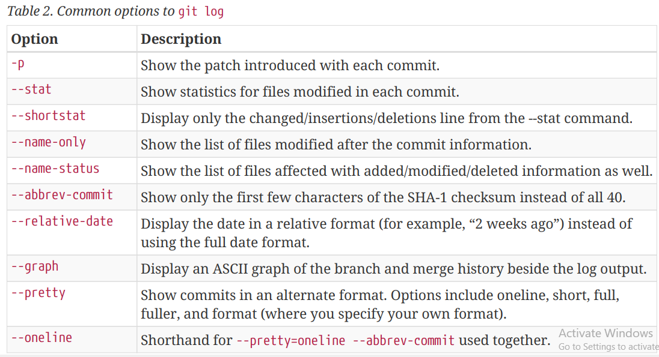

Slide 26
git commit --amend --no-edit
Adds your newly staged changes to the last commit
No-edit option tells that you don’t want to reword(change the commit message) .
If you want to edit commit message then write
“ git commit --amend “ hit enter , a vim window will show up
Press “i” for insert mode in vim
Change the commit message
Press “esc” then “:” “w” “q” then hit enter
working with commit
git rebase -i HEAD~2
Meaning , operate on last two commits from head
A vim window will show up, which will allow you to operate on commits

