Slide 1
My notes on git

Slide 2
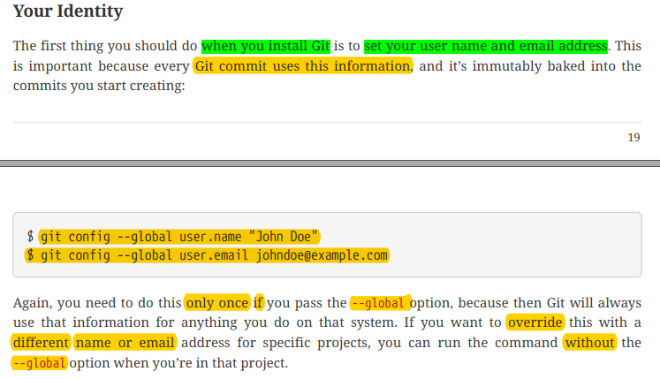

Slide 3
How to clone a repo and work and push?
git clone url_of_the_repo
It will clone the repo into your current dir
cd repo_name
To move inside the cloned repo folder
git add .
To stage all the changes u made
git add filename
To stage specific file name

Slide 4
Continued
git add *.txt
To stage all the txt files
git commit –m “ write some commit message here“
git push origin master
More generally – git push origin branch_name

Slide 5
Branching
Creating a branch :
git checkout –b “branch_name”
Example : git checkout –b “new-branch”
Checkout meaning you will move to new branch that you just created
Switching between branch:
git checkout branch_name
Example : git checkout master

Slide 6
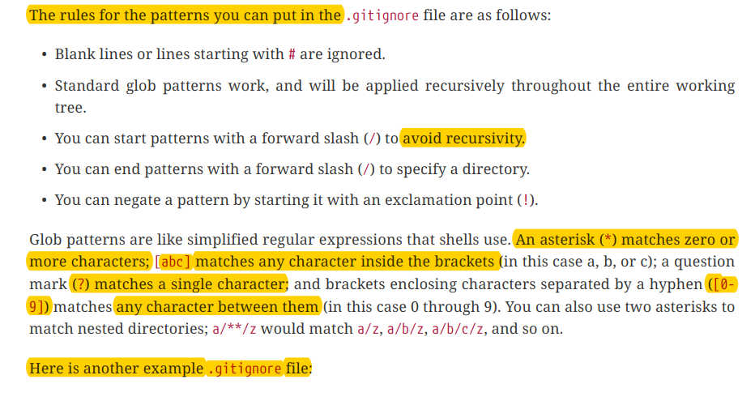
Everything about .gitignore

Slide 7
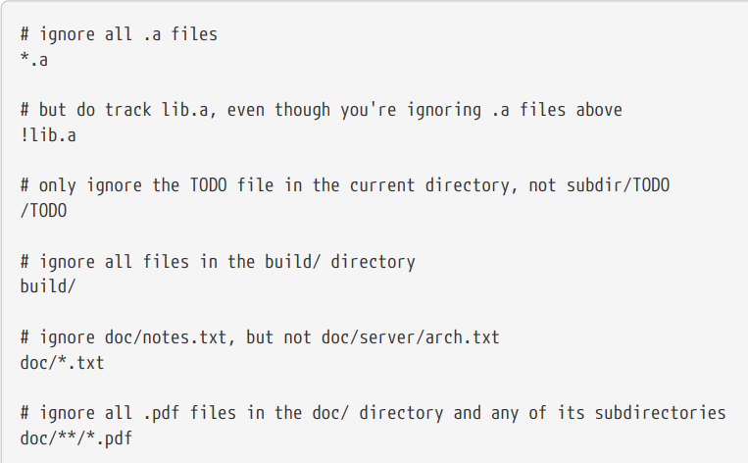
.gitignore (cont’d)

Slide 8
Commands

Slide 9
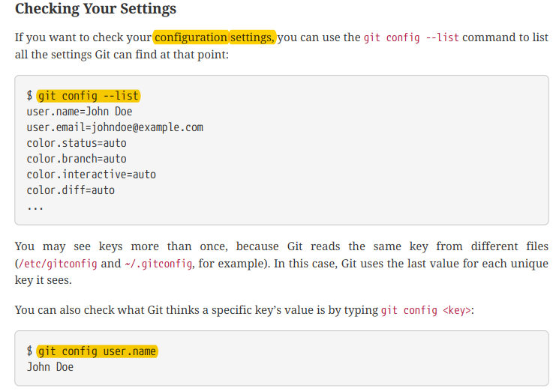
git --version

Slide 10
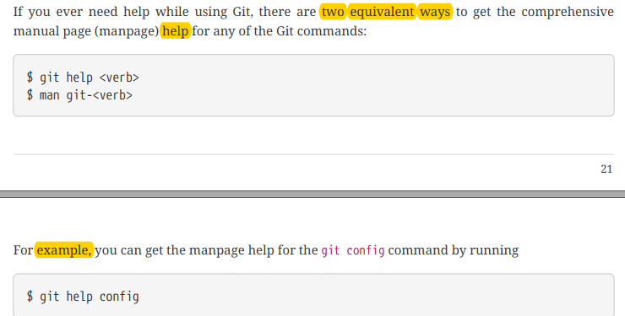

Slide 11
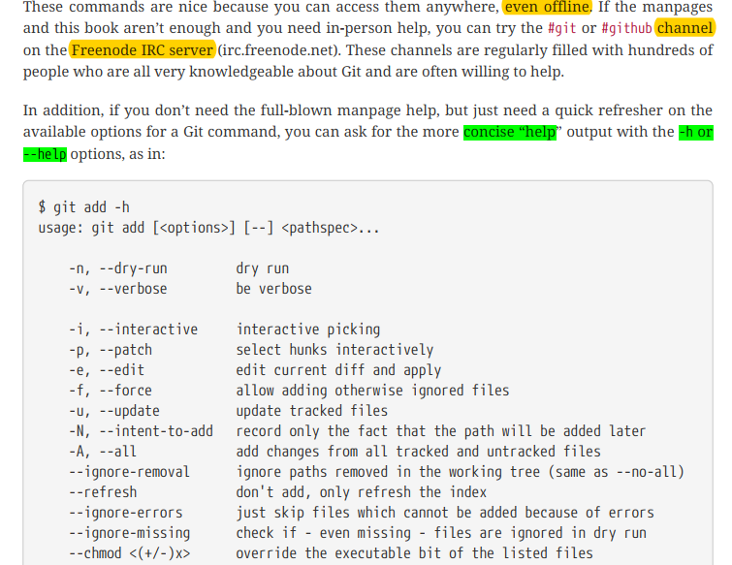

Slide 12
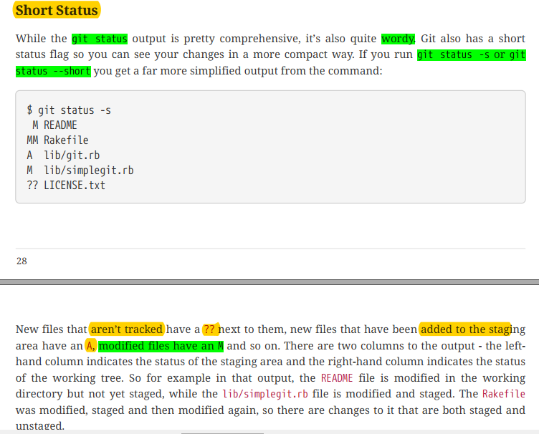

Slide 13
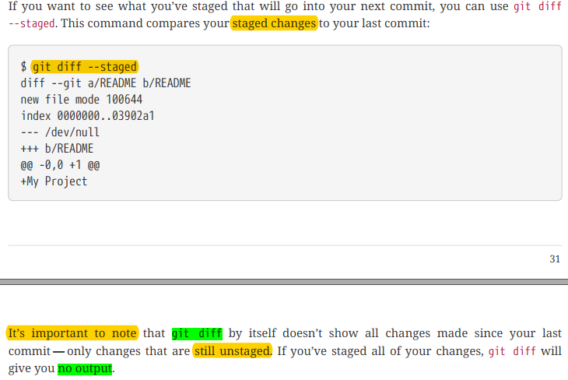

Slide 14
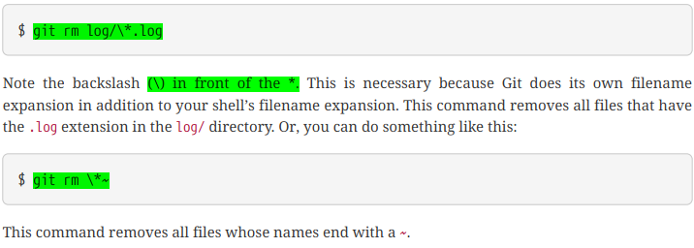


Slide 15
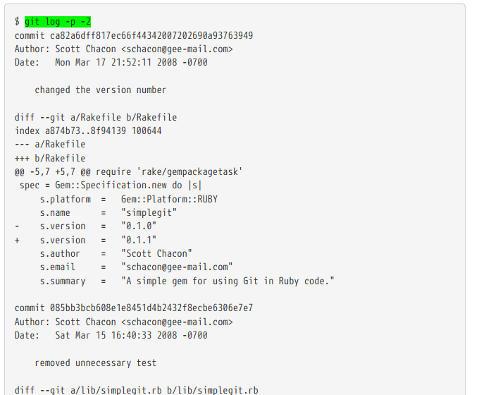

Slide 16
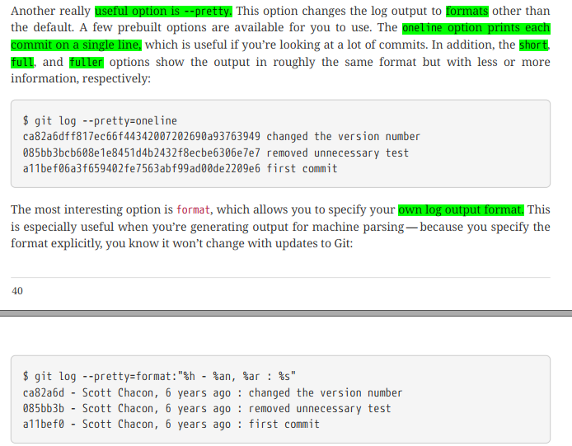

Slide 17
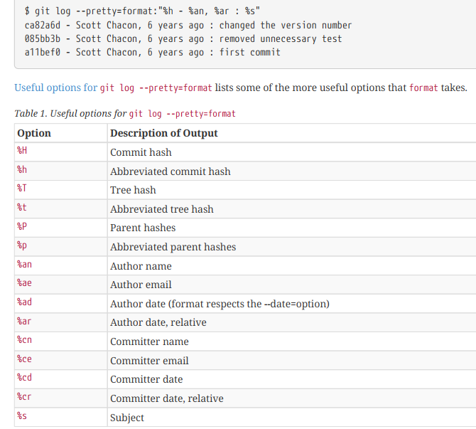

Slide 18
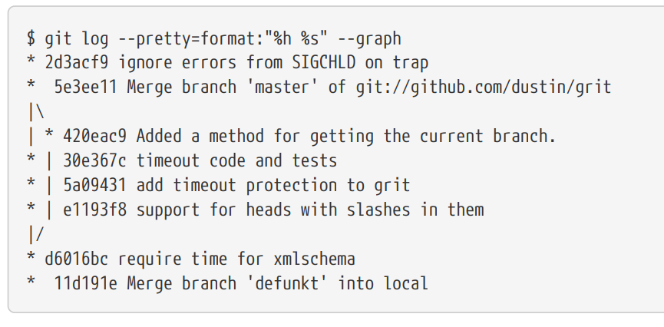

Slide 19
