Slide 1

Intrusion detection using machine learning MD. ANAS STD.NO. 1505087 MD. SAYEDUZZAMAN STD. NO. 0405035 SUPERVISED BY - DR. MD. MONIRUL ISLAM (Sr)

Slide 2
Presentation Outline
Introduction
Previous works
Motivation
Problem statement
Program
Future direction and conclusion

Slide 3
Introduction
Intrusion detection system (IDS)
monitors a network or systems for malicious activity or policy violations.
reports intrusion activities to an administrator.
has scope from single computers to large networks.
Classifications
Network intrusion detection systems (NIDS)
analyzes incoming network traffic.
Host based intrusion detection systems (HIDS)
e.g. monitors important operating system files

Slide 4
Introduction(cont’d)
Signature-based detection
Looks for “known patterns” in database
Low false alarm rate , accurate and fast
Unable to detect new type of attack
“Only strong as its rule set”
Anomaly-based detection
Tracks unknown unique behavior pattern.
Uses machine learning techniques.
Helps to reduce the “limitations problem”
High false alarm rate..

Slide 5
Previous Works
Intrusion Detection Using Error Correcting Output Code Based Ensemble (S. M. AbdElrahman, Ajith Abraham, 2014)
Used methods
Meta learning ensemble Methods
One-against-all (OAA)
One-against-one (OAO)
Error correcting code (ECOC).
Bottleneck : No feature selection method

Slide 6
Previous Works(cont’d)
Critical study of neural networks in detecting intrusions
(Rachid Beghdad,2008)
Used methods
Multilayer perceptron (MLP),
Generalized feed forward (GFF),
Self-organizing feature maps (SOFMs), Error correcting code (ECOC).
Principal component analysis networks (PCAs)
false alarm rate (8.16%)
Bottleneck :High false alarm rate

Slide 7
Previous Works(cont’d)
Wrapper Model
(Ron Kohavi, George H. John, 1997)
Finds subset of features from the feature space
Uses search techniques such as Sequential, Complete or Random Search
Measures accuracy of that generated feature subset using learning algorithm.
Support Vector Machine (SVM)
Artificial Neural Network (ANN)
Nearest Neighbor
Bottleneck : Computationally expensive

Slide 8
Previous Works(cont’d)
Hybrid Approach
(Manoranjan Dash, Huan Liu,1997.)
Combination of both filter and wrapper approach.
Uses intrinsic property of the dataset along with ML algorithm
Removes extremely redundant features through filter approach
Remaining features are applied in wrapper approach.

Slide 9
Motivation
Data quality affects the accuracy of data mining algorithms.
Two important aspects
data relevance
data redundancy
Concerns
allow algorithms to operate faster
improvement of accuracy of data mining algorithm
relevance of features
pairwise features correlation
redundant , irrelevant features affect accuracy of learning algorithms

Slide 10
Problem Statement
Improvement of detection rate of network attacks such as DOS, U2R, R2L and Probe by extracting appropriate features set.

Slide 11
Correlation metrics for feature extraction
Two correlation metrics
Decision independent correlation (DIC)
Decision dependent correlation (DDC)
Considerations
Dependency among the features,
Dependency with respect to a given data mining task
Removing data redundancy.

Slide 12
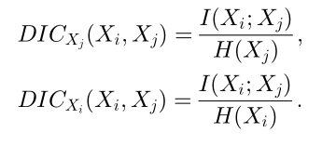

DIC metric Quantifies the relevance and the correlation among features .
I(Y;X) = mutual information between decision Y and features X
H(X) = uncertainty of feature X
DIC : decision independent correlation
0 <= DIC$(X_{i},X_{j})$ <= 1
DIC$(X_{i},X_{j})$ = 0
features Xi and Xj are uncorrelated.
DIC$(X_{i},X_{j})$ = 1
Full prediction between the features

Slide 13


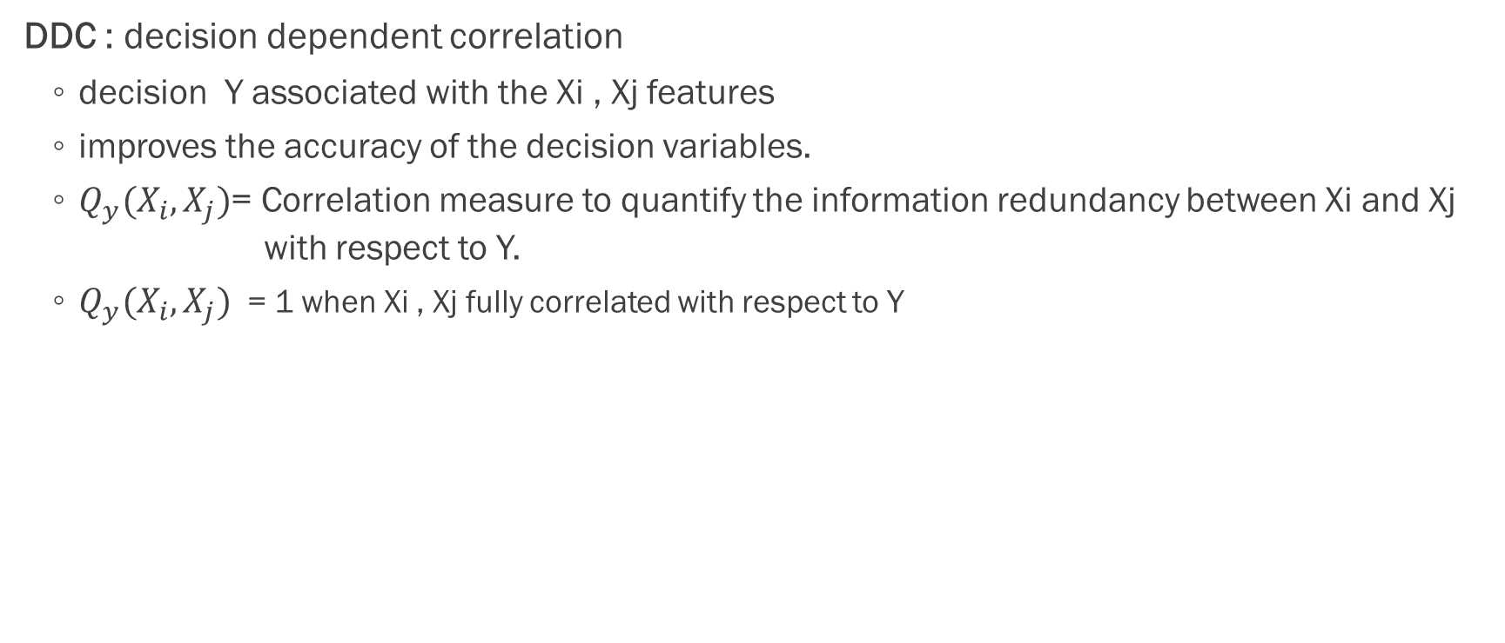
DDC metric
DDC : decision dependent correlation
decision Y associated with the Xi , Xj features
improves the accuracy of the decision variables.
$Q_{y}(X_{i},X_{j})$= Correlation measure to quantify the information redundancy between Xi and Xj with respect to Y.
$Q_{y}(X_{i},X_{j})$ = 1 when Xi , Xj fully correlated with respect to Y

Slide 14

Features set evaluation
S : Feature subset
e(S) = subset evaluation measure
an evaluation heuristic
specifies a subset of features with regard to the decision functions
DDC regarded as the penalty.
the bigger e(S), the better the feature subset

Slide 15
Feature Extraction Algorithm (FEA)
Goal
Select the minimum set of features
Select strongly related features to the desired decision variable
Decrease redundancy among features.
Two functional modules.
Focusing on removing irrelevance.
Focusing on eliminating redundancy

Slide 16
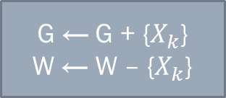

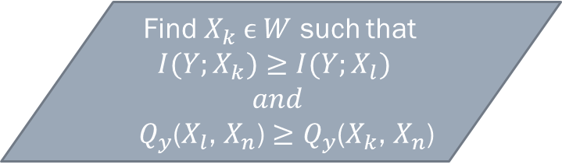
Feature Extraction Algorithm (FEA)
Start
Generate relevant features set R
W = NULL?
No
Yes
Yes
Find $X_{k} ϵ W$ such that
$${I(Y;X}_{k})≥{I(Y;X}_{l})$$
$$and$$
${{ Q}_{y}\text{(}X_{l}\text{,} X_{n}\text{)}≥Q}_{y}$($X_{k}$, $X_{n}$)
Goal set G= NULL
Working set W = R
e(G)<$λ_{2}$?
No
End
G ← G + {$X_{k}$}
W ← W – {$X_{k}$}

Slide 17
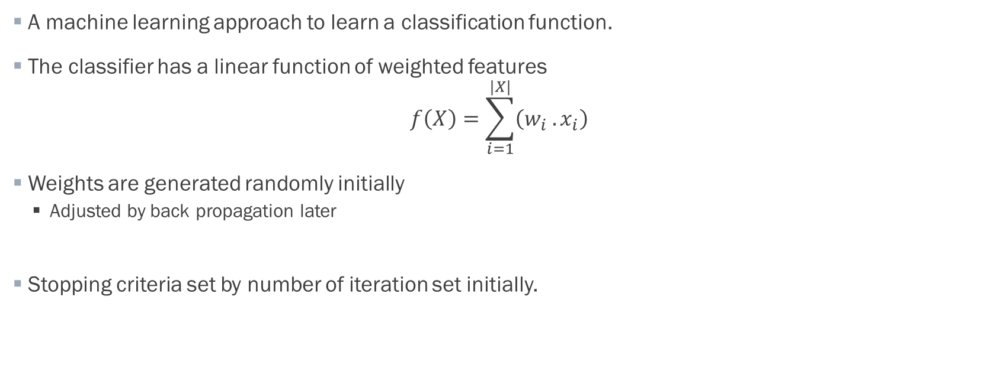
Classification Algorithm (CA)
A machine learning approach to learn a classification function.
The classifier has a linear function of weighted features $f\left(X\right)=\sum_{i=1}^{|X|}{\left(w_{i} .x_{i}\right)}$
Weights are generated randomly initially
Adjusted by back propagation later
Stopping criteria set by number of iteration set initially.

Slide 18


Classification Algorithm (CA)
Data discretization
Yes
Iteration>0
Yes
Update weights
Data normalization
No
Initialize weights
Calculate and print Accuracy
Predict testing Data
and Update count
Apply classifier
on training data
Iteration = Iteration − 1

Slide 19
Final Intrusion Detection System (IDS)
Start
Data pre-processing
FEA
Learning classifier
End

Slide 20
Future direction and conclusion:
DDC and the subset evaluation heuristic metric can be used to select the proper feature subset.
Based on these features, the Learning algorithm can be a better classifier than sequential selection strategy.
In future we will try to improve the accuracy, currently it is around 60%.

Slide 21
THANK YOU

