Slide 1

Intrusion detection using machine learning MD. ANAS STD.NO. 150587 MD. SAYEDUZZAMAN STD. NO. 0405035

Slide 2
Presentation Outline
Introduction
Previous works
Motivation
Problem statement
Program
Future direction and conclusion

Slide 3
Introduction
Intrusion detection system (IDS) is defined as
any unauthorized attempt to access,
modify or destroy information,
or render the system unreliable or unusable .
It detects this type of activities by
monitoring events
and searching for signatures or behavior that indicate intrusions.

Slide 4
Introduction(cont’d)
Machine learning based IDS system learns to classify events based on
knowledge obtained from the training set.
Training set is the set of network connection records formed from a raw network data.
It can capture the complex properties of the attack behavior
It improve the detection accuracy and speed than conventional signaturebased IDS.

Slide 5
Previous works
Intrusion Detection Using Error Correcting Output Code Based Ensemble (Shaza Merghani AbdElrahman and Ajith Abraham)
Used method :
Meta learning ensemble Methods,
Multi-class Binary Classification Methods,
One-against-all(OAA),
One-against-one(OAO),
Error correcting code(ECOC).
Shortcomings: Here no feature selection is implemented , also no data pre-processing is done.

Slide 6
Previous works (cont’d)
Critical study of neural networks in detecting intrusions (Rachid Beghdad,2008)
Used method :
Multilayer perceptron(MLP),
Generalized feed forward(GFF),
Radial basis function/generalized regression/probabilistic (RBF/GR/P),
Self-organizing feature maps (SOFMs),
Principal component analysis networks (PCAs).
The detection rate (93.83%) and false alarm rate (6.16%)
Bottleneck:
Low detection rate of U2R, PRB, and R2L attacks

Slide 7
Previous Works(cont’d)
Wrapper Model
(Ron Kohavi, George H. John, 1997)
Finds subset of features from the feature space
Uses search techniques such as Sequential, Complete or Random Search
Measures accuracy of that generated feature subset using learning algorithm.
Support Vector Machine (SVM)
Artificial Neural Network (ANN)
Nearest Neighbor
Bottleneck : Computationally expensive

Slide 8
Previous Works(cont’d)
Hybrid Approach
(Manoranjan Dash, Huan Liu,1997.)
Combination of both filter and wrapper approach.
Uses intrinsic property of the dataset along with ML algorithm
Removes extremely redundant features through filter approach
Remaining features are applied in wrapper approach.

Slide 9
Motivation
Data quality affects the accuracy of data mining algorithms.
Two important aspects
data relevance
data redundancy
Concerns:
allow algorithms to operate faster
improvement of prediction and accuracy of data mining algorithm. .
relevance of features
pairwise features correlation
redundant ,irrelevant features affect accuracy of learning algorithms

Slide 10
Problem Statement
Improvement of detection rate of network attacks such as DOS,U2R,R2L and Probe by improving data quality.
Dataset Used : KDD99

Slide 11
A New Dependency and Correlation Analysis for Features
Consideration :
dependency among the features,
dependency with respect to a given data mining task
Removing data redundancy.

Slide 12
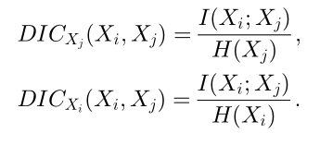
New metric ! Quantifies the relevance and the correlation among features .
I(Y;X) = mutual information between decision Y and features X
H(X) = uncertainty of feature X
DIC : decision independent correlation
0 <= DIC(Xi, Xj) <= 1
DIC(Xi, Xj) = 0
features Xi and Xj are uncorrelated.
DIC(Xi, Xj) = 1
Full prediction between the features

Slide 13


New metric ! (cont’d)
DDC : decision dependent correlation
decision Y associated with the Xi , Xj features
improves the accuracy of the decision variables.
Q_y(Xi,Xj) = Correlation measure to quantify the information redundancy between Xi and Xj with respect to Y.
Q_y(Xi,Xj) = 1 when Xi , Xj fully correlated with respect to Y

Slide 14

New metric ! (cont’d)
S : Feature subset
e(S) = new subset evaluation measure
an evaluation heuristic
specifies a subset of features with regard to the decision functions
DDC regarded as the penalty.
the bigger e(S), the better the feature subset

Slide 15
Feature Extraction Algorithm (FEA)
Based on DDC
Goal
select the minimum set of features
Select strongly related features to the desired decision variable
Decrease redundancy among features.
Two functional modules.
Focusing on removing irrelevance.
Focusing on eliminating redundancy

Slide 16
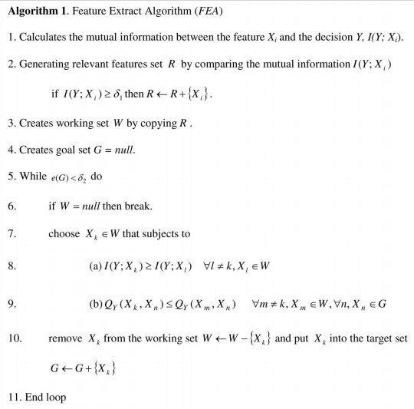

Slide 17
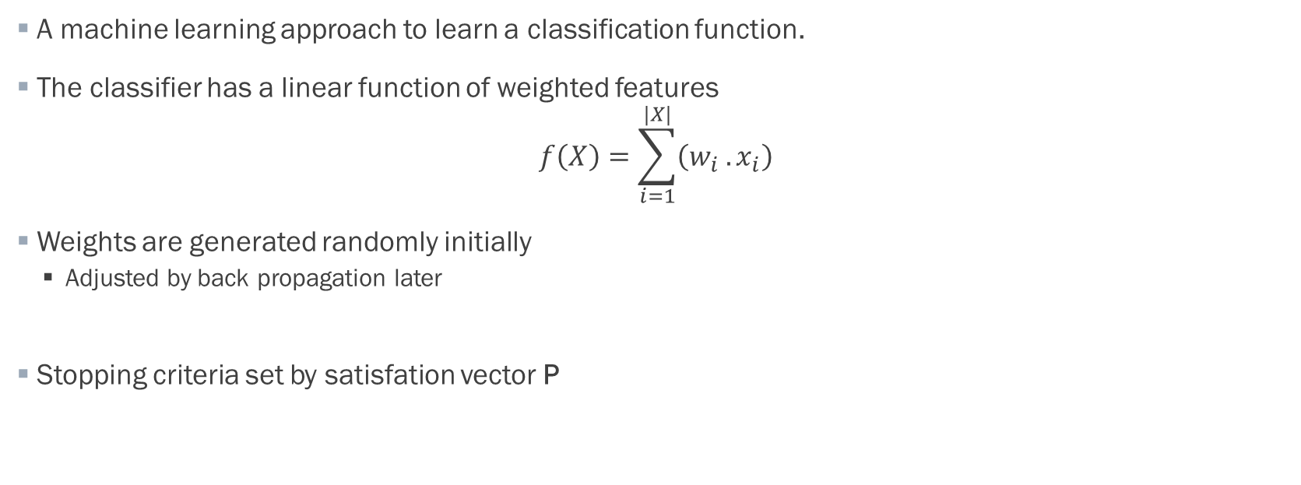
Classification Algorithm (CA)
A machine learning approach to learn a classification function.
The classifier has a linear function of weighted features $f\left(X\right)=\sum_{i=1}^{|X|}{\left(w_{i} .x_{i}\right)}$
Weights are generated randomly initially
Adjusted by back propagation later
Stopping criteria set by satisfation vector P

Slide 18
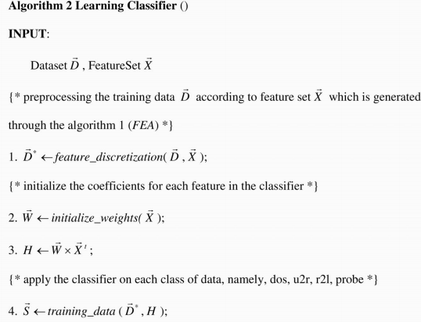
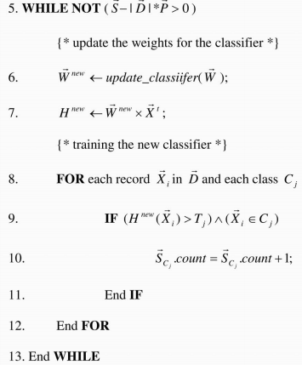

Slide 19
Future direction and conclusion:
We should add pre-processing step for removing duplicate data .
At feature extraction algorithm , we would first divide the data in normal and attacks, then we will consider only the attacks to improve accuracy and reduce the false positive rate.

Slide 20
THANK YOU

