Slide 1
A New Dependency and Correlation Analysis for Features by - Guangzhi Qu, Salim Hariri, Mazin Yousif.

Slide 2
Concern:
relevance of features
pairwise features correlation
improvement of prediction and accuracy of data mining algorithm.
allow algorithms to operate faster .
redundant ,irrelevant features affect accuracy of learning algorithms
Consideration :
dependency among the features,
dependency with respect to a given data mining task
Removing data redundancy.
What’s new?
a new feature correlation metric
feature subset merit measure
Quantifies the relevance and the correlation among features .

Slide 3
FEATURE EXTRACTION TECHNIQUES
Filter
uses general characteristics of the training data
operates independently of any learning algorithm.
good choice in case of large # of features.
Wrappers
evaluates attributes by learning algorithm.
computationally expensive

Slide 4
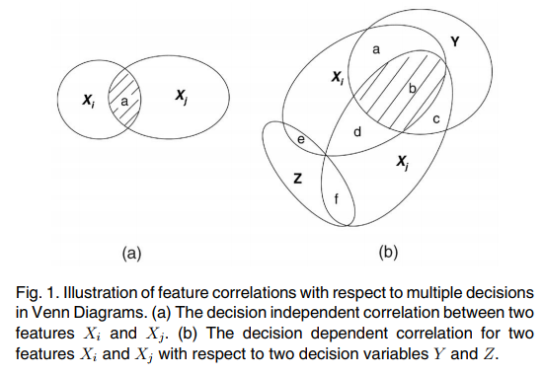
CORRELATION ANALYSIS MEASURE
Qualifies the accuracy of decision

Slide 5


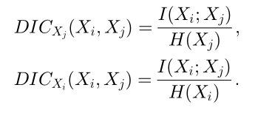
New metric !!
Definitions:
I(Y;X) = mutual information between decision Y and features X
I(X;Y) =
Where , f(x) = probability of event X=x occurring
H(X) = uncertainty of feature X
Where , p_i = probability of ith feature
DIC : decision independent correlation
0 <= DIC(Xi, Xj) <= 1
DIC(Xi, Xj) = 0
features Xi and Xj are uncorrelated.
DIC(Xi, Xj) = 1
Full prediction between the features

Slide 6
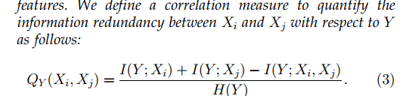

New metric !! (contd)
DDC : decision dependent correlation
decision Y associated with the Xi , Xj features
improves the accuracy of the decision variables.
Q_y(Xi,Xj) = 1 when Xi , Xj fully correlated with respect to Y

Slide 7

New metric !! (contd)
S : Feature subset
e(S) = new subset evaluation measure
an evaluation heuristic
specifies a subset of features with regard to the decision functions
DDC regarded as the penalty.
the bigger e(S), the better the feature subset

Slide 8
Feature Extraction Algorithm (FEA)
Based on DDC
Goal
select the minimum set of features
Select strongly related features to the desired decision variable
Decrease redundancy among features.
Two functional modules.
Focusing on removing irrelevance.
Focusing on eliminating redundancy

Slide 9
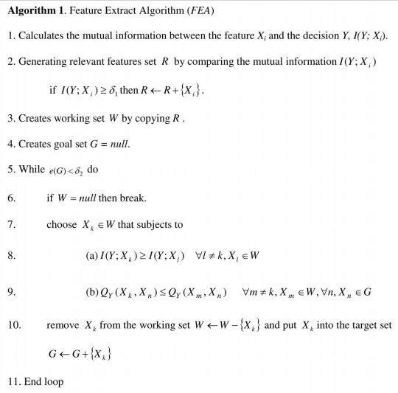

Slide 10
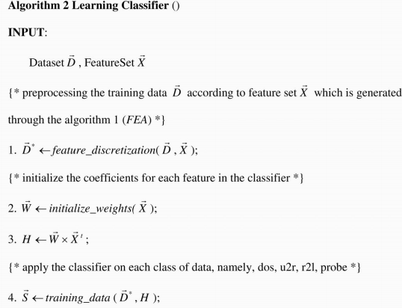
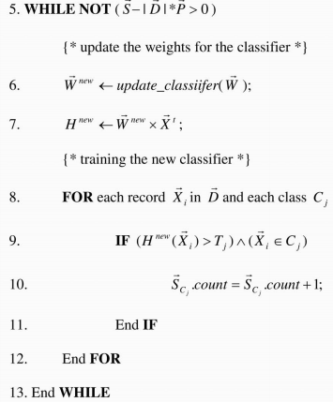

Slide 11
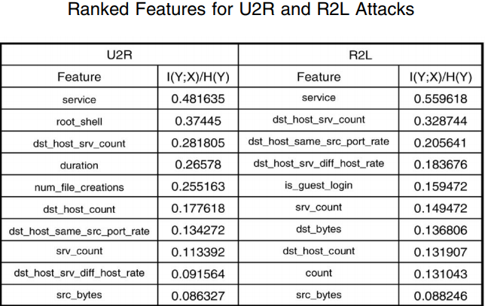
Features

Slide 12
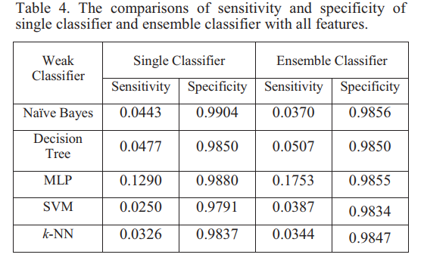
EXPERIMENTAL RESULT

Slide 13
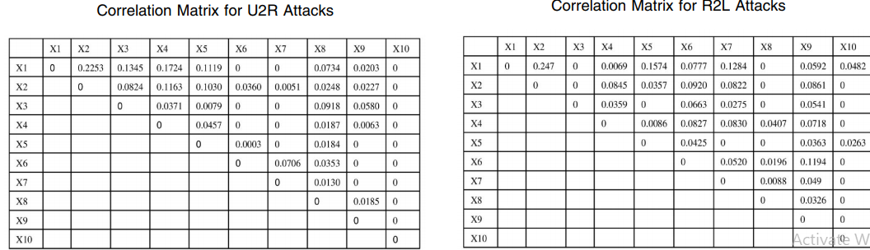
Calculating DDC among the features
obtained two correlation matrices

Slide 14
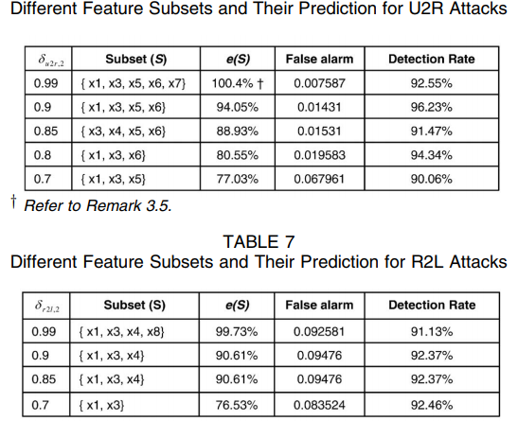

Slide 15
Conclusion
An efficient algorithm for feature extraction is proposed
Data quality maintained during data preparation period
irrelevance and redundancy information is removed
Found a better classifier compared to the sequential selection strategy.
Significant improvement in the detection of most difficult to detect U2R and R2L attacks

