Slide 1
QuadratiCa

Slide 2
Traditional Methods
Encapsulation
Multiple Inheritance
Composition
Modern Codes
Exception Handling

Slide 3
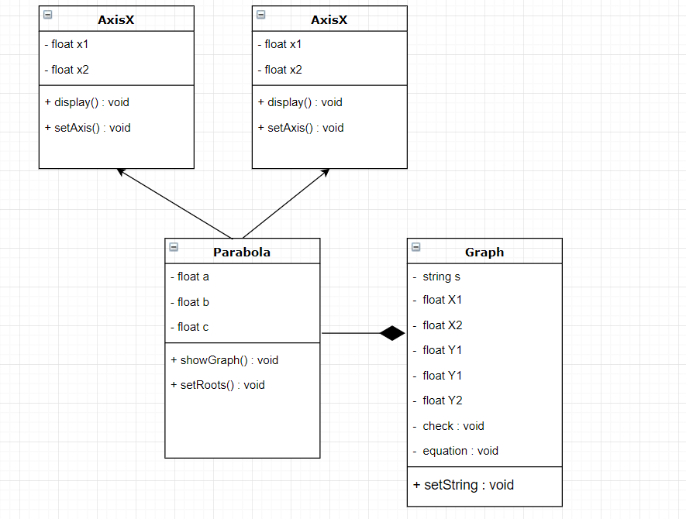

Slide 4
Relationship
X-Axis is a range of parabola
Y- Axis is a range of parabola
Graph has a parabola function

