Slide 1
Azure Kubernetes Service
Anantha Krishnan
anantha1708@gmail.com

Slide 2
Agenda
Docker Overview
Kubernetes Overview
Demo

Slide 3
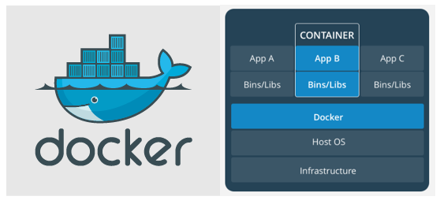
Docker

Slide 4
Kubernetes
Orchestration docker containers.
Open source
Designed by Google and maintained by Cloud Native Computation Foundation.

Slide 5
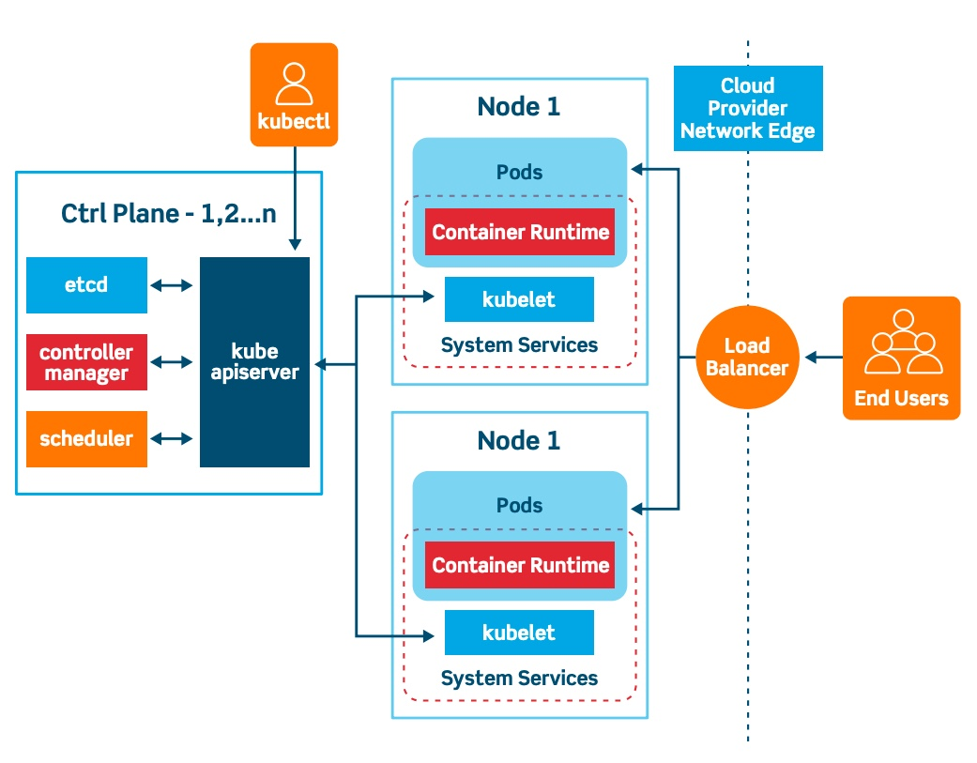
Kubernetes

Slide 6
Demo

Slide 7
Open Question

Slide 8
Reference
Demo sources - https://github.com/anasokan/azure_kubernetes
Kubectl commands - https://kubernetes.io/docs/reference/kubectl/cheatsheet/
Docker commands - https://www.docker.com/sites/default/files/d8/2019-09/docker-cheat-sheet.pdf
Azure cli commands - https://docs.microsoft.com/en-us/azure/virtual-machines/linux/cli-manage

Slide 9
Thanks

