Slide 1

Introduction to Accounting Management
Accounting management is the strategic oversight and control of a company's financial records and reporting. It involves planning, organizing, and directing the accounting function to ensure accurate and timely financial information for decision-making.
Ma
by M ajameih

Slide 2

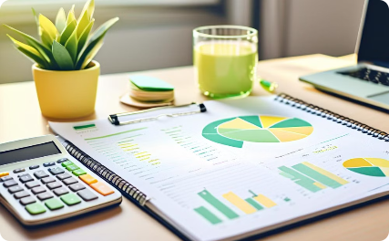

Importance of Accounting in Business
Financial Decision-Making
Regulatory Compliance
Performance Monitoring
Accounting provides crucial financial data to help managers make informed decisions about resource allocation, budgeting, and strategic planning.
Proper accounting practices ensure a business remains compliant with tax laws and financial reporting requirements.
Accounting records track a company's financial performance, allowing managers to identify trends, measure profitability, and make adjustments.

Slide 3
Principles and Concepts of Accounting
1
Accrual Basis Accounting
2
Double-Entry Bookkeeping
Revenues and expenses are recognized when they are earned or incurred, regardless of when cash is received or paid.
Every business transaction is recorded as a debit and a credit, ensuring the accounts are always in balance.
3
Generally Accepted Accounting Principles (GAAP)
4
Matching Principle
Revenues and the expenses associated with earning those revenues are recognized in the same accounting period.
A set of standardized accounting rules and guidelines that ensure financial reporting is consistent and comparable.

Slide 4
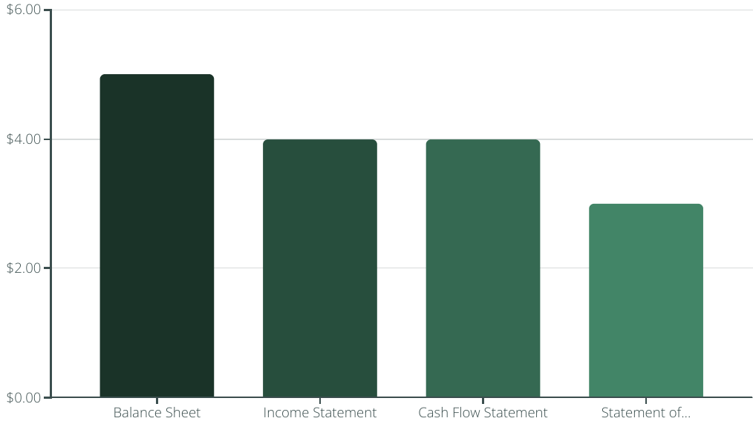
Financial Statements and Their Analysis
Financial statements are crucial in understanding a business's financial health and performance. They provide a comprehensive overview of a company's assets, liabilities, equity, income, expenses, and cash flows.
Analyzing these financial statements helps managers and stakeholders understand a company's profitability, liquidity, solvency, and overall financial health, enabling them to make informed decisions.

Slide 5




Budgeting and Forecasting
Establish Goals
Define clear financial objectives for the business, such as revenue targets, cost reductions, or profit margins.
Analyze Past Performance
Review historical data to identify trends, patterns, and areas of potential improvement in the company's finances.
Build Budgets
Develop detailed budgets that allocate resources and expenses across departments, projects, and time periods.
Forecast Future Scenarios
Create financial projections and forecasts to anticipate potential challenges and opportunities that may arise.

Slide 6
Cash Flow Management
Forecasting Cash Needs
Receivables Management
Accurately predicting cash inflows and outflows to ensure sufficient funds for operations and growth. This involves analyzing historical data and making projections based on business plans and market conditions.
Optimizing the collection of accounts receivable to maintain a healthy cash position. This includes efficient invoicing, credit policies, and collection strategies.
Payables Management
Liquidity Planning
Strategically managing payments to vendors and suppliers to maintain good relationships and leverage cash discounts while ensuring timely payments.
Ensuring the business has adequate cash reserves and access to financing to weather unexpected events and take advantage of opportunities.

Slide 7
Accounts Receivable and Payable
Accounts Receivable
Accounts Payable
Reconciliation
Automation
Regularly reconcile accounts receivable and payable records to ensure accuracy and identify any discrepancies.
Leveraging technology, such as accounting software and automation tools, can streamline accounts receivable and payable processes, reducing manual errors and improving overall efficiency.
Efficiently managing accounts receivable is crucial for maintaining a healthy cash flow. This involves tracking outstanding customer invoices, setting clear payment terms, and implementing effective collection strategies to ensure timely payments.
Carefully managing accounts payable helps optimize cash flow and strengthen relationships with suppliers. This includes processing vendor invoices, negotiating favorable payment terms, and ensuring timely payments to maintain a good credit standing.
Implement effective tracking systems to monitor aging accounts, minimize late payments, and identify potential issues early.
Collaborate with both customers and suppliers to address any payment-related concerns and maintain strong business relationships.

Slide 8

Inventory Management
Effective inventory management is crucial for businesses to optimize costs, meet customer demands, and maintain a healthy cash flow. This involves techniques such as forecasting, stock rotation, and just-in-time ordering to ensure the right products are available at the right time.
Leveraging technology like inventory management software, barcoding, and RFID can provide real-time visibility and automate processes to drive efficiency. Proper inventory controls and auditing also help prevent stock obsolescence and shrinkage.

Slide 9



Fixed Asset Management
Asset Valuation
Asset Maintenance
Asset Tracking
Accurately calculating the value of fixed assets is crucial for financial reporting and tax purposes. This involves depreciation, impairment, and other accounting methods.
Proactive maintenance of fixed assets helps extend their useful life and ensures optimal performance. Establishing a preventive maintenance program is key.
Implementing an effective asset tracking system allows you to monitor the location, usage, and condition of your fixed assets, enabling better decision-making.

Slide 10



Payroll and Tax Compliance
Payroll Processing
Tax Compliance
Employee Benefits
Accurate and timely payroll processing is crucial, ensuring employees are paid correctly and on time.
Staying up-to-date with ever-changing tax regulations and properly withholding and remitting taxes is essential to avoid penalties.
Managing employee benefits like healthcare, retirement plans, and paid time off is an integral part of payroll and compliance.

Slide 11
Financial Reporting and Auditing
Financial reporting is the process of communicating a company's financial information to stakeholders, including investors, regulators, and the public. This includes the preparation and distribution of financial statements, such as the balance sheet, income statement, and cash flow statement.
Auditing is the independent examination of a company's financial records and procedures to ensure accuracy, compliance, and the fair presentation of its financial position. Audits are conducted by external, independent auditors to provide an objective assessment of a company's financial health.
Financial Reporting
Auditing
Communicates financial information to stakeholders
Evaluates accuracy and reliability of financial information
Includes financial statements (balance sheet, income statement, cash flow)
Conducted by independent external auditors
Demonstrates a company's financial position and performance
Provides an objective assessment of a company's financial health

Slide 12
Cost Accounting and Control
1
Identifying Costs
2
Cost Allocation
Classify costs into categories like direct materials, direct labor, and overhead to understand the true cost of producing a product or delivering a service.
Distribute overhead costs across products or departments using appropriate allocation methods to ensure accurate cost information for decision-making.
3
Variance Analysis
4
Budgeting and Forecasting
Compare actual costs to standard or budgeted costs to identify areas of efficiency or overspending, enabling targeted cost control measures.
Develop detailed budgets and forecasts to anticipate future resource needs and plan for cost-effective operations.

Slide 13
Managerial Decision-Making
1
Identify Goals
Clearly define the objectives and desired outcomes.
2
Gather Data
Collect relevant financial and operational information.
3
Analyze Alternatives
Evaluate different scenarios and their potential impacts.
Make a Decision
4
Choose the best course of action based on the analysis.
Effective managerial decision-making is a critical aspect of accounting management. It involves a structured process of identifying goals, gathering relevant data, analyzing alternatives, and ultimately making an informed decision that aligns with the organization's objectives. This approach helps managers optimize financial performance, mitigate risks, and drive continuous improvement.

Slide 14

Technology in Accounting Management
Accounting management has been transformed by advancements in technology. Modern accounting software, cloud computing, and data analytics tools have revolutionized how businesses track finances, generate reports, and make informed decisions.
Automated accounting systems streamline processes, reduce errors, and provide real-time insights. Cloud-based solutions enable remote access and collaboration, while data visualization tools make complex financial data more accessible.
Technology empowers accountants to focus on strategic, advisory roles, leveraging artificial intelligence and machine learning to automate mundane tasks and uncover hidden opportunities.

Slide 15
Continuous Improvement in Accounting Practices
Embrace Technology
Ongoing Training
Adopt cloud-based accounting software and automation tools to streamline processes, reduce errors, and enhance productivity.
Invest in continuous professional development for your accounting team to stay up-to-date with industry best practices and regulations.
Analyze and Optimize
Collaborate Across Teams
Regularly review financial data, identify areas for improvement, and implement changes to boost efficiency and financial reporting accuracy.
Foster cross-functional collaboration between accounting, finance, and other departments to align goals and drive continuous improvement.

