Slide 1
Online Shopping Website
prepared by group [5]

Slide 2
Outlines:
Purpose
Main functionality
System components design
State Diagram
Sequence Diagram
Class Diagram
Data Structures
Detail design of User interface
task management and reallocation

Slide 3
Purpose
An online shopping website that providing products that everyone can buy without actually need to visit the store and he/she can add or remove the products from the cart easily

Slide 4
Main functionality
Items
Clicking on an item it will display the item name, price, categories, item description and reviews. The user can add the item to the cart or the favorite list.
Favorite list
The users can see the list of their favorite items as a shortlist for later reference.
Tagging
The website suggests new items that may interest the user based on his/her previous purchases or visits to products that have the same tag.
Payment
we are dealing with the mode of payment by cash on delivery or credit cards.

Slide 5
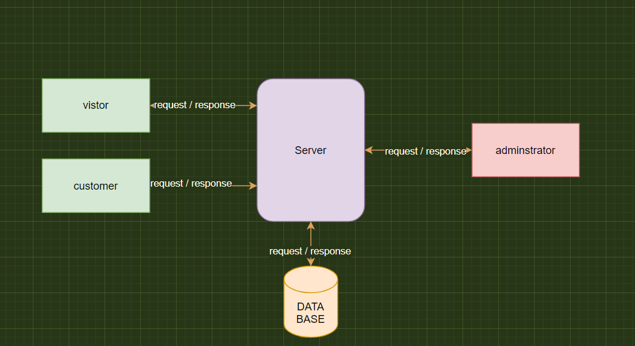
System components design

Slide 6
Features -
Visitors can visit the site without registration and they can see the products.
Customers have to LOGIN hence they must have a valid login name and password , also customers have SETTINGS so they can view/edit their personal details,and also have PURCHASING so they can buy products through a valid credit card.
Administrator has a DATABASE MANAGEMENT to control all database details ,and also has PERMISSION to give the vendors access to sell their products after testing the quality of products.

Slide 7
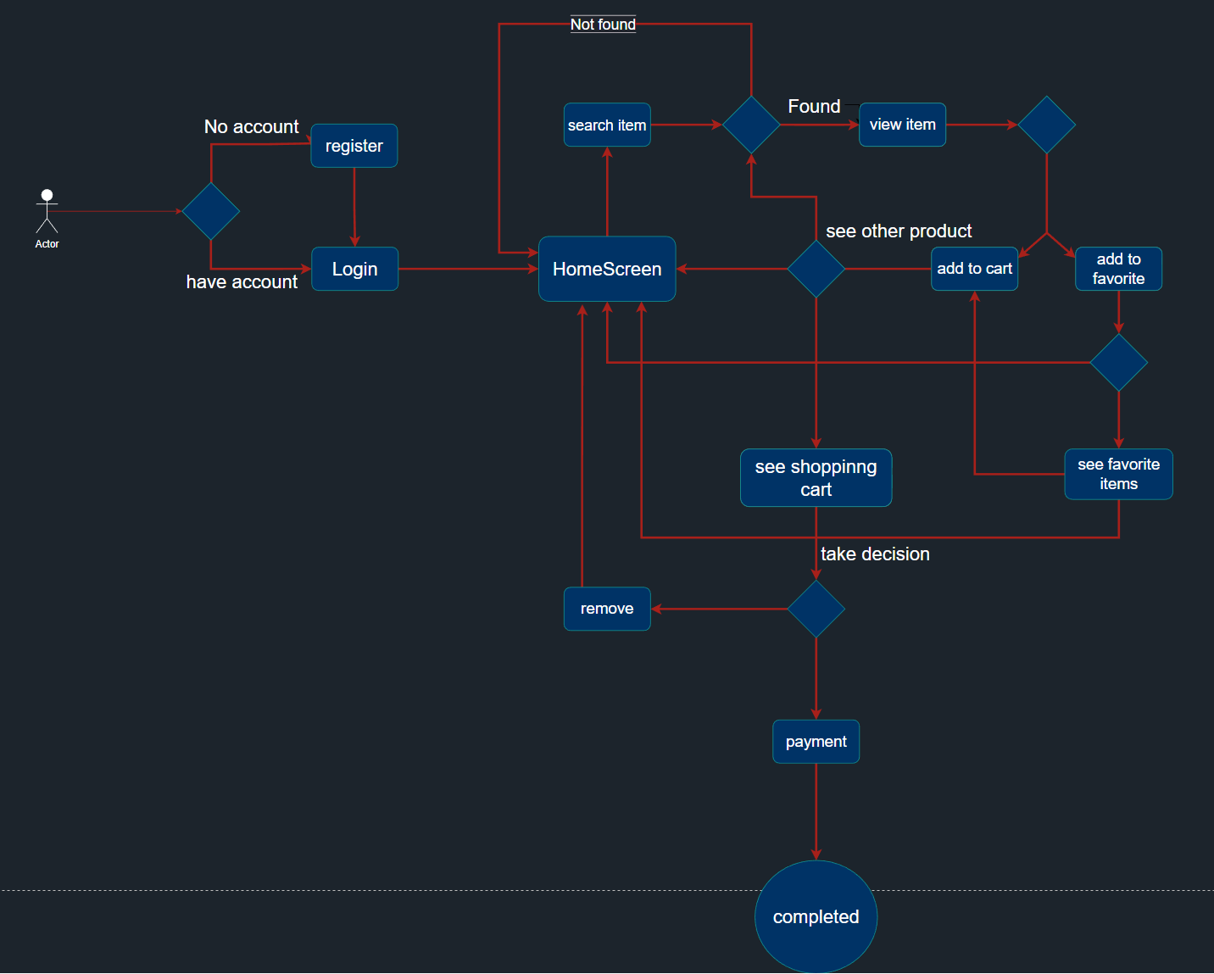
State Diagram

Slide 8
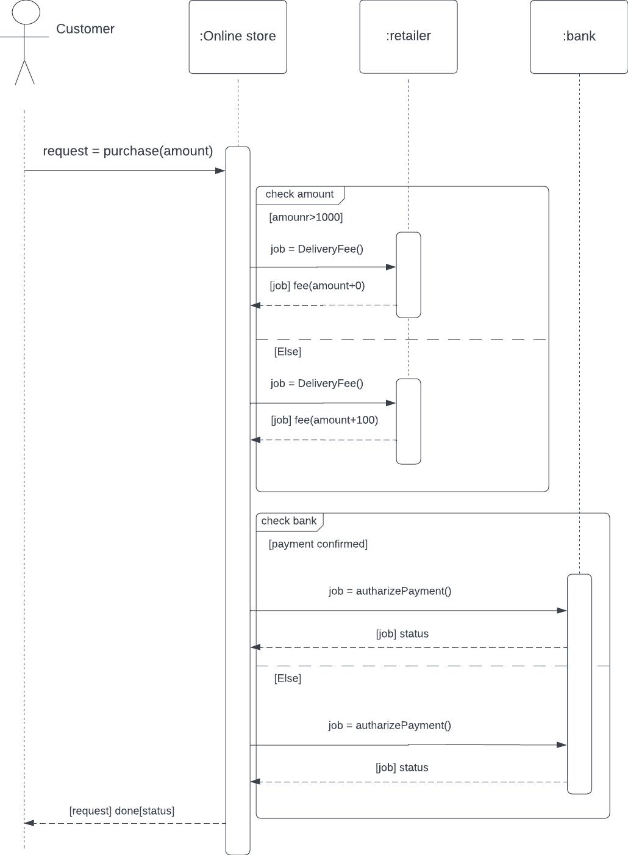
Sequence Diagram

Slide 9
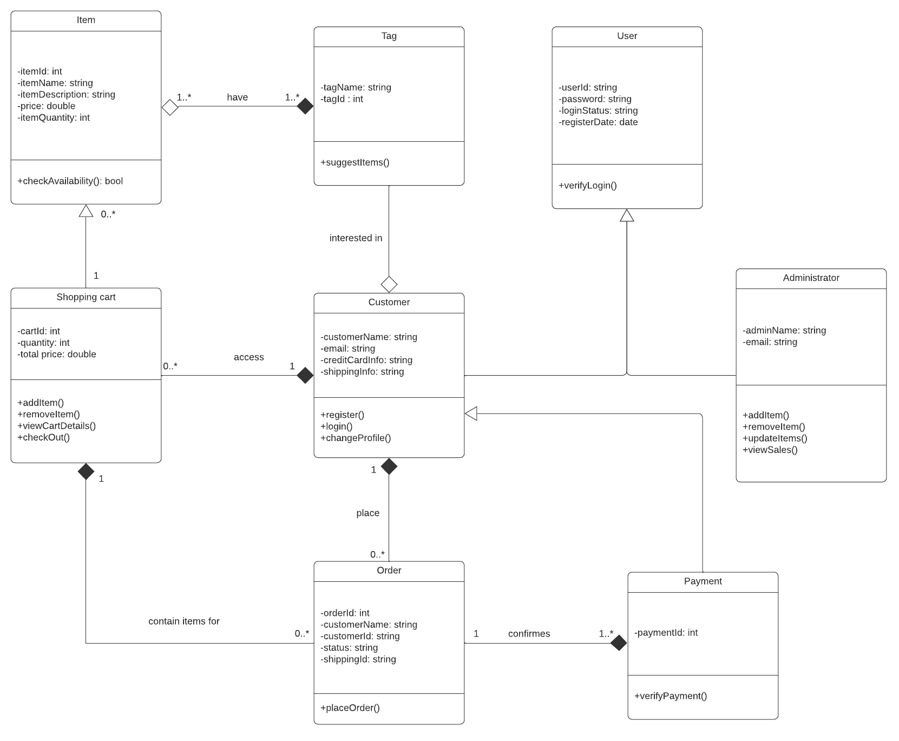
Class Diagram

Slide 10
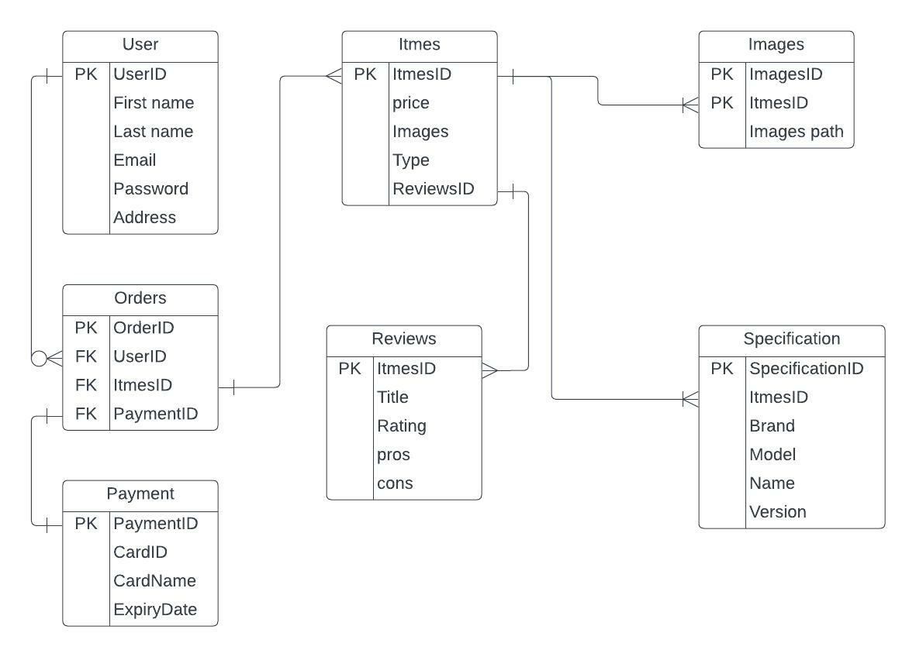
Data Structures

Slide 11
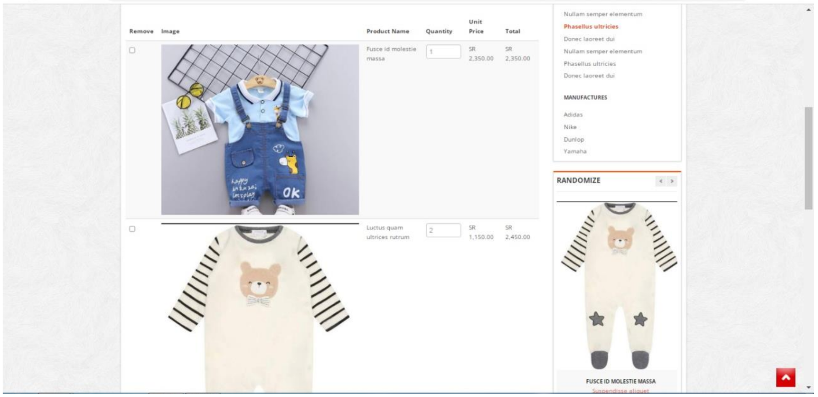
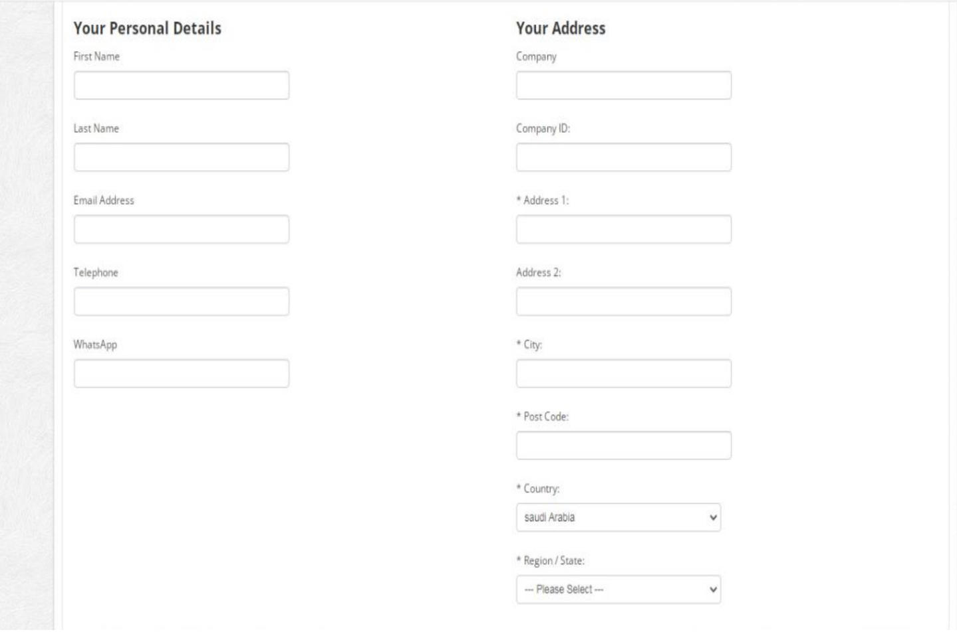
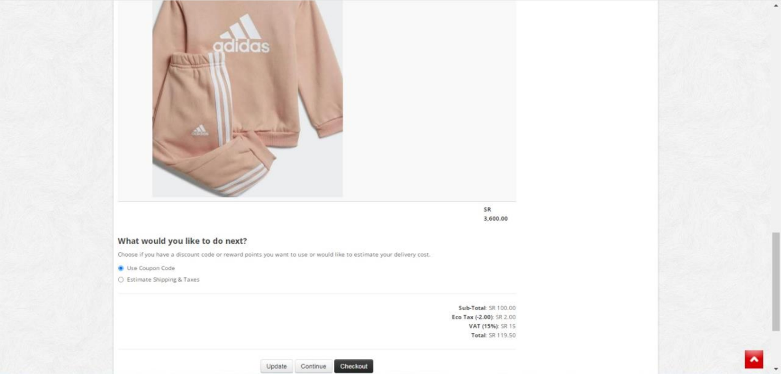
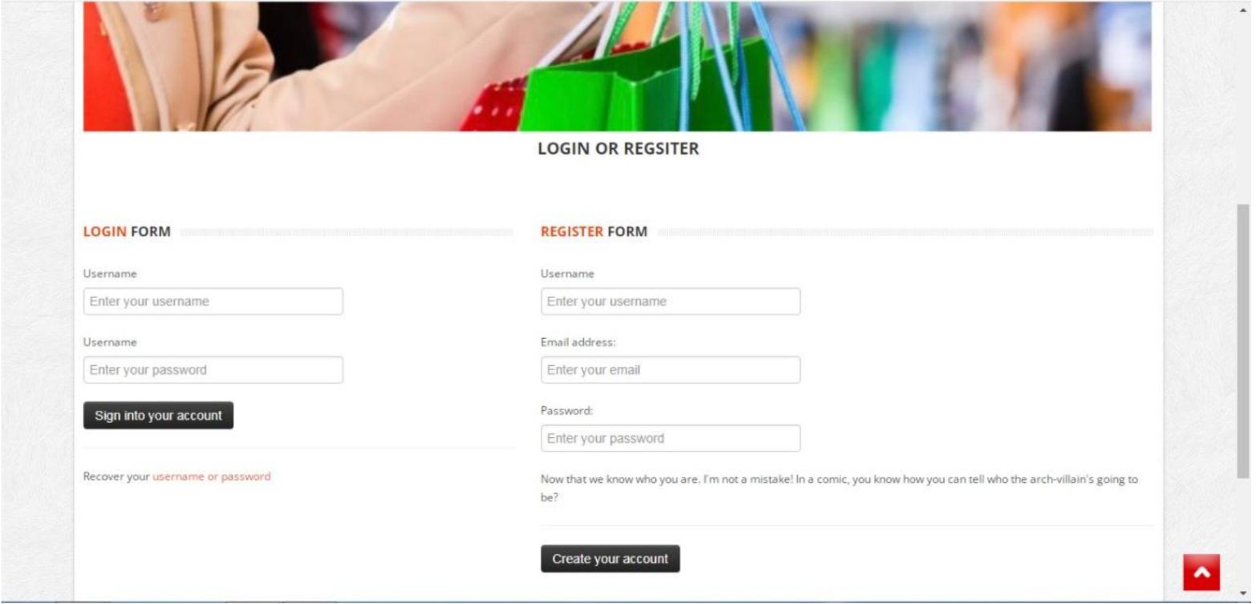
Detail design of User interface

Slide 12
task management and reallocation
FINALLY task management and reallocation for ONLINE SHOPPING WEBSITE
we worked as an individuals in SRS, and for the SDD we were separated into two groups

