Slide 1
Searching Algorithm Visualizer
Submitted to :
Dr. Ammar Mohammed
Engineer. Mohammed Soheil

Slide 2
Contributors
Nada Amr Attia 19P1621
Alaa Mohamed Hamdy 19P6621
Anas Salah Abdelrazek 19P9033
Ahmed Amr ElGayar 19P8349
Ahmed Akram Mohamed 19P4777

Slide 3
Graphical User Interface

Slide 4
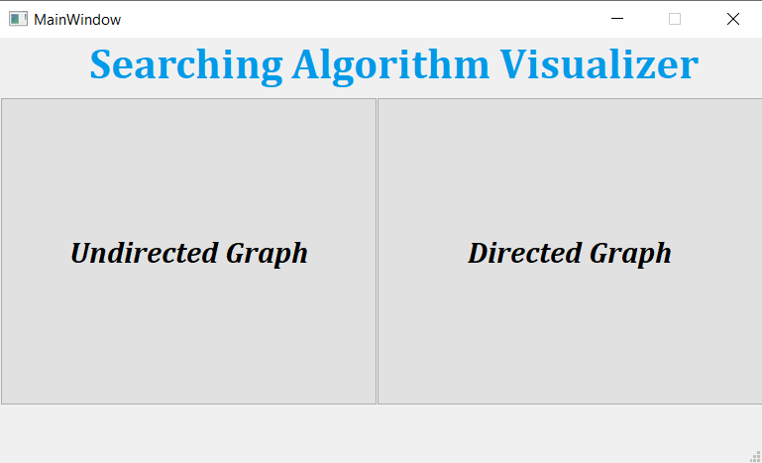
Landing Page (choosing Graph Type)

Slide 5
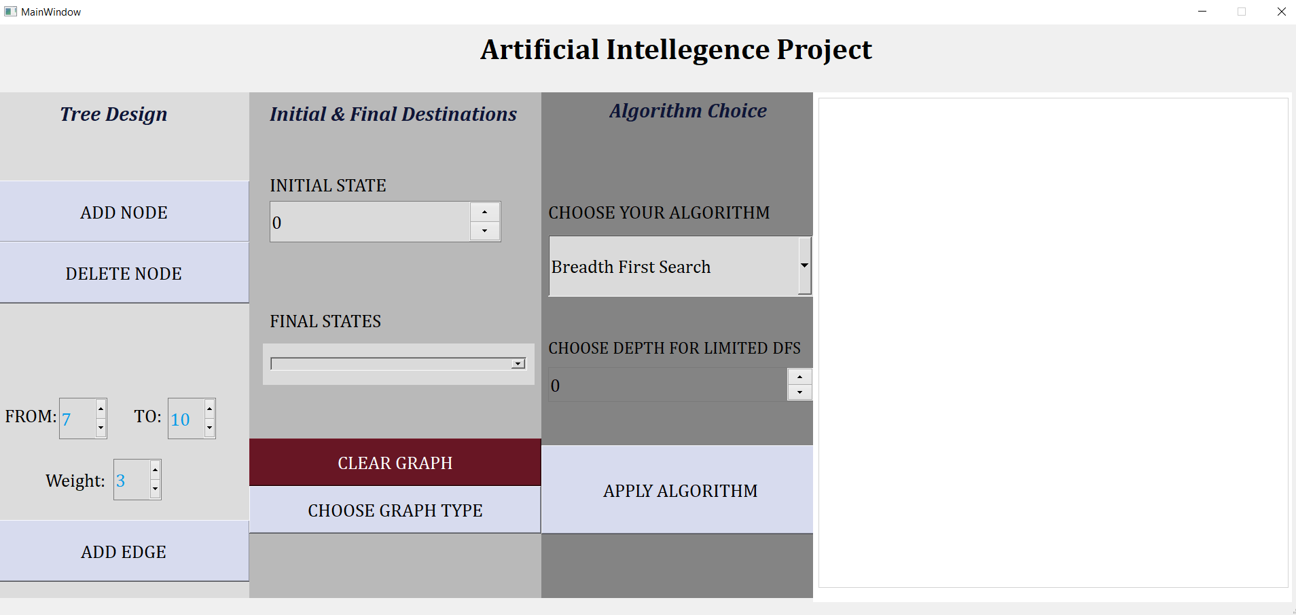
Main Window

Slide 6
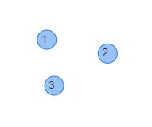
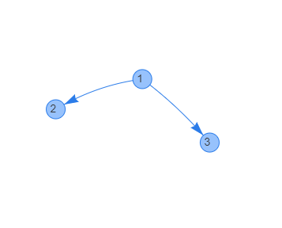
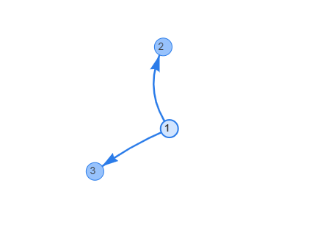
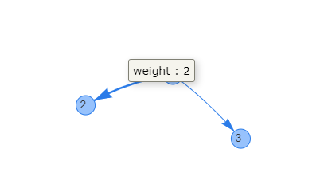
Graph Visualization

Slide 7
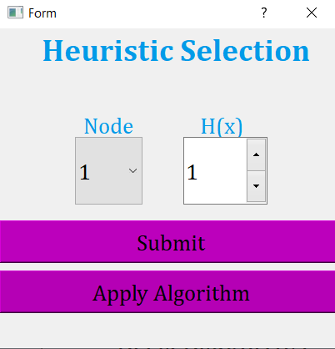
Heuristic addition

Slide 8
Algorithms implementation

Slide 9
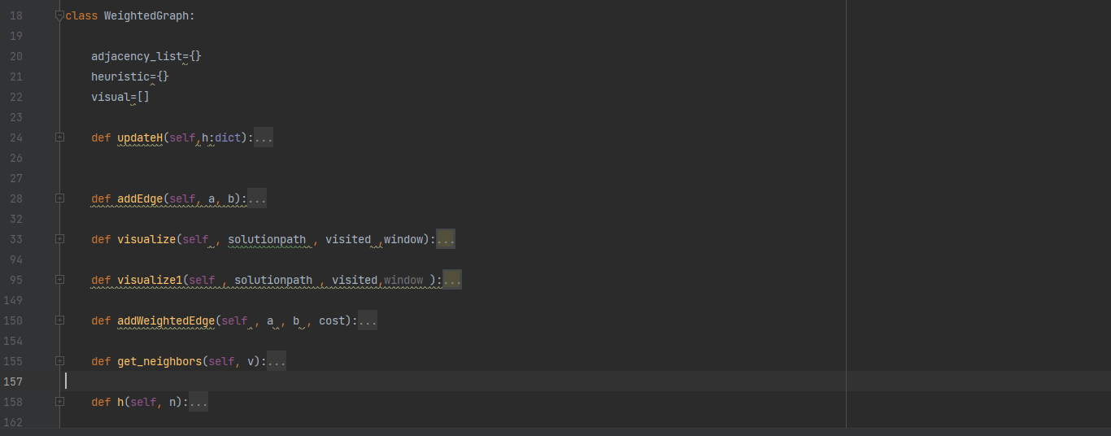
Weighted Graph class

Slide 10
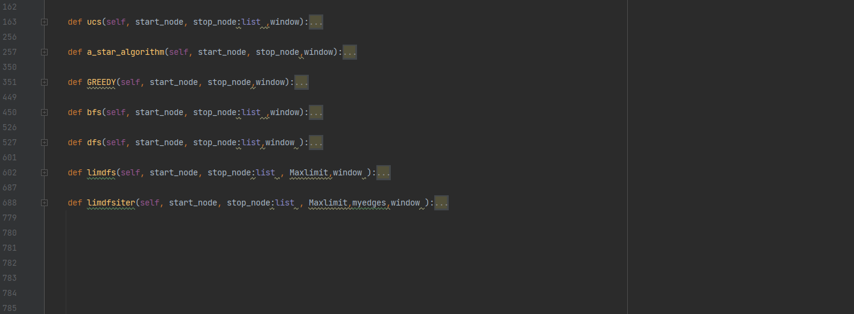

Slide 11
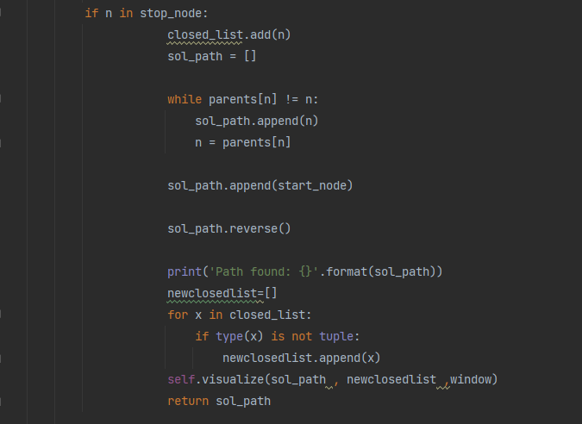
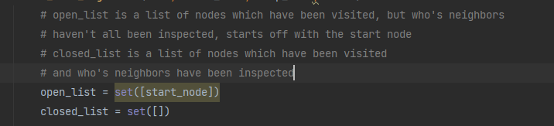
Common Components
Final Node reached ?
Main Containers to store Nodes

Slide 12
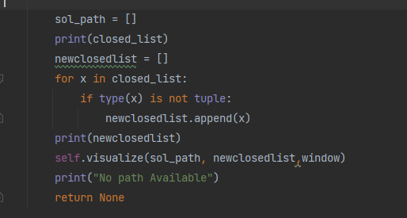
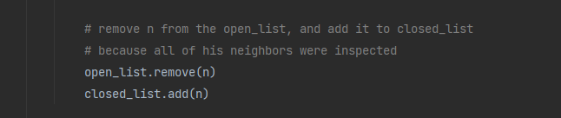
Common Components
No Path Available !!
Neighbors … done.

Slide 13
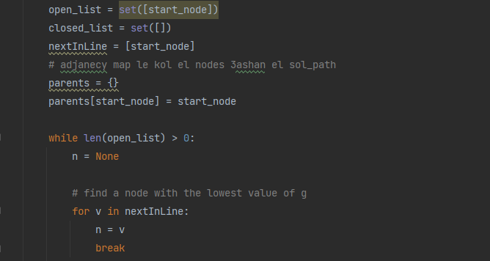
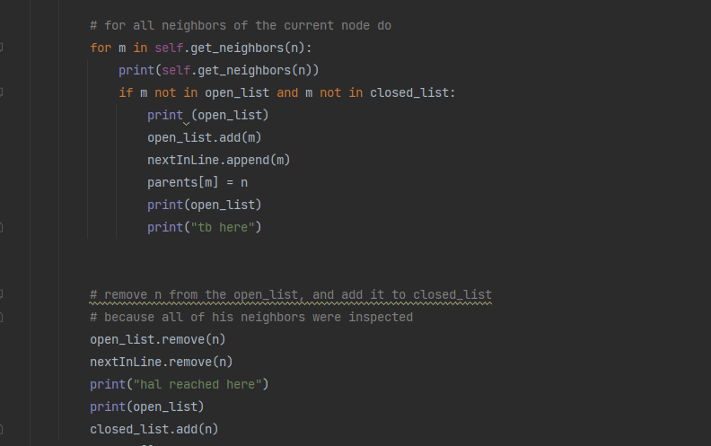
Breadth First Search
Parents , nextInLine and choice
Exploring and adding to fringe

Slide 14
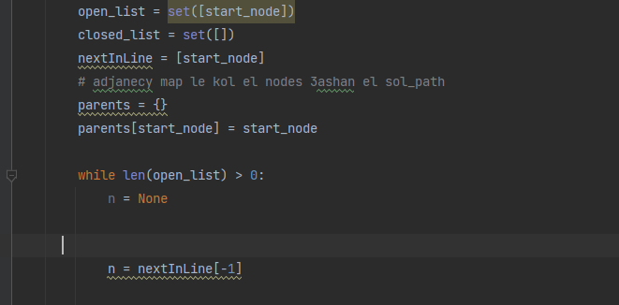
Depth First Search
Difference between BFS and DFS

Slide 15
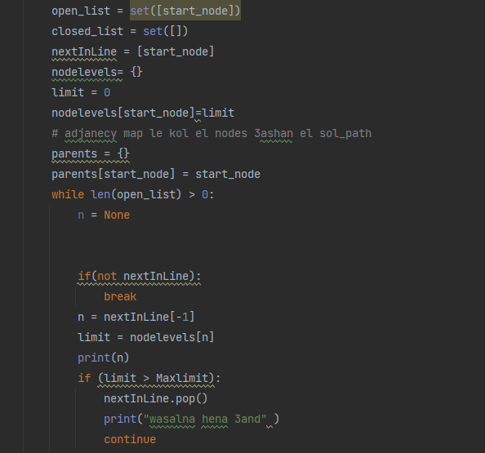
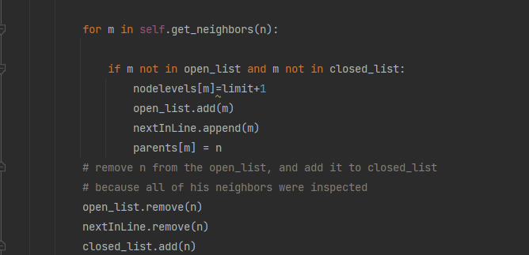
Depth limited Search
Limit Adjustment
Setting Node levels

Slide 16
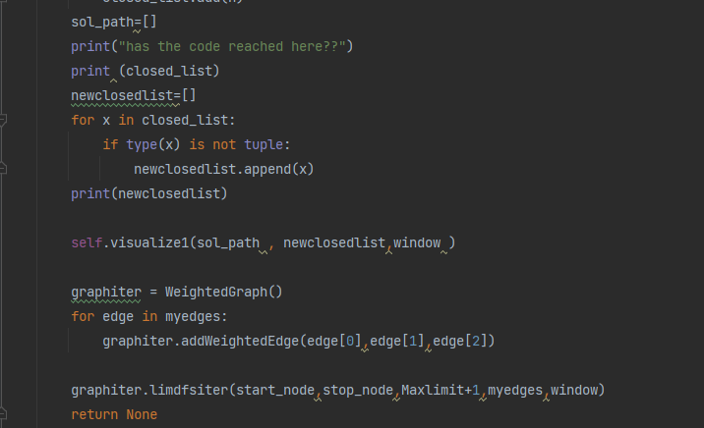
Iterative Deepening
Same as limited but adjustment happens when solution path not found

Slide 17
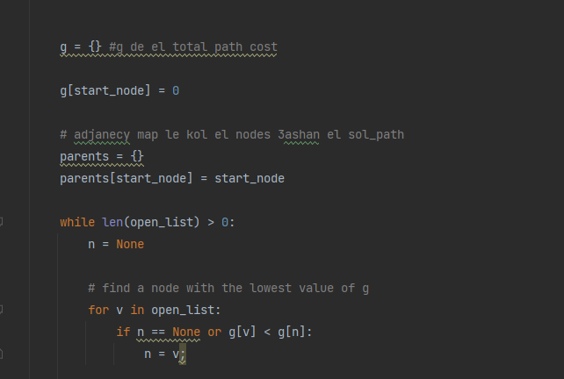
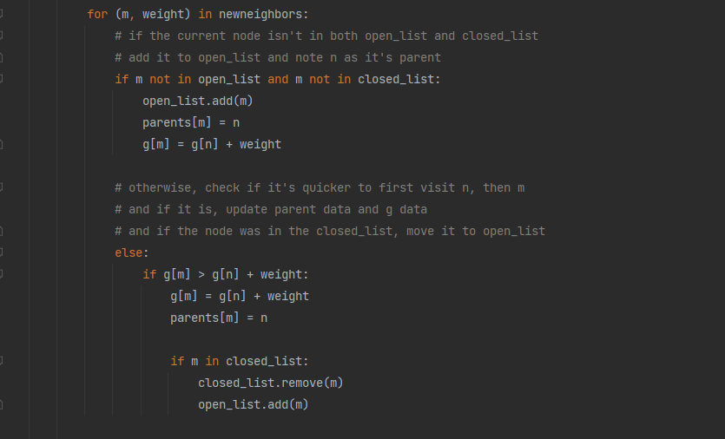
Uniform Cost
Why g ??
Keeping costs up-to-date

Slide 18
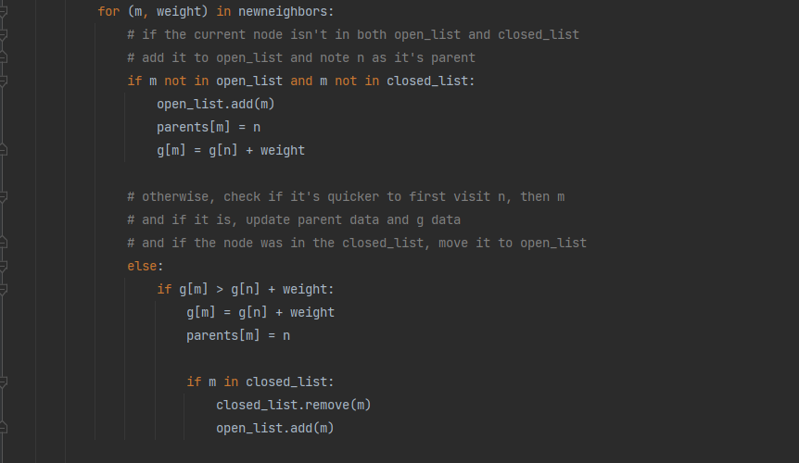
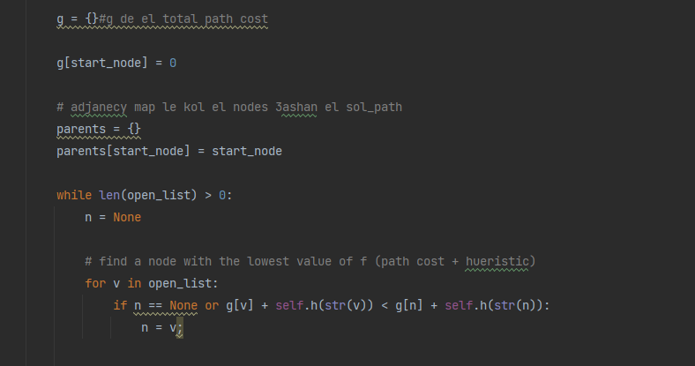
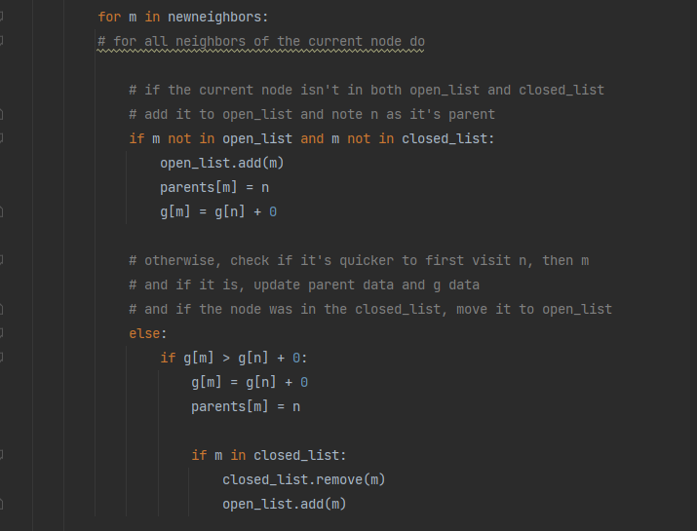
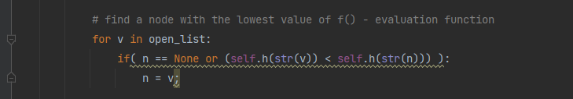
Greedy And A*
A* updating costs
A* concerned with cost and ‘h’
Greedy not concerned with costs
Greedy concerned with ‘h’ only

Slide 19
User Error Handling

Slide 20

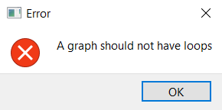
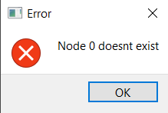

Edge entering
HAVING FROM AND TO POINTING TO SAME NODE
Initial node starts from 1

Slide 21
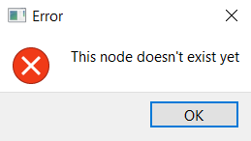
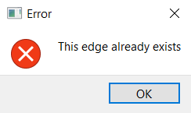
Edge entering
Adding edge with one end of edge is a node that doesn’t exist
Repeating edge entry

Slide 22
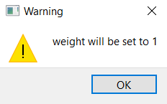
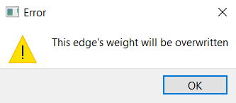
Edge entering
If weight was not chosen , default value is 1
Same edge different weight

Slide 23
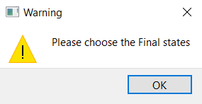
Final state
Applying algorithm without choosing final state

Slide 24
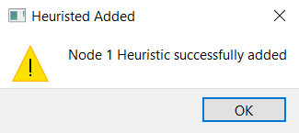
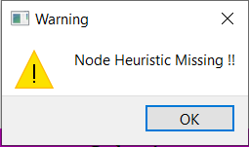

Heuristic selection
Confirming to user that heuristic was added when press submit
Applying algorithm without assigning a heuristic value to every node
NB. When heuristic added twice for same node , it is overwritten

