Slide 1
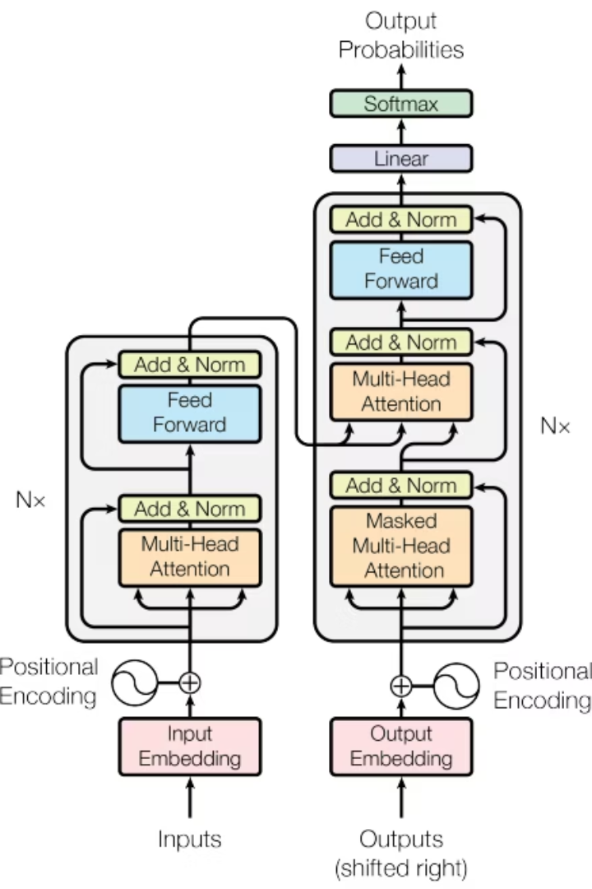

Arabic-English Neural Machine Translation using Transformer
by Anas Saleh

Slide 2
Introduction & Goal
Our Approach: Implementing a Neural Machine Translation (NMT) model based on the state-of-the-art Transformer architecture, and comparing it with a fine-tuned pre-trained model.
Brief overview of Machine Translation (MT).
Importance of Arabic-English translation in various domains (communication, business, research).
Problem: Building an accurate and efficient model to automatically translate text from Arabic to English.

Slide 3
Dataset Description
Parallel Corpus
Two Datasets Used
Parallel corpus dataset containing pairs of Arabic and English sentences.
Smaller: nmt-with-attention-for-ar-to-en (from GitHub).
Larger: Arabic to English Translation Sentences (from Kaggle)
Data Format
Purpose
Initial raw data format: Tab-separated English and Arabic sentences per line.
To train the model to learn the complex mapping between the two languages and observe the impact of data size.

Slide 4





Data Preprocessing Steps
Unicode Normalization & Cleaning
Standardizing text representation
Punctuation standardization
Adding spaces around punctuation marks
Lowercasing English text
Normalizing English text format
Character filtering
Removing unwanted characters
Adding special tokens
Adding [START] and [END] tokens to target (English) sentences
Example (Processed Pair - Custom Model):
AR Input: أنا أتتطلع لعطلة الصيف .
EN Target: [START] i m looking forward to summer vacation . [END]
Preprocessing (for Pre-trained MBart):
Tokenization using the MBart tokenizer, including adding special tokens and padding to a fixed length.

Slide 5
Data Statistics
Kaggle Dataset
GitHub Dataset
Data Source
80% Training, 20% Testing
80% Training, 20% Testing
Split Ratio
19710 sentence pairs
8593 sentence pairs
Training Set Size
4928 sentence pairs
2149 sentence pairs
Testing Set Size
179 / 225 tokens (Train/Test)
37 / 18 tokens (Train/Test)
Max Arabic Length
200 / 228 tokens (Train/Test)
42 / 25 tokens (Train/Test)
Max English Length
228 tokens (Custom), 256 tokens (MBart)
42 tokens
Max Sequence Length
49726 unique tokens
9504 unique tokens
Arabic Vocabulary Size
23358 unique tokens
3685 unique tokens
English Vocabulary Size

Slide 6



Model Architecture
Transformer Architecture
Model Parameters
Custom Components
Encoder-Decoder with attention mechanisms
num_layers: 4
Positional Embedding, Multi-Head Attention, Feed-Forward Networks
d_model: 128
dff: 512
num_heads: 8
dropout_rate: 0.1
Custom Transformer Architecture
Based on the standard Transformer architecture.
Composed of an Encoder and a Decoder. Relies entirely on attention mechanisms. Uses custom implementations for Positional Embedding, Multi-Head Attention, Feed-Forward Networks, and Encoder/Decoder layers.
Pre-trained MBart Architecture
Utilizes the facebook/mbart-large-50-many-to-many-mmt model from Hugging Face Transformers. A large, pre-trained sequence-to-sequence model designed for translation between many languages. Fine-tuned on the Arabic-English Kaggle dataset. Leverages knowledge learned during pre-training on a massive multilingual corpus. Uses a shared vocabulary and tokenizer across languages.

Slide 7
Training Configuration and Results
Custom Transformer (GitHub):
Optimizer: Adam (tf.keras.optimizers.Adam) with custom learning rate schedule.
Learning Rate Schedule: Custom CustomSchedule with d_model=128 and warmup_steps=4000.
Loss Function: Custom loss_function (Sparse Categorical Crossentropy with padding mask).
Metrics: Custom accuracy_function (with padding mask) and corpus BLEU score.
Training loop implemented manually.
Custom Transformer (Kaggle): Same configuration as GitHub model. Observations: Training on the larger dataset was significantly slower. The custom model's performance metrics were much worse on the larger, more complex dataset compared to the smaller one.
Pre-trained MBart (Kaggle):
Framework: Hugging Face transformers library (Seq2SeqTrainer).
Optimizer: Default AdamW used by Seq2SeqTrainer.
Learning Rate: Fixed learning_rate=3e-5 (as configured).
Loss Function: Cross-Entropy (handled internally by the model/trainer).
Metrics: SacreBLEU (evaluate.load("sacrebleu")).
Training Arguments (Seq2SeqTrainingArguments):
per_device_train_batch_size=2
gradient_accumulation_steps=4 (Effective batch size = 8)
num_train_epochs=4
predict_with_generate=True (for evaluation)
fp16=True (for mixed precision training)

Slide 8
Pre-trained MBart (Kaggle)
Custom Transformer (Kaggle)
Custom Transformer (GitHub)
Feature
Larger (~24k pairs)
Larger (~24k pairs)
Smaller (~10k pairs)
Dataset Size
256 (Configured)
228
42
Max Seq Length
Large (Shared)
Larger (AR 49.7k, EN 23.4k)
Smaller (AR 9.5k, EN 3.7k)
Vocab Size
Fine-tuned Pre-trained
From Scratch
From Scratch
Model Type
4
45
60
Epochs
~3.4 hours
~2.4 hours
~10.7 min
Total Train Time
0.6943
0.9669
Train Accuracy:
0.2109
1.2217
0.1164
Final Train Loss
0.2489
0.5988
Test Accuracy
Not available in logs
0.0049
0.0391
Final Test BLEU
More complex sentences
More complex sentences
Simpler sentences
Complexity Handled
High (due to transfer learning)
Low
Moderate
Expected Perf.

Slide 9
Inference Process and Limitations
Model Limitations
Inference Process
Data Size: Even the larger dataset is modest for achieving state-of-the-art results compared to datasets used for large pre-trained models.
Using the trained model to translate a new Arabic sentence (evaluate function for Custom Model, or MBart's generate method).
Custom Model Limitations: Struggled significantly with the larger dataset's complexity when trained from scratch.
Decoding Strategy:
Decoding Strategy: Greedy decoding may not always produce the optimal translation.
Custom Model: Greedy Decoding (selects the most probable token at each step).
MBart: Likely uses Beam Search (as indicated by num_beams=5 in config warnings), which explores multiple possibilities at each step for potentially better quality.
Fixed Max Length: Limits handling of very long sentences.
Translation Quality: Can vary depending on sentence complexity, domain, and unseen words/phrases.
Process: Input sentence is preprocessed and encoded. Decoding starts with a special token. Model predicts subsequent tokens iteratively until an end token or max length is reached. The sequence of predicted tokens forms the English translation.
Computational Resources: Training complex models requires significant processing power.
Future Work
A user-friendly web interface created using the Gradio library allows users to easily input Arabic text and receive the English translation generated by the trained model in real-time.
Obtain and train on a much larger, high-quality parallel corpus.
Conduct a full evaluation of the fine-tuned MBart model including final test metrics.
Implement and compare different decoding strategies.
Explore techniques for handling out-of-vocabulary words.
Optimize models for inference speed.
Investigate domain adaptation techniques.

