Slide 1
Enhancing image Resolution (GAN)
Adnane Mouhmid
Anass El Foughali

Slide 2
INTRODUCTION

Slide 3
In this project we aim to enhance the resolution of low-quality images using the Enhanced Super-Resolution Generative Adversarial Network (ESRGAN). This advanced technique is crucial in fields like medical imaging, satellite imaging, and photography, where high-quality images are essential for accurate analysis and better insights. By leveraging ESRGAN, we can upscale images, significantly improving their clarity and detail.

Slide 4
Project Objectives

Slide 5
Develop an ESRGAN model to upscale low-resolution images to high-resolution images.
Train the ESRGAN model using high-quality image datasets.
Create a user-friendly web application using Flask for image upload and enhancement.

Slide 6
Generative adversarial network (GAN)

Slide 7
A Generative Adversarial Network (GAN) is a class of machine learning frameworks designed by Ian Goodfellow and his colleagues in 2014. GANs are composed of two neural networks: a generator and a discriminator, which are pitted against each other in a zero-sum game.

Slide 8
Model Architecture

Slide 9
Generator
Upscale low-resolution images of shape (128, 128, 3) to high-resolution images of shape (256, 256, 3).
Captures low-level features from the input image.
Applies convolution operations to detect basic image features like edges and textures.

Slide 10
Discriminator
Differentiate between real high-resolution images and generated images.
Apply convolution with increasing filter sizes and down sampling.
Increase progressively to capture complex features.

Slide 11
Dataset Preparation

Slide 12
Resizing
Ensure all images have a consistent size, which is crucial for feeding into the model.
Resize images in the training set.
Resize images in the validation set.

Slide 13
Creating a low-resolution version of the images
To prepare images for training models focused on super-resolution or enhancement tasks by generating low-resolution versions.
Reduce the size of 256x256 images to 128x128 pixels.
This resizing simulates degraded input data for the model's learning process.

Slide 14
Data augmentation
Introducing variability into the training dataset to prevent overfitting and enhance the model's ability to generalize to new, unseen data.
Randomly rotate images within a specified range.
This variation exposes the model to images from different perspectives, improving robustness.

Slide 15
Generating the dataset

Slide 16
We implemented a TensorFlow pipeline to load, preprocess, and pair low-resolution and high-resolution images for training. The pipeline efficiently reads and normalizes images, then organizes them into batches, ensuring scalable and effective handling of large datasets

Slide 17
Building the model

Slide 18
The ESRGAN model has a generator that enhances low-resolution images to high-resolution, and a discriminator that distinguishes real HR images from generated ones.

Slide 19
Generator
The generator processes 128x128x3 LR images through a convolutional layer with LeakyReLU activation function
residual blocks with convolution, batch normalization, and LeakyReLU
then upsamples the image and outputs a 256x256x3 image

Slide 20
Discriminator
The discriminator processes 256x256x3 images through convolutional layers with increasing filters (64 to 512), batch normalization, and LeakyReLU activations
global average pooling and a dense layer to output the probability of the image being real or generated.

Slide 21
Combined Model
The combined model trains the generator and discriminator together in an adversarial setup
the generator creates realistic higher resolutions images to fool the discriminator, improving image quality through this iterative process.

Slide 22
Training process

Slide 23
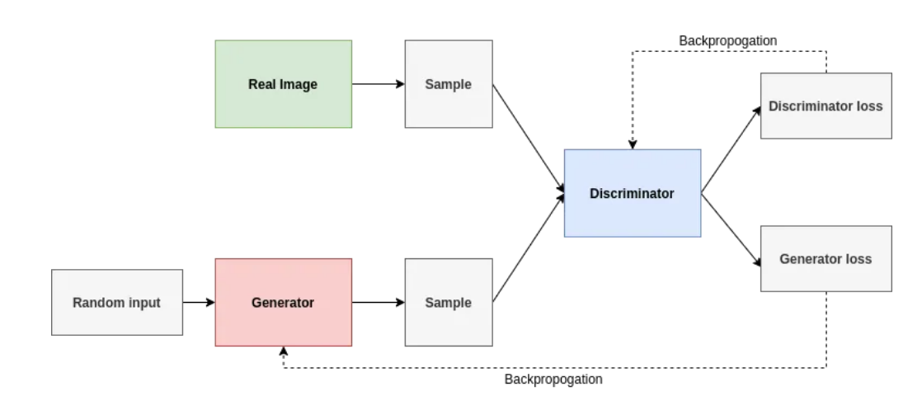
Training Loop
The training of the ESRGAN model focuses on enhancing the resolution of low-resolution images to high-resolution equivalents through adversarial and perceptual learning techniques.

Slide 24
Training Steps
Data Preparation: LR-HR image pairs are preprocessed for training.
Training Loop:
LR images go through the generator to produce SR images.
Losses (generator and discriminator) are computed between SR and HR images.
Gradients update generator and discriminator parameters.
Optimization: Adam optimizers adjust weights to minimize losses.
Monitoring: Progress is tracked by evaluating losses regularly.
Checkpointing: Model checkpoints are saved periodically.
ESRGAN iteratively improves SR image quality by balancing adversarial feedback and perceptual fidelity. This training alternates between the discriminator and generator.

Slide 25
Loss Functions
Generator Loss:
Content Loss: Measures perceptual similarity using a pre-trained VGG model.
Pixel Loss: Measures pixel-wise difference between hr_images and sr_images.
Total Generator Loss: Weighted sum of content and pixel losses.
Discriminator Loss:
Adversarial Loss: Measures how well the discriminator can distinguish fake (sr_images) from real (hr_images).
Discriminator Loss: Combined loss from correctly classifying both real and fake images.

Slide 26
Flask Application

Slide 27
Overview
The Flask appliation provides a user interface to take advantage of the capabilities of the model, we can upload low-resolution images and receiving enhanced high-resolution outputs

Slide 28
Key Endpoints
/: render the image upload page.
/upload: Handles image uploads.
/enhance: Processes the uploaded image using the ESRGAN model and returns the result.
/result/<image>: Renders a page to display the result, showing the generated image.
/uploads/<filename>: Serves the uploaded files from the UPLOAD_FOLDER directory
/generated/<filename>: Serves the generated (enhanced) files from the GENERATED_FOLDER directory.

