Slide 1
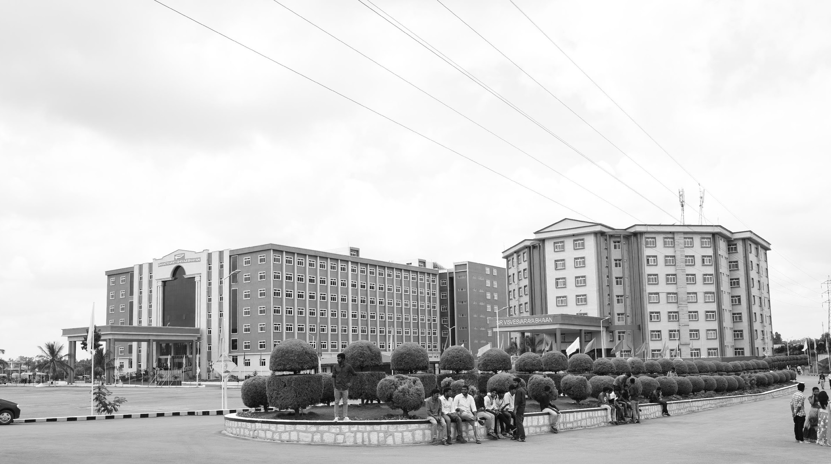

AI Health care chatbot using Python
Mid-Review 1/2/3
Major Project
Project ID: P7
AY 2021-25
GITAM (Deemed-to-be) University
Project Team:
Shaik Anas - BU21EECE0100102
Uday Kiran - BU21EECE0100415
Sai Sandeep - BU21EECE0100434
Department of Electrical Electronics and Communication Engineering
Project Mentor:
DR. P. Sundararaman
Project In-charge:
Dr.Rohan Prasad
www.gitam.edu

Slide 2
Objective and Goals
Objective
Brief Description
A Python-Powered AI Healthcare Chatbot created to serve users with the following responsibilities:
Symptom Checking: Diagnosing what's wrong and telling you to go see the doc or not
Health Information: General information on diseases, drugs and medication; treatment.
Mental Health Support: Basic counselling and referring to a mental health expert.
Data Collection: To collect health-related data for measurement and sharing with providers
Custom Advice: Providing personal health advice on the basis of user data.
Home Remedies: Advicing Basic Home Remedies without Tablets.
.Key Emergency Guidance: Instant steps for complete emergencies.
These are implemented with the Python using such libraries as NLP, machine learning and web frameworks.
Goals
Main Goals
Home Remedies
Ayurvedic
Personalized Health Advice
Mental Health Support
Reduce Healthcare Costs
Additional Goals
Enhance Access to Healthcare
Tracks your Health through sensors
Information Delivery

Slide 3
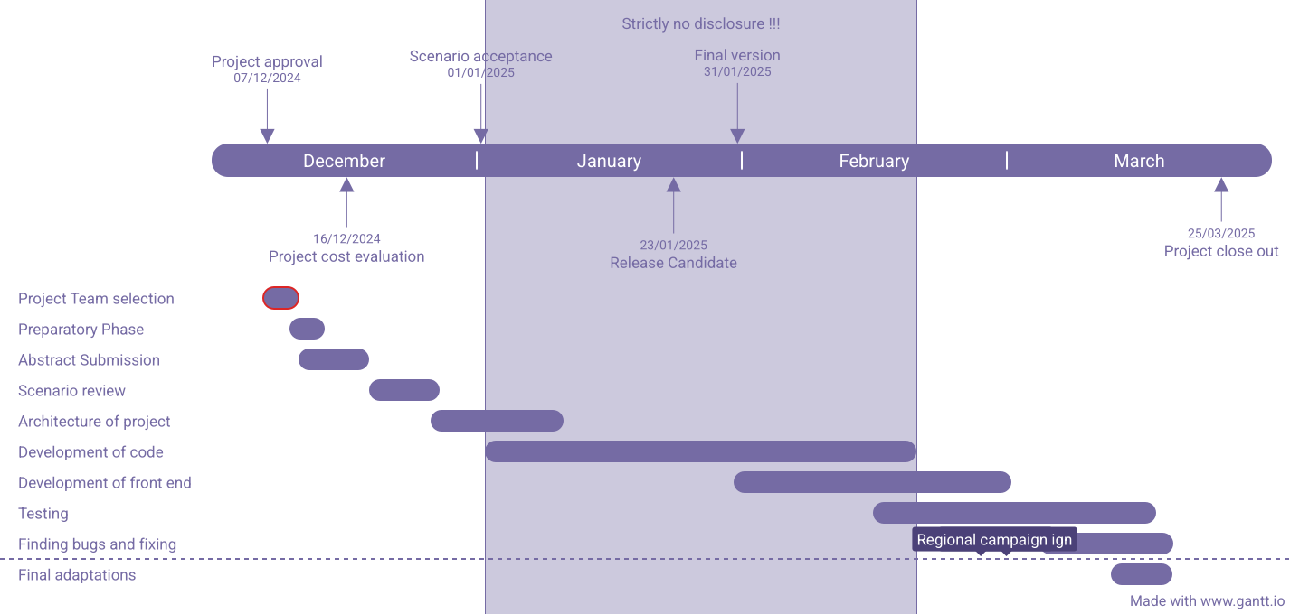
Project Plan (Clearly mention milestone for objectives under each reviews)
Gant Chart - Milestones and Activities

Slide 4
Literature Survey (Improved post minor project)
Key Publications
https://www.pnrjournal.com/index.php/home/article/view/10131?__cf_chl_rt_tk=kmpgo4hD_SKAaMx3W1CqEfoyHQyziipy4EMoenk.mFg-1736314356-1.0.1.1-9oVKt3IagopsimoaLK0RO5EOuU3Y6X4VA7QC2xPL5fc
To sustain a cherished and happy life healthcare plays a very important role in it. However, it is very difficult to consult a doctor if you have any health problems. Chat bots is basically interact using text or voice and to get answers using artificial intelligence. A chatbot is a program that is programmed in such a way that it takes some sort of input from the user then it process it using decision tree or some sort of decision making algorithm to give an accurate and desired output to the user.
https://journal.ijresm.com/index.php/ijresm/article/view/2327
The healthcare sector represents one of the most significant segments of the economy. This sector offers medical services and goods to everyone. A reliable healthcare system ensures a strong economy by increasing life expectancy, contributing to national growth, and reducing the burden on families.
https://ieeexplore.ieee.org/abstract/document/9137944?casa_token=DPM7jvB6KEwAAAAA:-zbYIimYmBBvRMPh_i8RVPECffMkGGGUDRsFevaE-jaaP5X7NAOgddwvdlmDHo0r4qHnEgCd5o4
Telemedicine can be used by medical practitioners to connect with their patients during the recent Coronavirus outbreak, whilst attempting to reduce COVID-19 transmission among patients and clinicians. Amidst the pandemic, Telemedicine has the potential to help by permitting patients to receive supportive care without having to physically visit a hospital by using a conversational artificial intelligence-based application for their treatment
Existing Implementations – Products| Opensource| GitHub etc
https://github.com/manyasrinivas2021/ARTIFICIAL-INTELLIGENCE-HEALTHCARE-CHATBOT-SYSTEM-USING-PYTHON
Through chatbots one can communicate with text or voice interface and get reply through Artificial intelligence. Typically, a chat bot will communicate with a real person. Chat bots are used in applications such as ecommerce customer service, call centres and Internet gaming. Chatbots are programs built to automatically engage with received messages.
https://github.com/neeraj542/Medico-Assistance-OpenAI-ChatBot-Using-Python
This project is a Medico Assistance Chatbot built using OpenAI's GPT-3 and Python with the Textbase library. The chatbot aims to provide medical information and support to users while emphasizing that it is not a substitute for professional medical advice.

Slide 5
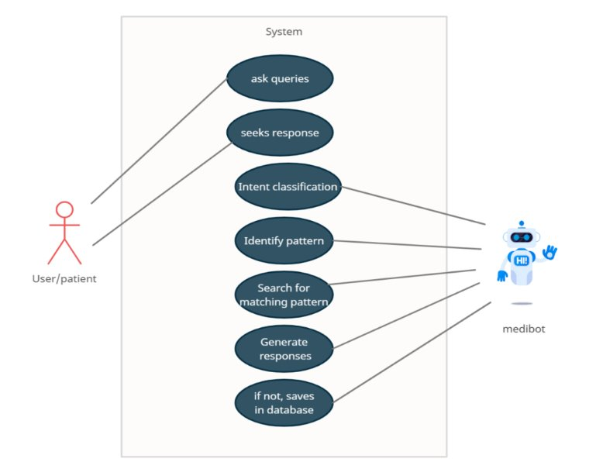
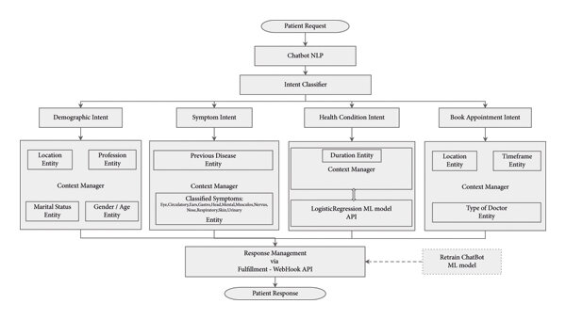
Architecture
Structural Diagram
Block Diagram/Pin Diagram
Resource - https://www.lucidchart.com/pages/examples/uml_diagram_tool
Behaviour Diagram
Flow chart/ State machine
Resource - https://www.lucidchart.com/pages/examples/uml_diagram_tool

Slide 6
Conclusion & Future Work
Summary and Conclusion
The AI Health Care Chatbot represents a significant step toward automating and improving patient care, addressing the growing demand for AI-driven health care solutions. By reducing the burden on health care providers and offering 24/7 access to medical information, the chatbot can enhance both patient experience and operational efficiency. As health care continues to adopt AI technologies, this project has the potential to scale and contribute to the broader landscape of digital health innovation, ultimately improving health outcomes and reducing barriers to care.
Future Work
The AI Health Care Chatbot has demonstrated promising potential in assisting users with preliminary health guidance and support. However, there are several areas for future enhancement to maximize its effectiveness and scalability:
Integration with Wearable Devices
Incorporate data from wearable health devices (e.g., heart rate monitors, fitness trackers) to provide real-time health insights and more personalized recommendations.
Advanced Natural Language Processing (NLP)
Enhance the chatbot's NLP capabilities using advanced models like GPT-4 or similar frameworks to better understand complex medical queries, regional languages, and dialects for a wider audience reach.

Slide 7
THANK YOU
Have a Great Day !

