Slide 1
MSc in Business Analytics Machine Learning and Content Analytics Project – Argumentation Mining
Anastasia Polichronopoulou (f2822022)
Athanasios Papakonstantinou (f2822024)

Slide 2
The aim of this Project
Development of models in order to recognize the structure and the argument of some abstracts, and also create clusters
The datasets consist of 1017 abstracts. For each abstract we have
structure
argument
Each abstract belongs to a project and each project is being funded by an EU call.

Slide 3
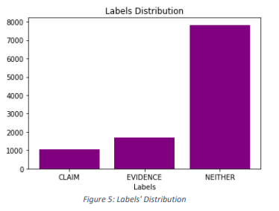
Arguments’ Dataset Analysis
Most of the sentences have no argument (“Neither”).

Slide 4
Arguments’ Dataset Analysis
Our models will be based on the words that each sentence contains,
Thus, we have to analyze the words of each “group”
Firstly, we look at the most common words of our dataset.

Slide 5
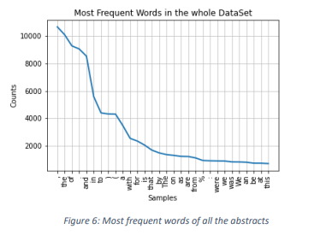
Arguments’ Dataset Analysis
Here we see the most frequent words of all the abstracts.
Problems we can see:
symbols
the word “we” appears twice with small and capital “w”
a lot of “stop words” appear but this type of words gives no information for the sentence
different grammatic types of the words

Slide 6
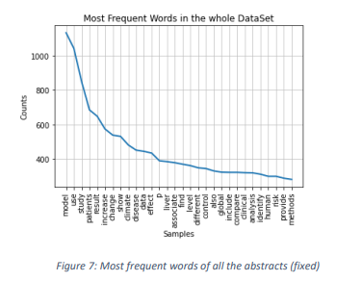
Arguments’ Dataset Analysis
After fixing all the above problems, let’s look again at the most common words of our abstracts

Slide 7
Arguments’ Dataset Analysis
Our goal is to find if a sentence is a “Evidence” or “Claim” or “Neither”
We found the most common words in “Evidence” and “Claim”

Slide 8
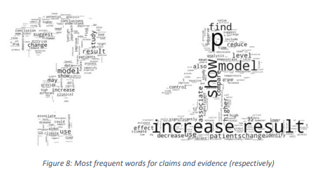
Arguments’ Dataset Analysis
The most frequent words only for claims and evidence, respectively

Slide 9
Greedy Classifier
Firstly, we build a Greedy Classifier in order to identify the argument of a given sentence.
Greedy Classifier takes as input the sentence and two list of words, one for claims and one for evidence
Checks where most of the sentence’s words belong
Gives the label “Claims” if most of the words belong in claims’ list of words, “Evidence” if most of the words belong in evidence’s list of words else it gives the label “Neither”

Slide 10
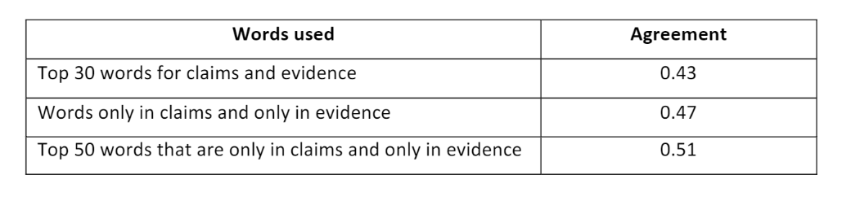
Greedy Classifier
We saw that there are some common words for both “Evidence” and “Claims”
Thus, we checked the greedy classifier 3 different cases

Slide 11
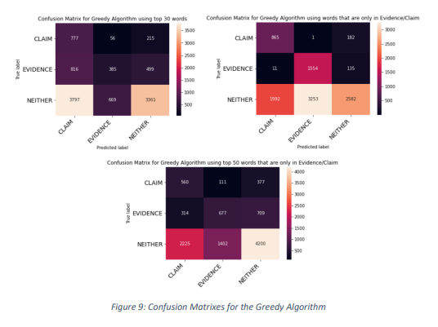
Greedy Classifier

Slide 12
Greedy Classifier
Greedy classifier founds right
in the first case 4523 (42,77%) labels,
in the second 5001 (47,29%) and
in the last one 5437 (51,41%).

Slide 13
FastText Approach
Then, we used the FastText approach in order to predict the argument labels for the sentences.
We split our dataset in train and validation and convert it to the expected format for the model.
The first classifier gave us precision 0.75.
In order to make it better,
we should preprocess the data and
change the model’s variables
Learning Rate: change the learning speed of our mode, how much the model changes after processing each example
Epoch: The times that fasttext sees each training example
Dim: size of word vectors
WordNgram: size of word vectors

Slide 14

FastText Approach
The best model we accuracy 0.77 had:

Slide 15
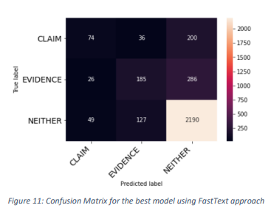
FastText Approach
The model using FastText with the above variables founds correctly 2449 of the labels

Slide 16
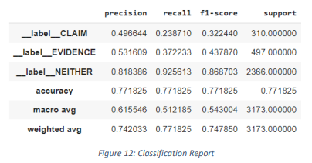
FastText Approach
For “Neither” we can see that it has:
Biggest precision, i.e., the most correctly predicted labels among all the labels
biggest recall, i.e., the most correctly predicted labels among the real labels
biggest support value, which is logical since most of our data had “Neither” labels and, also, it can be derived from the confusion matrix since the predicted “Neither” has the most values (2676).

Slide 17
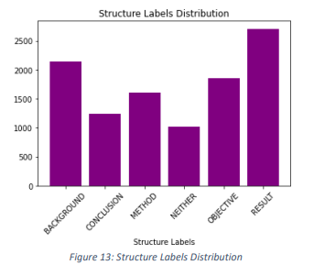
Structure Labels – Data set insights
We can see that most of the sentences are either result either background.

Slide 18
Structure Labels
We will use the FastText approach again in order to predict the structure labels of each sentence.
We split our dataset in train and validation and convert it to the expected format for the model.
The first classifier gave us precision 0.55.
In order to make it better, we should preprocess the data and change the model’s variables.

Slide 19

Structure Labels
We got the best accuracy (0.62) with the following values:

Slide 20
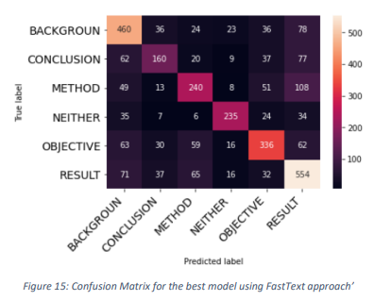
Structure Labels
The model using FastText with the above variables founds correctly 1985 of the labels.

Slide 21
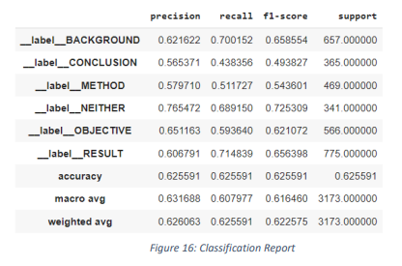
Structure Labels
“Neither” has the biggest precision, i.e., the most correctly predicted labels among all the labels.
“Result” has the biggest recall, i.e., the most correctly predicted labels among the real labels.
“Result” has the biggest support value, which is logical since most of our data had “Result” labels and, also, it can be derived from the confusion matrix since the predicted “Result” has the most values (913).

Slide 22
Abstract Clustering using DE
We want to create cluster for our abstracts by using document embeddings for the abstract, project or EU Call and words embeddings for the arguments
We should preprocess the text and find the embeddings and then find the optimal number of clusters in order to train our model.

Slide 23
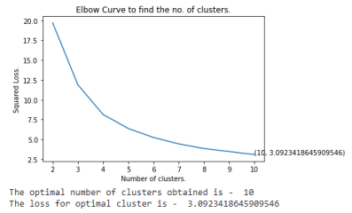
Abstract Clustering using DE
We found that the optimal number of Clusters is 10.

Slide 24
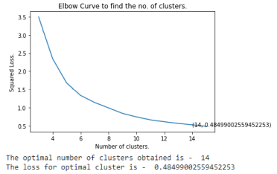
Clustering using DE from the abstracts, project, and EU calls
Again, preprocess the text, find the embeddings and then find the optimal number of clusters.
Now our text is the combined string of the abstract’s text with the text of the project and the EU Call it belong.
The optimal number of Cluster is 14 now

Slide 25
THANK YOU!

