Slide 1
Vocal Emotion Recognition
from Singing — RAVDESS Dataset
CNN | LSTM | GRU | MLP | SVM
Machine Learning — Final Project
UniKore | A.Y. 2025/2026

Slide 2
Agenda
1
Problem & Motivation
Why detect emotions from voice?
2
Dataset
RAVDESS Song — 1,012 clips, 6 emotions
3
Audio Features
MFCC and Mel-Spectrograms
4
Models
MLP, CNN, LSTM, GRU
5
Results & Comparison
Accuracy, F1, Confusion Matrices
6
Interpretability
SHAP analysis on CNN
7
Conclusions
Best model and takeaways

Slide 3
Problem & Motivation
Can a machine understand how a person feels from their voice?
Healthcare
HCI
Detect depression or anxiety from vocal patterns
Voice assistants that adapt to the user's mood
Entertainment
Security
Adaptive music or game soundtracks
Stress detection in call centres

Slide 4
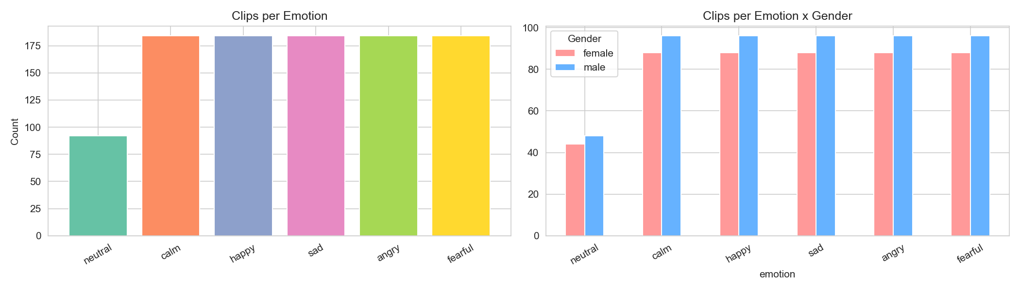
Dataset — RAVDESS Song
1,012
Emotion Classes
01
Neutral
audio clips
Very few clips — class imbalance
24
Calm
02
actors (12M + 12F)
Relaxed, soft singing
6
03
Happy
emotion classes
Energetic, bright tone
04
Sad
22,050
Slow, low pitch
Hz sample rate
05
Angry
4 sec
Loud, high energy
clip duration
Fearful
06
Tense, irregular

Slide 5
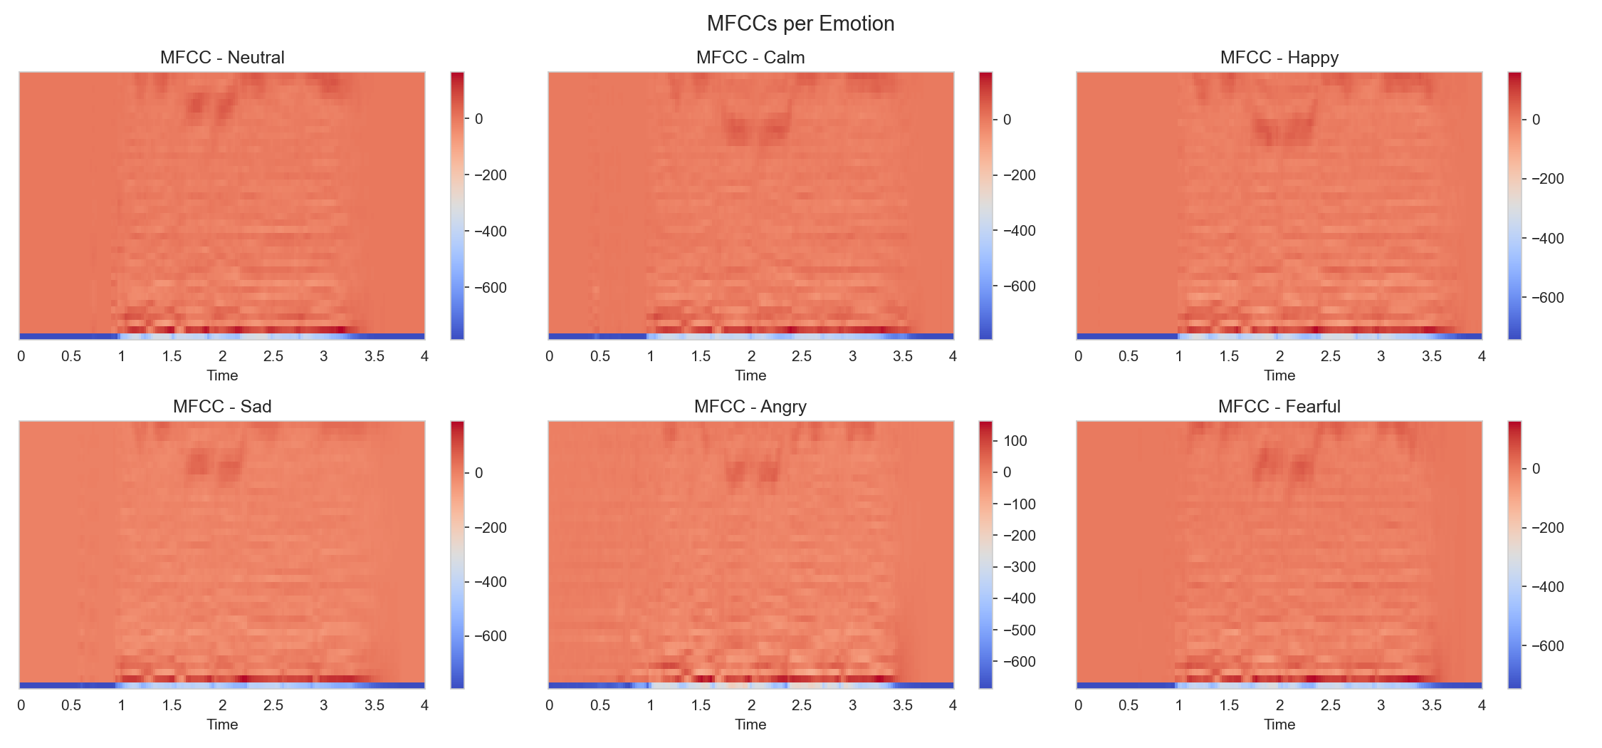
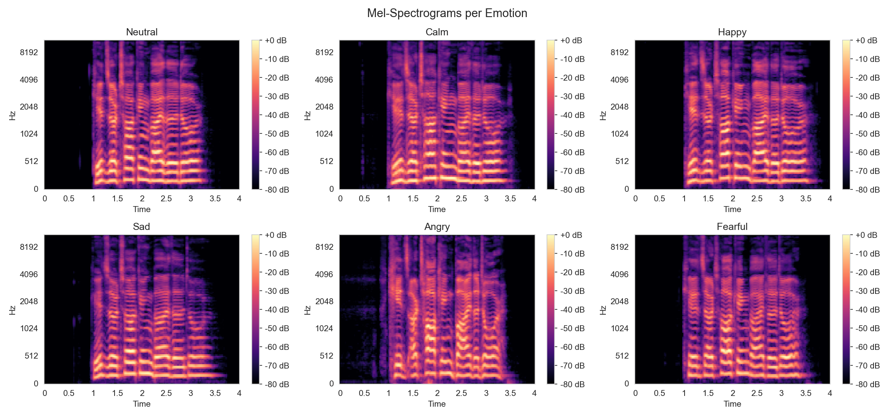
Audio Feature Extraction
MFCC (Mel-Frequency Cepstral Coefficients)
Mel-Spectrogram
40 coefficients per time frame Captures timbre and vocal tract shape Input for RNN/LSTM and MLP Shape per clip: (173 frames x 40 coefficients)
128 mel frequency bands Frequency vs time 'image' Input for CNN (treated as 2D image) Shape per clip: (1 x 128 bands x 173 frames)

Slide 6
Models Overview
MLP
SVM
CNN
LSTM
Baseline
Classical ML
Deep Learning
Deep Learning
Input: mean+std of MFCC 80-dim vector 2 hidden layers (256 -> 128 -> 6)
Input: mean+std of MFCC RBF kernel Class-weighted Scikit-learn
Input: mel-spectrogram 4 conv blocks Global Avg Pooling 45,830 parameters
Input: MFCC sequence 2-layer Bi-LSTM Hidden size: 128 Last timestep output
All models use speaker-independent evaluation: actors 21-24 reserved for test

Slide 7
Results — Model Comparison
Model
Accuracy
F1 Macro
F1 Weighted
MLP
67.0%
66.9%
65.5%
CNN
73.9%
73.8%
71.4%
LSTM
42.0%
37.1%
36.7%
GRU
59.1%
58.4%
58.9%
[Run notebooks to generate chart]
Best model accuracy: 73.9%

Slide 8
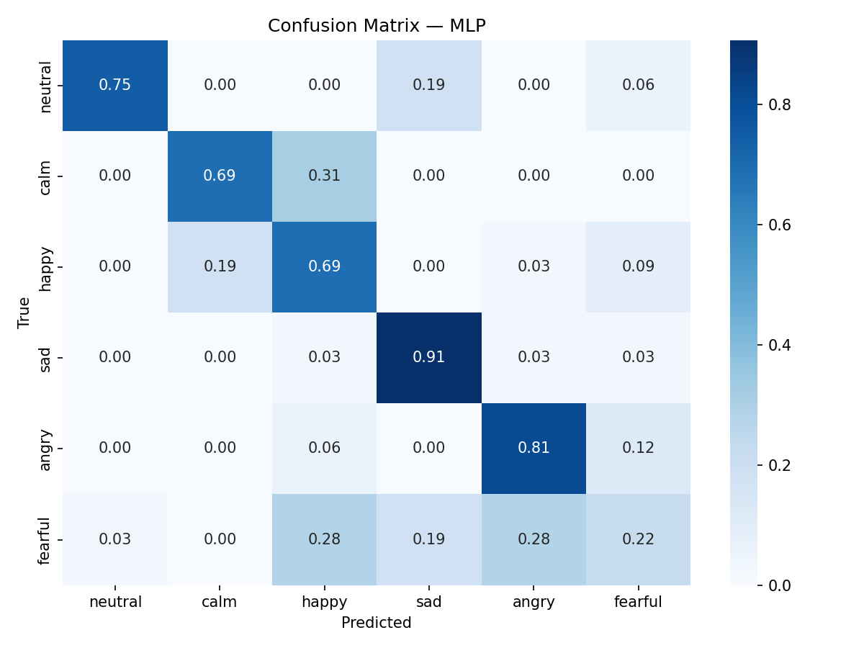
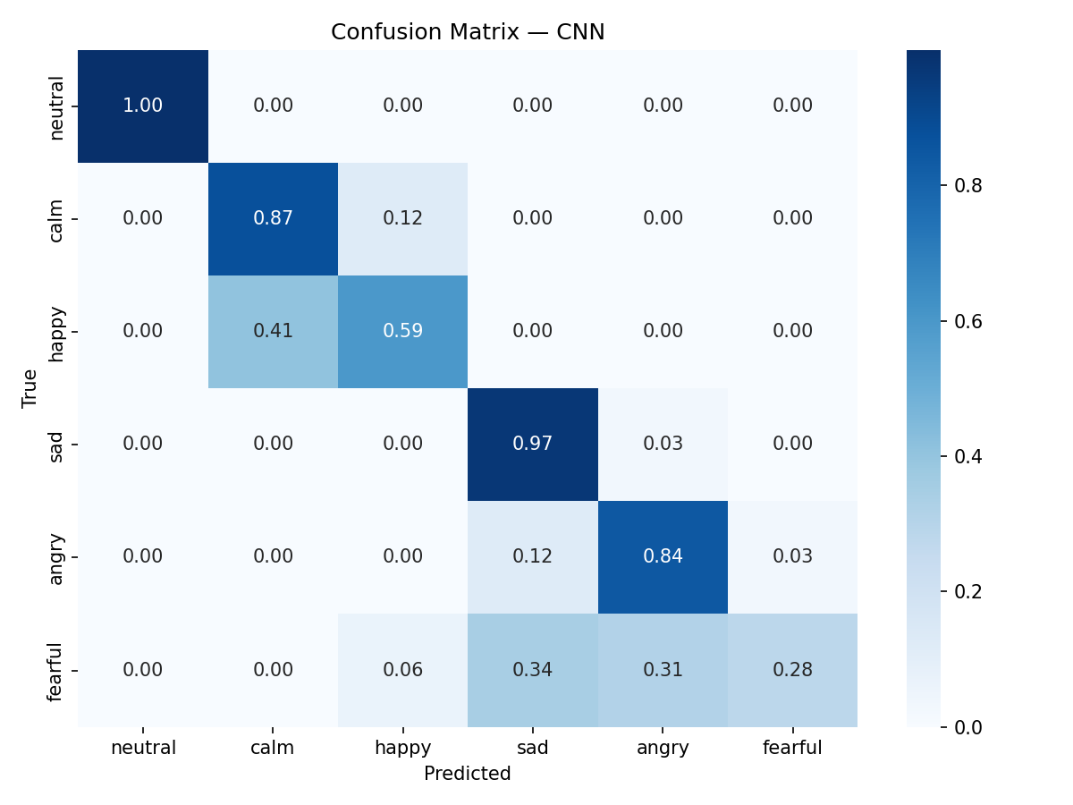
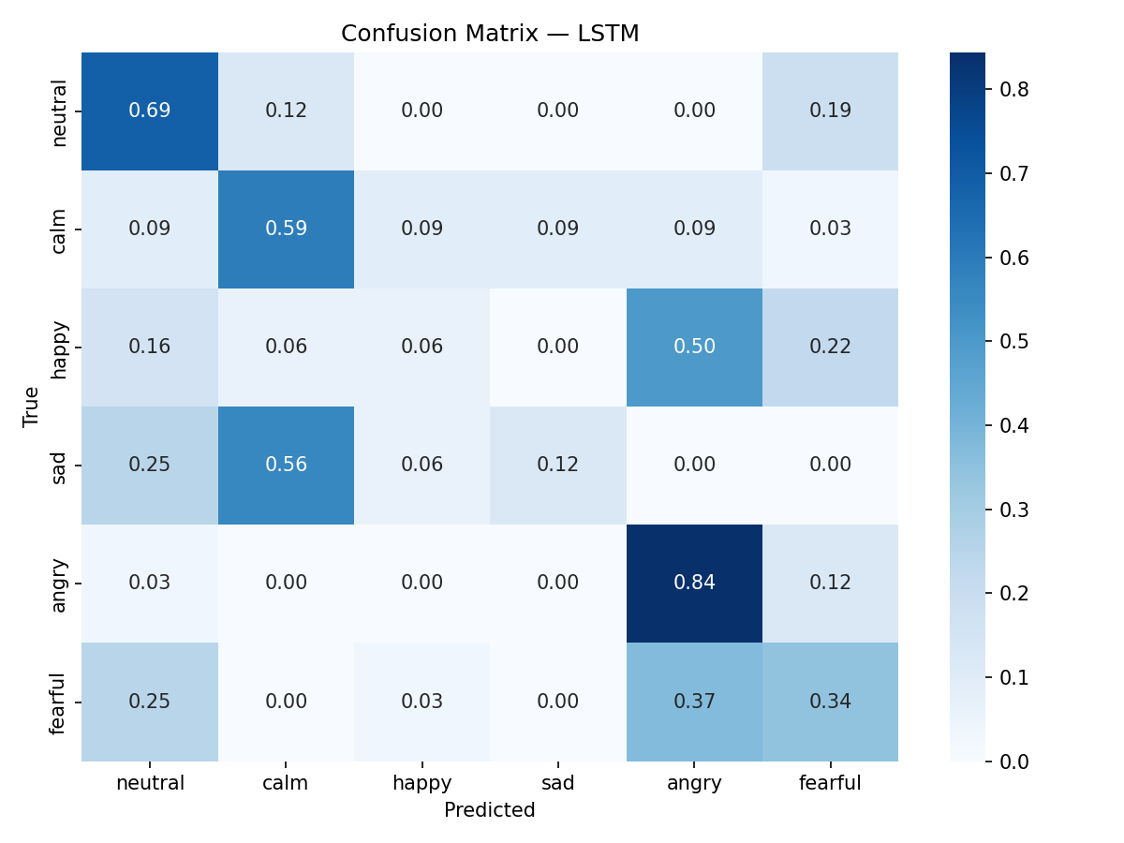
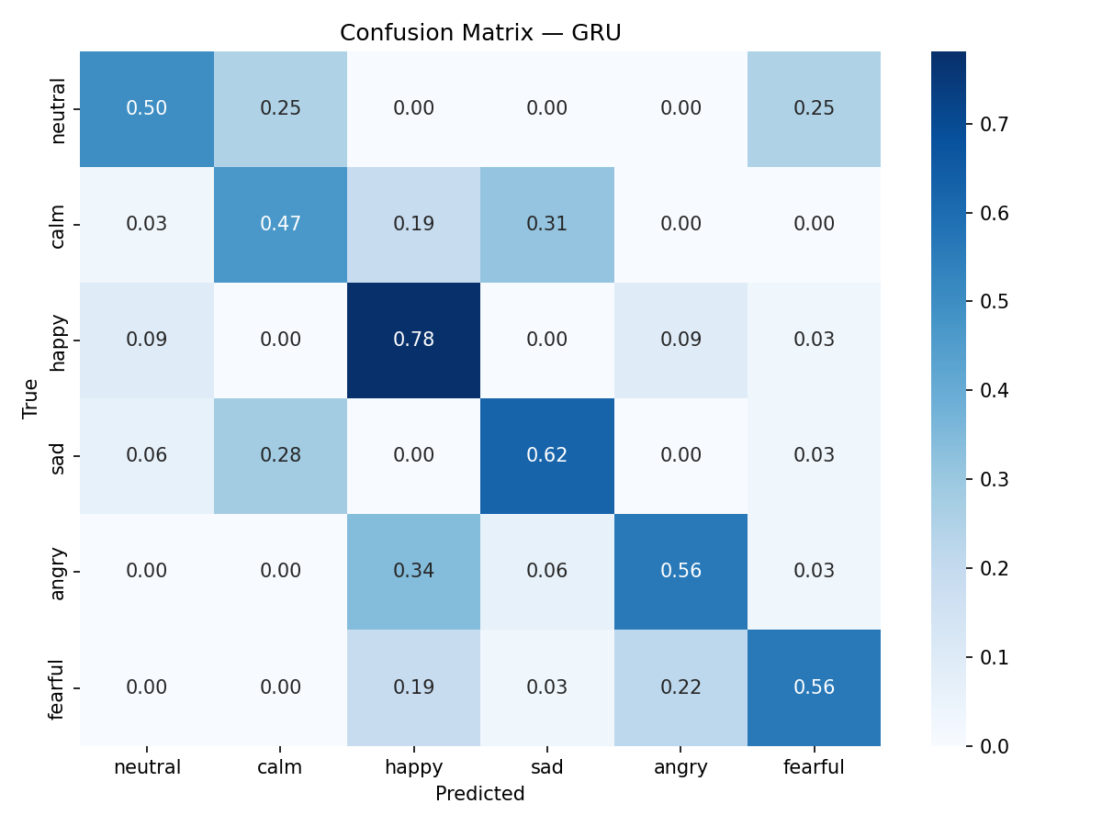
Confusion Matrices
MLP
CNN
LSTM
GRU

Slide 9
Interpretability — SHAP Analysis
Which regions of the mel-spectrogram most influence the CNN's prediction?
SHAP (SHapley Additive exPlanations) Red regions = frequency bands that strongly push toward the predicted emotion Blue regions = areas that suppress the prediction Allows us to understand what the CNN 'hears'
[Run notebook 05_evaluation.ipynb]

Slide 10
Conclusions
Best model: CNN — Accuracy 73.9%, F1 macro 73.8%
CNN excels by treating audio as a 2D image (mel-spectrogram)
LSTM/GRU capture temporal dynamics of vocal emotion effectively
SHAP reveals which frequency bands are most discriminative per emotion
Neutral class remains hardest to classify (fewest training samples)
Future work: transformer-based models (Wav2Vec 2.0), cross-corpus evaluation

Slide 11
Thank You
Questions?
GitHub: github.com/anastasia-drojjina/ravdess-emotion-recognition
Dataset: RAVDESS — Livingstone & Russo (2018) — doi:10.5281/zenodo.1188976

