Slide 1
Best Web Development Frameworks Comparison
by Kupriyanova A.A.
КТмо2-3

Slide 2
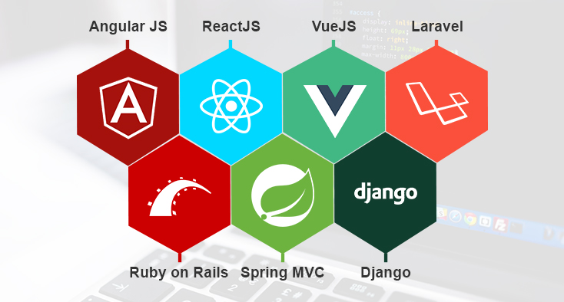


Competitors

Slide 3
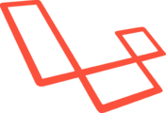
Laravel
Laravel is a free open-source PHP web development framework.
Advantages | Disadvantages
large web development community on GitHub fast development cycles convention over configuration quite well documented packaging system with dedicated dependency manager different ways to access the database | a slow and a new platform for many new developers Fresh developers face problems while executing Laravel codes and classes Community support is less when compared to other platforms Methods included in the reverse routing are very complex
Laravel can be used by the businesses who want to create a back-end website which deals with huge amount of data.

Slide 4
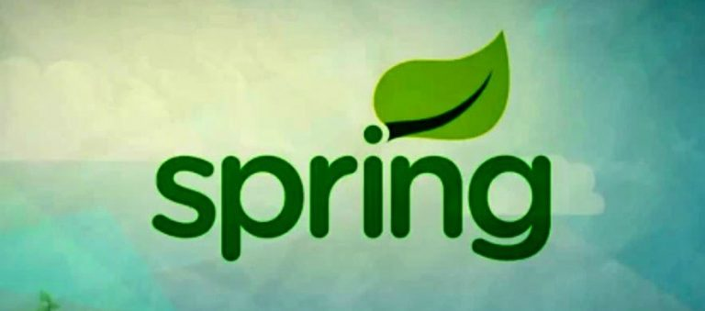
Spring MVC
Framework for creating/developing Java applications. Moreover, Spring MVC provides great features to create applications on the top of Java EE platform. The Spring MVC framework is open source.
Advantages | Disadvantages
a lightweight container, it can deploy Tomcat server easily Deploys Tomcat server on the cross platform Provides lots of API for various domains Can be configured in three ways XML, @nnotation or java config | Developers have to add the JAR file of the respective WAR file is not based on Java JEE standard Difficulty in getting knowledge

Slide 5

Django
Django is a full-stack open-source framework powered by Python.
Advantages | Disadvantages
All key features are included initially with the framework Model-Template-View (very similar to MVC) architecture using Object Relational Mapper (ORM) natively supports common database engines comes with its own lightweight development server | Low development speed Django is a monolithic framework and keeps you within given patterns You always get entire relatively large structure even if you make a simple landing page Setting up asynchronous processes for chats and real-time games is possible but fairly complex
Django is suitable for being used in high-loaded websites.

Slide 6

Ruby on Rails (RoR)
One more famous and reliable open-source MVC framework, created with Ruby.
Advantages | Disadvantages
Convention Over Configuration follows MVC concept provides default structure for the database, the web service and web pages relational and non-relational database engines | A barrier to entry for beginners Ruby requires more server capacity and resources than Python or PHP
Rails is a good tool for professionals to build any kind of web applications, from basic websites to high-traffic web portals or internal corporate application.

Slide 7
Express.js
Express.js is an open-source framework for Node.js to build classical web applications with server side and API.
Advantages | Disadvantages
simple interface very flexible Pluggable quick | You have to install tens of additional libraries and packages compatibility issues It won't work for heavy computation
Express is better for developing simple web services and APIs rather than web portals or high-loaded calculating backends.

Slide 8
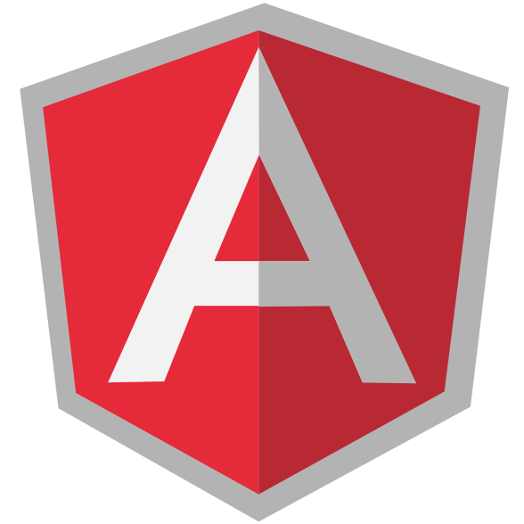
Angular
Angular is a javascript open-source framework designed specially for single-page web apps and mobile application development
Advantages | Disadvantages
allows to use dynamic data to create a web application MVC architectural pattern, using components Good performance | No backward compatibility to Angular 1.x Entry barrier - get familiar with TypeScript first May seem not SEO-friendly
Angular is, probably, the most powerful framework to build single-page web and cross-platform mobile applications because it have a lot of features “in the box” and you don’t need to worry about choosing and updating many plugins, install and work.

Slide 9

React
ReactJS is one of the javascript framework developed by Facebook. It is one of the powerful front-end frameworks.
Advantages | Disadvantages
fast view renders (allows to re-render not whole set of DOM elements but just changed ones) Virtual DOM using same components in different pages | You can’t create a powerful application with full-featured server side using React Using it with Node you will need to add a lot of packages It’s quite complicated to move complex designs from photoshop or any sketch to JSX files
Facebook has created it so it uses it, also for Instagram. This is a good evidence of React’s utility. But to develop a multifunctional full-featured web portal or application you will need something more that pure React, probably Express or even Django for server side.

Slide 10
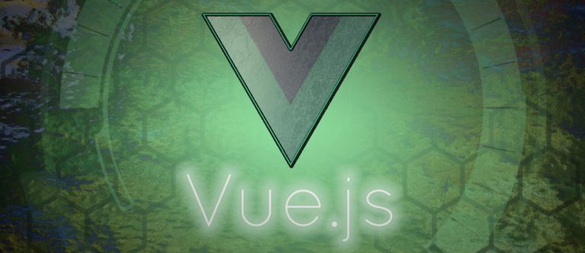
Vue.js
Now Vue.js is open source javascript framework. It has been learning from the mistakes and successes of React & Angular.
Advantages | Disadvantages
Use MVVM pattern Reactivity syntax is more friendly to designers and it’s easier to read it fast UI development | Not enough features “in the box”: you will need additional tools and libraries for: routing, state-management, server communication and a build tool like Webpack much less documentation and plugins
Vue perfectly fits for single page applications and is being used in lots of them. It’s a good choice for beginners for their next projects. Especially if you want to focus on frontend and UI.

Slide 11
Meteor
Meteor is a full-stack framework that uses javascript both for frontend (as others) and for backend designed for developing realtime applications for web and mobile.
Advantages | Disadvantages
requires just knowledge of Javascript one code is supported on a client and a server No need to use REST to get data The core is DDP protocol used for realtime transfer of JSON objects across application’s frontend, server part and DB totally autonomous app compiler | Maybe not good of you need to develop an app for Windows Phone It works well only with MongoDB.
With Meteor, you can create a frontend, backend and a database, all in Javascript what gives you a cross-platform advantage (web, Apple iOS, Android).

