Slide 1

By Kupriyanova Anastasia
КТмо1-3

Slide 2
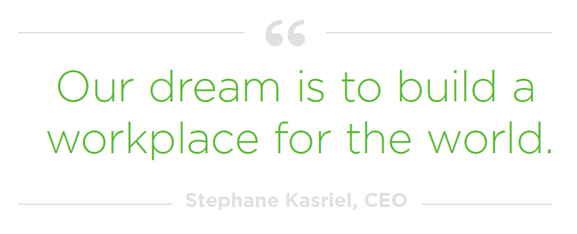
What UpWork is
UpWork is a workspace for:
self-employed individuals and small companies that have a specific skill set and are looking to work on their own.
companies and freelancers that have subcontractors or employees who plan to tackle projects together on Upwork.

Slide 3
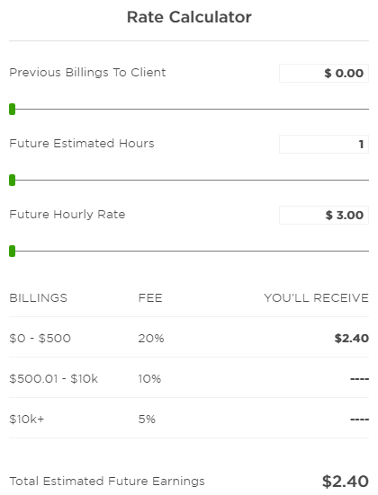
Service fees
Upwork charges freelancers a sliding service fee based on the total amount billed to a single client. You pay:
20% for the first $500 you bill your client across all contracts
10% for total billings with your client between $500.01 and $10,000
5% for total billings with your client that exceed $10,000

Slide 4
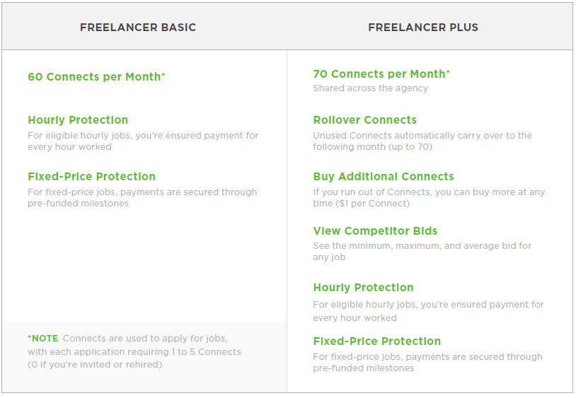
Membership plan options

Slide 5
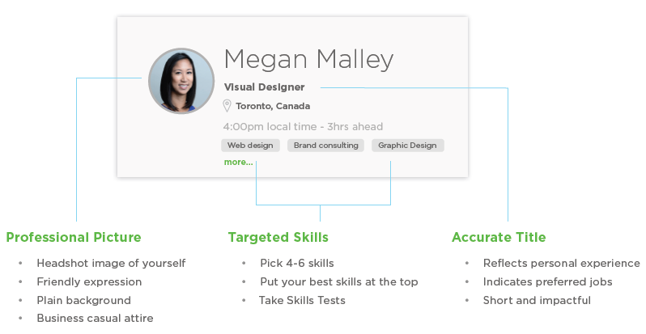
Profile

Slide 6
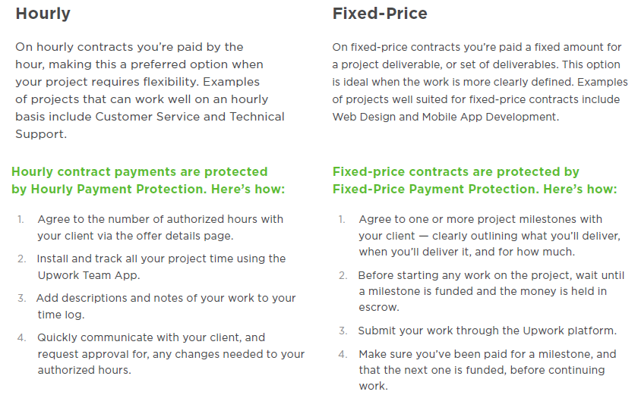
Fixed-price vs. hourly projects

Slide 7
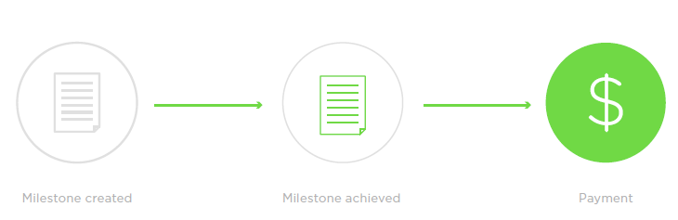
Managing and delivering work Fixed-price contracts
For fixed-price contracts, you and your clients will create a list of milestones. The client will prefund each milestone with escrow, and the money will be visibly held on the Upwork platform. When you’ve completed the work for a milestone, it’s a good idea to let your client know and submit your work to them on Upwork. If they’re satisfied with the work, the funds will be released to your account, and you’ll follow the same sequence for the next milestone.

Slide 8
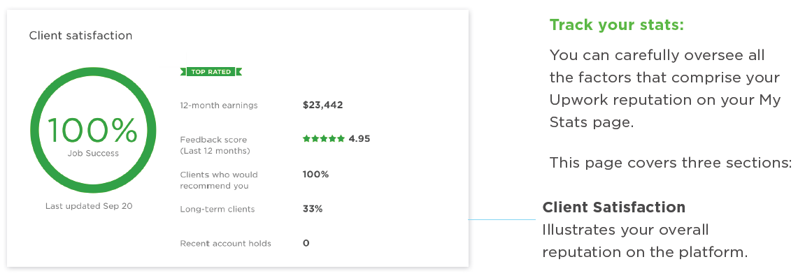
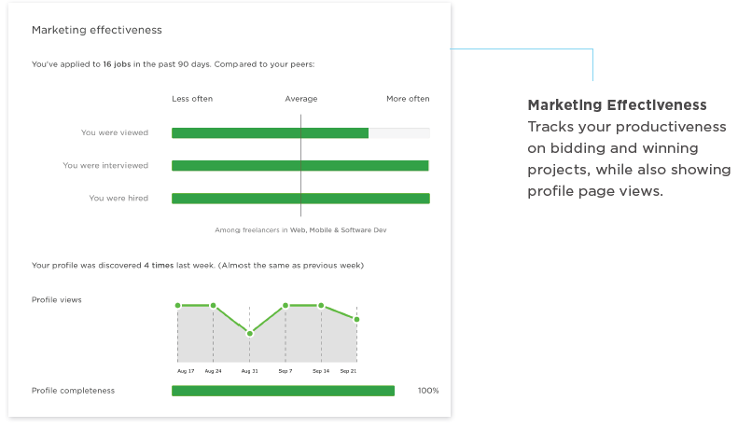
Managing your reputation and profile

Slide 9
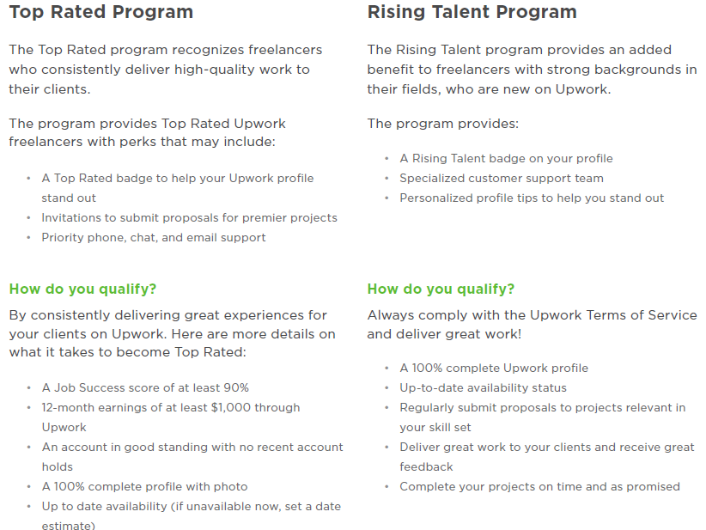
Top Rated program and Rising Talent program

Slide 10
Best practices
Communicate early, communicate often
Be proactive—clients usually get concerned when they don’t hear from a freelancer.
Respect deadlines
Deliver your work on time, every time. If you think you’ll miss a deadline, let your client know so they can plan accordingly.
When in doubt, ask
This will help clear up confusion, save time, and keep the engagement running smoothly.
Be a pleasure to work with
Listen to your client’s concerns and respond with a positive attitude. Developing a rapport can make for a great work experience for both parties.
Set clear expectations
Provide honest and realistic project updates and quickly alert your client when you encounter a problem.
Under-promise, over-deliver
Never promise more than you can deliver and consider giving a little extra to every project.

