Slide 1
INFSCI 1530 - Final Presentation
Anastasia Sosnovskikh
(and Dr. Yurko) (helped a lot)

Slide 2
Problem
Time series forecasting problem

Slide 3
Research Question
Explore if there are dates that can be clustered together
Predict the closing price of bitcoin in the next 6 month
Use historical ‘date’ and ‘close’ to predict the future ‘close’ value

Slide 4
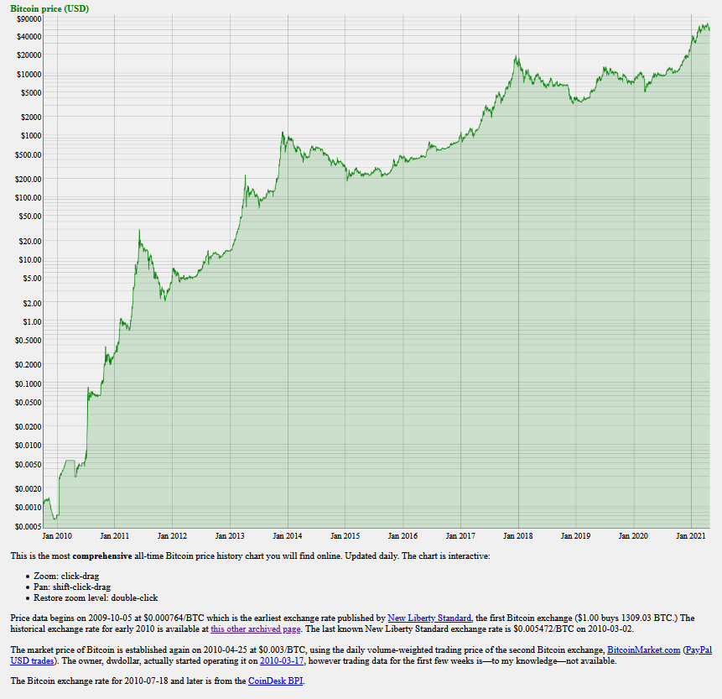
Getting the Data
Bitcoin:
Scraping from https://bitcoin.zorinaq.com/price/
Full history
Daily closing value
Notes:
Updated daily
But just did the easier and faster thing
Copied the page
Parsed the data

Slide 5

Getting the Data
Exogenous Variables (6):
Gold
Crude Oil
S&P 500
Vanguard Financials Fund ETF
Vanguard Information Technology Index Fund ETF
NVIDIA
Same time interval
Daily closing price
Notes:
* For the

Slide 6
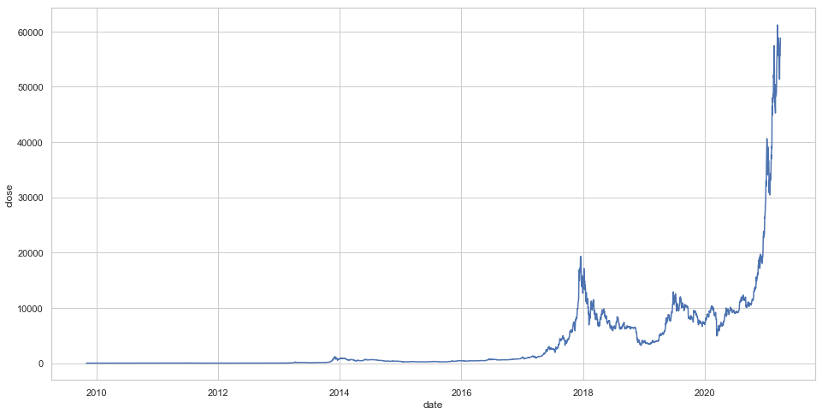
EDA – Bitcoin
The Bitcoin price just skyrocketed in 2021!

Slide 7
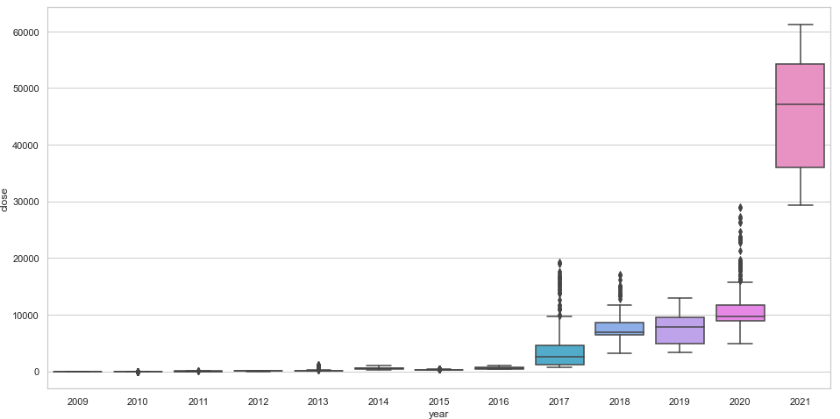
EDA – Bitcoin
The Bitcoin price just skyrocketed in 2021!

Slide 8
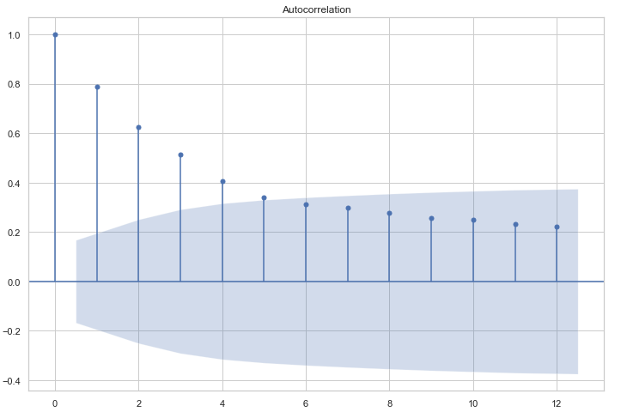
EDA – Bitcoin Monthly Autocorrelation
For the last 6 months

Slide 9
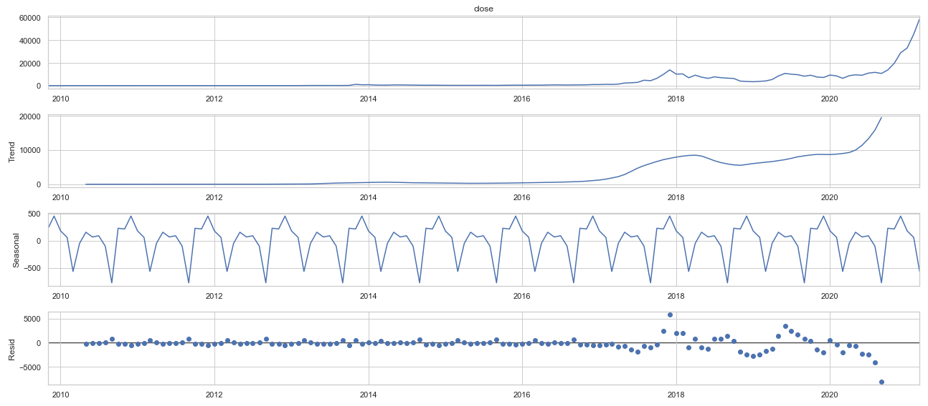
EDA – Bitcoin Monthly Decomposition
For the last 6 months

Slide 10
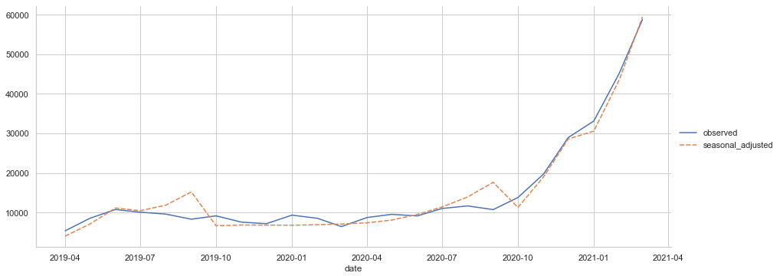
EDA – Bitcoin Monthly Decomposition
For the last 24 months

Slide 11
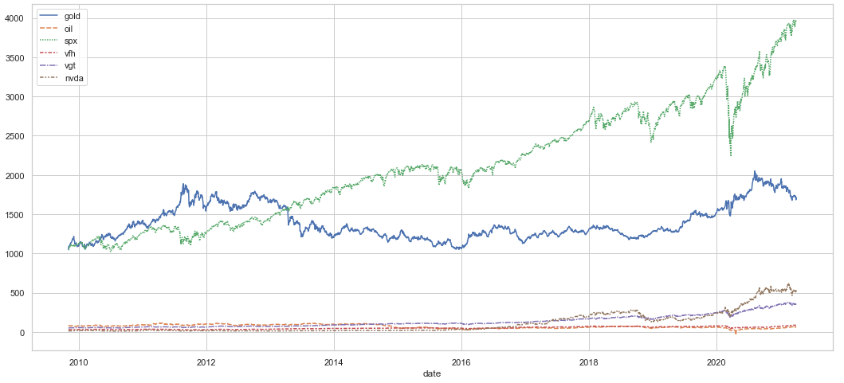
EDA – Exogenous Variables
The interval is from the beginning of Bitcoin history up to now

Slide 12
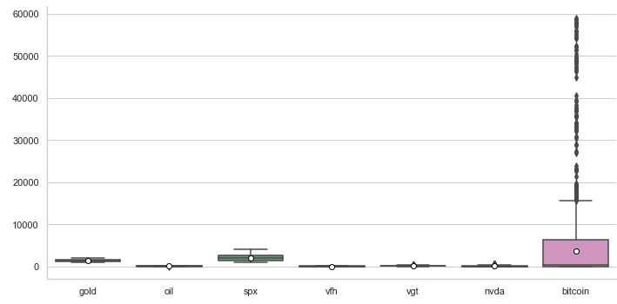
Unsupervised Learning – Clustering
GOAL: explore if some dates can be grouped together
Daily Data
Bitcoin
Exogenous
Log-Transformed

Slide 13
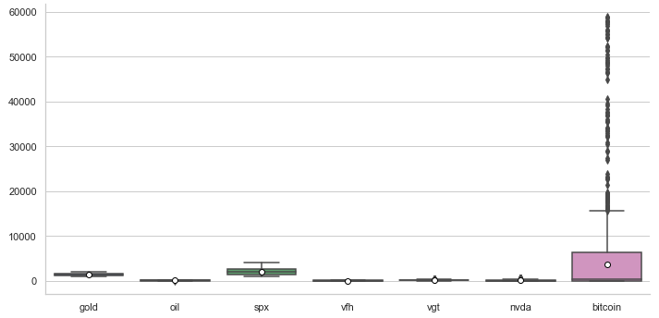
Unsupervised Learning – Clustering
Before Log-Transformation

Slide 14
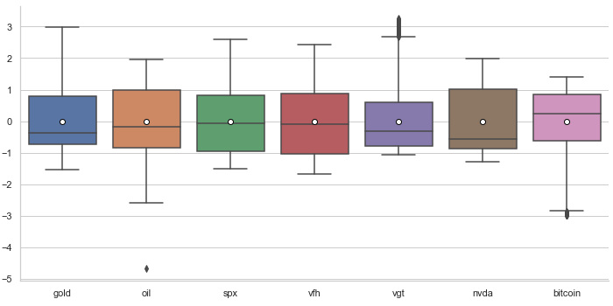
Unsupervised Learning – Clustering
After Log-Transformation

Slide 15
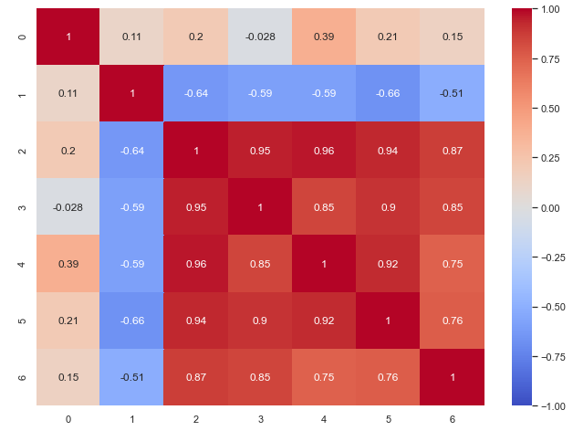
Unsupervised Learning – Correlation
Exogenous Variables (6):
Gold
Crude Oil
S&P 500
Vanguard Financials Fund ETF
Vanguard Information Technology Index Fund ETF
NVIDIA
* After Log-Transformation

Slide 16
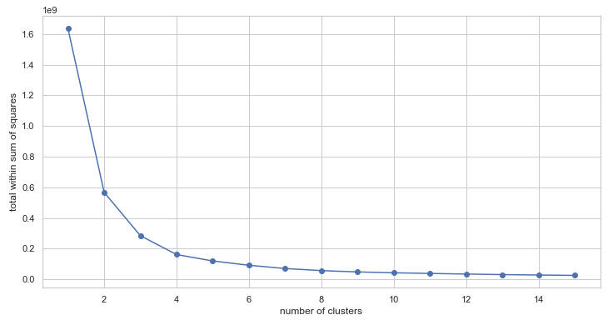
Unsupervised Learning – KMeans
1.. 16 clusters

Slide 17
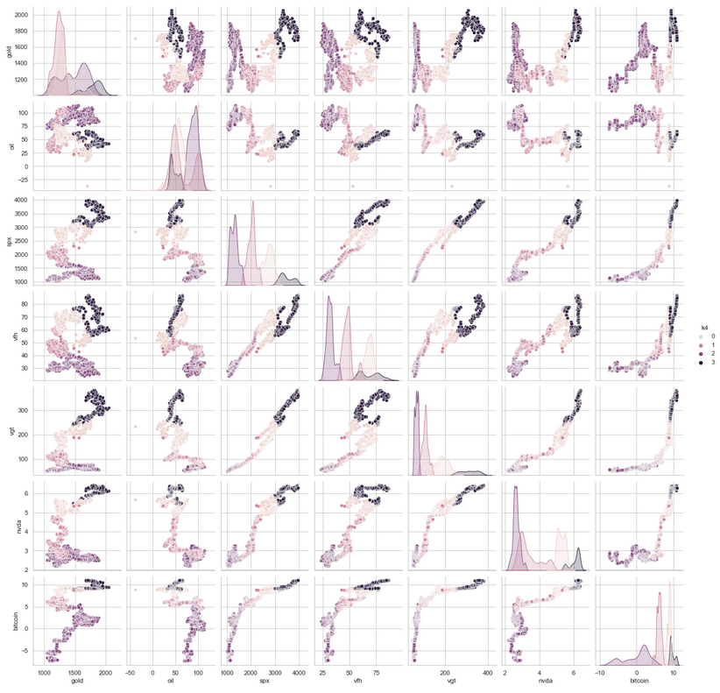
Unsupervised Learning – KMeans
4 clusters
No trend
Autocorrelation?

Slide 18
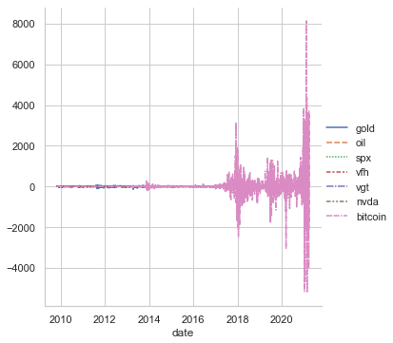
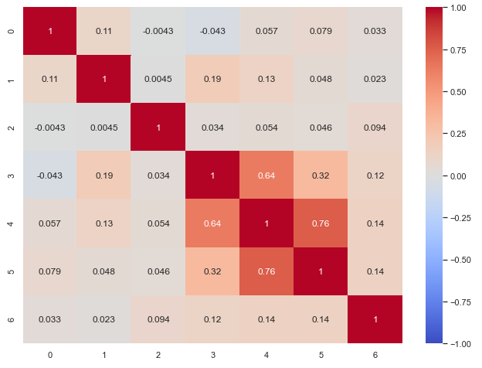
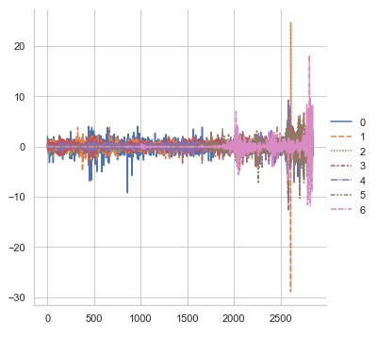
Unsupervised Learning – KMeans with Differencing
Detrend series to avoid the autocorrelation
Standardize detrended features
Check Correlation

Slide 19
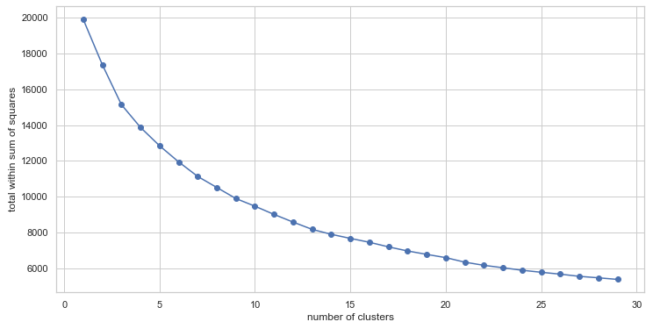
Unsupervised Learning – Kmeans with Differencing
1.. 30 clusters

Slide 20
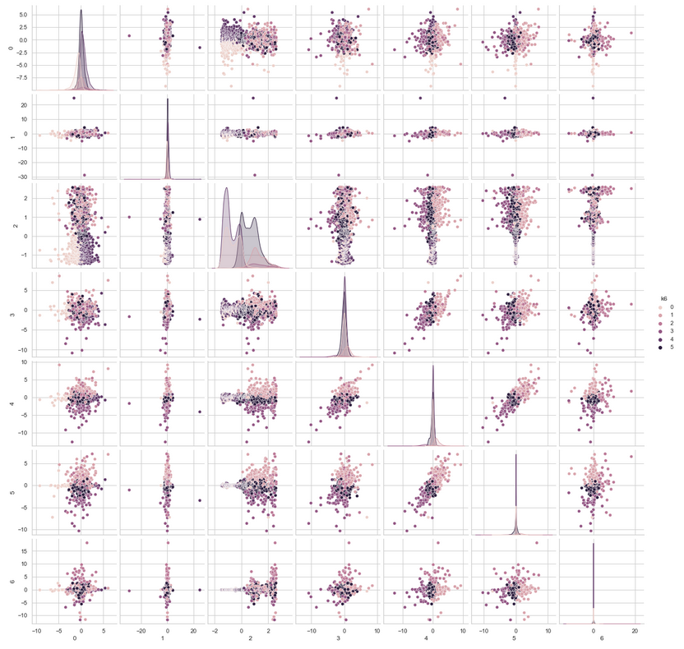
Unsupervised Learning – KMeans with Differencing
6 clusters
Still no trend

Slide 21
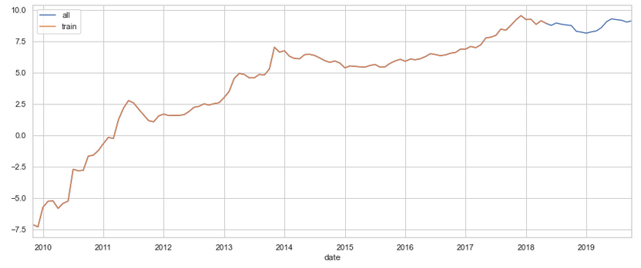
Supervised Learning – Bitcoin Monthly Log Data
Train: October 2009 .. June 2018
Test: June 2018 .. November 2019

Slide 22
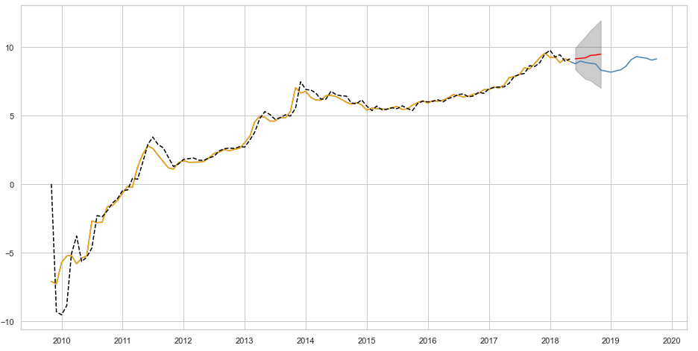
Supervised Learning – ARIMA
In Log Space

Slide 23
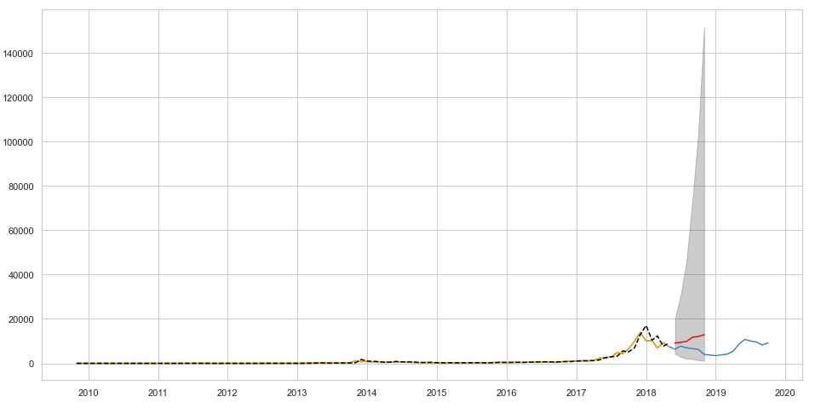
Supervised Learning – ARIMA
Back Transformed

Slide 24
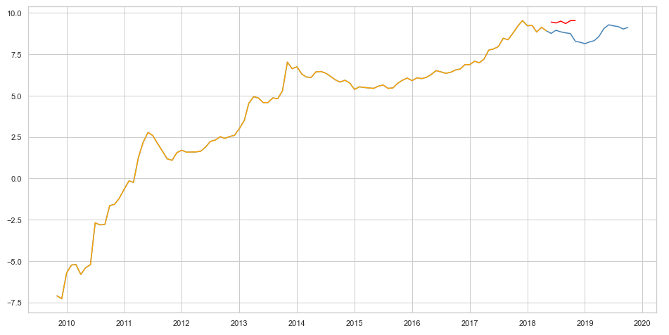
Supervised Learning – SES with STL
In Log Space
Notes:
(2, 2, 3)

Slide 25
Supervised Learning – SES with STL
In Log Space
Notes:
(2, 2, 3)

Slide 26
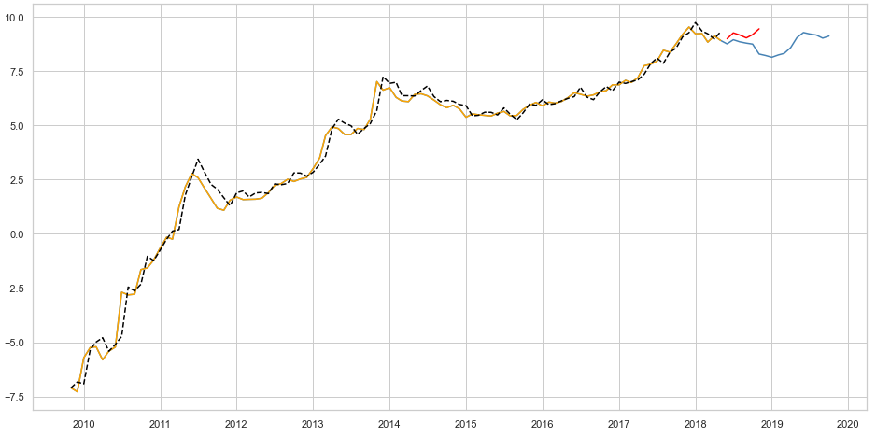
Supervised Learning – Holt-Winters method
In Log Space

Slide 27
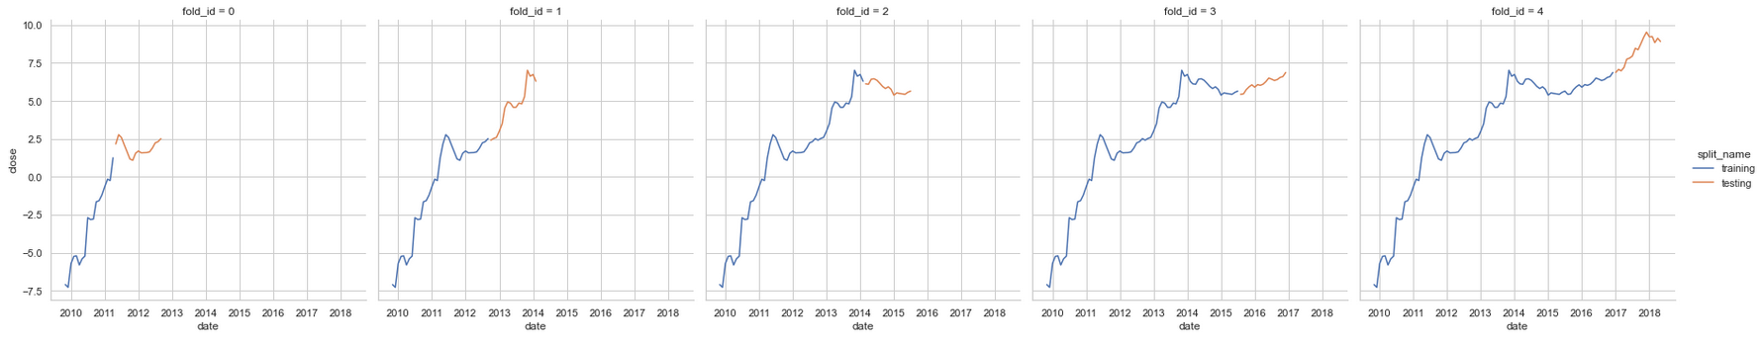
Supervised Learning – Time Series CV
In Log Space

Slide 28
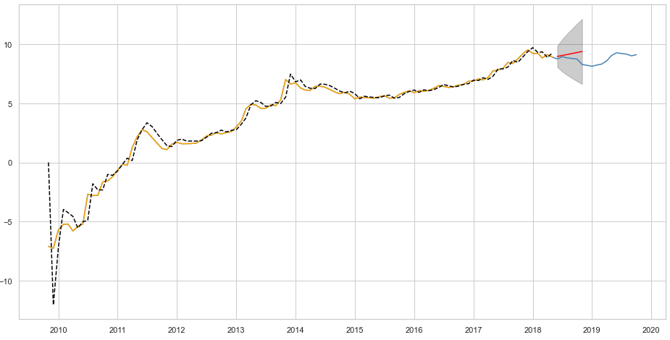
Supervised Learning – ARIMA with CV
In Log Space
Notes:
(2, 2, 3)

Slide 29
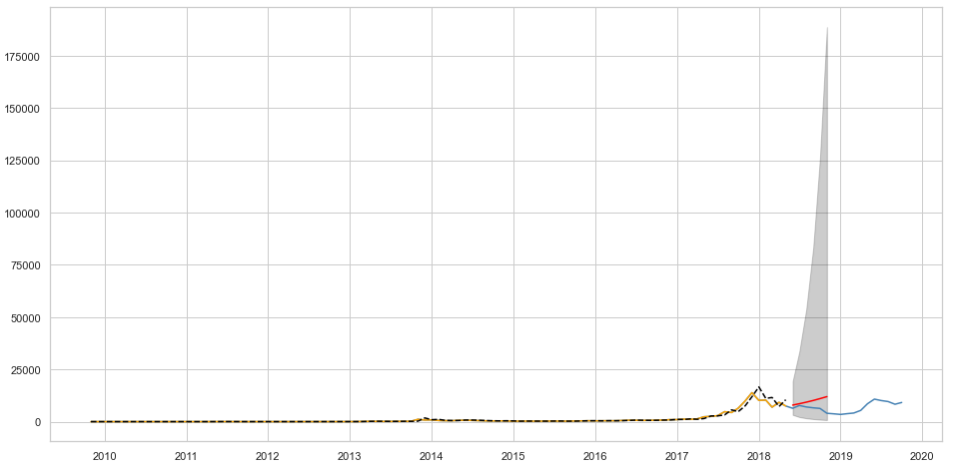
Supervised Learning – ARIMA with CV
Back Transformed
Notes:
(1, 2, 1)

Slide 30
Supervised Learning – Performance
Model | RMSE
ARIMA with CV | 0.553
Holt-Winters | 0.556
ARIMA | 0.635
SES with STL | 0.771
RMSE – the lower the better

Slide 31
Take-Aways
Clustering Task
No pattern found
Prediction Task
Hard to predict!
Still captures the overall trend

Slide 32
Future Directions
Clustering Task
Mixture Model (Gaussian Distribution assumed)
No Differencing
Prediction Task
ARIMA with Fourie Series via CV

