Slide 1
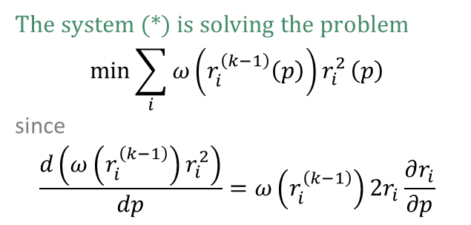
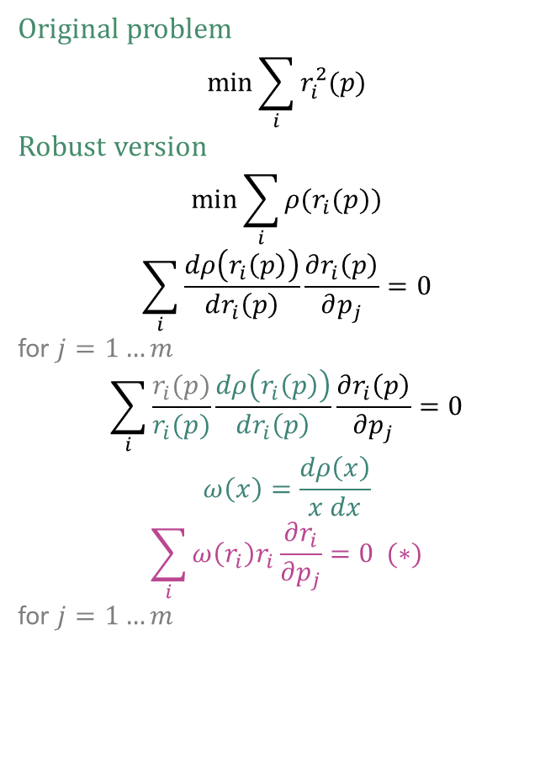
Iteratively reweighted least squares
Original problem
$$\min{\sum_{i}{r_{i}^{2}(p)}}$$
Robust version
$$\min{\sum_{i}{ρ(r_{i}(p))}}$$
$$\sum_{i}{\frac{dρ\left(r_{i}\left(p\right)\right)}{dr_{i}\left(p\right)}\frac{∂r_{i}\left(p\right)}{∂p_{j}}}=0$$
for $j=1…m$
$$\sum_{i}{\frac{r_{i}(p)}{r_{i}(p)}\frac{dρ\left(r_{i}\left(p\right)\right)}{dr_{i}\left(p\right)}\frac{∂r_{i}\left(p\right)}{∂p_{j}}}=0$$
$$ω\left(x\right)=\frac{dρ\left(x\right)}{x dx}$$
$$\sum_{i}{ω\left(r_{i}\right)r_{i}\frac{∂r_{i}}{∂p_{j}}}=0 (∗)$$
for $j=1…m$
The system (*) is solving the problem
$$\min{\sum_{i}{ω\left(r_{i}^{\left(k−1\right)}\left(p\right)\right)r_{i}^{2}}}\left(p\right)$$
since
$$\frac{d\left(ω\left(r_{i}^{\left(k−1\right)}\right)r_{i}^{2}\right)}{dp}=ω\left(r_{i}^{\left(k−1\right)}\right)2r_{i}\frac{∂r_{i}}{∂p}$$

Slide 2
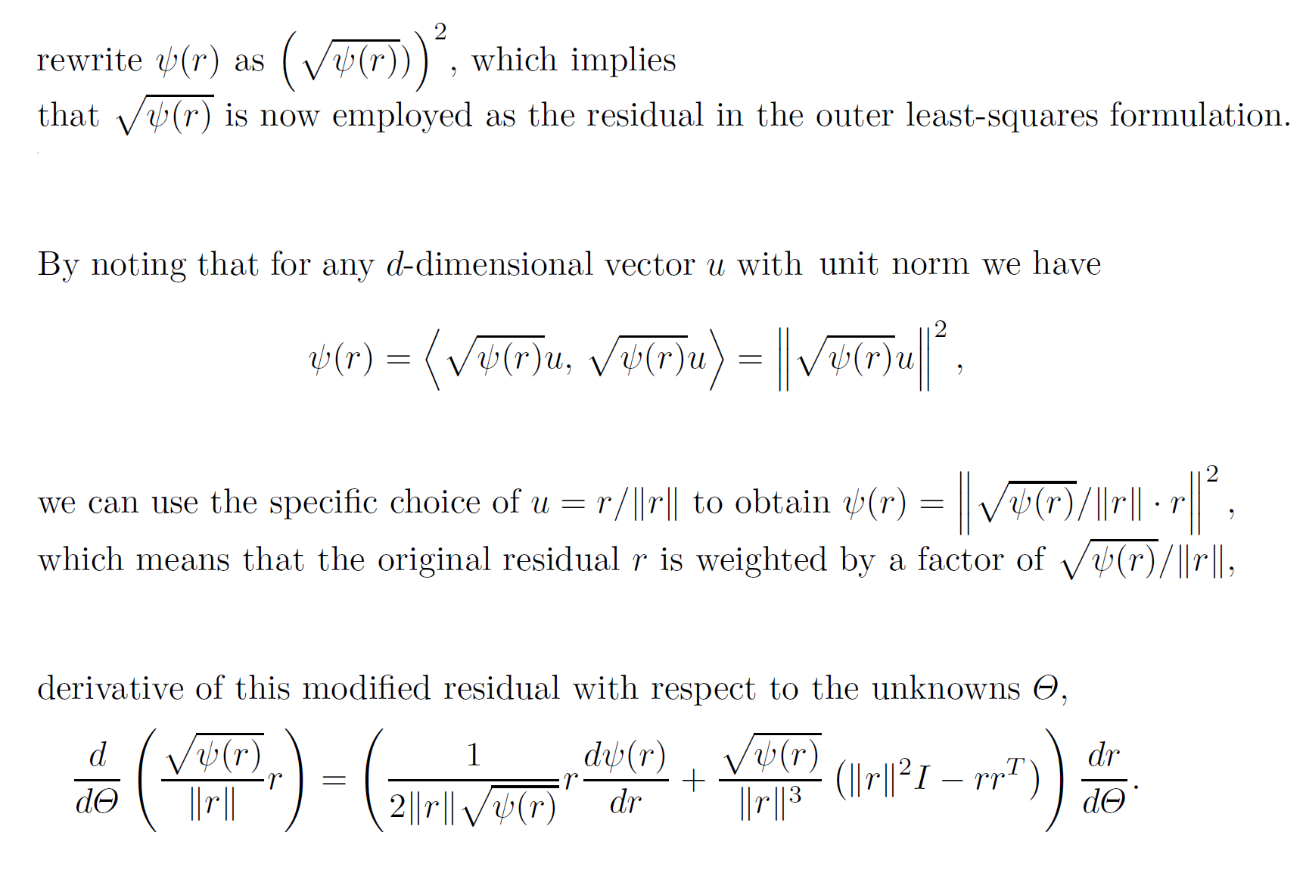
Square-rooting the kernel

Slide 3


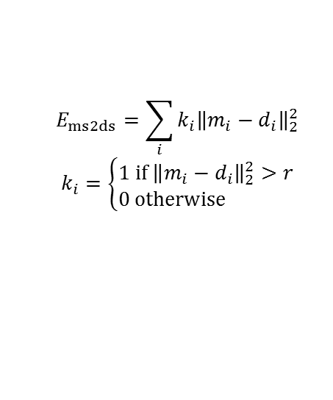

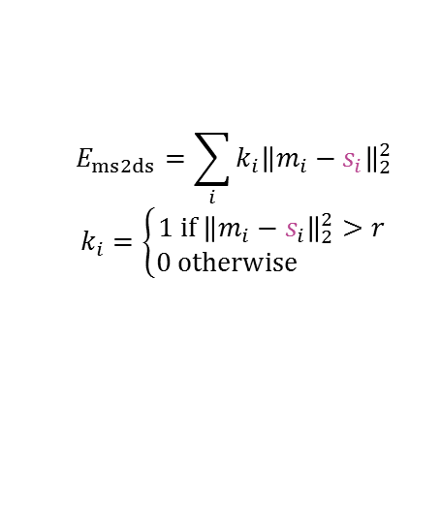


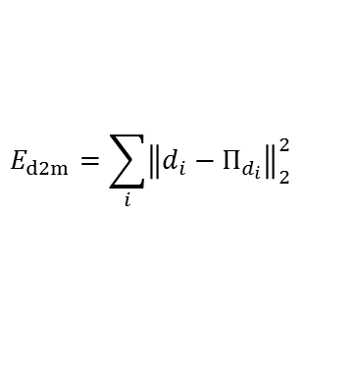

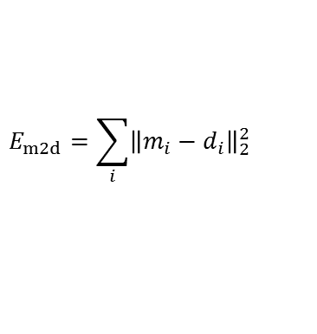










Data energies
d2m – data to model energy
m2d – model to data energy
ms2ds – model-silhouette to data-silhouette energy
fixed ms2ds – model-silhouette to data-silhouette energy
$$m_{1}$$
$$m_{1}$$
$$m_{1}$$
$$s_{1}$$
$$r$$
$$r$$
$$Π_{d_{1}}$$
$$d_{1}$$
$$d_{1}$$
$$d_{1}$$
$$m_{2}$$
$$m_{2}$$
$$d_{1}$$
$$m_{2}$$
$$Π_{d_{2}}$$
$$d_{2}$$
$$d_{2}$$
$$d_{2}$$
$$d_{2}$$
$$Π_{d_{3}}$$
$$d_{3}$$
$$m_{3}$$
$$d_{3}$$
$$d_{3}$$
$$d_{3}$$
$$m_{3}$$
$$m_{3}$$
$$E_{d2m}=\sum_{i}{{\left\|d_{i}−Π_{d_{i}}\right\|}_{2}^{2}}$$
$$E_{m2d}=\sum_{i}{{\left\|m_{i}−d_{i}\right\|}_{2}^{2}}$$
$$E_{ms2ds}=\sum_{i}{{k_{i}\left\|m_{i}−d_{i}\right\|}_{2}^{2}}$$
$$k_{i}=\left\{\begin{matrix}1 if{ \left\|m_{i}−d_{i}\right\|}_{2}^{2}>r \\ 0 otherwise \end{matrix}\right.$$
$$E_{ms2ds}=\sum_{i}{{k_{i}\left\|m_{i}−s_{i}\right\|}_{2}^{2}}$$
$$k_{i}=\left\{\begin{matrix}1 if{ \left\|m_{i}−s_{i}\right\|}_{2}^{2}>r \\ 0 otherwise \end{matrix}\right.$$

Slide 4
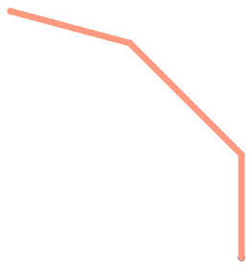
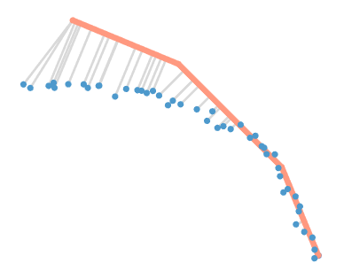







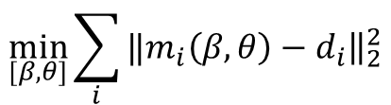







$$β_{3}$$
$$θ_{3}$$
$$\frac{∂m}{∂β_{1}}$$
$$\frac{∂m}{∂θ_{1}}$$
$$\frac{∂m}{∂β_{2}}$$
$$m$$
$$β_{2}$$
$$\frac{∂m}{∂θ_{2}}$$
$$m$$
$$θ_{2}$$
$$β_{1}$$
$$θ_{1}$$
$$m_{i}$$
$$d_{i}$$
$$\min_{[β, θ]}{\sum_{i}{‖{\left.​m_{i}\left(β, θ\right)−d_{i}\right\|}_{2}^{2}}}$$

Slide 6
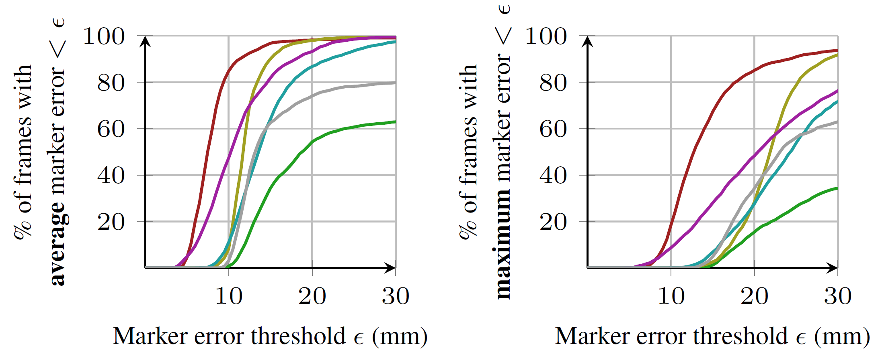
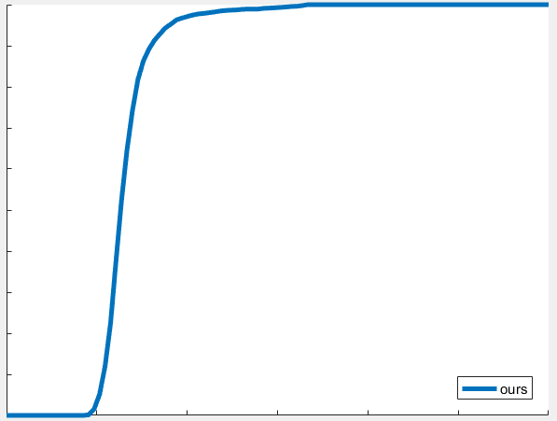
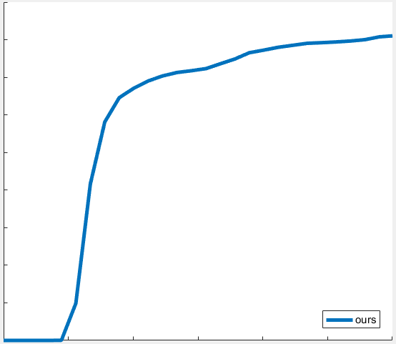
Comparing with [Taylor et al. 2016] on NUY dat

Slide 7
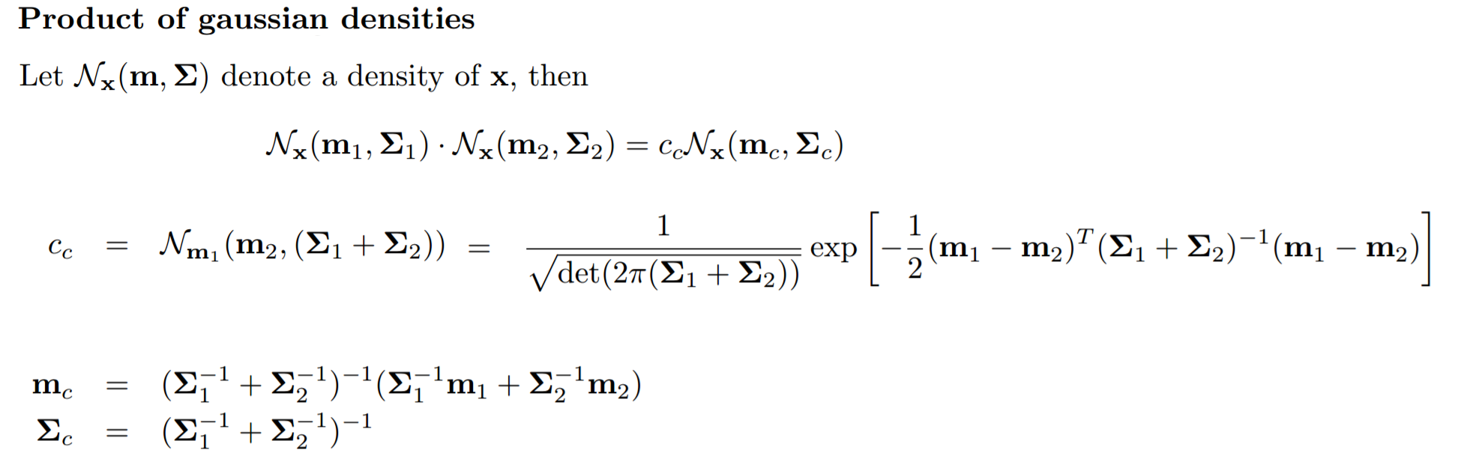
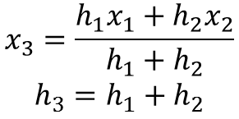
$$x_{3}=\frac{h_{1}x_{1}+h_{2}x_{2}}{h_{1}+h_{2}}$$
$$h_{3}=h_{1}+h_{2}$$

Slide 8
Adding new dofs
Edit shape chains
Edit block-id to beta-id
Set up phalange, type and limit of new dofs
Set up damping
Serialize parametrization of new dofs
Edit update-beta
Edit get-beta
Edit Jacobians on Cuda
Edit update-phalanges

Slide 9










$$θ_{20}$$
$$θ_{29}$$
$$β_{15}$$
$${\tilde{θ}}_{2}$$
$${\tilde{β}}_{1}$$
$$β_{15}$$
$${\tilde{θ}}_{2}$$
$${\tilde{β}}_{1}$$
$$θ_{20}$$
$${\tilde{θ}}_{2}$$

Slide 10











$$θ_{1}$$
$$θ_{1}$$
$${\tilde{θ}}_{1}$$
$${\tilde{θ}}_{1}$$
$$θ_{2}$$
$$β$$
$$\tilde{β}$$
$${\tilde{θ}}_{2}$$
$$β$$
$$θ_{2}$$
$${\tilde{θ}}_{2}$$
$$\tilde{β}$$
$$θ_{1}$$
$${\tilde{θ}}_{1}$$
$$β$$
$$\tilde{β}$$

Slide 11
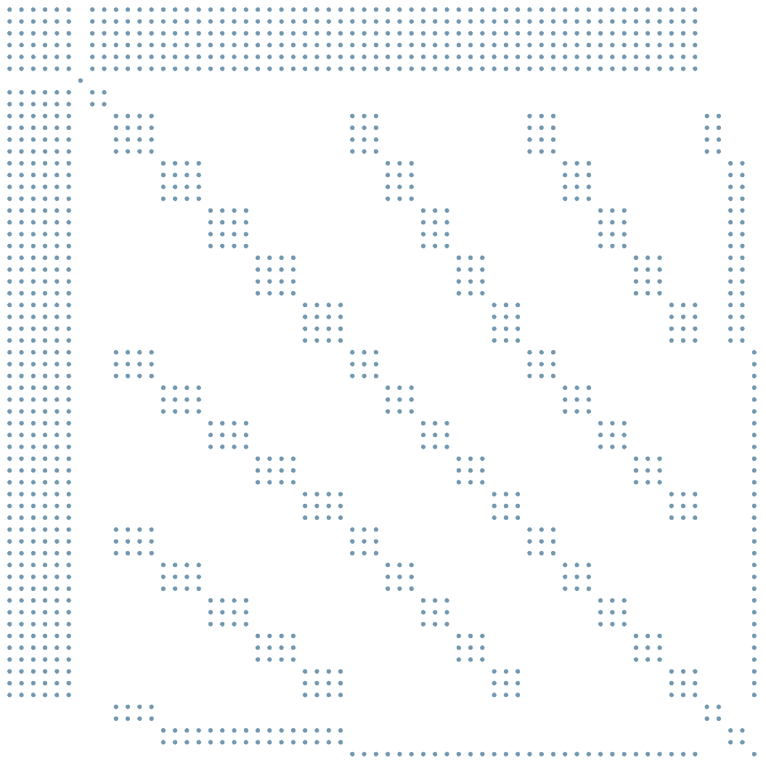




$$θ_{20}$$
$$β_{15}$$
$${\tilde{θ}}_{2}$$
$${\tilde{β}}_{1}$$
$$θ_{1}$$
$${\tilde{θ}}_{1}$$
$$β$$
$$\tilde{β}$$

Slide 12
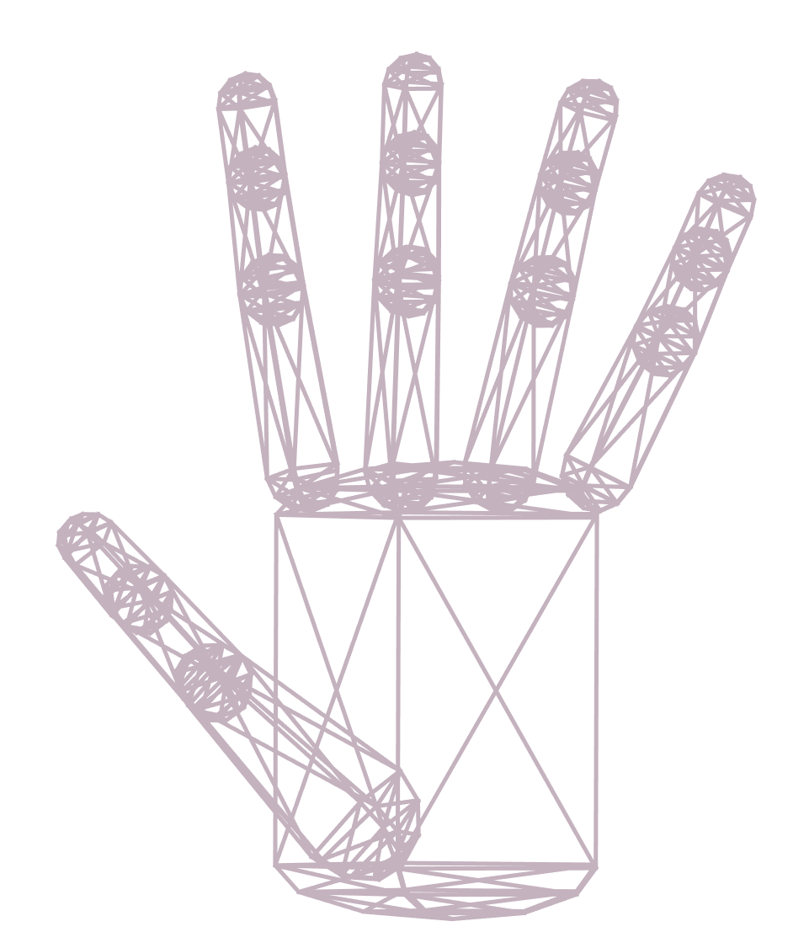
Centers &
Blocks
12
8
6
4
9
3
13
9
5
0
0
7
4
10
1
1
14
10
6
2
11
8
5
2
15
11
7
3
16
4
12
17
13
18
14
19

Slide 13





Betas
8
11
5
14
7
10
4
13
6
9
12
3
$$\begin{matrix}18 \\ 19 \\ 20\end{matrix}$$
$$\begin{matrix}21 \\ 22 \\ 23\end{matrix}$$
$$\begin{matrix}24 \\ 25 \\ 26\end{matrix}$$
$$\begin{matrix}27 \\ 28 \\ 29\end{matrix}$$
2
[0, 1, 0]
1
Y
[1, 0, 0]
X
[0, 0, 1]
0
$$\begin{matrix}15 \\ 16 \\ 17\end{matrix}$$
Z

Slide 14
Centers &
Phalanges
12
8
12
4
15
9
13
9
5
6
0
11
8
14
5
1
14
10
6
2
13
10
7
4
15
11
7
3
16
4
3
17
2
18
0
1
19
16

Slide 15
Thetas
0
[1, 0, 0]
20
1
[0, 1, 0]
16
24
2
[0, 0, 1]
19
23
28
3
[1, 0, 0]
15
4
[0, 1, 0]
27
5
[0, 0, 1]
18
22
17
21
14
13
26
25
12
[0, 1, 0]
[1, 0, 0]
11
flexion (X)
[0, 0, 1]
9
10
abduction (Z)

Slide 17
Centers
12
8
4
0
13
9
5
pinky-top = 0
pinky-middle = 1
pinky-bottom = 2
pinky-base = 3
ring-top = 4
ring-middle = 5
ring-bottom = 6
ring-base = 7
middle-top = 8
middle-middle = 9
middle-bottom = 10
middle-base = 11
thumb-top = 16
thumb-middle = 17
thumb-bottom = 18
thumb-base = 19
index-top = 12
index-middle = 13
index-bottom = 14
index-base = 15
palm-pinky = 20
palm-ring = 21
palm-middle = 22
palm-index = 23
palm-thumb = 24
palm-back = 25
palm-right = 26
palm-left = 27
pinky-membrane = 28
ring-membrane = 29
middle-membrane = 30
index-membrane = 31
thumb-additional = 32
thumb-fold = 33
wrist-top-left = 34
wrist-top-right = 35
wrist-bottom-left = 36
wrist-bottom-right = 37
1
14
10
6
2
32
16
31
30
29
28
15
11
7
3
17
23
22
21
20
33
24
18
19
27
25
26
34
35
36
37

Slide 18
Blocks
6
3
0: (1, 0, 32767)
1: (2, 1, 32767)
2: (3, 2, 32767)
3: (5, 4, 32767)
4: (6, 5, 32767)
5: (7, 6, 32767)
6: (9, 8, 32767)
7: (10, 9, 32767)
8: (11, 10, 32767)
9: (13, 12, 32767)
10: (14, 13, 32767)
11: (15, 14, 32767)
12: (17, 16, 32767)
13: (18, 17, 32767)
14: (19, 18, 33)
15: (26, 21, 20)
16: (25, 26, 21)
17: (25, 22, 21)
18: (25, 27, 22)
19: (27, 22, 23)
20: (20, 29, 28)
21: (21, 20, 29)
22: (21, 30, 29)
23: (22, 21, 30)
24: (22, 23, 30)
25: (23, 30, 31)
26: (19, 33, 24)
27: (16, 32, 32767)
28: (36, 34, 35)
29: (37, 36, 35)
9
0
pinky-top = 0
pinky-middle = 1
pinky-bottom = 2
pinky-base = 3
ring-top = 4
ring-middle = 5
ring-bottom = 6
ring-base = 7
middle-top = 8
middle-middle = 9
middle-bottom = 10
middle-base = 11
thumb-top = 16
thumb-middle = 17
thumb-bottom = 18
thumb-base = 19
index-top = 12
index-middle = 13
index-bottom = 14
index-base = 15
palm-pinky = 20
palm-ring = 21
palm-middle = 22
palm-index = 23
palm-thumb = 24
palm-back = 25
palm-right = 26
palm-left = 27
pinky-membrane = 28
ring-membrane = 29
middle-membrane = 30
index-membrane = 31
thumb-additional = 32
thumb-fold = 33
wrist-top-left = 34
wrist-top-right = 35
wrist-bottom-left = 36
wrist-bottom-right = 37
10
7
4
1
11
8
5
2
27
25
22
20
12
24
23
21
13
19
17
15
26
14
18
16
28
29

Slide 19



Phalanges
Thetas
Kinematic Chains (Chain of Thetas)
15
12
9
20
phalange $→$ thetas its shape depends on
0: “” $→$
1: “” $→$
2: “” $→$
3: “” $→$
4: “” $→$
5: “” $→$
6: “” $→$
7: “” $→$
8: “” $→$
9: “” $→$
10: “” $→$
11: “” $→$
12: “” $→$
13: “” $→$
14: “” $→$
15: “” $→$
16: “” $→$
6
16
24
14
11
28
8
5
15
19
23
27
13
10
7
4
13
14
17
18
21
22
25
26
3
12
0
[1, 0, 0]
2
1
[0, 1, 0]
$$0$$
2
[0, 0, 1]
11
3
[1, 0, 0]
1
4
[0, 1, 0]
9
10
5
[0, 0, 1]
[0, 1, 0]
[1, 0, 0]
flexion (X)
$$16$$
[0, 0, 1]
abduction (Z)

Slide 20



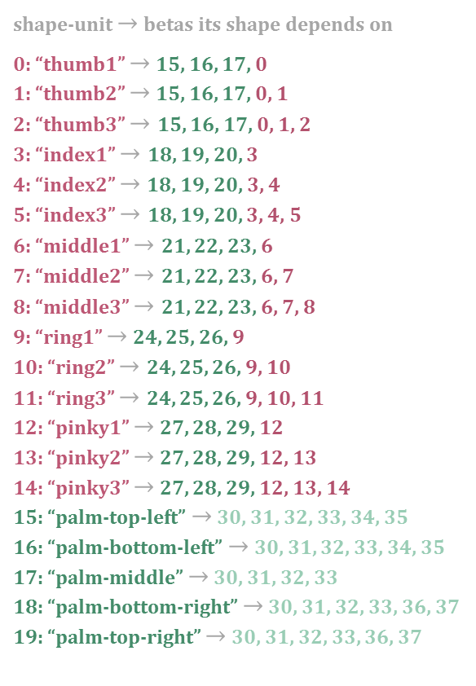











Shape Units
Betas
Shape Chains (Chain of Betas)
5
8
5
8
11
11
shape-unit $→$ betas its shape depends on
0: “thumb1” $→$ 15, 16, 17, 0
1: “thumb2” $→$ 15, 16, 17, 0, 1
2: “thumb3” $→$ 15, 16, 17, 0, 1, 2
3: “index1” $→$ 18, 19, 20, 3
4: “index2” $→$18, 19, 20, 3, 4
5: “index3” $→$ 18, 19, 20, 3, 4, 5
6: “middle1” $→$ 21, 22, 23, 6
7: “middle2” $→$ 21, 22, 23, 6, 7
8: “middle3” $→$ 21, 22, 23, 6, 7, 8
9: “ring1” $→$ 24, 25, 26, 9
10: “ring2” $→$ 24, 25, 26, 9, 10
11: “ring3” $→$ 24, 25, 26, 9, 10, 11
12: “pinky1” $→$ 27, 28, 29, 12
13: “pinky2” $→$ 27, 28, 29, 12, 13
14: “pinky3” $→$ 27, 28, 29, 12, 13, 14
15: “palm-top-left” $→$ 30, 31, 32, 33, 34, 35
16: “palm-bottom-left” $→$ 30, 31, 32, 33, 34, 35
17: “palm-middle” $→$ 30, 31, 32, 33
18: “palm-bottom-right” $→$ 30, 31, 32, 33, 36, 37
19: “palm-top-right” $→$ 30, 31, 32, 33, 36, 37
14
14
4
7
10
4
7
10
13
13
3
6
9
12
3
6
9
12
2
2
$$30 31$$
$$32 33$$
$$\begin{matrix}18 \\ 19 \\ 20\end{matrix}$$
$$\begin{matrix}21 \\ 22 \\ 23\end{matrix}$$
$$\begin{matrix}24 \\ 25 \\ 26\end{matrix}$$
$$\begin{matrix}27 \\ 28 \\ 29\end{matrix}$$
1
$$15$$
$$17$$
$$19$$
1
$$16$$
$$18$$
0
0
$$\begin{matrix}15 \\ 16 \\ 17\end{matrix}$$
$$34 35$$
$$36 37$$

