Slide 1
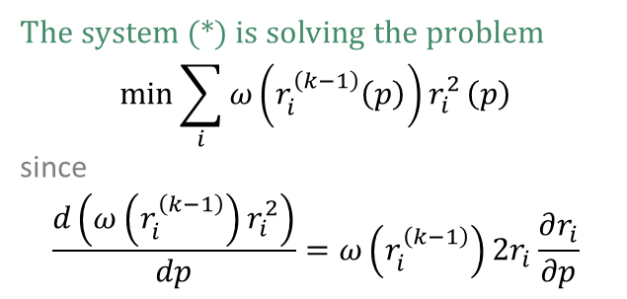
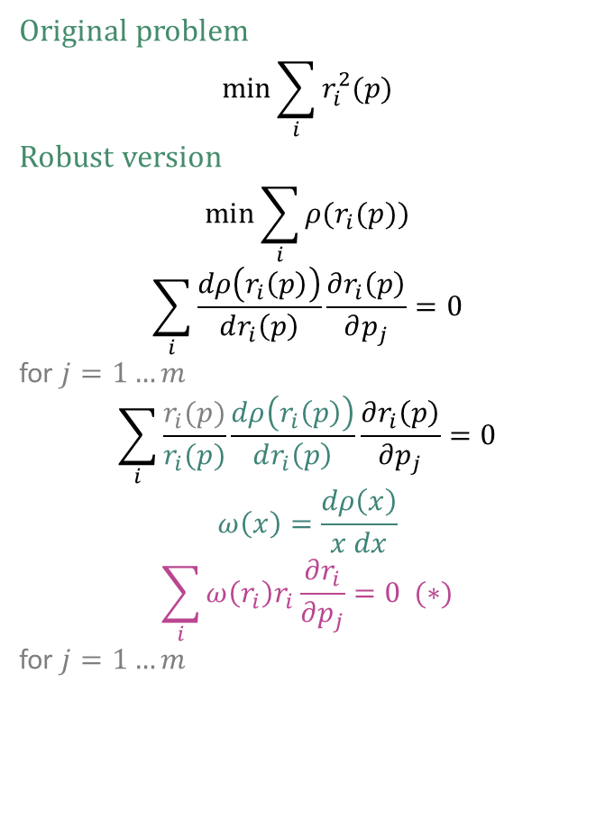
Iteratively reweighted least squares
Original problem
$$\min{\sum_{i}{r_{i}^{2}(p)}}$$
Robust version
$$\min{\sum_{i}{ρ(r_{i}(p))}}$$
$$\sum_{i}{\frac{dρ\left(r_{i}\left(p\right)\right)}{dr_{i}\left(p\right)}\frac{∂r_{i}\left(p\right)}{∂p_{j}}}=0$$
for $j=1…m$
$$\sum_{i}{\frac{r_{i}(p)}{r_{i}(p)}\frac{dρ\left(r_{i}\left(p\right)\right)}{dr_{i}\left(p\right)}\frac{∂r_{i}\left(p\right)}{∂p_{j}}}=0$$
$$ω\left(x\right)=\frac{dρ\left(x\right)}{x dx}$$
$$\sum_{i}{ω\left(r_{i}\right)r_{i}\frac{∂r_{i}}{∂p_{j}}}=0 (∗)$$
for $j=1…m$
The system (*) is solving the problem
$$\min{\sum_{i}{ω\left(r_{i}^{\left(k−1\right)}\left(p\right)\right)r_{i}^{2}}}\left(p\right)$$
since
$$\frac{d\left(ω\left(r_{i}^{\left(k−1\right)}\right)r_{i}^{2}\right)}{dp}=ω\left(r_{i}^{\left(k−1\right)}\right)2r_{i}\frac{∂r_{i}}{∂p}$$

Slide 2
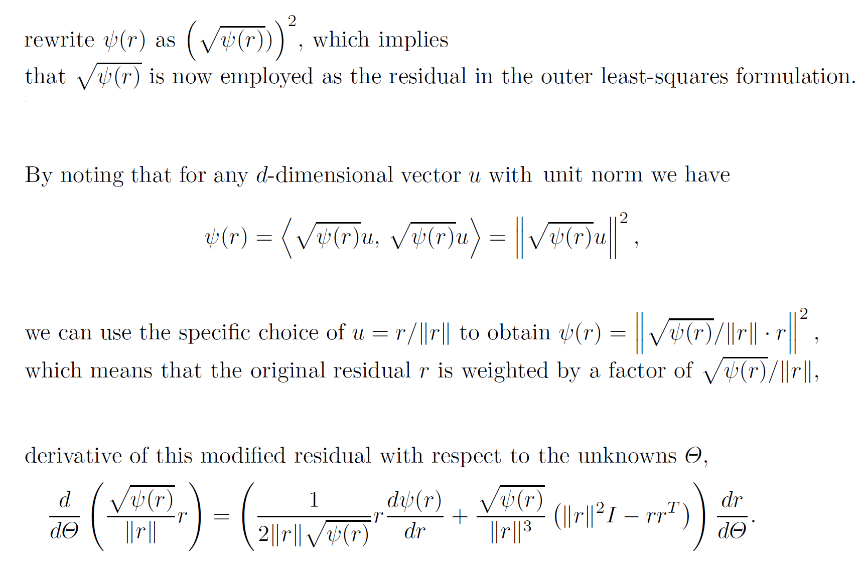
Square-rooting the kernel

Slide 3


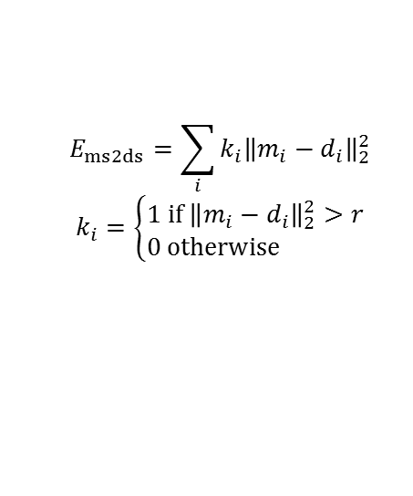

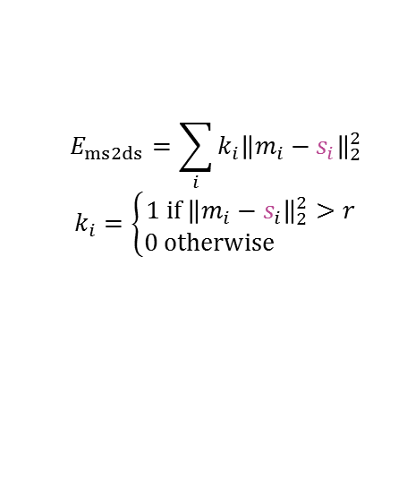


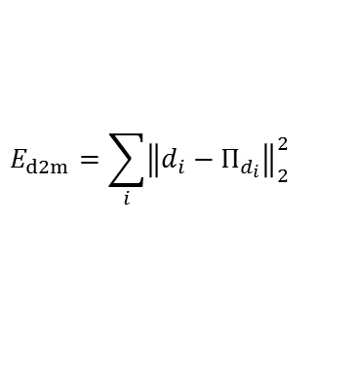

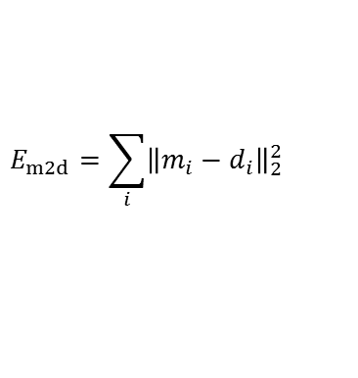










Data energies
d2m – data to model energy
m2d – model to data energy
ms2ds – model-silhouette to data-silhouette energy
fixed ms2ds – model-silhouette to data-silhouette energy
$$m_{1}$$
$$m_{1}$$
$$m_{1}$$
$$s_{1}$$
$$r$$
$$r$$
$$Π_{d_{1}}$$
$$d_{1}$$
$$d_{1}$$
$$d_{1}$$
$$m_{2}$$
$$m_{2}$$
$$d_{1}$$
$$m_{2}$$
$$Π_{d_{2}}$$
$$d_{2}$$
$$d_{2}$$
$$d_{2}$$
$$d_{2}$$
$$Π_{d_{3}}$$
$$d_{3}$$
$$m_{3}$$
$$d_{3}$$
$$d_{3}$$
$$d_{3}$$
$$m_{3}$$
$$m_{3}$$
$$E_{d2m}=\sum_{i}{{\left\|d_{i}−Π_{d_{i}}\right\|}_{2}^{2}}$$
$$E_{m2d}=\sum_{i}{{\left\|m_{i}−d_{i}\right\|}_{2}^{2}}$$
$$E_{ms2ds}=\sum_{i}{{k_{i}\left\|m_{i}−d_{i}\right\|}_{2}^{2}}$$
$$k_{i}=\left\{\begin{matrix}1 if{ \left\|m_{i}−d_{i}\right\|}_{2}^{2}>r \\ 0 otherwise \end{matrix}\right.$$
$$E_{ms2ds}=\sum_{i}{{k_{i}\left\|m_{i}−s_{i}\right\|}_{2}^{2}}$$
$$k_{i}=\left\{\begin{matrix}1 if{ \left\|m_{i}−s_{i}\right\|}_{2}^{2}>r \\ 0 otherwise \end{matrix}\right.$$

Slide 4
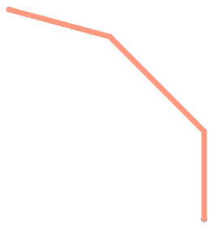
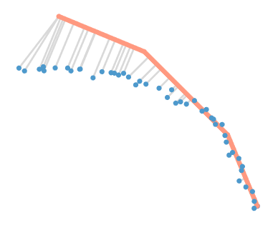







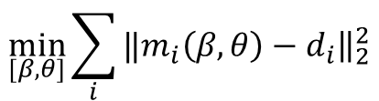







$$β_{3}$$
$$θ_{3}$$
$$\frac{∂m}{∂β_{1}}$$
$$\frac{∂m}{∂θ_{1}}$$
$$\frac{∂m}{∂β_{2}}$$
$$m$$
$$β_{2}$$
$$\frac{∂m}{∂θ_{2}}$$
$$m$$
$$θ_{2}$$
$$β_{1}$$
$$θ_{1}$$
$$m_{i}$$
$$d_{i}$$
$$\min_{[β, θ]}{\sum_{i}{‖{\left.​m_{i}\left(β, θ\right)−d_{i}\right\|}_{2}^{2}}}$$

Slide 5
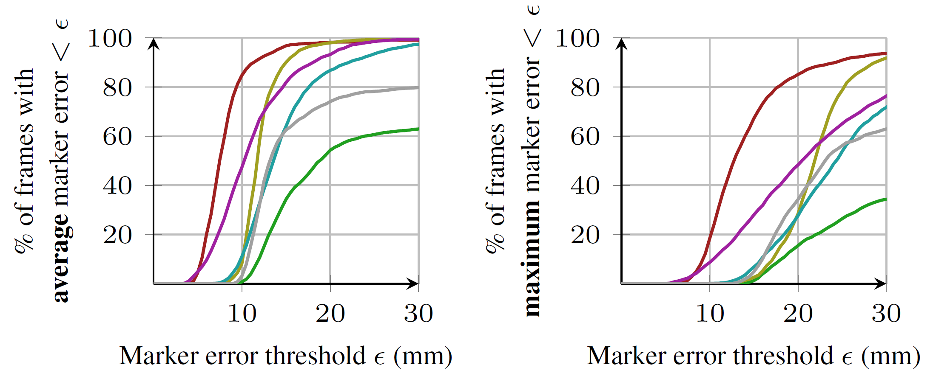
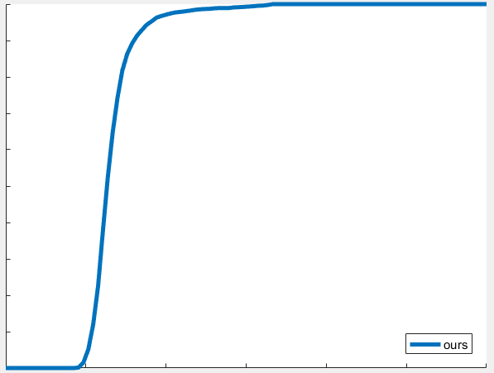
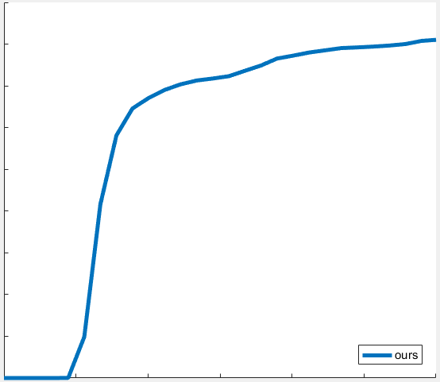
Comparing with [Taylor et al. 2016] on NUY dat

Slide 6
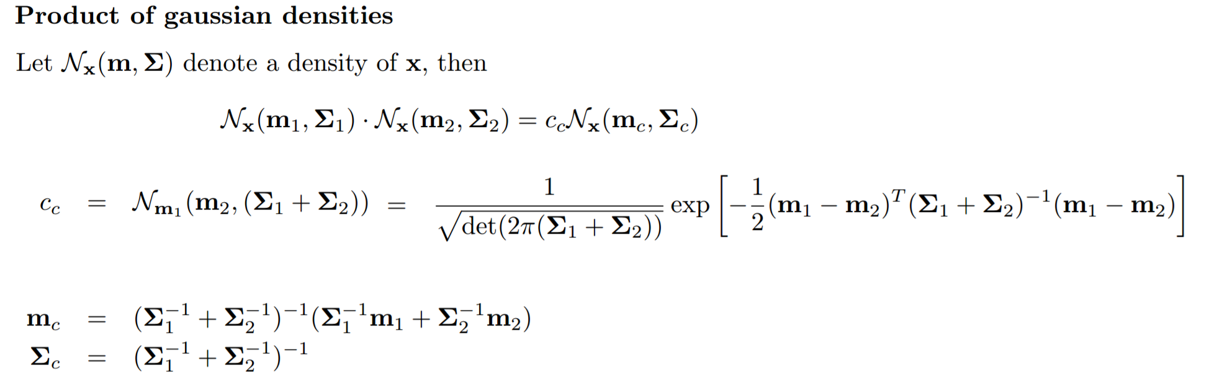
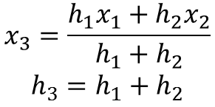
$$x_{3}=\frac{h_{1}x_{1}+h_{2}x_{2}}{h_{1}+h_{2}}$$
$$h_{3}=h_{1}+h_{2}$$

Slide 7
Adding new dofs
Edit shape chains
Change SHAPE_MAX_LENGTH
Edit block-id to beta-id
Set up phalange, type and limit of new dofs
Set up damping
Serialize-beta-infos
Edit update-beta
Edit get-beta
Edit update-beta-double
Edit Jacobians on Cuda
Edit update-phalanges

Slide 8










$$θ_{20}$$
$$θ_{29}$$
$$β_{15}$$
$${\tilde{θ}}_{2}$$
$${\tilde{β}}_{1}$$
$$β_{15}$$
$${\tilde{θ}}_{2}$$
$${\tilde{β}}_{1}$$
$$θ_{20}$$
$${\tilde{θ}}_{2}$$

Slide 9











$$θ_{1}$$
$$θ_{1}$$
$${\tilde{θ}}_{1}$$
$${\tilde{θ}}_{1}$$
$$θ_{2}$$
$$β$$
$$\tilde{β}$$
$${\tilde{θ}}_{2}$$
$$β$$
$$θ_{2}$$
$${\tilde{θ}}_{2}$$
$$\tilde{β}$$
$$θ_{1}$$
$${\tilde{θ}}_{1}$$
$$β$$
$$\tilde{β}$$

Slide 10
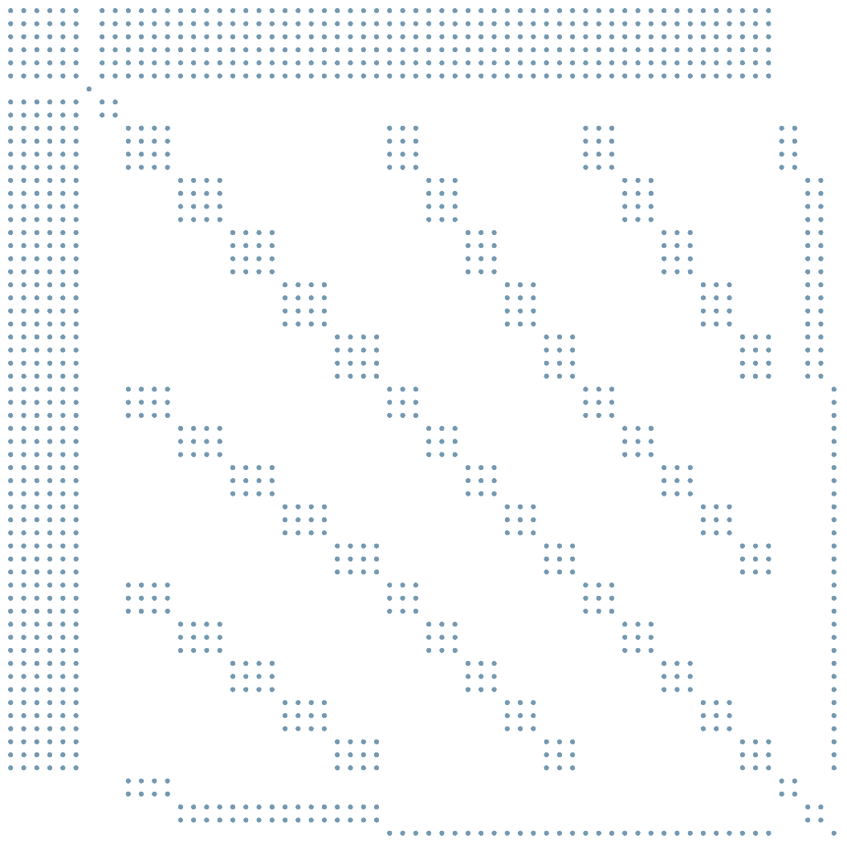




$$θ_{20}$$
$$β_{15}$$
$${\tilde{θ}}_{2}$$
$${\tilde{β}}_{1}$$
$$θ_{1}$$
$${\tilde{θ}}_{1}$$
$$β$$
$$\tilde{β}$$

Slide 11
Centers
Blocks
0: pinky-top
1: pinky-middle
2: pinky-bottom
3: pinky-base
4: ring-top
5: ring-middle
6: ring-bottom
7: ring-base
8: middle-top
9: middle-middle
10: middle-bottom
11: middle-base
12: index-top
13: index-middle
14: index-bottom
15: index-base
16: thumb-top
17: thumb-middle
18: thumb-bottom
19: thumb-base
20: palm-pinky
21: palm-ring
22: palm-middle
23: palm-index
24: palm-thumb
25: palm-back
26: palm-right
27: palm-left
28: pinky-membrane
29: ring-membrane
30: middle-membrane
31: index-membrane
32: thumb-additional
33: thumb-fold
34: wrist-top-left
35: wrist-top-right
36: wrist-bottom-left
37: wrist-bottom-right
12
8
4
0: (1, 0)
1: (2, 1)
2: (3, 2)
3: (5, 4)
4: (6, 5)
5: (7, 6)
6: (9, 8)
7: (10, 9)
8: (11, 10)
9: (13, 12)
10: (14, 13)
11: (15, 14)
12: (17, 16)
13: (18, 17)
14: (19, 18, 33)
15: (26, 21, 20)
16: (25, 26, 21)
17: (25, 22, 21)
18: (25, 27, 22)
19: (27, 22, 23)
20: (20, 29, 28)
21: (21, 20, 29)
22: (21, 30, 29)
23: (22, 21, 30)
24: (22, 23, 30)
25: (23, 30, 31)
26: (19, 33, 24)
27: (16, 32)
28: (36, 34, 35)
29: (37, 36, 35)
6
3
0
9
13
9
5
0
1
10
7
4
10
1
14
6
2
32
11
8
5
2
16
31
30
29
28
27
25
22
20
15
11
7
3
12
24
23
21
17
23
22
21
20
33
24
13
19
17
15
18
26
14
18
16
19
27
25
26
34
35
28
36
37
29

Slide 12

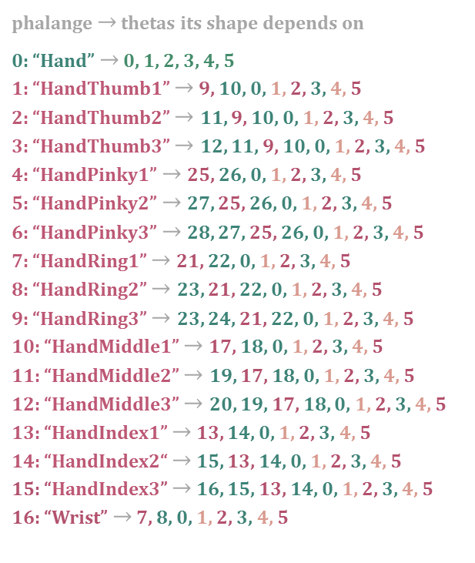

Phalanges
Thetas
Kinematic Chains (Chain of Thetas)
15
12
9
20
phalange $→$ thetas its shape depends on
0: “Hand” $→$ 0, 1, 2, 3, 4, 5
1: “HandThumb1” $→$ 9, 10, 0, 1, 2, 3, 4, 5
2: “HandThumb2” $→$ 11, 9, 10, 0, 1, 2, 3, 4, 5
3: “HandThumb3” $→$ 12, 11, 9, 10, 0, 1, 2, 3, 4, 5
4: “HandPinky1” $→$25, 26, 0, 1, 2, 3, 4, 5
5: “HandPinky2” $→$ 27, 25, 26, 0, 1, 2, 3, 4, 5
6: “HandPinky3” $→$ 28, 27, 25, 26, 0, 1, 2, 3, 4, 5
7: “HandRing1” $→$21, 22, 0, 1, 2, 3, 4, 5
8: “HandRing2” $→$ 23, 21, 22, 0, 1, 2, 3, 4, 5
9: “HandRing3” $→$ 23, 24, 21, 22, 0, 1, 2, 3, 4, 5
10: “HandMiddle1” $→$17, 18, 0, 1, 2, 3, 4, 5
11: “HandMiddle2” $→$ 19, 17, 18, 0, 1, 2, 3, 4, 5
12: “HandMiddle3” $→$ 20, 19, 17, 18, 0, 1, 2, 3, 4, 5
13: “HandIndex1” $→$ 13, 14, 0, 1, 2, 3, 4, 5
14: “HandIndex2“ $→$ 15, 13, 14, 0, 1, 2, 3, 4, 5
15: “HandIndex3” $→$ 16, 15, 13, 14, 0, 1, 2, 3, 4, 5
16: “Wrist” $→$ 7, 8, 0, 1, 2, 3, 4, 5
6
16
24
14
11
8
28
5
15
19
23
27
13
10
7
4
3
13
14
17
18
21
22
25
26
12
2
$$0$$
11
1
0
3
9
10
1
4
twist (Y)
2
5
[0, 1, 0]
7
8
[1, 0, 0]
flexion (X)
[0, 0, 1]
$$16$$
abduction (Z)

Slide 13
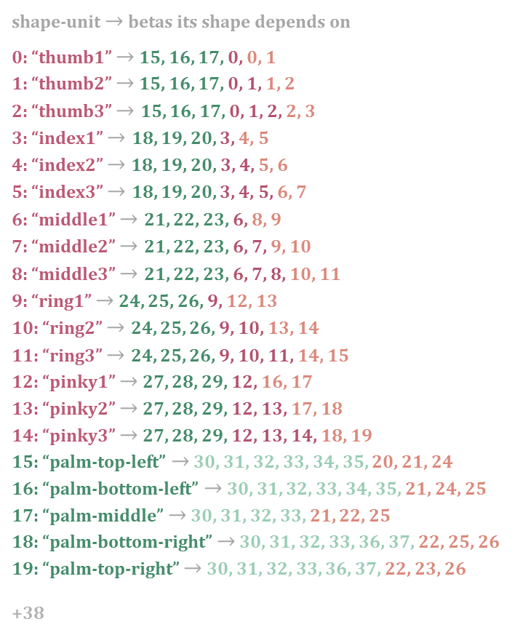














Shape Units
Betas
Shape Chains (Chain of Betas)
11
7
15
5
8
5
8
shape-unit $→$ betas its shape depends on
0: “thumb1” $→$ 15, 16, 17, 0, 0, 1
1: “thumb2” $→$ 15, 16, 17, 0, 1, 1, 2
2: “thumb3” $→$ 15, 16, 17, 0, 1, 2, 2, 3
3: “index1” $→$ 18, 19, 20, 3, 4, 5
4: “index2” $→$18, 19, 20, 3, 4, 5, 6
5: “index3” $→$ 18, 19, 20, 3, 4, 5, 6, 7
6: “middle1” $→$ 21, 22, 23, 6, 8, 9
7: “middle2” $→$ 21, 22, 23, 6, 7, 9, 10
8: “middle3” $→$ 21, 22, 23, 6, 7, 8, 10, 11
9: “ring1” $→$ 24, 25, 26, 9, 12, 13
10: “ring2” $→$ 24, 25, 26, 9, 10, 13, 14
11: “ring3” $→$ 24, 25, 26, 9, 10, 11, 14, 15
12: “pinky1” $→$ 27, 28, 29, 12, 16, 17
13: “pinky2” $→$ 27, 28, 29, 12, 13, 17, 18
14: “pinky3” $→$ 27, 28, 29, 12, 13, 14, 18, 19
15: “palm-top-left” $→$ 30, 31, 32, 33, 34, 35, 20, 21, 24
16: “palm-bottom-left” $→$ 30, 31, 32, 33, 34, 35, 21, 24, 25
17: “palm-middle” $→$ 30, 31, 32, 33, 21, 22, 25
18: “palm-bottom-right” $→$ 30, 31, 32, 33, 36, 37, 22, 25, 26
19: “palm-top-right” $→$ 30, 31, 32, 33, 36, 37, 22, 23, 26
+38
11
11
19
14
6
10
14
14
7
7
18
4
10
4
10
13
13
5
9
13
17
3
6
9
12
3
6
9
12
3
2
2
4
8
12
16
$$30 31$$
$$32 33$$
2
20
21
22
23
$$\begin{matrix}18 \\ 19 \\ 20\end{matrix}$$
$$\begin{matrix}21 \\ 22 \\ 23\end{matrix}$$
$$\begin{matrix}24 \\ 25 \\ 26\end{matrix}$$
$$\begin{matrix}27 \\ 28 \\ 29\end{matrix}$$
1
$$15$$
$$17$$
$$19$$
1
$$16$$
$$18$$
1
0
0
0
$$\begin{matrix}15 \\ 16 \\ 17\end{matrix}$$
24
25
26
$$34 35$$
$$36 37$$

Slide 14
Semantic Limits
palm-index-y + palm-index-r < index-base-y
palm-index-r <
index-base-z + index-base-r
index-base-x + index-base-r <
palm-index-x + palm-index-r

Slide 15





Known Covariances
$${\tilde{β}}_{4}$$
$${\tilde{β}}_{1}$$
$${\tilde{β}}_{5}$$
$${\tilde{β}}_{3}$$
$${\tilde{β}}_{2}$$

