Slide 1
Machine Learning
Anastasia Leiker

Slide 2

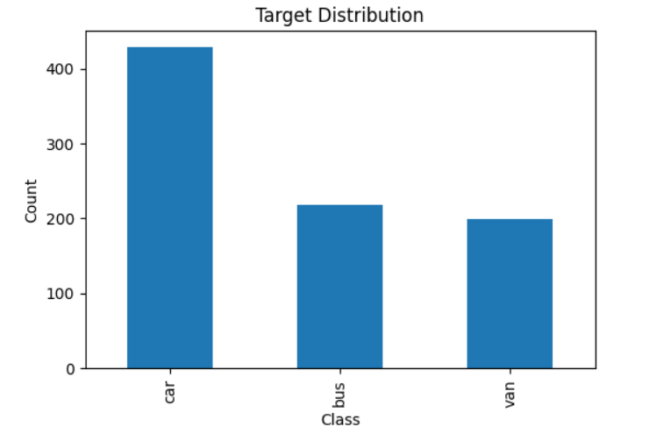
Datenset

Slide 3
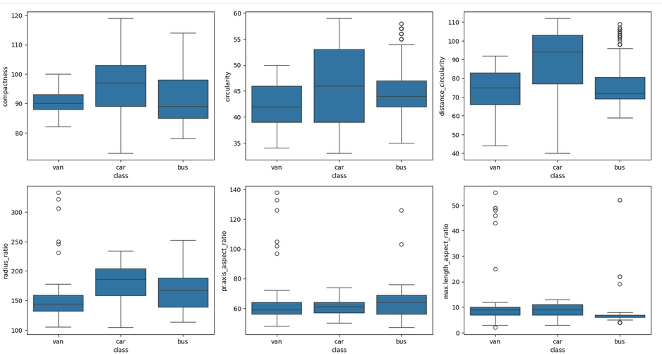
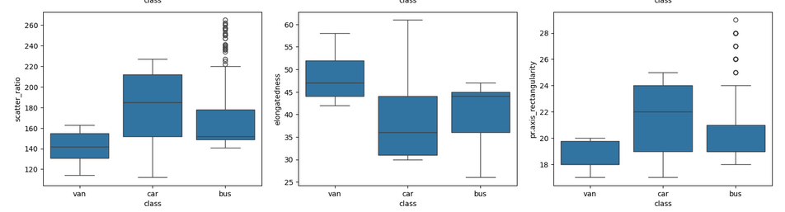
Exploratory Data Analysis

Slide 4
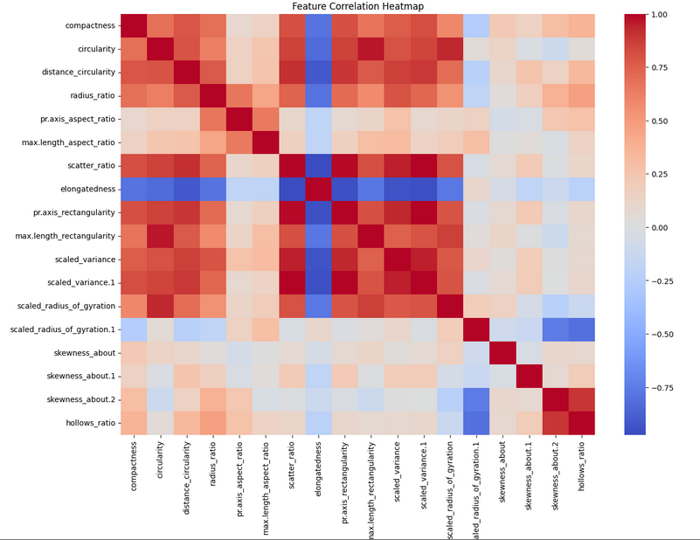
Feature Correlation Heatmap

Slide 5
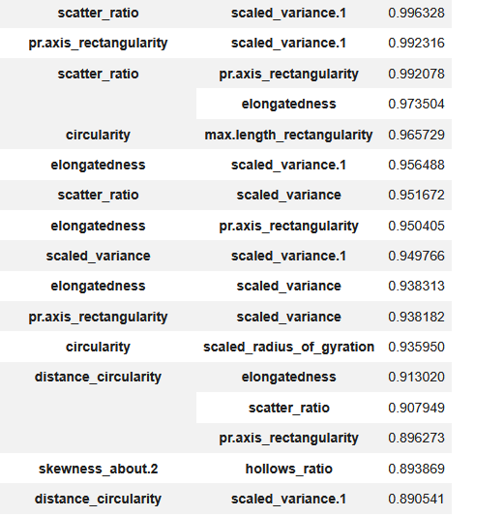
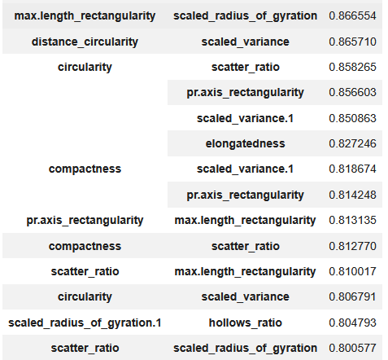
Highly Correlated Pairs

Slide 6
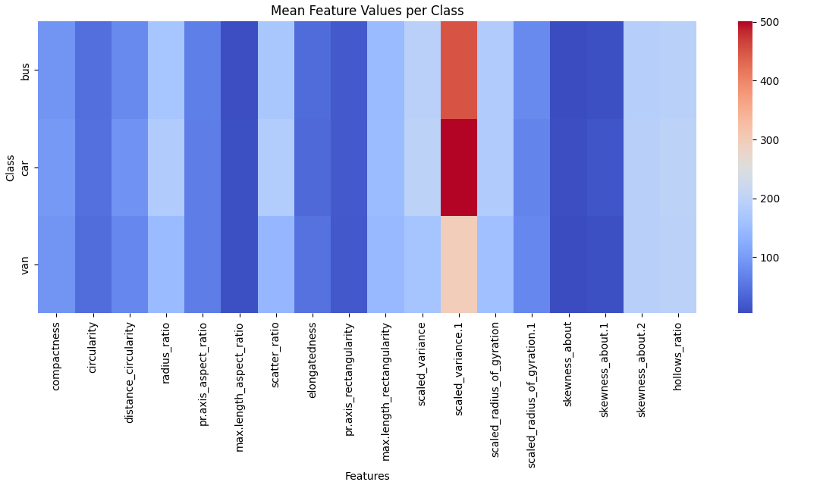
Mean Feature Value per Class
- Cars tend to have the highest average values across several features.
Vans generally have lower values.
Buses lie between cars and vans for many

Slide 7
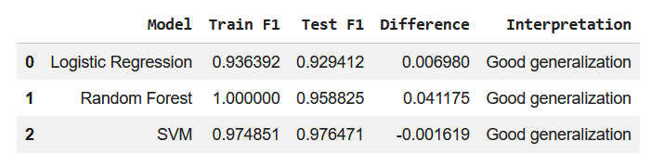
Overfit/Underfit Results
Logistic Regression:
very small difference between train and test, no overfitting - the dataset contains learnable patterns, linear relationships already explain a large part of the classification problem
Random Forest
perfect training performance but test performance is also extremely high - the model learned the training data extremely well, but still generalizes well. There may be: slight overfitting. Random Forest appears to be a very strong model for this dataset.
SVM (Support Vector Machine)
almost identical train and test performance, excellent generalization, highly stable model. This is a very strong result. For our case SVM appears to be the best-balanced model.

Slide 8
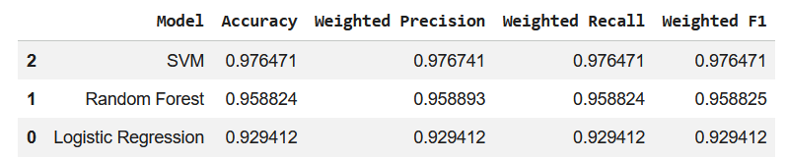
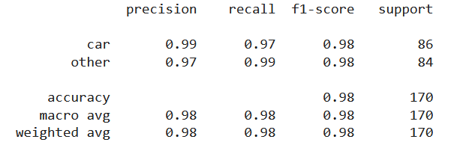
Train Models and Compares Metrics

Slide 9
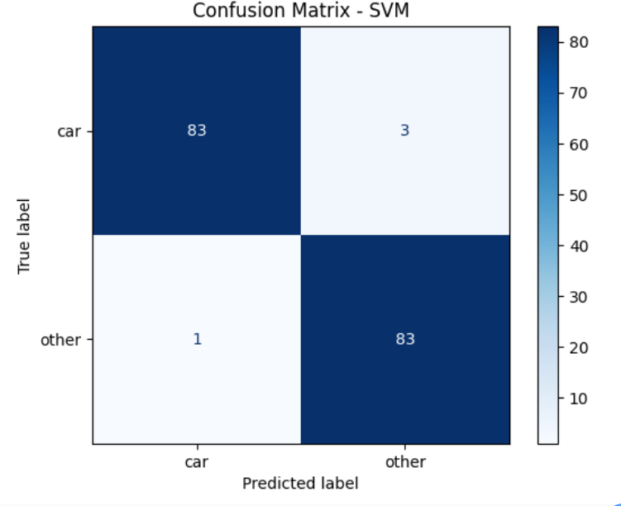
Confusion Matrics - SVM

Slide 10
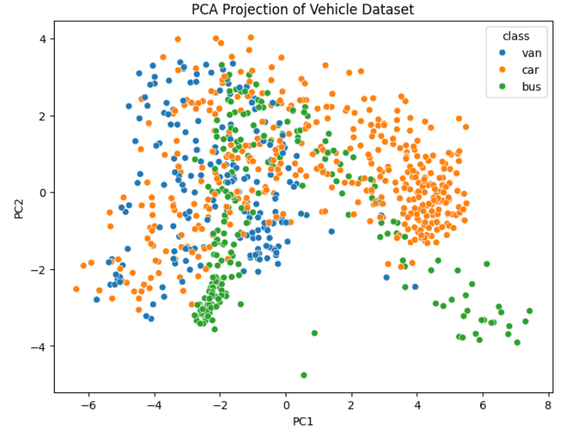
PCA Projection of Vehicle Dataset
- buses forming a distinct cluster
- overlap between vans and cars
- partially separable groups

Slide 11
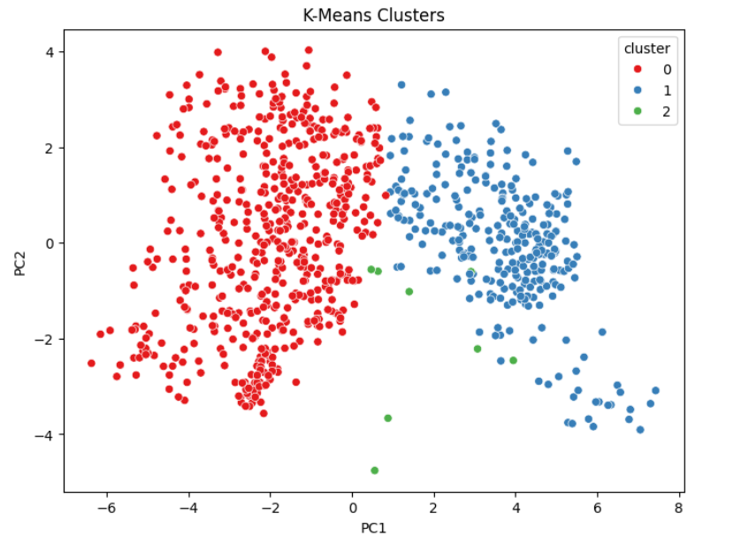
K-Means Clusters
Two Large Clearly Separated
The green cluster is very small and contains only a few observations.
Most separation occurs horizontally along PC1
Some overlap exists near the center of the plot.
[0.52186034 0.16729768]

Slide 12
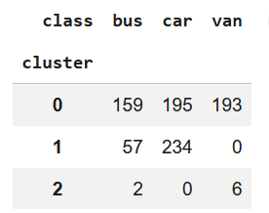
Compare Clusters with True Classes

