Slide 1
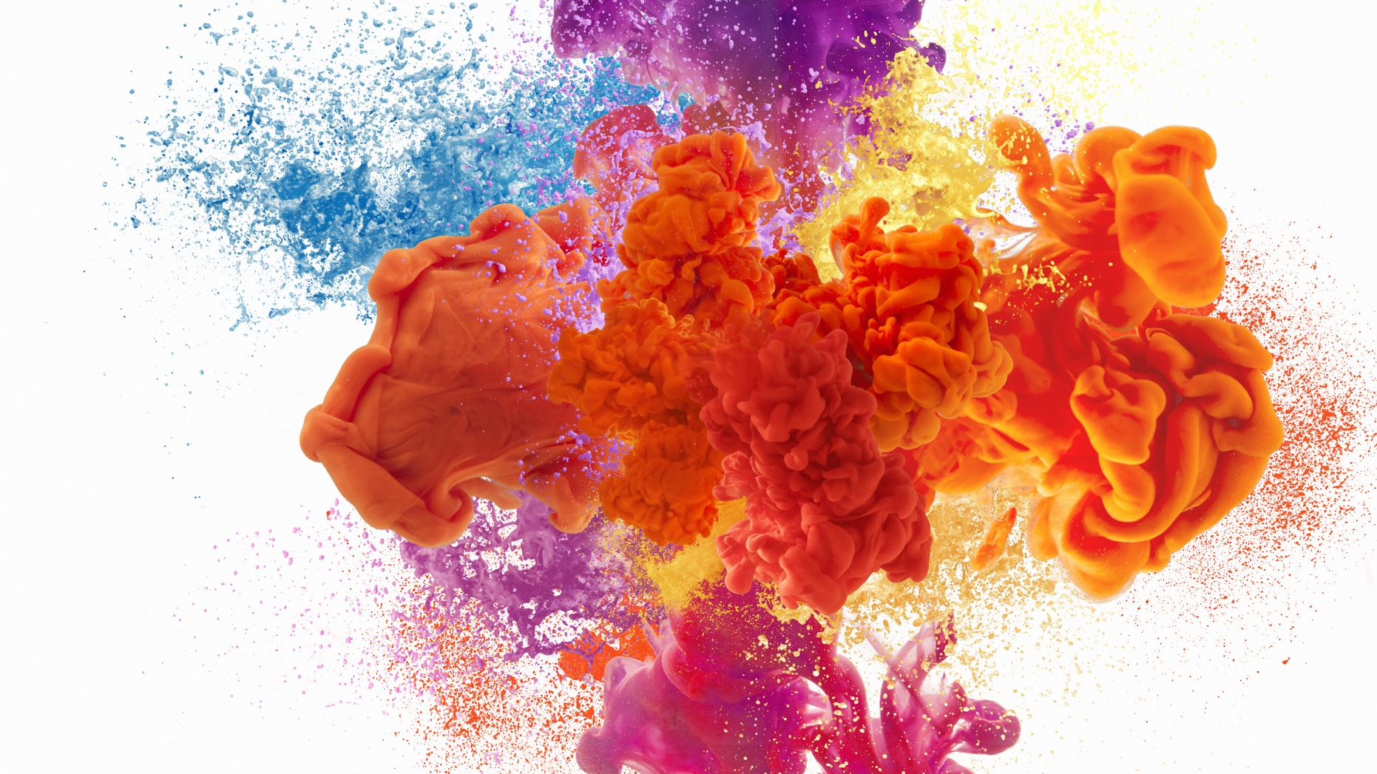
Image colorization for Netflix
ALEXIOU DIMITRIS | FOTOPOULOS SPUROS | KAILANI ANASTASIA | KOURTESI IOANNA

Slide 2

OUR TEAM
DIMITRIS alexiou
( dATa scientist )
SPUROS fotopoulos
(dATa scientist )
ANASTASIA kailani
(project manager)
IOANNA kourtesi
(business analyst)

Slide 3
Our mission
Implementing image colorization project for Netflix
The problem Young people, nowadays, are not used to watch something without a color
Netflix goal Convert black and white movies to colorized once.
Project goal Attract more customers.

Slide 4
We used two different datasets
data
first dataset was from “MIT places” and contained pictures of various themes such as places, people, dogs.
Then we add to our dataset a part of dataset of dogs’ pictures that we found in “standford vision” and we saw that the results we improved a lot

Slide 5
Class of deep neural networks
Use the data that is represented in images to learn
Use Pytorch to train the data
Convolutional Neural Network (CNN)

Slide 6

Why pytorch
Dynamic Approach To Graph Computation
Faster Deep Learning Training Than TensorFlow
Increased Developer Productivity
Easier To Learn And Simpler To Code
Simplicity and transparency
Easy To Debug
Data Parallelism

Slide 7
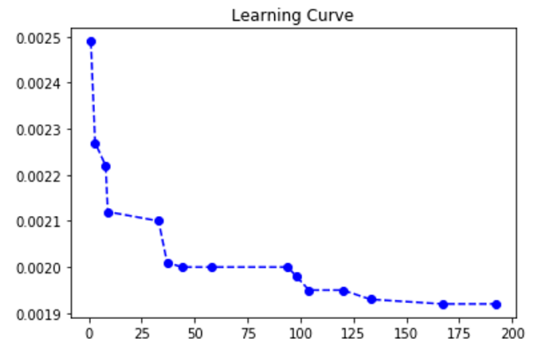
mean square error loss function and epocs
WE choose the model of epoch 104

Slide 8
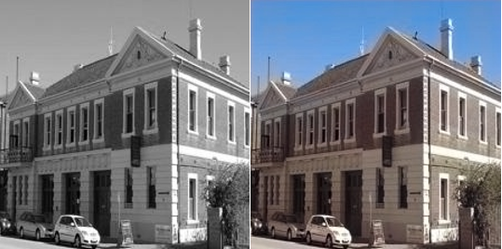
results
THE first OUTPUT OF OUR MODEL

Slide 9
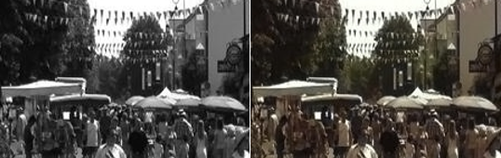
Is it ok ?
We observed that in complicated pictures with many different colors in small areas of the picture our model usually fails.
Why ?

Slide 10
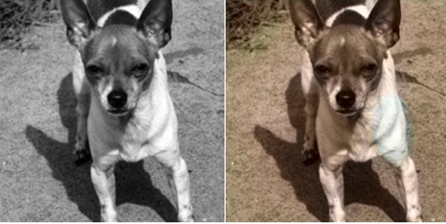
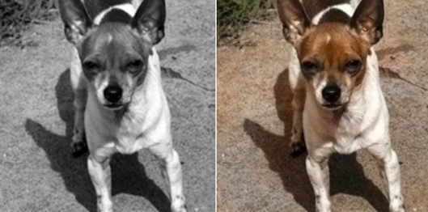
The first dataset
was from “MIT places” and contained pictures of various themes such as places, people, dogs etc.
We observed that although we had good results for the places we have bad results for the dogs.
The second
We add in our dataset a part of dataset of dogs’ pictures that we found in “standford vision” .
We saw that the results we improved a lot.

Slide 11
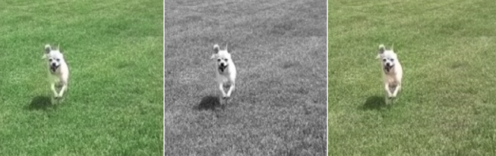


82% of them chose as more accurate the pictures with warm colors
the left picture was judged to be better colorized than the right although the dog’s left side on it was green.

Slide 12

Thank you !

