Slide 1

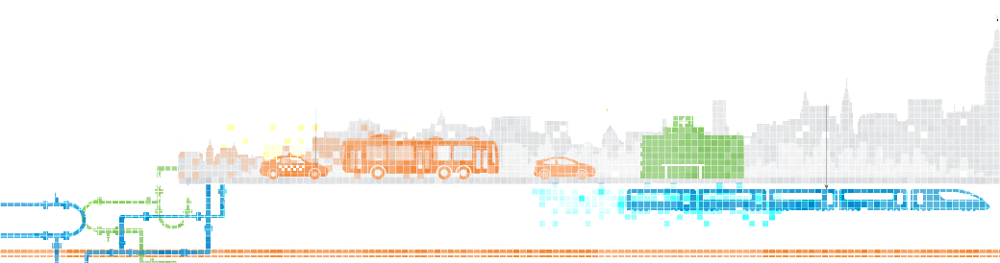
Making Big Data Personal: Predicting Life Expectancy in Real Time
Adrian Dahlin, Anastasia Shegay, Danny Fay, Kristi Korsberg
Center for Urban Science and Progress
New York University

Slide 2
Motivation
Work with the World Population Project to create a more robust, granular life expectancy model for its beta website population.io

Slide 3
Initial Project Scope
Use population.io’s national-level life expectancy model to calculate sub-national life expectancy trends, incorporating health risk factors
Notes:
Comments

Slide 4
Initial Project Scope
Use population.io’s national-level life expectancy model to calculate sub-national life expectancy trends, incorporating health risk factors
Understand existing methodology behind life expectancy calculations on the national level
Notes:
Comments

Slide 5
Initial Project Scope
Use population.io’s national-level life expectancy model to calculate sub-national life expectancy trends, incorporating health risk factors
Understand existing methodology behind life expectancy calculations on the national level
Calculate life expectancy at subnational (state, county, city) level
Notes:
Comments

Slide 6
Initial Project Scope
Use population.io’s national-level life expectancy model to calculate sub-national life expectancy trends, incorporating health risk factors
Understand existing methodology behind life expectancy calculations on the national level
Calculate life expectancy at subnational (state, county, city) level
Identify data on three risk factors: obesity, physical activity, and traffic accidents
Notes:
Comments

Slide 7
Initial Project Scope
Use population.io’s national-level life expectancy model to calculate sub-national life expectancy trends, incorporating health risk factors
Understand existing methodology behind life expectancy calculations on the national level
Calculate life expectancy at subnational (state, county, city) level
Identify data on three risk factors: obesity, physical activity, and traffic accidents
Model effects of different health risk factors on life expectancy
Notes:
Comments

Slide 8
Initial Project Scope
Use population.io’s national-level life expectancy model to calculate sub-national life expectancy trends, incorporating health risk factors
Understand existing methodology behind life expectancy calculations on the national level
Calculate life expectancy at subnational (state, county, city) level
Identify data on three risk factors: obesity, physical activity, and traffic accidents
Model effects of different health risk factors on life expectancy
Integrate into existing population/life expectancy data platform
Notes:
Comments

Slide 9
Revised Project Scope
Use population.io’s national-level life expectancy model to calculate sub-national life expectancy trends, incorporating health risk factors
Understand existing methodology behind life expectancy calculations on the national level
Calculate life expectancy at state level
Identify data on a single risk factor: obesity
Model effects of different health risk factors on life expectancy

Slide 10
Methodology
Identify obesity prevalence data and life expectancy data at the sub-national level
Plot life expectancy data for males and females between 1985 and 2010
Fit life expectancy growth trends with a linear model for each state
Report results on state with highest growth rate
Conduct cluster analysis between obesity prevalence and life expectancy growth trends

Slide 11
Data Challenges
State-level life table data
Years 1949-1989 scanned as PDFS
Primary extrapolation data point used in population.io model not available in the state-level life table
No mortality data for physical activity, obesity, or traffic accidents at the state-level
Focus on obesity
Use CDC cause of death data, pulling data where obesity is a risk factor (diabetes, cancer, and heart disease)
https://wonder.cdc.gov/

Slide 12
Data Sources
Obesity prevalence from Global Burden of Disease estimates at county level, aggregated to state level
http://ghdx.healthdata.org/us-data
United States life expectancy from Global Burden of Disease estimates at county level, aggregated to state level
http://ghdx.healthdata.org/record/united-states-life-expectancy-estimates-county-1985-2010

Slide 13
Findings
Linear model fits state life expectancy trends well for available data between 1985-2010
Washington, D.C. exhibited highest rate of life expectancy increase between 1985 and 2010
Males in Washington, D.C experienced a drop in life expectancy between 1986-1998
Clustering comparison of state-level obesity and life expectancy
Some states with lowest increase of life expectancy have highest rates of obesity
OK, AR, LA, MS, AL, TN, MO, OH, KY, WV

Slide 14
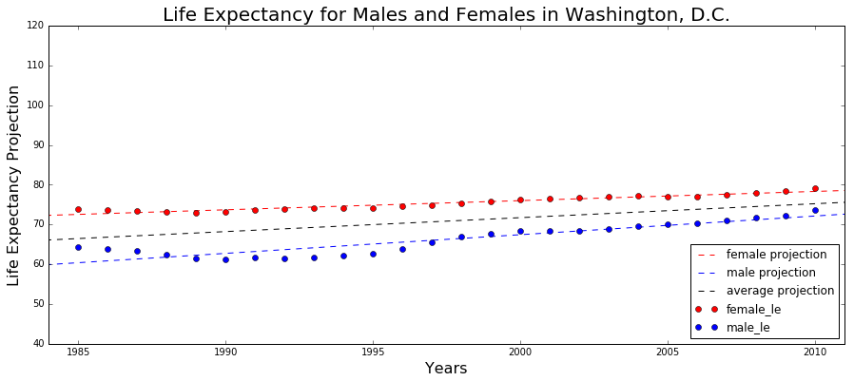
Notes:
Model: life expectancy = constant + (rate of change)*year
*model constants and coefficients change by gender and state
DC
Highest rate of change
Male slope - 0.4698
Female slope - 0.2312
Males R2 - 0.8322 (worst R2)
Female R2 - 0.9234 (37th R2)

Slide 15
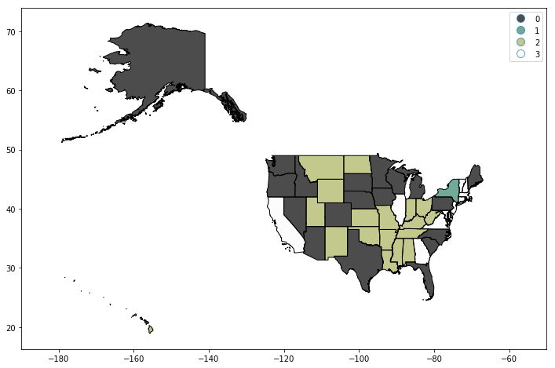
Life Expectancy Rate of Increase (1985-2010)
Light green = lowest
Dark grey = low
White = high
Teal = highest

Slide 16
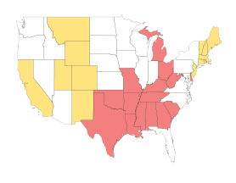
Obesity Prevalence 2011
Grey = lowest
Yellow = low
White = high
Red = highest
Notes:
6 states changed clusters: Delaware, Michigan, Montana, Ohio, North Dakota, South Dakota
DC is the only one in the cluster #3
0 27.874953 1 24.063638 2 30.603017 3 17.910000

Slide 17
Challenges and lessons learned
Data availability
Adopting existing methodology
Lack of domain expertise
Conflicting timelines
Client engagement

Slide 18
Next Steps
Improving the model/data
Applying the insights

Slide 19
Next Steps
Improving the model/data
Add data and domain expertise to improve life expectancy projections
Sub-national geographies
Update the model to be able to measure effect of various risk factors on LE, then add these as inputs to population.io

Slide 20
Next Steps
Applying the insights
Education & behavior change
Policy implications
Business/technology use

Slide 21
Making Big Data Personal: Predicting Life Expectancy in Real Time
Adrian Dahlin, Anastasia Shegay, Danny Fay, Kristi Korsberg
Center for Urban Science and Progress
New York University

