Slide 5
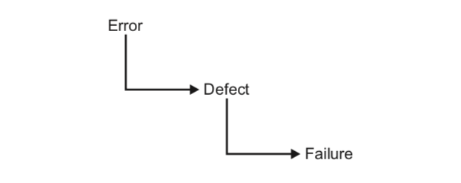

Slide 18
Notes:
There are a lot of different software types, let’s stop on the 7 most popular and discover them one by one.
Desktop applications. For example, web browsers, office applications.
Web-based applications. It is a client–server software application which the client (or user interface) runs in a web browser. For example, email services, online calendars, etc.
Network solutions. For example, applications which helps to access another network like Cisco AnyConnect Secure Mobility Client or VoIP Phone Services like Skype.
Firmware. It is type of software that provides control, monitoring and data manipulation of engineered products and systems. For example, iOS 10 or Android 6.0 are good examples of mobile firmware.
Multimedia applications are related to content that uses a combination of different content forms such as text, audio, images, animation, video and interactive content. For example, it can be photo editing applications or multimedia players which use IPTV protocol.
Web services are client and server applications that communicate over the World Wide Web’s (WWW) HyperText Transfer Protocol (HTTP). Unlike traditional client/server models, such as a Web server/Web page system, Web services do not provide the user with a GUI. Web services instead share business logic, data and processes through a programmatic interface across a network
Mobile applications are the software applications designed to run on mobile devices, such as smartphones and tablet computers. Facebook Messenger, WhatsApp, Viber, Instagram and Swarm are good examples of the most popular mobile applications.

Slide 19
Notes:
Definition is from https://en.wikipedia.org/wiki/Project:
Project can be further defined as temporary rather than permanent social systems or work systems that are constituted by teams within or across organizations to accomplish particular tasks under time constraints

Slide 20
Notes:
Project life cycle is a collection of generally sequential and sometimes overlapping project phases.
Their name and number are determined by the management and control needs of the organization or organizations involved in the project, the nature of the project itself, and its area of application.
While every project has a definite start and a definite end, the specific deliverables and activities that take place in between will vary widely with the project.
All projects can be mapped to the following life cycle structure:
Starting the project
Organizing and preparing
Carrying out the project work
Closing the project

Slide 21
Notes:
The ISTQB glossary definition covers not just the specified requirements but also user and customer needs and expectations.
It is important that the project team, the customers and any other project stakeholders set and agree expectations.
We need to understand what the customers understand by quality and what their expectations are.
What we as software developers and testers may see as quality - that the software meets its defined specification, is technically excellent and has few bugs in it - may not provide a quality solution for our customers.
Furthermore, if our customers find they have spent more money than they wanted or that the software doesn't help them carry out their tasks, they won't be impressed by the technical excellence of the solution.
In addition to understanding what quality feels and looks like to customers, users, and other stakeholders, it helps to have some quality attributes to measure quality against.

Slide 23
 | QA | QC
What it is | Ensure quality in software development process | Ensure quality in software products
Aim | Improve development and test processes | Identify failures/ defects
Approach | Proactive | Reactive
Responsibility | Project Team | Testing Team
Lifetime | Before software development process | Post software development
Activities | Process Definition and Implementation Audits Trainings | Reviews Testing

