Slide 1
Automatic visualization of metabolic modules (graphs from gatom package )
July, 27
2017
Student: Anastasiia Gainullina
Supervisor: Alexey Sergushichev

Slide 2
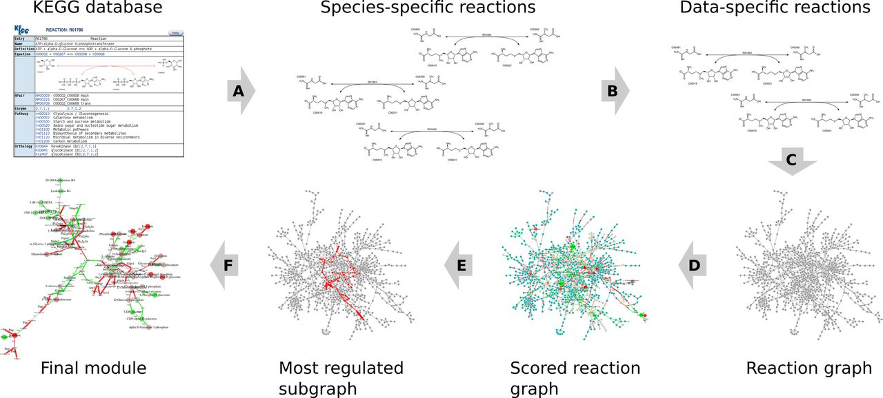
Gatom graphs origin.
Metabolic modules are marked out as a most regulated subgraph of a total data-related reaction graph:

Slide 3
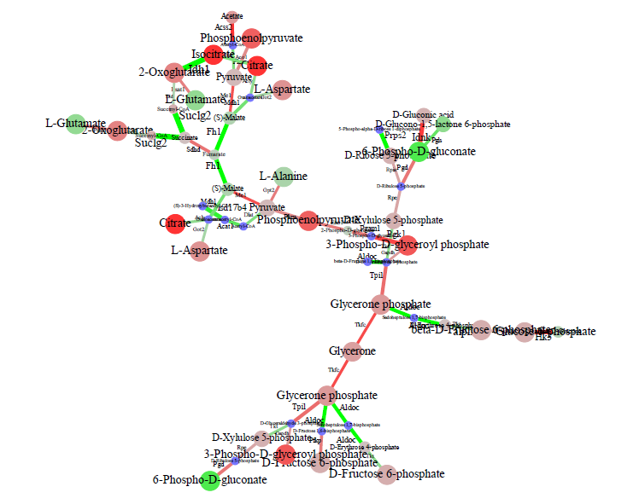
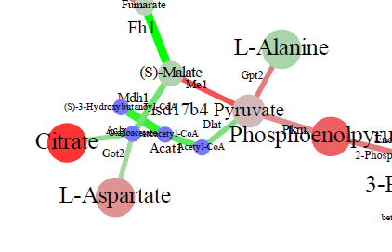
Entry point.
Even Graphviz.neato produces layouts of planar gatom igraphs with edge and label crossings:

Slide 4
The goal of the project:
Build an algorithm that would draw gatom graphs satisfying the following requirements:
No edge crossings
No label crossings
Compact layout
Typical* layout

Slide 5
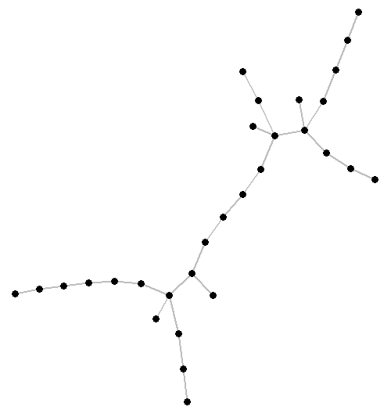
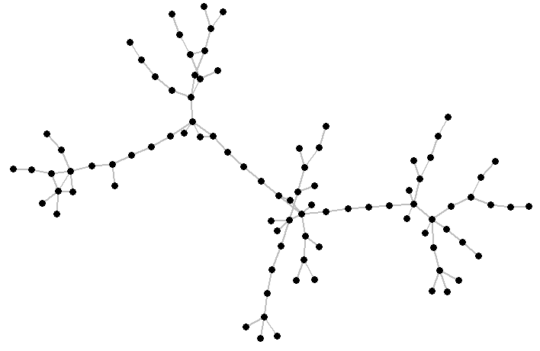
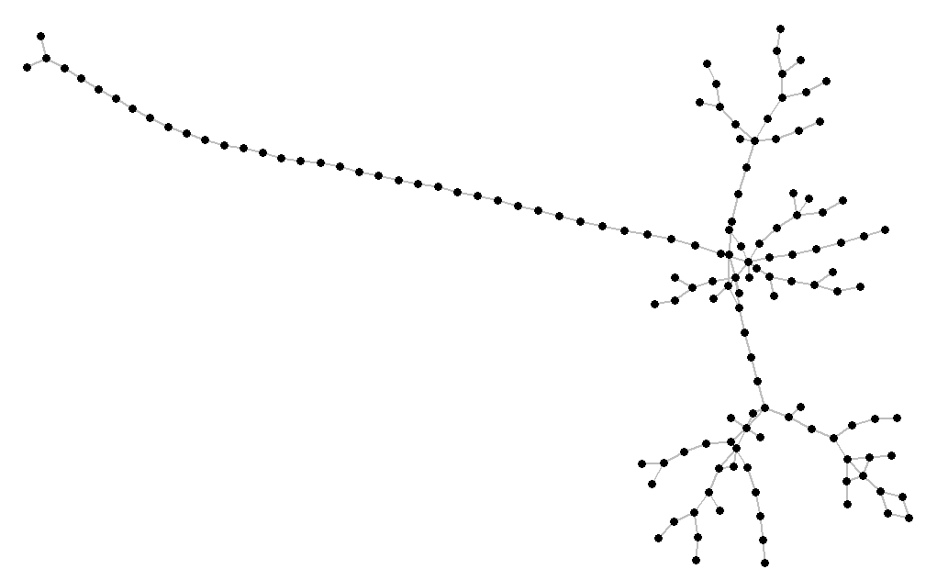
Graph types.
In general, diversity of gatom graphs can be divided into three large groups:
“Simple”
shabaana_tb765, graph3
“Complex”
shabaana_tb765, graph1
“Long and complex”
shabaana_tb765, graph4

Slide 6
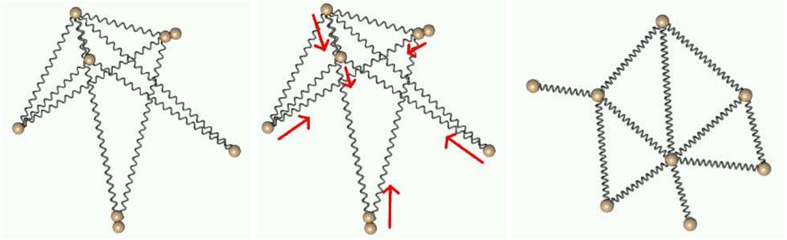
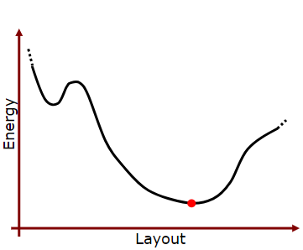
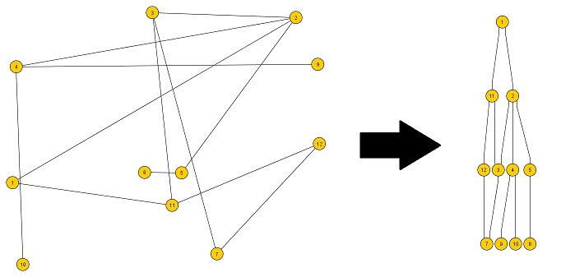
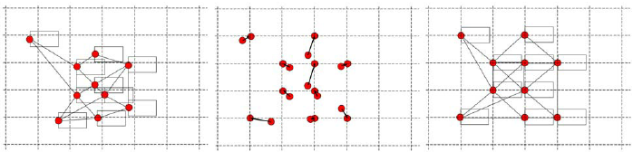
Algorithms producing aesthetically pleasant graph layouts.
Here are some of them that try to guarantee no edge crossings and compactness:
Force-directed (e.g., Kamada and Kawai)
Hierarchical (Sugiyama’s method)
Genetic
…

Slide 7
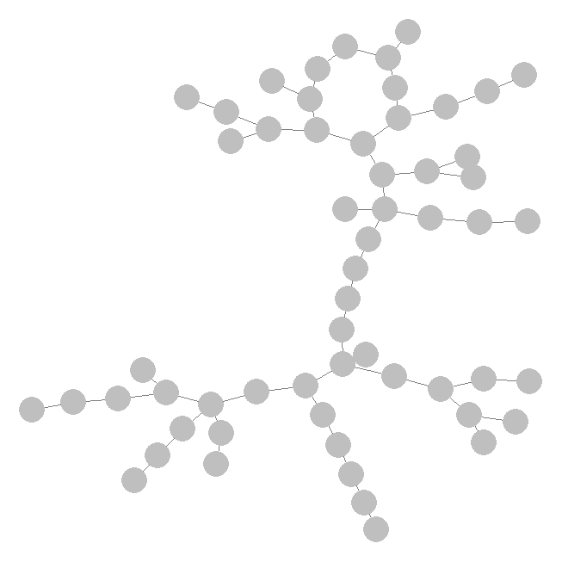
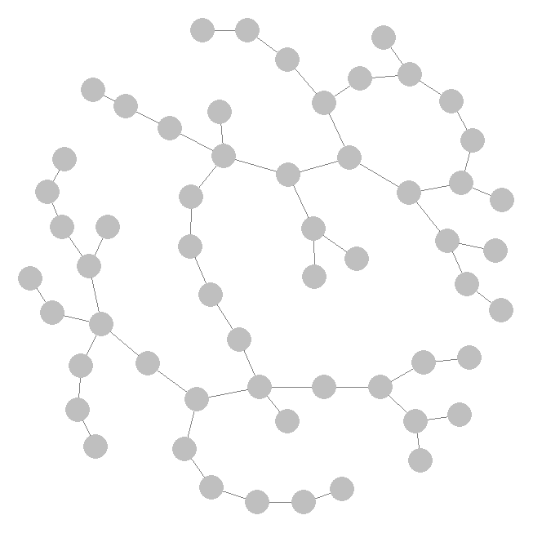
Layout algorithms (igraph and sna packages).
Force-directed algorithms produce something like that:
Fruchterman-Reingold =>
for “Simple” graphs
*
Kamada and Kawai =>
for “Complex” graphs

Slide 8
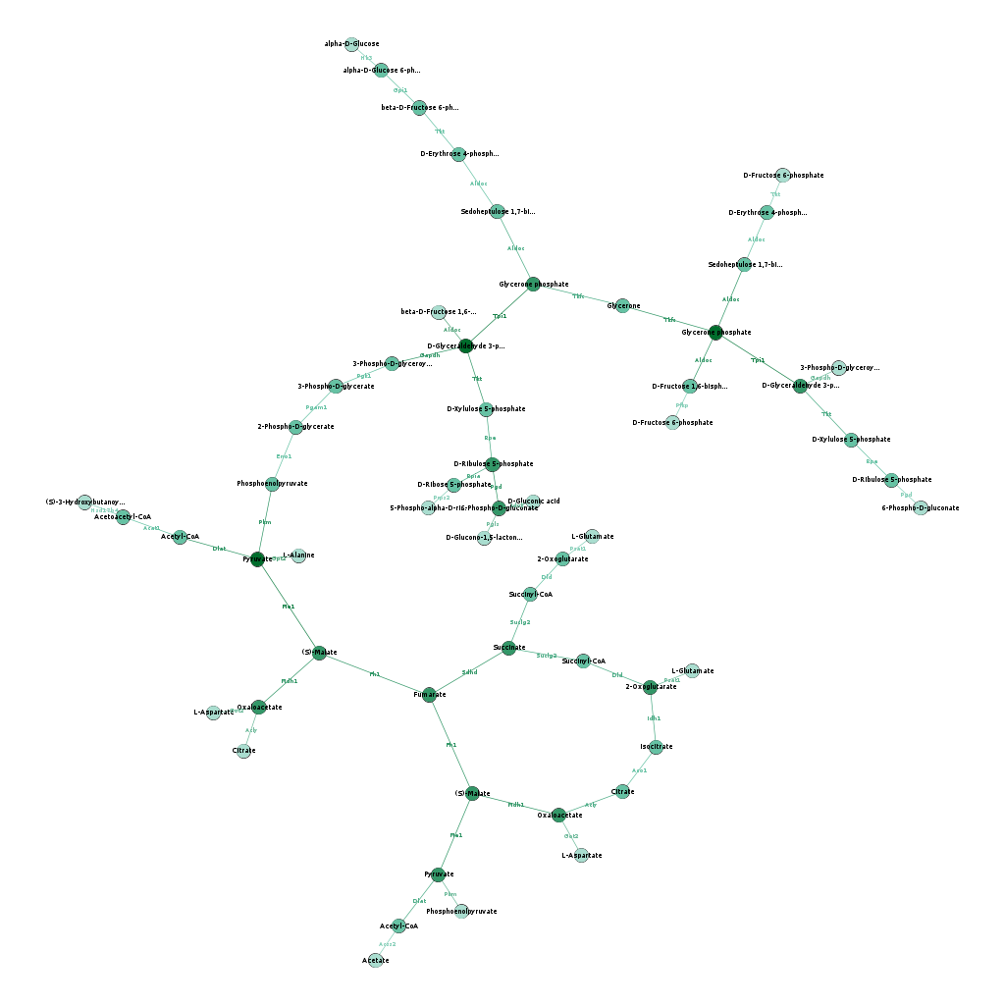
Layout algorithms (R implementation of ForceAtlas2 from Gephi).
This force-directed algorithm may spiral “Long and complex” graph to make it compact:
@param gravity =>
for “Long and complex” graphs
=> + make initial layout algorithm selection as a function of N(node), graph density …

Slide 9
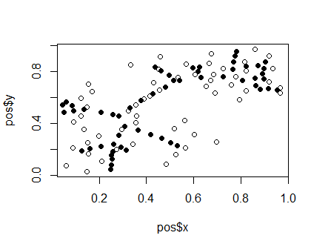
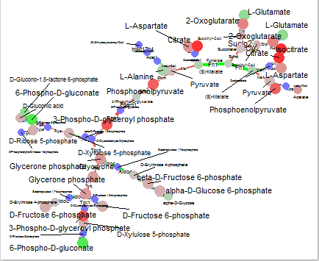
What about labels positions?
The idea is to use ggrepel package which automatically places node labels
and afterwards move nodes to these positions ourselves:

Slide 10
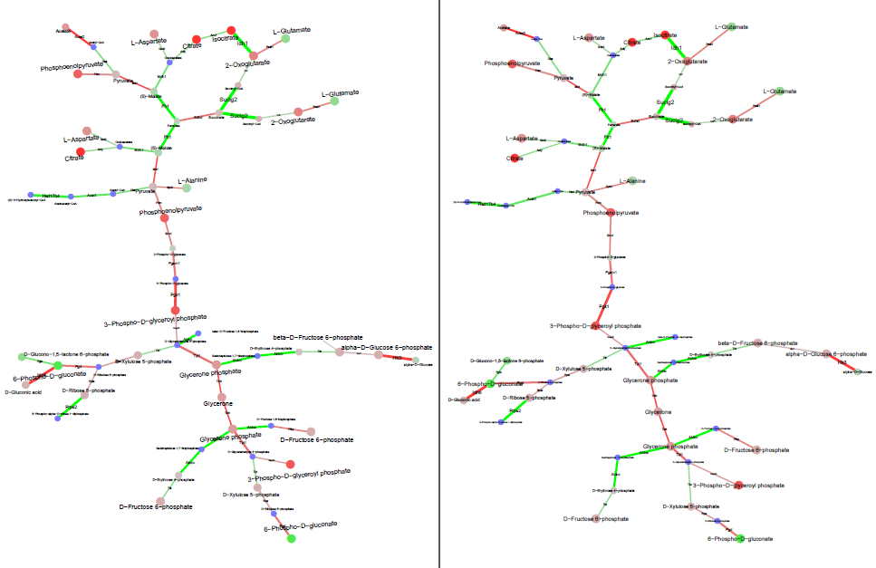
Pretty nice result with exact graph
(kk algorithm + moving nodes to ggrepel positions), but…

Slide 11
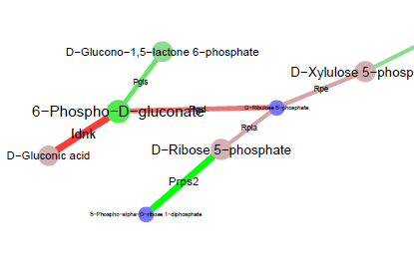
… but crossings of edge labels with node labels still occur.
The idea is to modify ggrepel package functions to consider edge labels in final labels layout as well.

Slide 12
Ggrepel framework.
There is a force that repels overlapping labels presented as proportionally drawn boxes:
Label of Node B
Label of Node A
Node A
Node B

Slide 13
Ggrepel framework.
We may add dummy nodes at the middle of the edge to the total list of the labels but we won’t move these dummy nodes to label positions as it breaks
linearity of edges.
Label of Node B
Label of Node A
Edge A
Edge B

Slide 14
How about prohibition to move dummy edge nodes to new positions?
Let us just add blue force produced by edge labels repelling to red forces operating on its connected nodes:
Label of Node B
Label of Node A
Node A
Node B
dummy edge
node A-C
dummy edge
node B-D
Node C
Node D
Label of Node D
Label of Node C

Slide 15
All in all, final pipeline should look something like that:
step = 0
Drawing_graph_layout <- function (…) {
Selection_of_initial_layout_algorithm (N(nodes), graph_density)
Application_of_initial_layout_algorithm (N(iter) ~ step)
If (N(edge_crossings) != 0) {
Application_of_additional_layout_algorithm (kk -> fru) |
application_of_additional_iteration_of_initial_algorithm
}
Placing_labels_by_modified_ggrepel_functions
  Moving_nodes_to_new_positions #under labels
If (N(edge_crossings) != 0) {
step += 1
Drawing_graph_layout()
}
}
It would be perfect to merge fitness-functions from all algorithms into one
to avoid recursion.

Slide 16
Now I work on this:
step = 0
Drawing_graph_layout <- function (…) {
Selection_of_initial_layout_algorithm (N(nodes), graph_density)
Application_of_initial_layout_algorithm (N(iter) ~ step)
If (N(edge_crossings) != 0) {
Application_of_additional_layout_algorithm (kk -> fru) |
application_of_additional_iteration_of_initial_algorithm
}
Placing_labels_by_modified_ggrepel_functions
  Moving_nodes_to_new_positions #under labels
If (N(edge_crossings) != 0) {
step += 1
Drawing_graph_layout()
}
}
this
and this

Slide 17
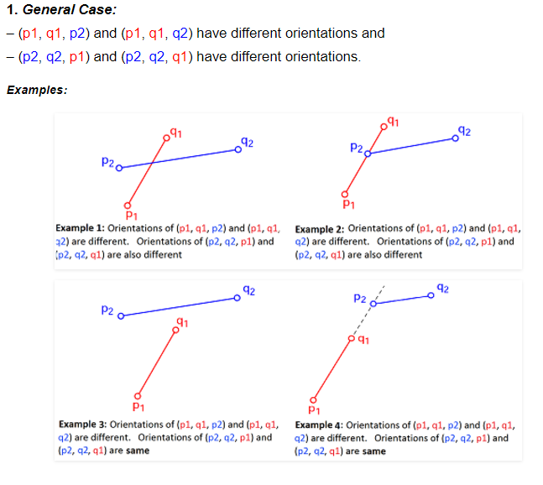
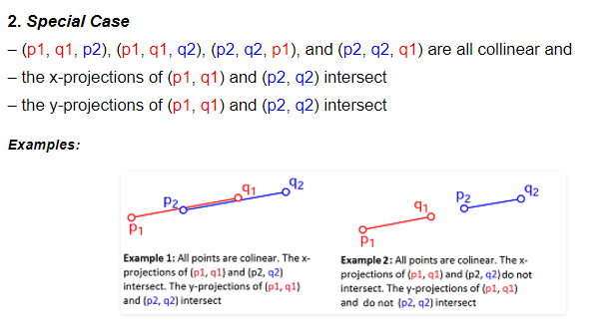
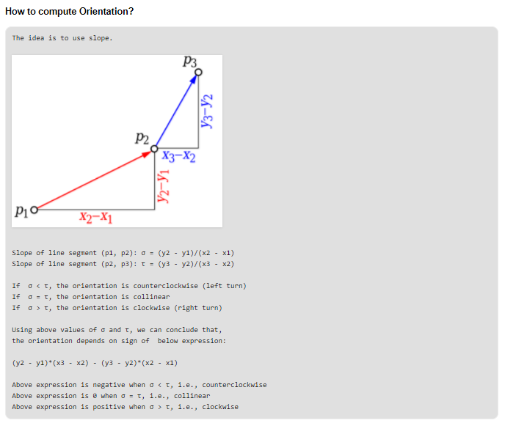
P.S.
This is how edge crossings are detected:

Slide 18
Thank you for attention!

Slide 20
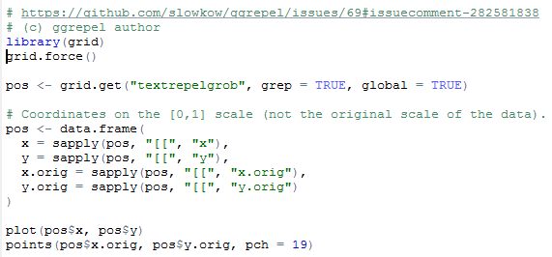
Getting label
coordinates
grid.get {grid} R Documentation
Get a Grid Graphical Object
Description
Retrieve a grob or a descendant of a grob.
Graphic Object Bitmap File (grob)

Slide 21
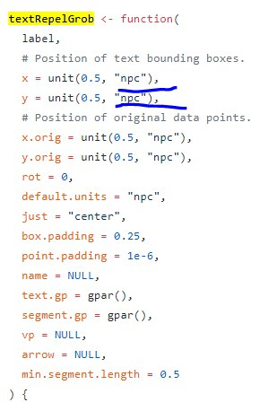
problem1: normilized
"npc"
Normalised Parent Coordinates
Remove “ncp” (destroy algorithm?)
Dummy MAX and MIN labels to a=(x-min)/(max-min)

Slide 22
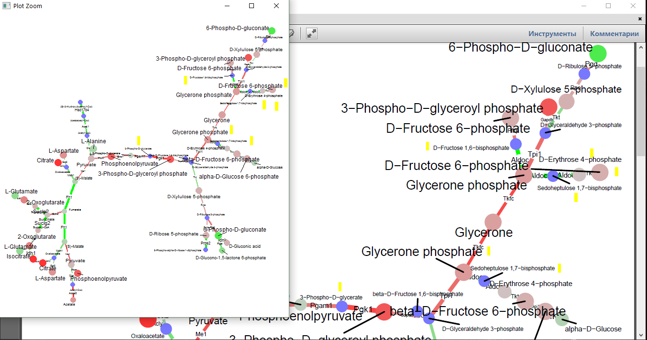
problem2: geom_text_repel is interactive – means labels move during canvas size changes
ggsave("../../../Desktop/plt_box2.pdf", width = 12, height = 12, dpi = 240)
Even if fix output canvas size at which these manipulations should be held.
(how)

Slide 23
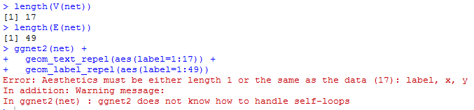
r plot to file pfd
pdf("SampleGraph.pdf",width=7,height=5)
x=rnorm(100)
y=rnorm(100,5,1)
plot(x,lty=2,lwd=2,col="red") lines(y,lty=3,col="green")
dev.off()
problem3: остаются пересечения с лейблами рёбер.

Slide 24
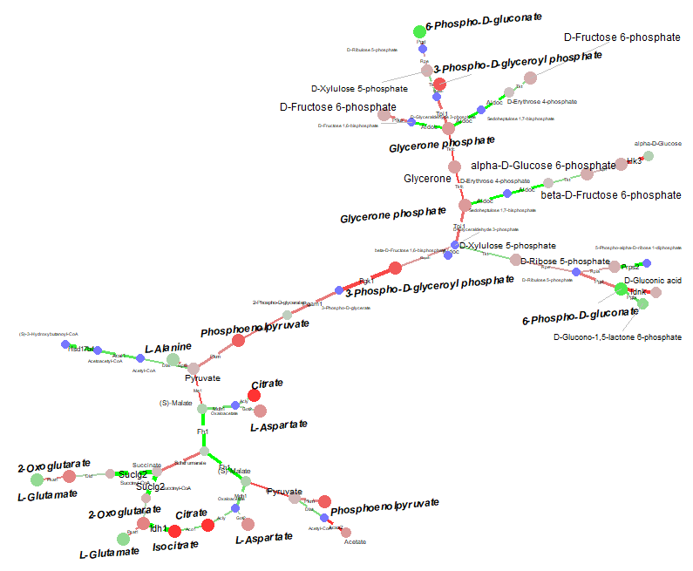
Possible solution:
Tuning ggrepel
With labeled (“IF”)
dummy
middle-nodes labels
(=edge labels)
btw, не будет пересечений
подписей с нодами/рёбрами

Slide 25
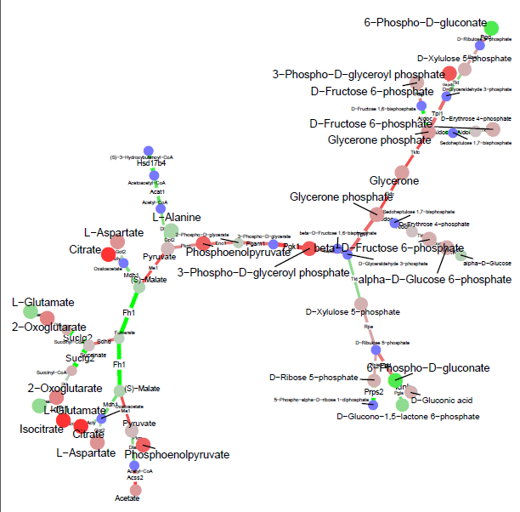

Сразу две проблемы
---Палки-указатели посветлее и потоньше
---Можно подписи подальше от лейблов, а палку-указатель визуализировать,
начиная с определённой длины
---потюнить разброс размера шрифтов под ggnet2

Slide 26
Java/R – layout with NODES+labels (polygons) + algorithm
? Gephi (layout)
? with THIKER EDGES (with labels on it) => ?Gephi labelings
? Gephi CLI
Python/R
python igraph
Sweep line
R
Ggrepel interactive
Igraph & sna layout algorithms

