Slide 1

Anastasiia Leskiv
COVID-19
Logistic Regression Model

Slide 2

Overview
COVID-19 is a disease caused by a virus named SARS-CoV-2.
Very contagious
Spreads quickly.
Notes:
“COVID-19 (coronavirus disease 2019) is a virus that can be very contagious and spreads quickly. Over one million people have died from COVID-19 in the United States. COVID-19 most often causes respiratory symptoms that can feel much like a cold, the flu, or pneumonia.

Slide 3
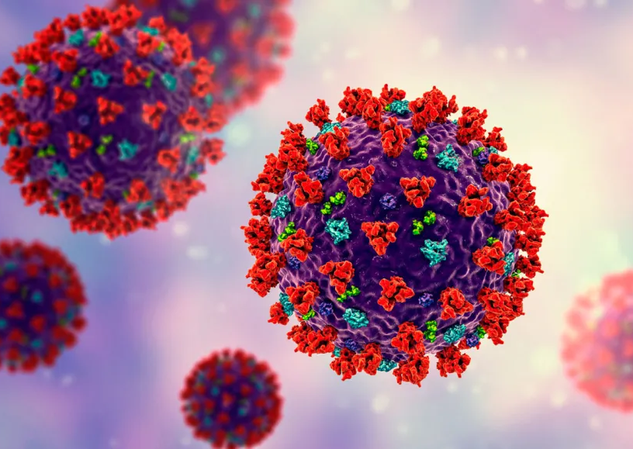
Goal
Build a machine learning model to show my client (a hospital) patient’s:
Current symptom
Medical history
Factors that increasing chances of death
Predict risk of death from COVID-19
Notes:
The goal of this project is to build a machine learning model that, shows patient's current symptom, status, and medical history, predict patients who are at high risk of death from covid. This predictive ability could significantly assist authorities in proactively sourcing and organizing the requisite resources, potentially saving lives in critical situations during these challenging times.

Slide 4
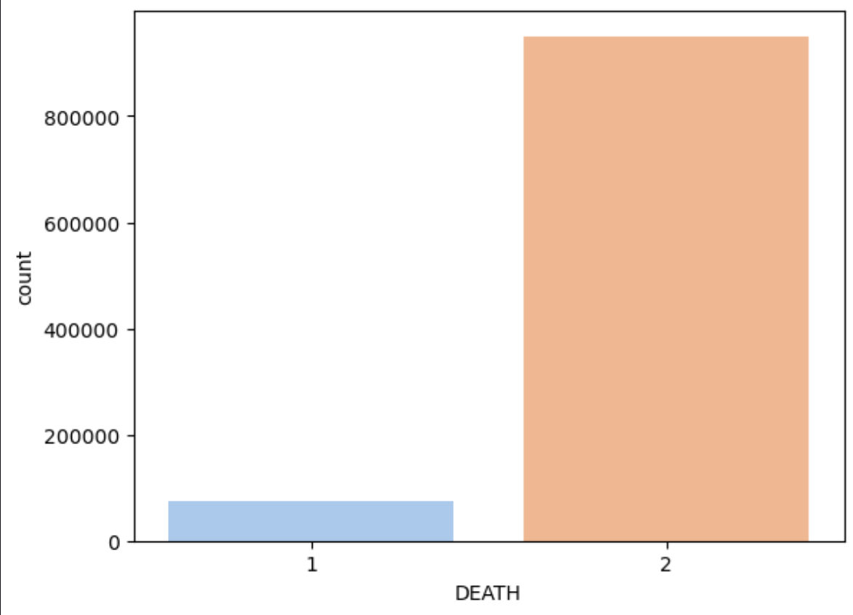
Crosstab plot
Number of patients who died from COVID-19
2- means alive
1-means dead
Notes:
First I wanted to show number of death in our data set Using crosstab plot to see Number of patients who died from COVID-19 based on age where 2- means this patient is alive, 1- dead

Slide 5
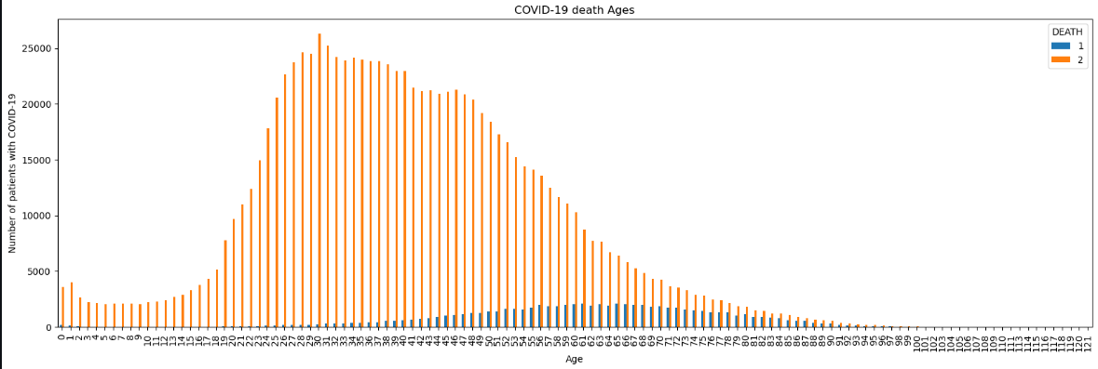
Age Distribution
Larger number of people who died from COVID-19 are between the ages of 50 and 80
Notes:
Here I wanted to see what age is in high rist of death from covid. With this plot we can come to the conclusion, it's very rerely happens at a youg age it's mostly at the age of 50-80 y.o

Slide 6
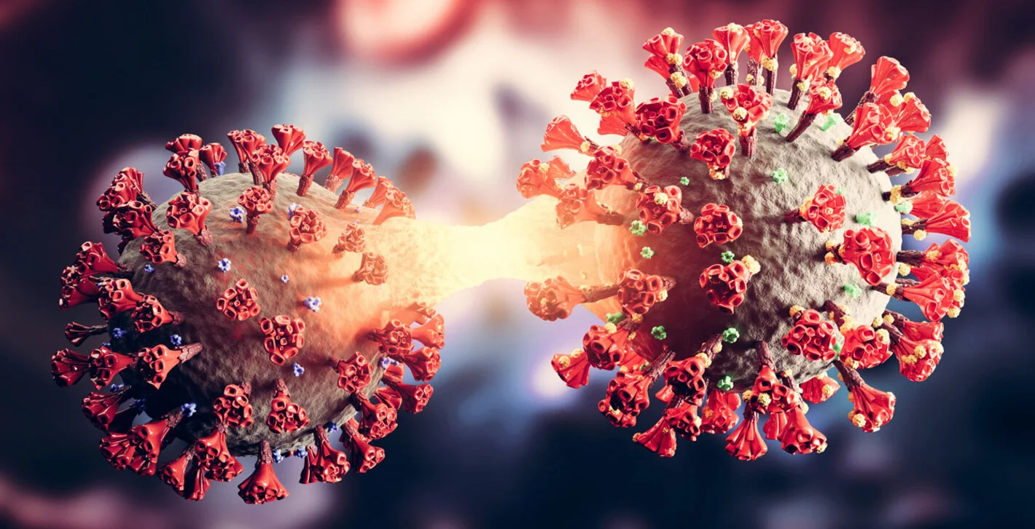
What factors increase the risk of death from COVID-19?

Slide 7
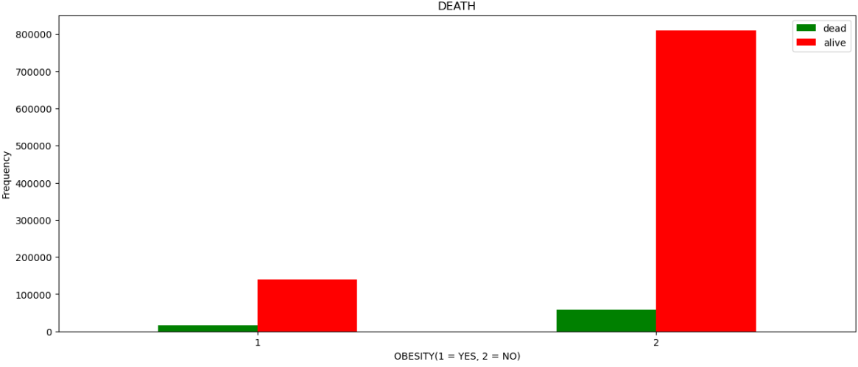
Risk of death from COVID-19 people with obesity
Patients with obesity are more likely to die from COVIS-19

Slide 8
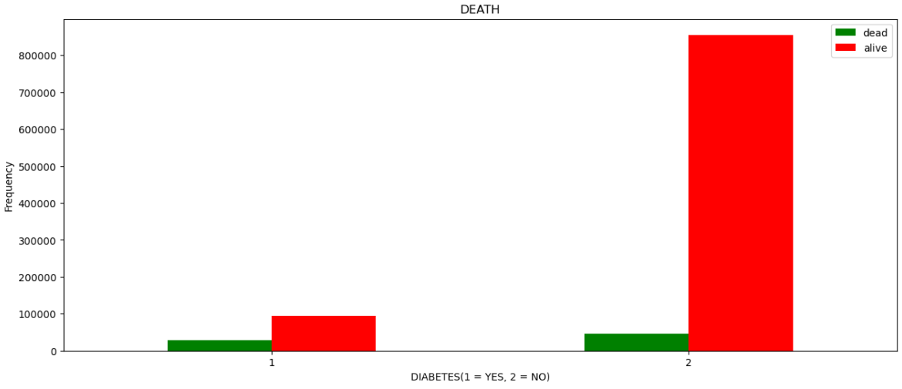
Patients with diabetes are more likely to die from COVIS-19
Risk of death from COVID-19 people with diabetes

Slide 9
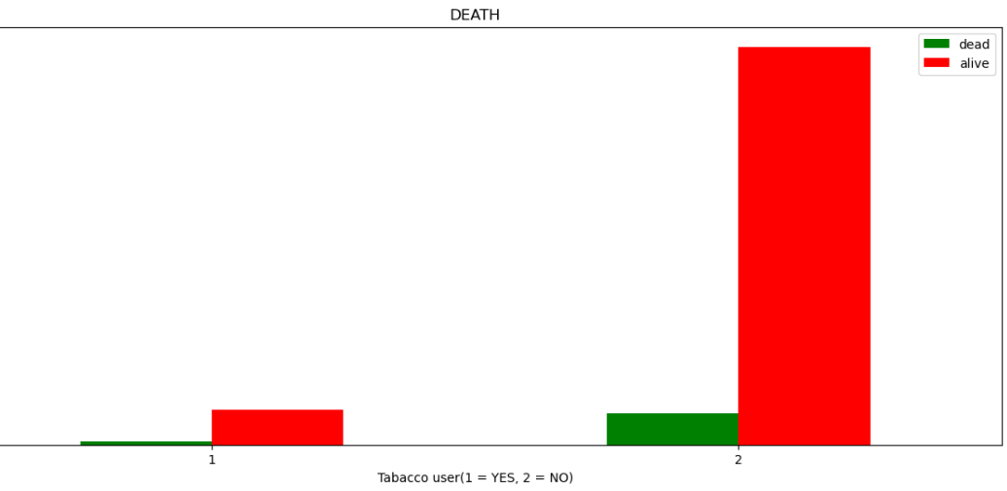
Risk of death from COVID-19 smokers
Tobacco users are more likely to die from COVIS-19

Slide 10
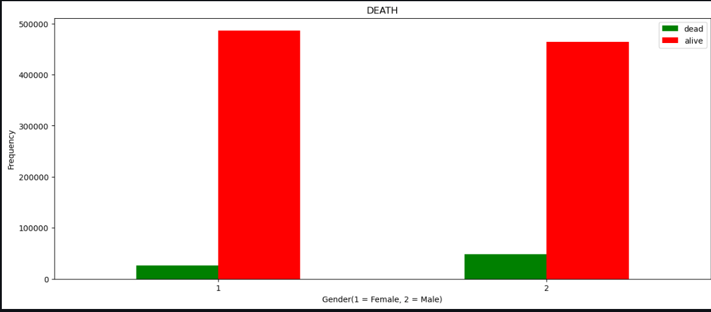
Risk of death from COVID-19 based on gender
Gender does not affect the number of death.

Slide 11
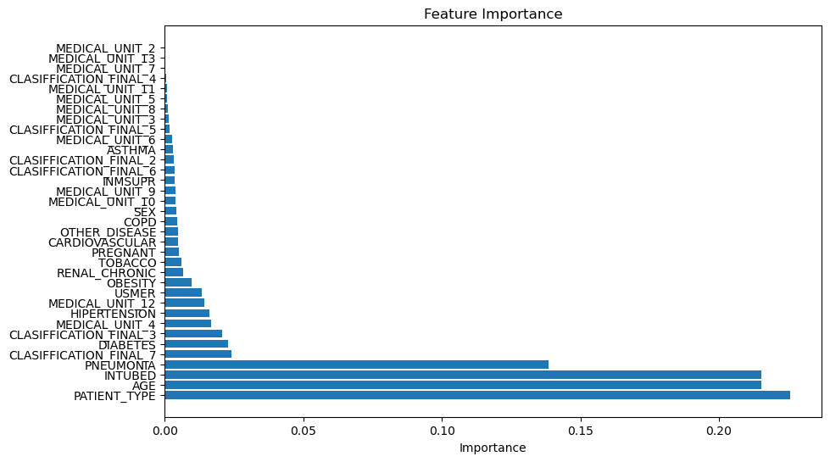
Feature importance of the most performant model

Slide 12
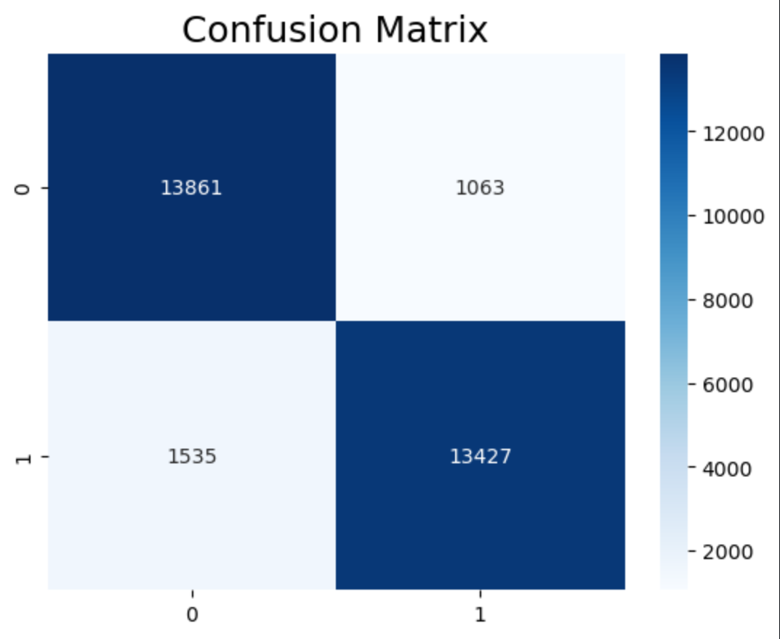
My prediction :
- Patient has risk of death from COVID-19 and patient has it - 13861
- Patient does not have risk of death from COVID-19 but patient has it - 13427
- Patient has risk of death from COVID-19 and patient does not have it -1535
- Patient does not have risk of death from COVID-19 and patient has it -1063
Notes:
True Positive(we predict our patient has risk of death from COVID-19 and patient actually has it)-13861
True Negative (we predict our patient does not have risk of death from COVID-19 and patient actually has it)-13427
False Positive(we predict our patient has risk of death from COVID-19 and patient actually does not have it)-1535
False Negative(we predict our patient does not have risk of death from COVID-19 and patient actually has it)-1063

Slide 13
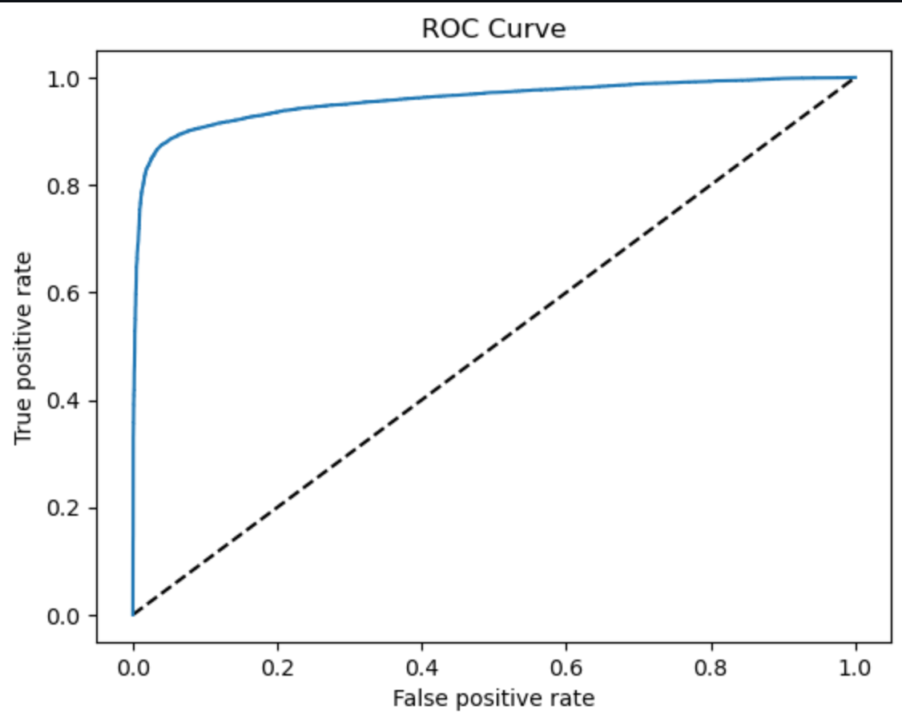
Best Model Random Forest
Area under the curve Score : 0.91
The classifier can almost perfectly distinguish between all the Positive and the Negative class points with accuracy 91%
Notes:
Plotting the ROC Curve: The ROC curve is plotted using Matplotlib, with the diagonal line representing a random classifier, and the curve showing the trade-off between true positive rate and false positive rate.
The ROC curve is a useful visualization for understanding the model's discrimination ability across different threshold settings.
In my case the classifier can almost perfectly distinguish between all the Positive and the Negative class points with accuracy 91%

Slide 14
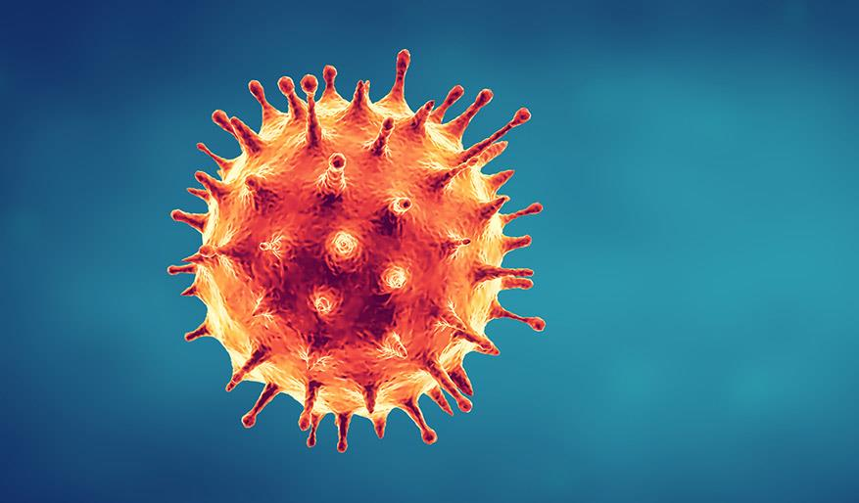
Conclusion
To prevent death situation with COVID patients we must pay careful attention to factors that increase the chance of death such as:
Age
Diabetes
Obesity
Pneumonia
Model predicted with 91% accuracy
Notes:
The whole dataset was split into 80/20 train/holdout. Predictions on 20% holdout were limited till the end. After I finished this project I came to the conclusion that people who are getting COVID are at a very high risk of getting pneumonia. Tobacco users are more likely to die from COVIS-19.Patients with diabetes are more likely to die from COVIS-19.Patients with obesity are more likely to die from COVIS-19 Age also affects the number of people who died from COVID-19. It's very rarely happens at a young age it's mostly at the age of 50-80 y.o
For modeling: I used logistic regression, random forest, decision tree, stacking resembling for setting on random forest as the model with the best cross-validation performance. I used Logistic Regression to predict the risk of death from COVID-19 virus with 91% accuracy and with F1 Score for Class 0: Approximately 0.9143. The F1 score is a useful metric, especially in imbalanced datasets, as it considers both false positives and false negatives. A higher F1 score indicates better performance, considering both precision and recall.

Slide 15

Limitation
No information about:
Patient’s lifestyle
Patient’s habits

Slide 16
Recommendation
I would recommend to pay more attention to:
Patients with diabetes
Patients with obesity
Patients with pneumonia
Patients over 50 y.o.
Patients who use tobacco
Notes:
I would recommend to my client to pay more attention to patient's sugar level, patients who use tobacco, recommend patients to do more exercise and keep healthy diet.Be more attentive to patients with age of 50 and older, and patients with obesity

Slide 17
Next Steps
-Continue with developing model for better result.
-Use more data for better prediction.
Notes:
My next step would be to continue with developing model for better result. Use more data for better prediction.

Slide 18
Thank you
Anastasiia Leskiv
GitHub:https://github.com/anastasiialeskiv
Linkedin:https://www.linkedin.com/in/anastasiialeskiv/

