Slide 1
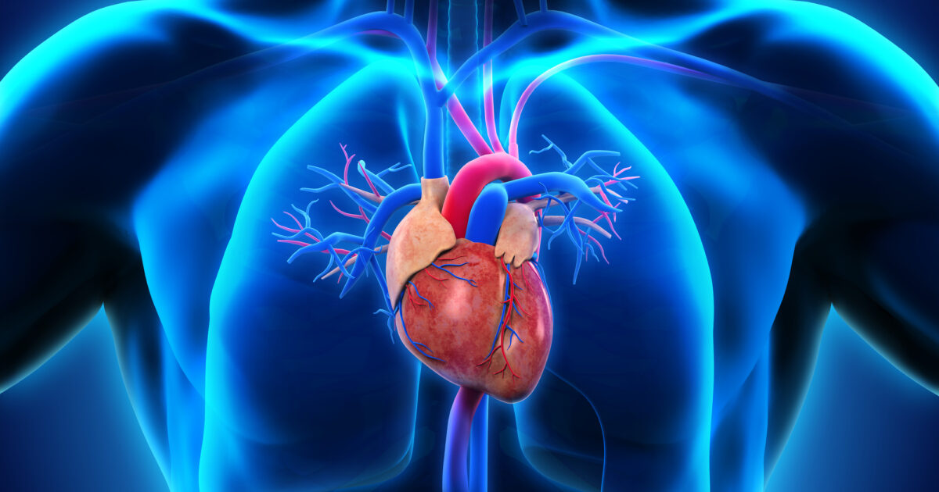
Heart Disease Classification Model
Anastasiia Leskiv

Slide 2
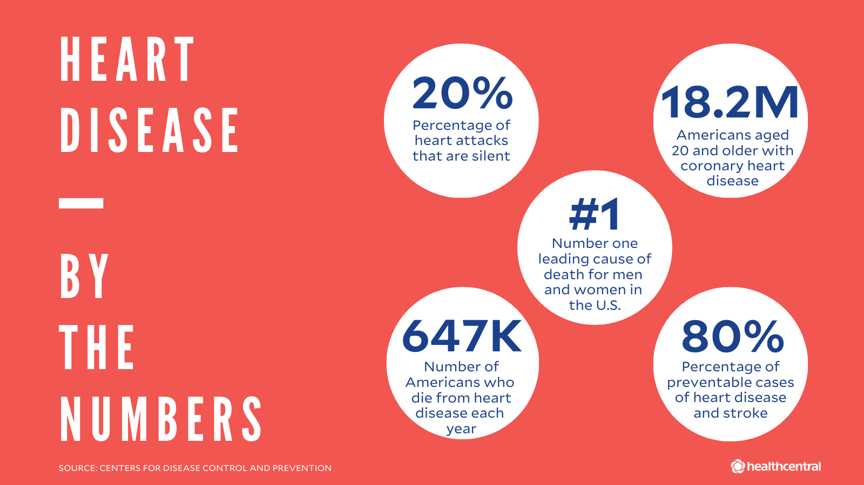
Overview:
More than 16 million people have heart disease in the USA.
About 7 percent of Americans aged 20 and older have CHD.
Target:
Build classification model to see whether or to patient has hart disease
Notes:
More than 16 million people have heart disease and it’s only in the USA. About 7 percent of Americans aged 20 and older have CHD. Together with the health care organization we decided to create a classification model to predict whether or not patients have a heart disease. I used a Heart disease data set which contained thousands of data points. I built classification algorithms and then I selected the best model to present to my client. In this project I was focusing on the best accuracy of the model.

Slide 3

Features
Age
Sex
Chest Pain Type
Resting Blood Pressure
Cholesterol
Fasting Blood sugar
Resting ECG
Max Heart Rate
Exercise Angina
Oldpeak
ST_Slope
HeartDisease

Slide 4
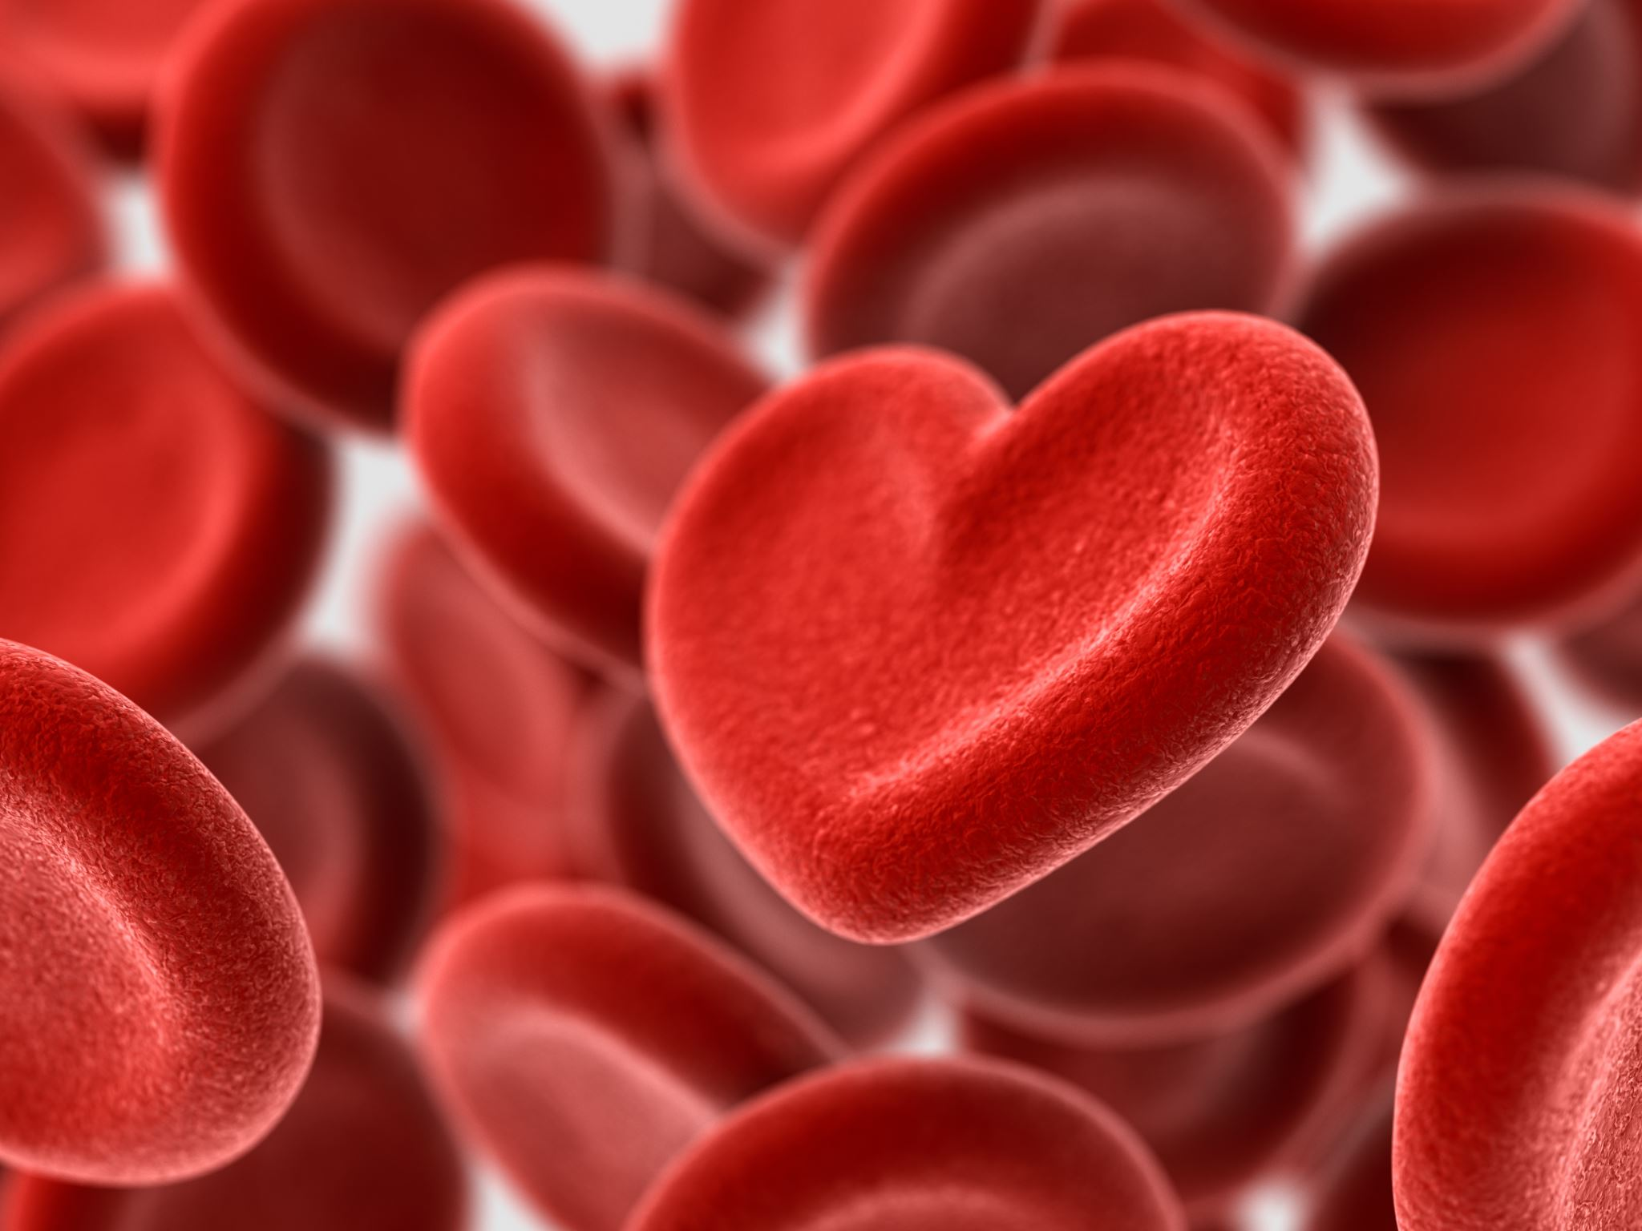
Steps to predict if someone has Heart Disease:
EDA
Baseline
Model Comparing
Selecting the best performing model
Notes:
A baseline model is essentially a simple model that acts as a reference in a machine learning project. A baseline is a simple model that provides reasonable results on a task and does not require much expertise and time to build.

Slide 5
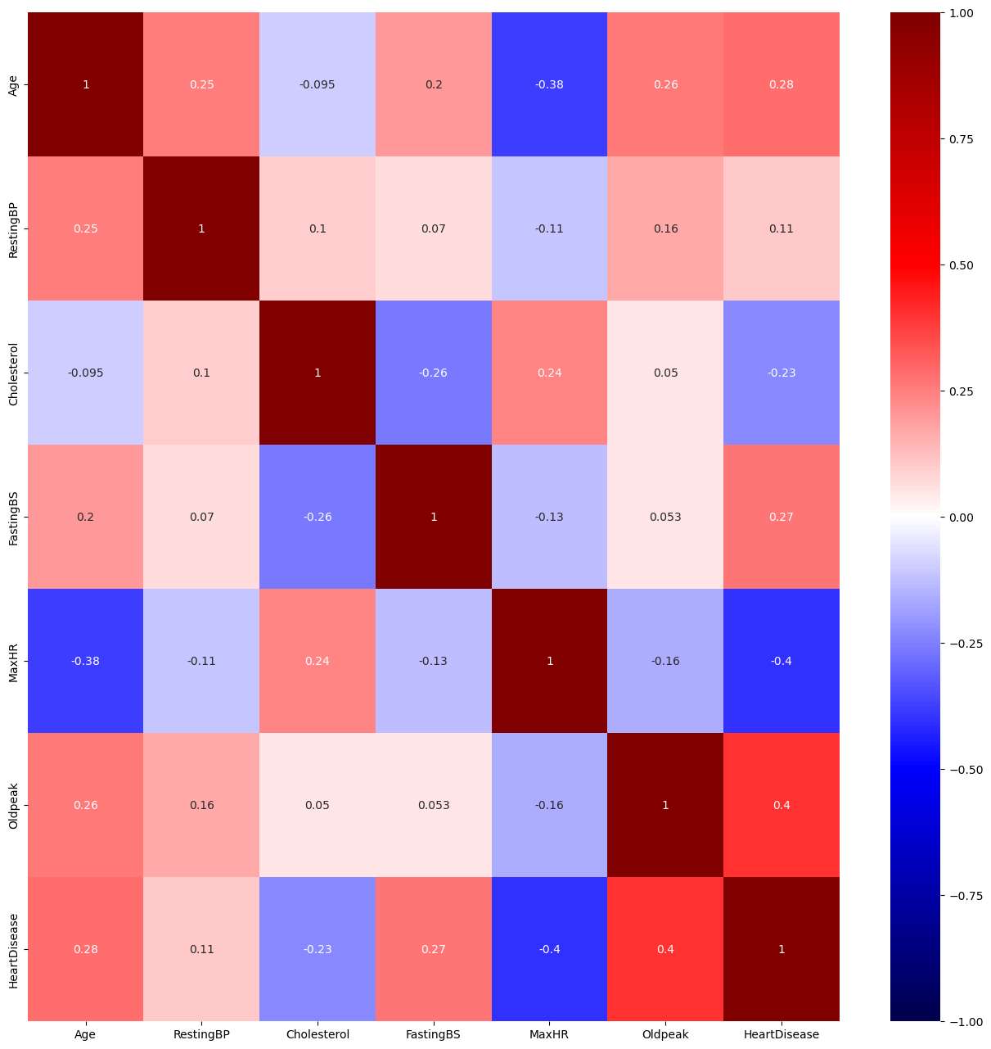
EDA
Notes:
Each square shows the correlation between the variables on each axis. Correlation ranges from -1 to +1. Values closer to zero means there is no linear trend between the two variables. The close to 1 the correlation is the more positively correlated they are; that is as one increases so does the other and the closer to 1 the stronger this relationship is. A correlation closer to -1 is similar, but instead of both increasing one variable will decrease as the other increases. The diagonals are all 1/dark because those squares are correlating each variable to itself (so it's a perfect correlation). For the rest the larger the number and darker the color the higher the correlation between the two variables.

Slide 6
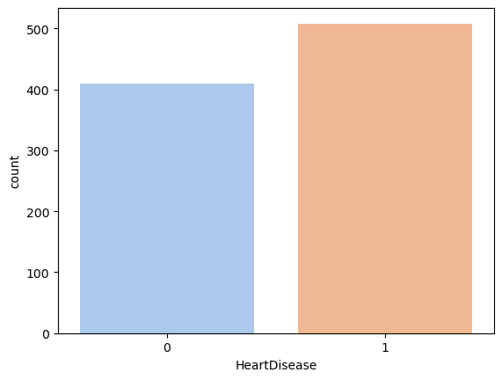
Heart Disease
Notes:
In this plot we can see that in this dataset 44.66% of people don't have Heart Disease and 55.34% of people have Heart Disease

Slide 7
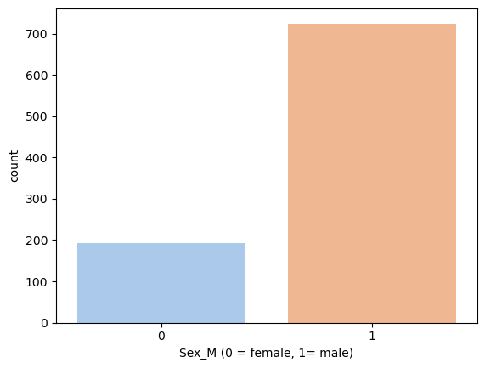
Heart Disease
Notes:
This plot shows that in our data set we have more males with heart disease then females. Female Proscentage: 21.02% Male Percentage: 78.98%

Slide 8
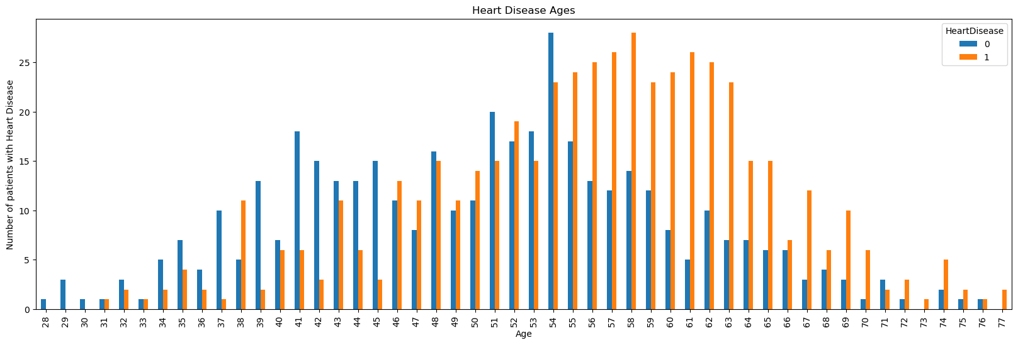
Notes:
This plot shows us that people have heart disease at the age of 50-65 it very rarely happens to young people.

Slide 9
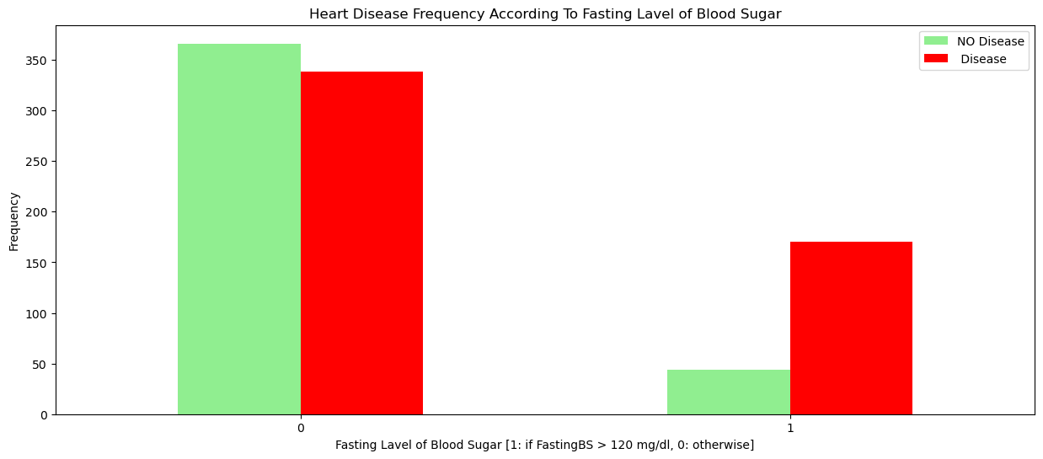
Notes:
If fasting Lavel of sugar more then 120 mg/dl people with heart disease almost 3 times more then without

Slide 10
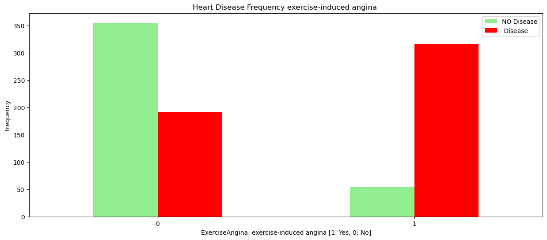
Notes:
People with Angina defenatly have a risk to get Heart Disease

Slide 11
Hyperparameter Tuning
First Model
Accuracy: 0.6141 Precision: 0.6636 Recall: 0.6822 F1: 0.6728 Cross Validation Accuracy: Score: 0.6294
Second Model
Accuracy: 0.6033 Precision: 0.6771 Recall: 0.6075 F1: 0.6404 Cross Validation Accuracy: Score: 0.6280
Third Model
Accuracy: 0.6087 Precision: 0.6842 Recall: 0.6075 F1: 0.6436 Cross Validation Accuracy: Score: 0.6239
Best Model
Accuracy: 0.5978 Precision: 0.6051 Recall: 0.8879 F1: 0.7197 Cross Validation Accuracy: Score: 0.5954
Notes:
Accuracy is a measure of how well a model is able to predict the correct output for a given input. It is usually expressed as a percentage
Precision defines how accurately a model can predict the true positive rate. It's calculated as the number of true positives divided by the total number of predicted positives
Recall measures the model’s ability to classify all positive examples. It is calculated by taking the correctly identified positives, over all the actual positives in our dataset. Note the difference here from precision is that precision takes into account the predicted positives and false positives, whereas recall takes into the total number of actual positives from our dataset.
The F1 score is the harmonic mean of precision and recall. In statistics, the harmonic mean is a type of average that is calculated by taking the reciprocal of the arithmetic mean of the reciprocals of a set of numbers. It is often used to average rates or ratios, such as speeds or grades.In the context of the F1 score, the harmonic mean is used to combine the precision and recall of a classifier into a single metric. The F1 score is defined as the harmonic mean of precision and recall, with a score of 1 being the best possible score and a score of 0 being the worst. The F1 score is often used as a balance between precision and recall.

Slide 12
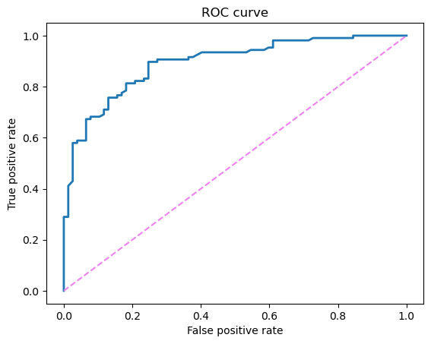
Best model Random Forest
ROS AUC Score – 0.9
Notes:
Score of 0.9 means the classifier can almost perfectly distinguish between all the Positive and the Negative class points. Area under the curve ROC (Receiver Operator Characteristic)score tells us how efficient the model is. The higher the AUC, the better the model's performance at distinguishing between the positive and negative classes. An AUC score of 1 means the classifier can perfectly distinguish between all the Positive and negative class points

Slide 13
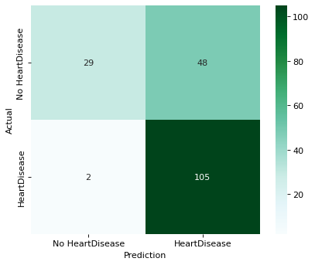
Best Performance Model Random Forest
Notes:
True Positive(we predict our patient has Heart Disease and patient actually has it)-29
True Negative (we predict our patient does not have Heart Disease and patient actually has it)-105
False Positive(we predict our patient has Heart Disease and patient actually does not have it)-2
False Negative(we predict our patient does not have Heart Disease and patient actually has it)-48

Slide 14
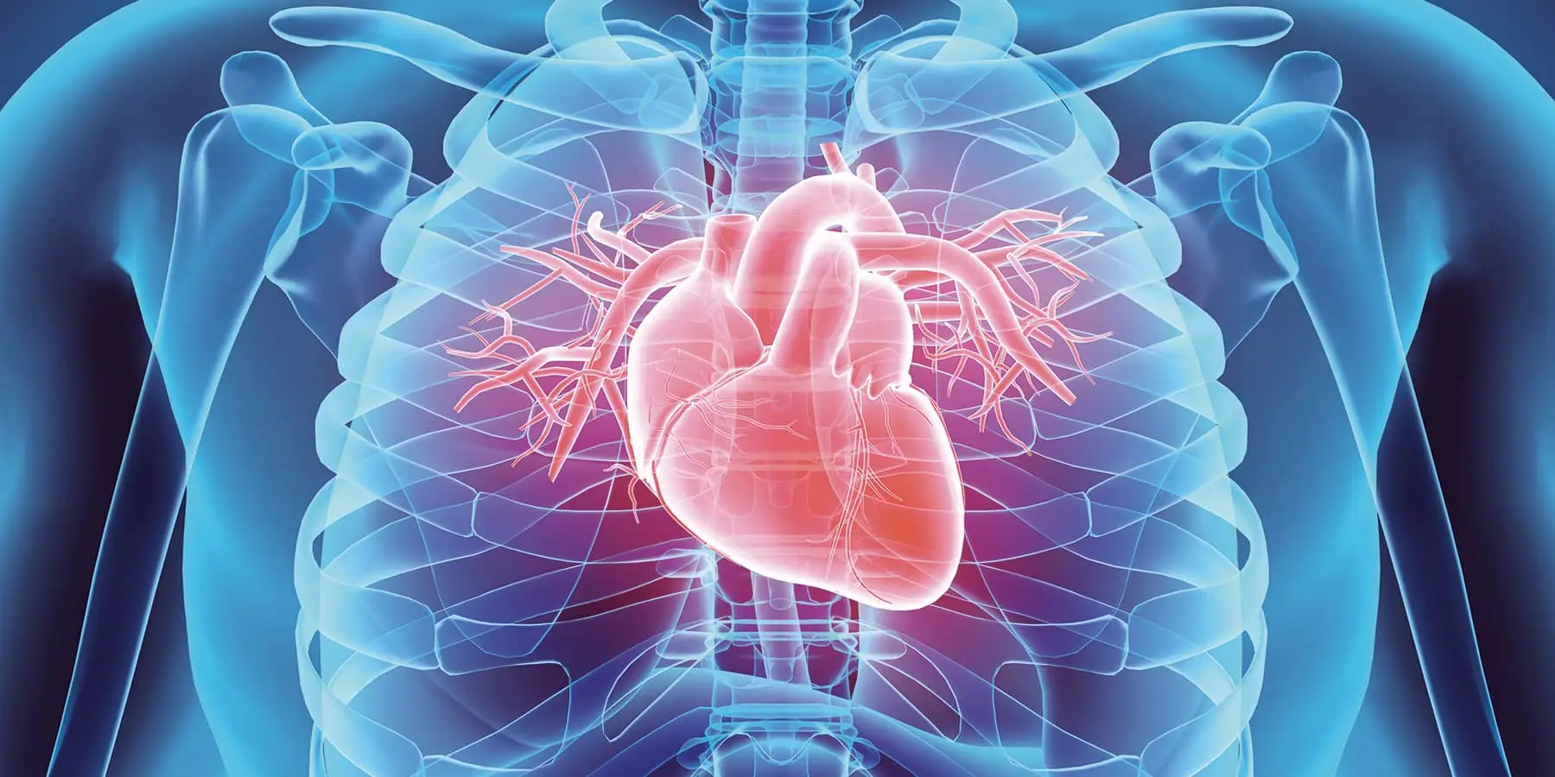
Conclusion
Factors that increases the chances of getting heart disease:
Age
Gender
Sugar level
Angina
My model predicted with
Accuracy: 0.5978
Precision: 0.6051
Recall: 0.8879
F1: 0.7197
The Area under the ROC curve is 0.89
Notes:
The whole dataset was split into 80/20 train/holdout. Prediction on 20% holdout were limited till the end.
Men getting Heart Disease much more often the females. Also, we can see that age plays a large role in the development of Heart Disease. If fasting Lavel of sugar more then 120 mg/dl people with heart disease almost 3 times more then without
People with Angina defenatly have a risk to get Heart Disease
My model predicted with
Accuracy: 0.5978
Precision: 0.6051
Recall: 0.8879
F1: 0.7197
The Area under the ROC curve is 0.89 which is good score.
Overall model could be improved with more data.

Slide 15
Limitation
Notes:
If I would have bigger dataset I woul make better prediction.I wish I would also have more information ebout patients health information,genetics, and habbits. I would like to have some survey to see why there is bigger percentage of mans with Heart Disease, and why Age effect percentage of people with Heart Disease.

Slide 16
Recomendation
Notes:
I would recommend caring a little bit more about their health. Control your Blood pressure and sugar level, do your check up on time to prevent any health issues.

Slide 17
Next Steps
Notes:
My next step would be to continue with developing model for better result. Use more data for better prediction.

Slide 18
Thank you
Anastasiia Leskiv
GitHub:https://github.com/anastasiialeskiv
Linkedin:https://www.linkedin.com/in/anastasiia-leskiv-684b4b250/

