Slide 1
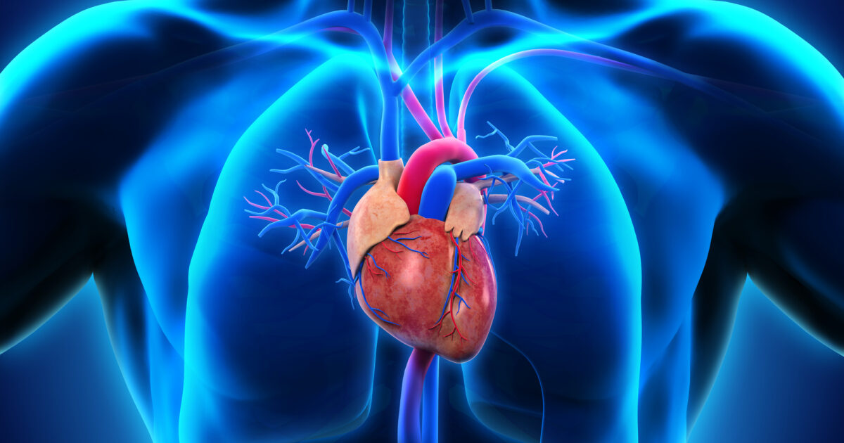
Heart Disease Classification Model
Anastasiia Leskiv

Slide 2
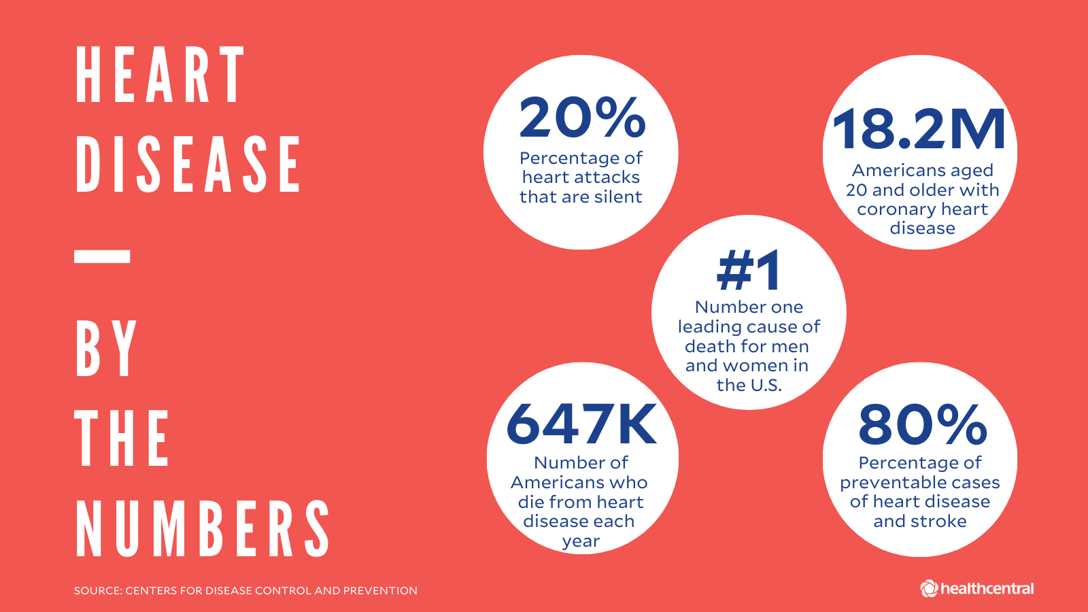
Target:
Build classification models to see whether or not a patient has heart disease.
Notes:
More than 16 million people have heart disease and it’s only in the USA. About 7 percent of Americans aged 20 and older have CHD. Together with the health care organization we decided to create a classification model to predict whether or not patients have a heart disease. I used a Heart disease data set which contained thousands of data points. I built classification algorithms and then I selected the best model to present to my client. In this project I was focusing on the best accuracy of the model.

Slide 3

Features
Age
Sex
Resting Blood Pressure
Fasting Blood sugar
Resting ECG
Cholesterol
Chest Pain Type
Max Heart Rate
Exercise Angina
Oldpeak
ST_Slope
HeartDisease

Slide 4
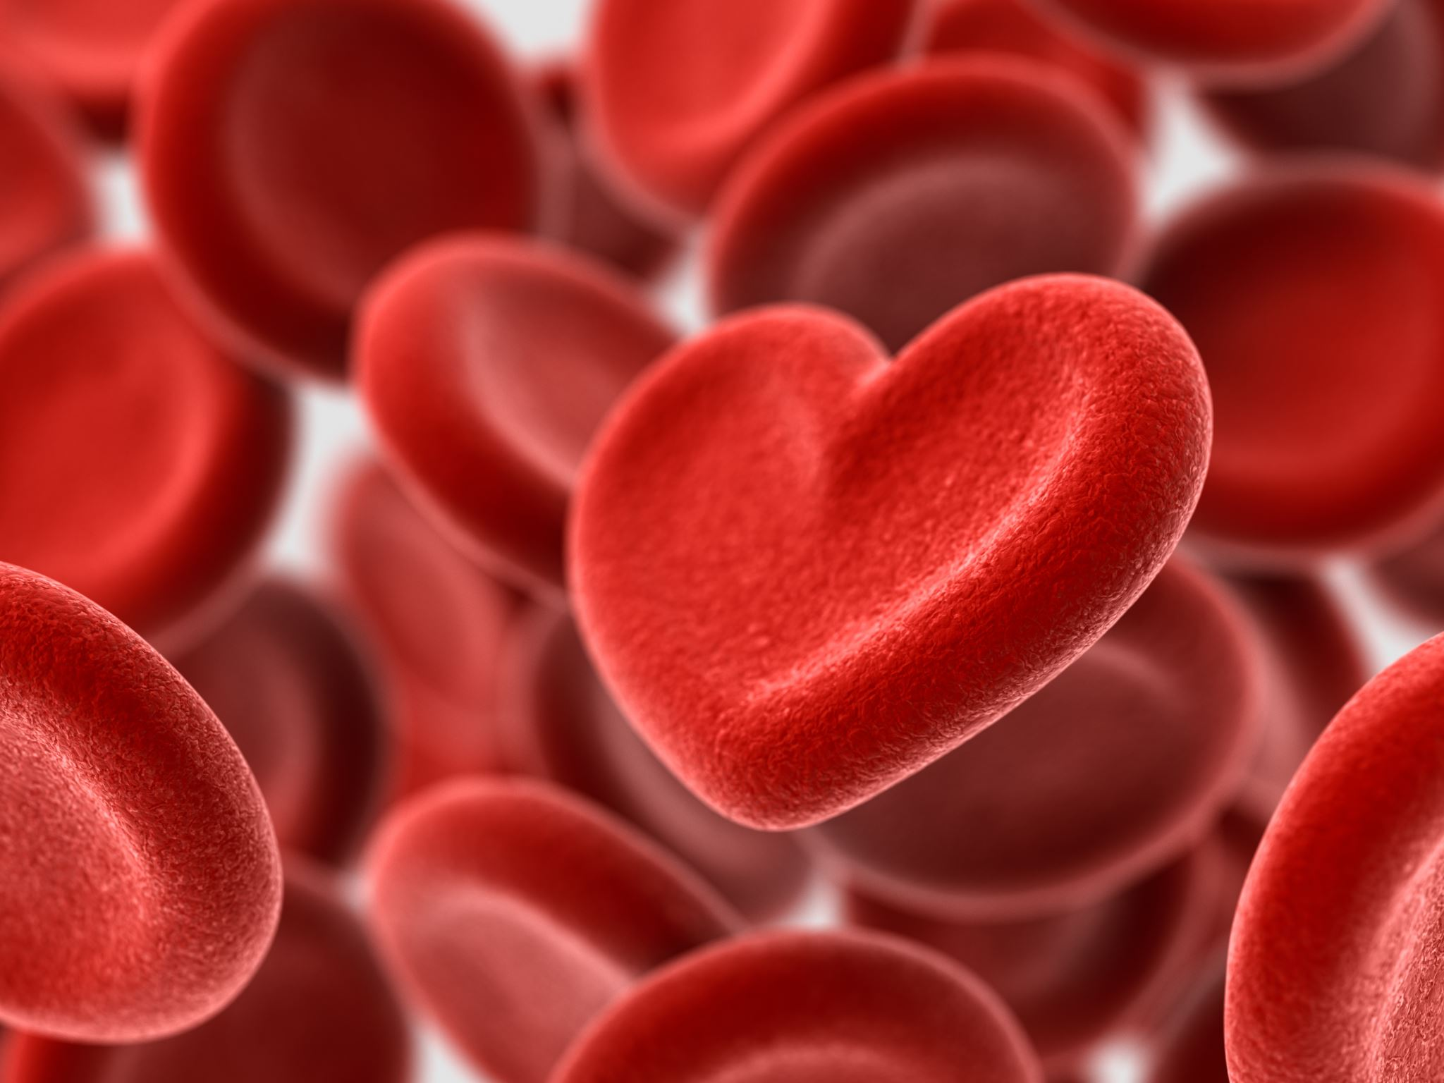
Steps to predict if someone has Heart Disease:
EDA
Baseline
Model Comparing
Selecting the best performing model
Notes:
A baseline model is essentially a simple model that acts as a reference in a machine learning project. A baseline is a simple model that provides reasonable results on a task and does not require much expertise and time to build.
So, lets start with EDA

Slide 5
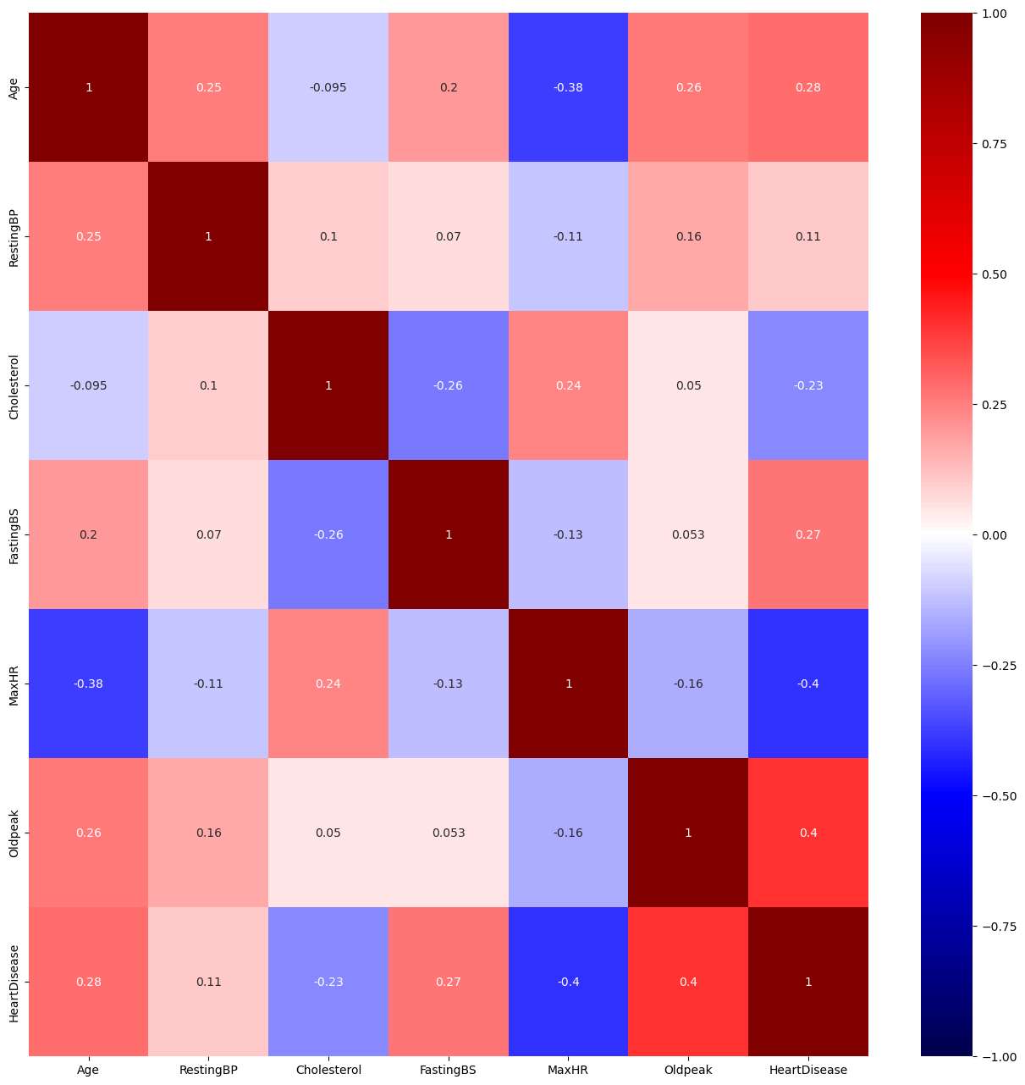
Correlation between the variables the larger the number the higher the correlation.
Notes:
Each square shows the correlation between the variables on each axis. Correlation ranges from -1 to +1. The close to 1 the correlation is the more positively correlated they are; A correlation closer to -1 is similar, but instead of both increasing one variable will decrease as the other increases.
The diagonal are all 1 because those squares are correlating each variable to itself (so it's a perfect correlation). For the rest the larger the number the higher the correlation between the two variables.

Slide 6
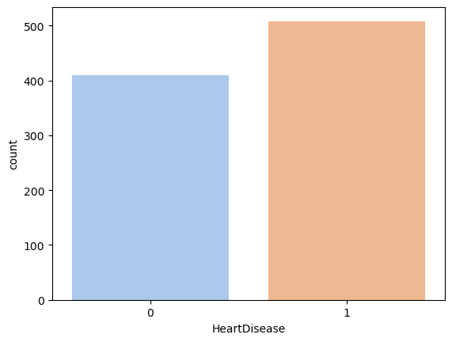
Patients with Heart Disease (1) VS Patients without Heart Disease (0)
Notes:
In this plot we can see that in this dataset 44.66% of people don't have Heart Disease and 55.34% of people have Heart Disease

Slide 7
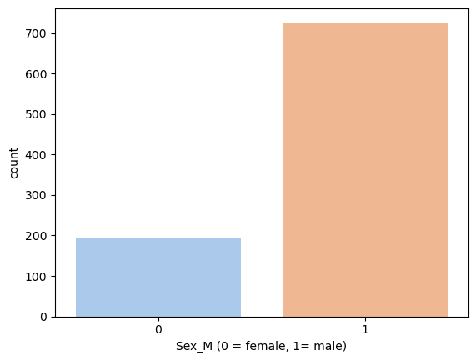
Who has a greater risk of getting a Heart Disease Male VS Female
Notes:
This plot shows that in our data set we have more males with heart disease then females. Female Proscentage: 21.02% Male Percentage: 78.98%

Slide 8
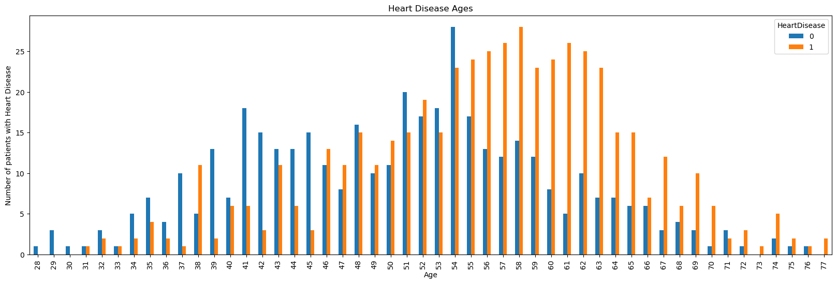
People at the age between the ages of 50-65 have the heist risk of getting a Heart Disease.
Notes:
This plot shows us that people have heart disease at the age of 50-65 it very rarely happens to young people.

Slide 9
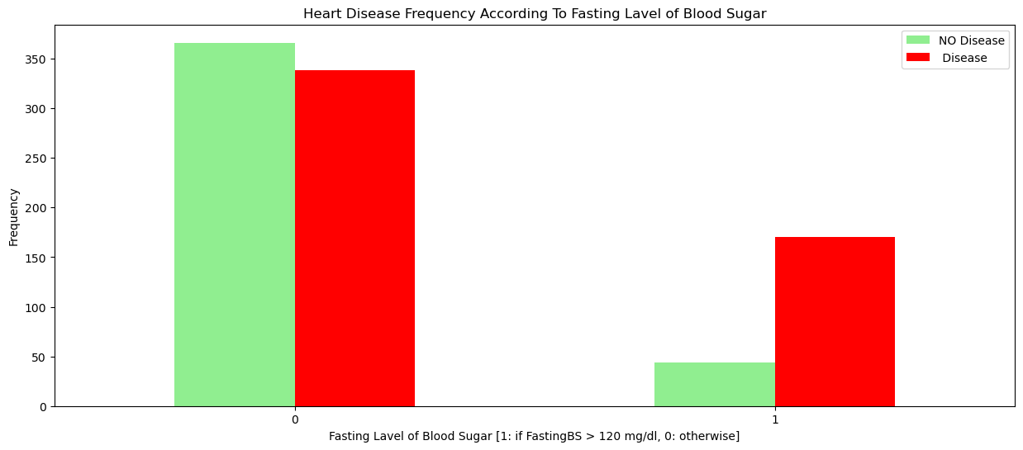
People with high levels of sugar have a higher risk of getting a Heart Disease.
Notes:
If fasting Lavel of sugar over 120 . people with heart disease almost 3 times more then without

Slide 10
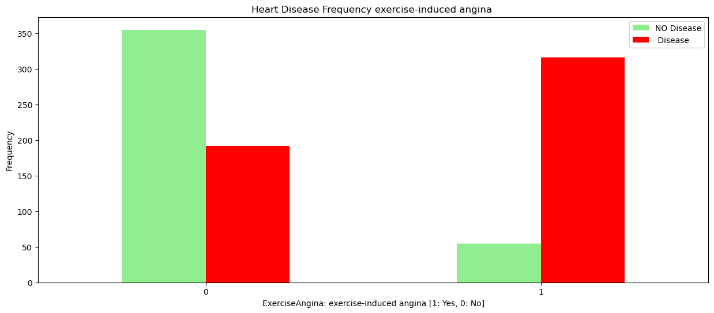
People who experienced Angina have a higher risk of getting a Heart Disease.
Notes:
People with Angina defenatly have a risk to get Heart Disease

Slide 11
Hyperparameter Tuning
First Model
Accuracy: 0.6141 Precision: 0.6636 Recall: 0.6822 F1: 0.6728 Cross Validation Accuracy: Score: 0.6294
Second Model
Accuracy: 0.6033 Precision: 0.6771 Recall: 0.6075 F1: 0.6404 Cross Validation Accuracy: Score: 0.6280
Third Model
Accuracy: 0.6087 Precision: 0.6842 Recall: 0.6075 F1: 0.6436 Cross Validation Accuracy: Score: 0.6239
Best Model
Accuracy: 0.5978 Precision: 0.6051 Recall: 0.8879 F1: 0.7197 Cross Validation Accuracy: Score: 0.5954
Notes:
Accuracy is a measure of how well a model is able to predict the correct output for a given input. It is usually expressed as a percentage
Precision defines how accurately a model can predict the true positive rate. It's calculated as the number of true positives divided by the total number of predicted positives
Recall measures the model’s ability to classify all positive examples. It is calculated by taking the correctly identified positives, over all the actual positives in our dataset. (the difference here from precision is that precision takes into account the predicted positives and false positives, whereas recall takes into the total number of actual positives from our dataset.)
The F1 score is defined as the harmonic mean of precision and recall, with a score of 1 being the best possible score and a score of 0 being the worst. The F1 score is often used as a balance between precision and recall.

Slide 12
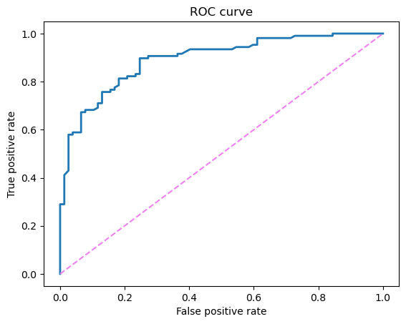
Best model Random Forest
Area under the curve ROC Score : 0.89
means the classifier can almost perfectly distinguish between all the Positive and the Negative class points.
Notes:
Area under the curve ROC (Receiver Operator Characteristic)score tells us how ===efficient= the model is. The higher the AUC, the better the model's performance at distinguishing between the positive and negative classes. An AUC score of 1 means the classifier can perfectly distinguish between all the Positive and negative class points
Area under the curve Score of 0.9 means the classifier can almost perfectly distinguish between all the Positive and the Negative class points.

Slide 13
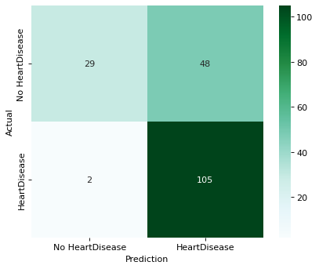
Best Performance Model Random Forest
Notes:
True Positive(we predict our patient has Heart Disease and patient actually has it)-29
True Negative (we predict our patient does not have Heart Disease and patient actually has it)-105
False Positive(we predict our patient has Heart Disease and patient actually does not have it)-2
False Negative(we predict our patient does not have Heart Disease and patient actually has it)-48

Slide 14
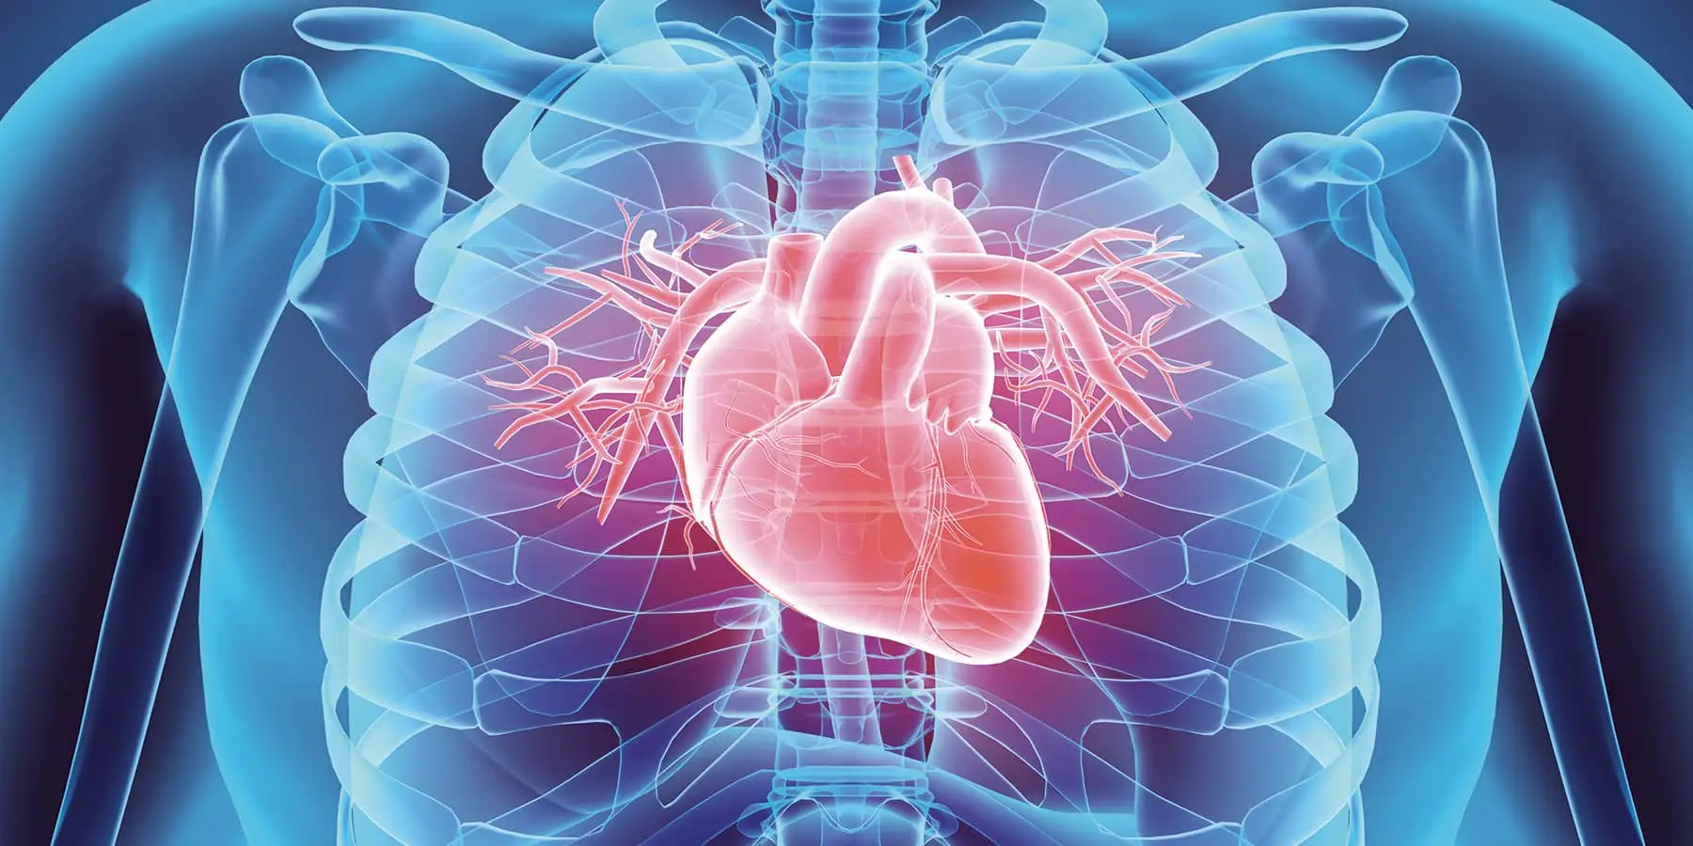
Conclusion
In conclusion, to diagnose if a patient has a Heart Disease, we must pay careful attention to factors that increase the chances of getting heart disease such as:
Age
Gender
Sugar level
Angina
Blood pressure
My model predicted with
The Area under the ROC curve is 0.89
Notes:
The whole dataset was split into 80/20 train/holdout. Prediction on 20% holdout were limited till the end.
Men getting Heart Disease much more often the females.
Also, we can see that age plays a large role in the development of Heart Disease.
when Fasting Lavel of sugar is high people also have a bigger rist to get heart disease
People with Angina defenatly have a risk to get Heart Disease
My model predicted with
Accuracy: 60%
Precision: 61%
Recall: 89%
F1: 72%
The Area under the ROC curve is 0.89 which is good score.
Overall model could be improved with more data.

Slide 15
Limitation No information about: - genetics -patient’s lifestyle -patient’s habits
Notes:
If I would have bigger dataset I woul make better prediction.I wish I would also have more information ebout patients health information,genetics, and habbits. I would like to have some survey to see why there is bigger percentage of mans with Heart Disease, and why Age effect percentage of people with Heart Disease.

Slide 16
Recommendation I would recommend to my client to pay more attention to: -Gender - Sugar level -Blood pressure -Age of the patient -If patient experienced Angina -.
Notes:
I would recommend caring a little bit more about their health. Control your Blood pressure and sugar level, do your check up on time to prevent any health issues.

Slide 17
Next Steps -Continue with developing model for better result. - Use more data for better prediction.
Notes:
My next step would be to continue with developing model for better result. Use more data for better prediction.

Slide 18
Thank you
Anastasiia Leskiv
GitHub:https://github.com/anastasiialeskiv
Linkedin:https://www.linkedin.com/in/anastasiia-leskiv-684b4b250/

